Slide 1
Fine-grained image recognition meth is not clearly understand
Image aligned with prototypical model

Slide 2
A Survey on Deep Learning-based Fine-grained Object Classification and Semantic Segmentation
Bo Zhao1,2 Jiashi Feng2 Xiao Wu1 Shuicheng Yan2
Notes:
第一页

Slide 3
Abstract
FGIC four approaches：CNNs，part detection based，ensemble of networks based and visual attention based。
Notes:
第二页

Slide 4
Introduction
Deep Learning’ core:layers of features learned from data。
Reinforcement learning：The rule is that discover which actions yield the most reward by try them。

Slide 5
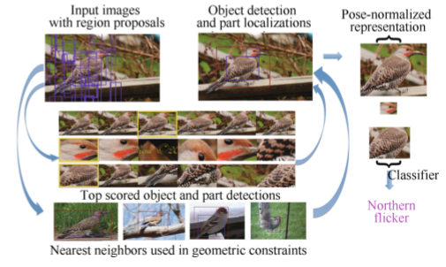
Deep fine-grained image classification
General CNN for FGVC：AlexNet，VGG，GoogLeNet。
Part detection and alignment based approaches：part-based R-CNN

Slide 6
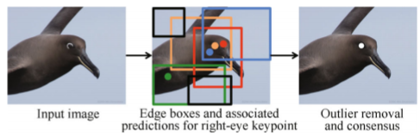
Part localization using multi-proposal consensus：

Slide 7
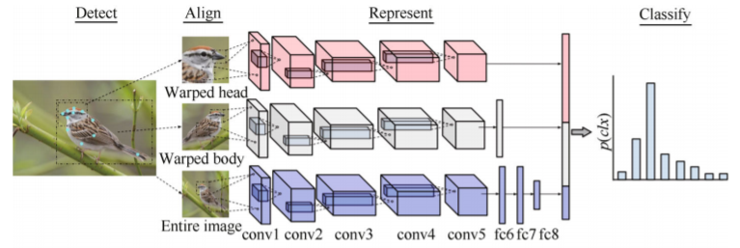
Pose normalized nets：
first computes an estimate of the object s pose,then use it to locating and normalizing image patches .Send it into CNN to get features.

Slide 8
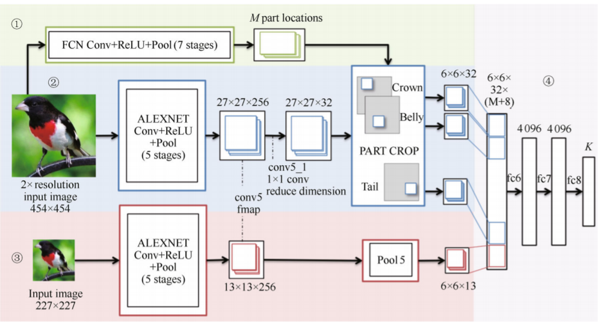
Part stack CNN：

Slide 9
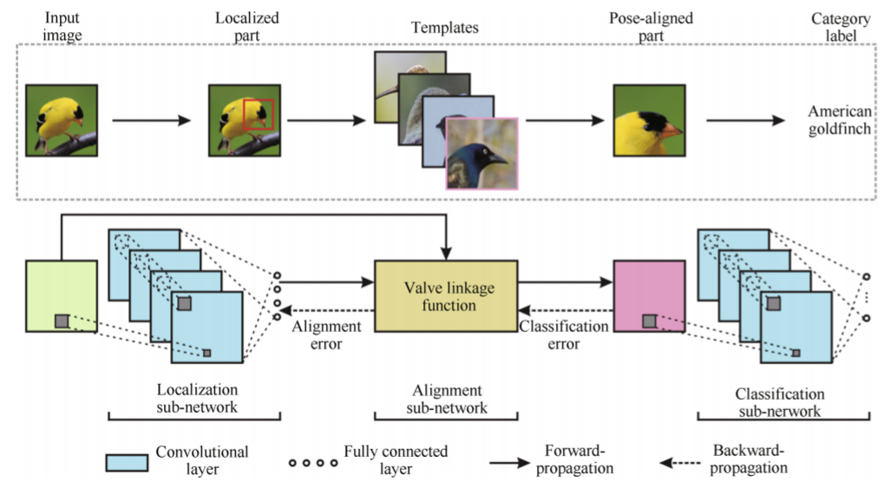
Deep LAC

Slide 10
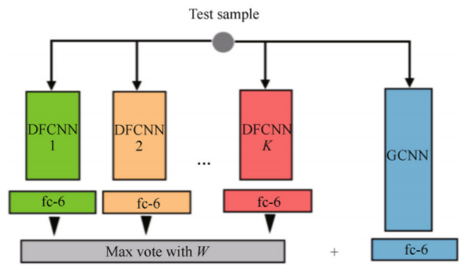
Ensemble of networks based approaches：
Subset feature learning networks

Slide 11
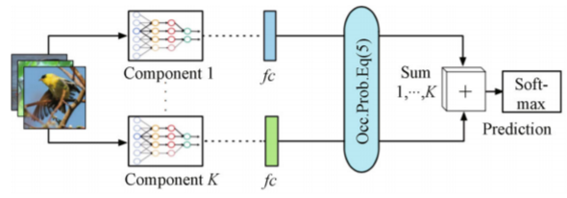
Mixture of deep CNN

Slide 12
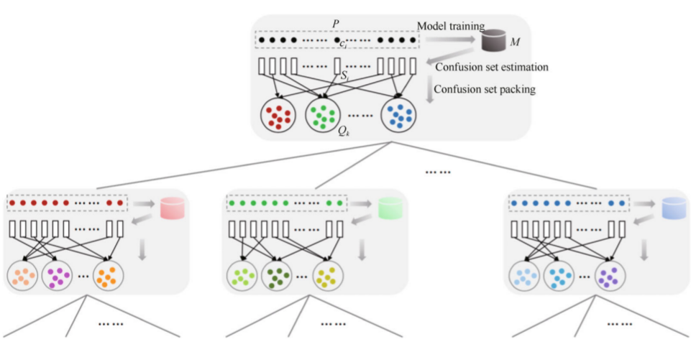
CNN tree

Slide 13
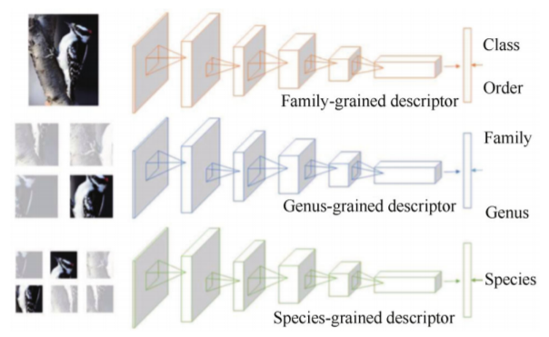
Multiple granularity CNN

Slide 14
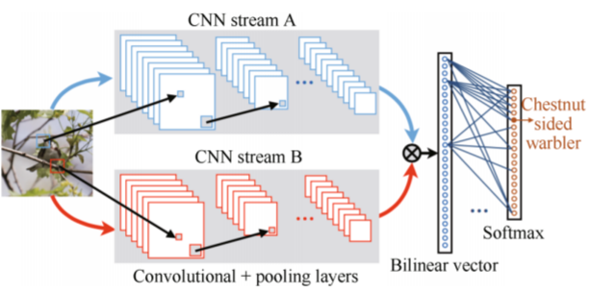
Bilinear deep network models

Slide 15
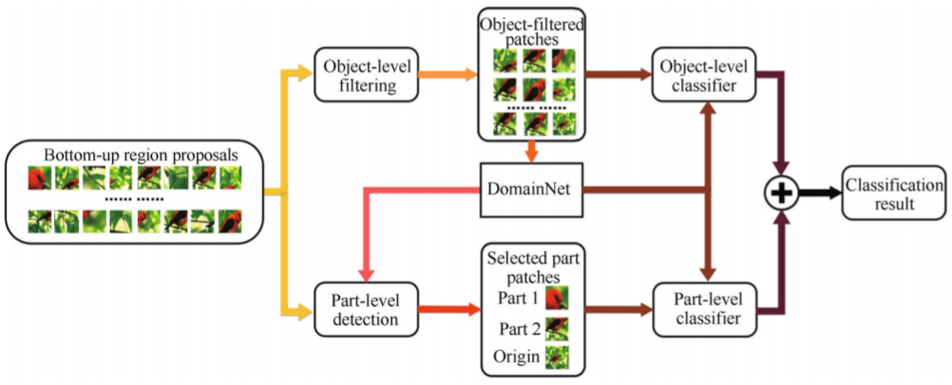
Visual attention based approaches：
Two-level attention：bottom-up attention，object level top-down attention，part-level top-down attention。

Slide 16
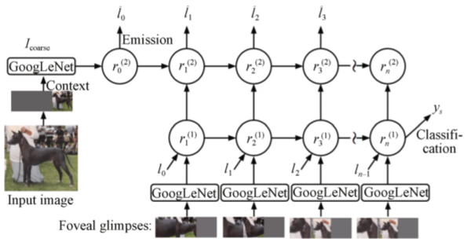
Attention for fine-grained categorization

Slide 17
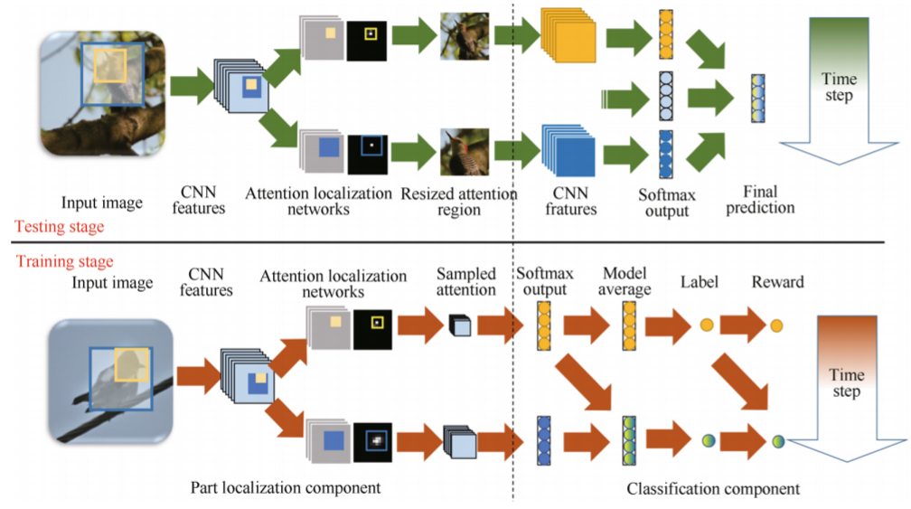
FCN attention

Slide 18
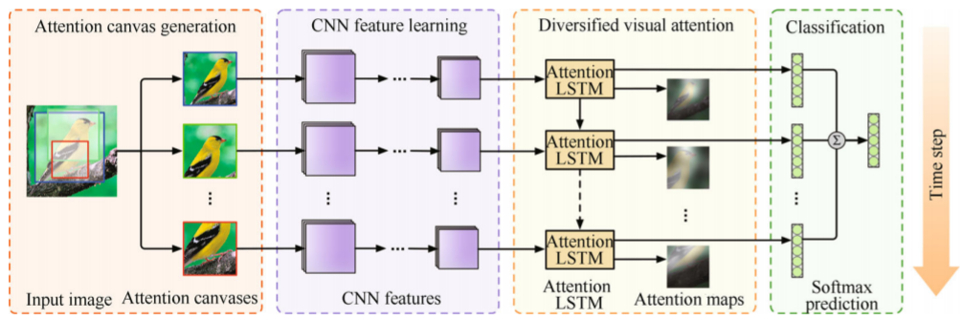
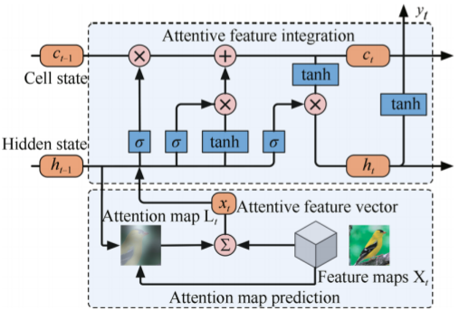
Diversified visual attention

Slide 19
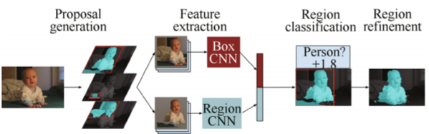
Deep image semantic segmentation
Region proposal based approaches：
Simultaneous detection and segmentation

Slide 20
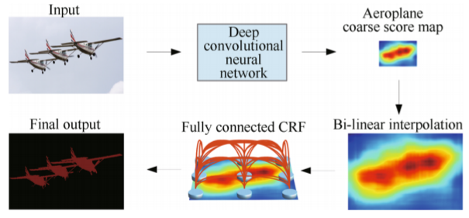
FCN based approaches
DeepLab：

Slide 21
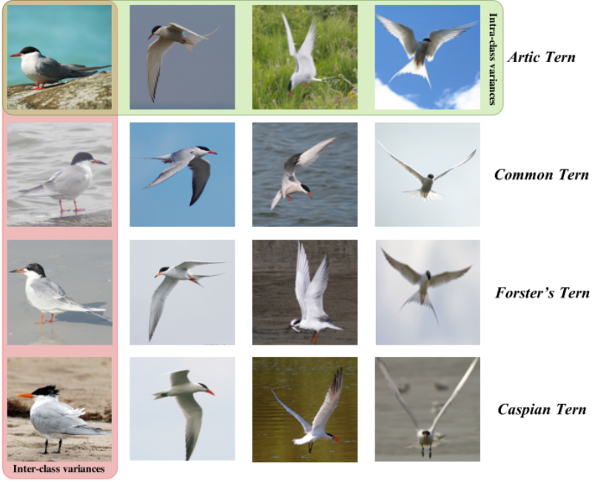
Background: problem and main challenges
Large intra-class
Variation。
Small inter-class
Variation。

Slide 22
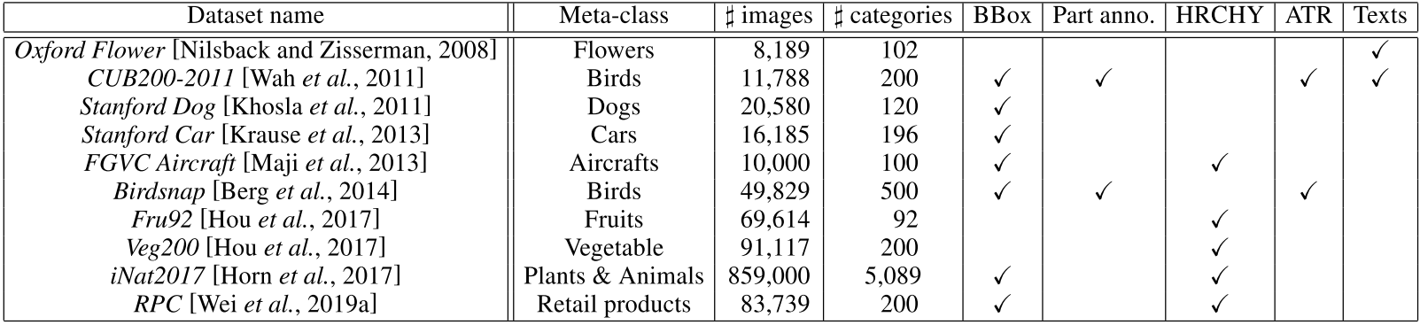
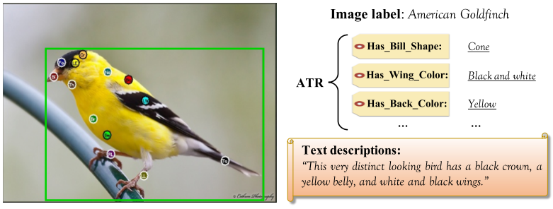
Benchmark datasets
Part anno：key part localizations。
HRCHY: hierarchical labels。
ATR：wing color，gender。
Texts

Slide 23
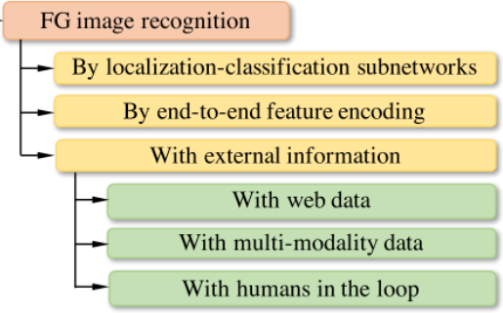
Fine-grained image recognition
LCS：

Slide 24
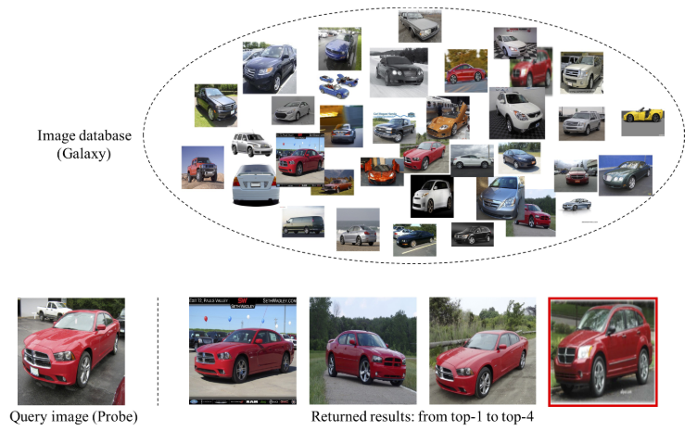
Fine-grained image retrieval
a

Slide 25
Conclusion
G produces the attention map via an attentive-recurrent network and applies this map along with the input image to generate a raindrop-free image through a contextual autoencoder。
Our novelty lies on the use of the attention map in both generative and discriminative network。

