Slide 1

PRATHYUSHA ENGINEERING COLLEGE
AN AUTONOMOUS INSTITUTION
DEPARTMENT OF EEE
PROJECT TITLE:
DUAL CORE EDGE COMPUTING FRAMEWORK FOR POWER FACTOR CORRECTION AND LOAD DEMAND MANAGEMENT
TEAM MEMBERS:
JANAKI RAMAN K (111422105007)
PURUSHOTHAMAN M (111422105014)
RAJA PANDI P (111422105016)
INTERNAL GUIDE : Dr. VENKATARAMANAN K

Slide 2
PRATHYUSHA ENGINEERING COLLEGE
AN AUTONOMOUS INSTITUTION
DEPARTMENT OF EEE
CONTENTS
ABSTRACT
INTRODUCTION
LITERATURE REVIEW
EXISTING SYSTEM
PROPOSED SYSTEM
HARDWARE/SOFTWARE REQUIREMENTS
METHODOLOGY
REAL-TIME INTEGRATION
SIMULATION
RESULTS
HARDWARE PROTOTYPE

Slide 3
PRATHYUSHA ENGINEERING COLLEGE
AN AUTONOMOUS INSTITUTION
DEPARTMENT OF EEE
ABSTRACT
Managing fluctuating load demand and maintaining near-unity power factor presents significant challenges. This Dual Core Power Factor Optimization and Smart Load Demand Management System integrates with real-time power quality monitoring to achieve ≥0.98 power factor and 15-25% peak demand reduction through predictive load shifting and intelligent demand response. Featuring reinforcement learning-based demand response, neural network compensation sizing, precise electrical parameter sensing, and adaptive reactive power control via capacitor banks or STATCOM, the IoT-enabled edge computing solution delivers harmonic mitigation and substantial cost savings. Scalable for industrial and utility applications, it overcomes traditional APFC limitations through predictive analytics and smart demand orchestration for sustainable power systems.

Slide 4
PRATHYUSHA ENGINEERING COLLEGE
AN AUTONOMOUS INSTITUTION
DEPARTMENT OF EEE
INTRODUCTION
Rapid technological advancement and growing electrical energy demand require innovative power management solutions
Traditional frameworks struggle with modern challenges like variable consumption trends and renewable energy integration
Need for real-time, adaptive control systems in contemporary power grids
Smart Integrated Load and Power Management System ensures a groundbreaking approach transforming electrical power management
Combines established load compensation methods with IoT and technologies
Self-regulating control system providing high-precision, real-time Power Factor optimization
Function Fitting Neural Network architecture chosen over traditional methods
Moves beyond slow rule-based systems and evolutionary algorithms (e.g., Genetic Algorithms)

Slide 5
PRATHYUSHA ENGINEERING COLLEGE
AN AUTONOMOUS INSTITUTION
DEPARTMENT OF EEE
INTRODUCTION (Continued..)
Operates under Supervised Learning framework for intelligent decision-making
Automatically maps hidden patterns between varying loads – non-linear loads
Perfect Power Factor Control: Maintains 1.0 PF via Capacitor Bank
Handles complex grid data in milliseconds on ESP32 microcontroller
Optimizes renewable sources (Solar and Wind) based on real-time load spikes and predictive weather patterns
Improves efficiency, reliability, and sustainability of contemporary power systems
Cohesive, self-regulating control with groundbreaking performance

Slide 6
PRATHYUSHA ENGINEERING COLLEGE
AN AUTONOMOUS INSTITUTION
DEPARTMENT OF EEE
LITERATURE REVIEW
Author | Year | Adopted scheme | Features | Challenges
Biswas et al. | 2025 | AI frameworks for smart grid optimization including demand response, renewable forecasting, and real-time control | Integration strategies for, IoT, and power quality management across grid scale operations | Broad review lacks specific implementation details for industrial PF correction and capacitor bank control hardware integration
Witharama et al. | 2024 | Advanced Genetic Algorithm with LightGBM forecasting for multi-objective microgrid optimization | Comprehensive cost modeling including battery degradation and demand response coordination for long-term optimization | Computationally intensive GA unsuitable for real-time PF correction requiring sub-second capacitor switching decisions
Jat et al. | 2024 | AI/ML controllers (neural networks, fuzzy logic) for PV grid stabilization | Real-time fluctuation mitigation and reactive power management for renewable integration | Solar PV-specific focus requires adaptation for general industrial load PF correction scenarios
Farsi et al. | 2021 | Parallel Deep LSTM-CNN hybrid model for short-term load prediction | Superior temporal pattern capture and spatial feature extraction for accurate demand forecasting | High computational complexity of parallel architecture

Slide 7
PRATHYUSHA ENGINEERING COLLEGE
AN AUTONOMOUS INSTITUTION
DEPARTMENT OF EEE
LITERATURE REVIEW
Author | Year | Adopted scheme | Features | Challenges
Mishra et al. | 2020 | Dynamic load balancing algorithms for resource optimization | Multi-criteria load distribution strategies adaptable to power system demand management scenarios | Cloud computing with real-time electrical power constraints
Swarna Priya et al. | 2020 | Hybrid Wind Driven Optimization (WDO) + Firefly Algorithm for IoE energy cloud clustering and CH selection | Bio-inspired optimization for energy-efficient load distribution across distributed IoT networks | Energy cloud IoE focus incompatible with single-site industrial PF correction requiring deterministic real-time capacitor switching
Proposed Solution Summary
Our project overcomes these challenges by replacing slow cloud reliance and complex algorithms with deterministic edge-computing. Using a dual-core ESP32, our system executes lightweight Neural Networks locally, guaranteeing the sub-second capacitor switching and precise hardware integration required for reliable, single-site industrial Power Factor correction and load management.

Slide 8
PRATHYUSHA ENGINEERING COLLEGE
AN AUTONOMOUS INSTITUTION
DEPARTMENT OF EEE
EXISTING SYSTEM
Fixed Capacitor Switching - Manual or relay-based control unable to adapt to load variations
Overshoot & Resonance - Inadequate compensation causes system instability and inefficiency
Utility Penalties - Fixed tariffs impose fines for low power factor regardless of real-time conditions
Reactive Power Losses - Additional transmission losses and increased kVA demand charges
Uncoordinated Control - Power factor correction and demand response operate independently without integration
No Real-Time Monitoring - Lack of visibility prevents early fault detection and proactive adjustments

Slide 9
PRATHYUSHA ENGINEERING COLLEGE
AN AUTONOMOUS INSTITUTION
DEPARTMENT OF EEE
PROPOSED SYSTEM
Neural Network Analysis – Real-time power factor monitoring and adaptive capacitor bank control
Near-Unity Power Factor – Dynamic maintenance across varying loads, eliminating overshoot & resonance
IoT Sensing Integration – Continuous electrical parameter monitoring with edge computing
Reinforcement Learning – Smart demand response automatically shifts flexible loads
Real-Time Optimization – Responds to tariffs, grid signals, and operational constraints
Predictive Analytics – Harmonic mitigation and fault prevention through forecasting
Continuous Feedback Loops – Self-optimizing performance adapts to load changes
Renewable Integration Ready – Handles variable generation and distributed energy resources
Proven Results – Eliminates penalties, 15-25% peak demand reduction, sustained power quality
Interface for users and admin – Web application accessed by the users and the admins

Slide 10
PRATHYUSHA ENGINEERING COLLEGE
AN AUTONOMOUS INSTITUTION
DEPARTMENT OF EEE
HARDWARE/SOFTWARE REQUIREMENTS
PREREQUISITES | SOFTWARE | HARDWARE
Knowledge of Power Systems & Power Electronics | MATLAB / Simulink | Microcontroller: ESP32, Transformers
Understanding of Control Systems & Automation | Cloud Platform (AWS) | Relays & Motor Drives, Power Supply Units, Capacitor Banks
Basics of Machine Learning & Neural Networks | Supervised Learning | Data Logger & Network Switch
IoT & Embedded Systems Concepts | LabVIEW | IoT Module: Wi-Fi, MQTT

Slide 11
PRATHYUSHA ENGINEERING COLLEGE
AN AUTONOMOUS INSTITUTION
DEPARTMENT OF EEE
COMPARISON OF CONTROLLERS
Feature | Arduino Uno | Raspberry Pi | ESP32 (Chosen) | Justification
Processor Speed | 16 MHz | 1.5 GHz | 240 MHz (Dual-Core) | Handles the 0.0002s logic cycles that Arduino cannot process.
Core Architecture | Single-Core | Quad-Core | Dual-Core (Symmetric) | Core 0 runs PF Optimization while Core 1 manages Load Demand.
Built-in Connectivity | None (Requires Shields) | Wi-Fi / Bluetooth | Integrated Wi-Fi / BLE | Direct uplink to the User/Admin Web App without extra hardware.
ADC Resolution | 10-bit | N/A (Digital only) | 12-bit (High Precision) | Provides the precise current/voltage data needed for the Neural Network.
Power Consumption | Medium | Very High | Low Power (Sleep Modes) | Fits the project goal of an energy-efficient, self-regulating control system.
Cost & Complexity | Low / Simple | High / Complex OS | Optimized Efficiency | Offers the "Edge AI" power of a Pi with the hardware simplicity of an Arduino.

Slide 12
PRATHYUSHA ENGINEERING COLLEGE
AN AUTONOMOUS INSTITUTION
DEPARTMENT OF EEE
METHODOLOGY
The approach of the Smart Integrated Load Demand Management System incorporates a control circuit, along with load monitoring units associated with both the load and generation aspects. Power generated by motors paired with alternators is regulated through IoT-enabled Narrow Band communication, providing voltage-adjusted power to users according to immediate demand. An overload is detected by a current transformer, which triggers the controller to engage additional motors for supplementary power, repeating this process as necessary.
Prior to providing extra power, the synchronization unit guarantees the alignment of voltage and frequency. The system independently handles load requirements, ensuring a consistent and dependable power supply, while also accommodating various renewable energy sources. The project progression consists of acquiring components, conducting tests, designing, developing, assembling, and monitoring.

Slide 13
PRATHYUSHA ENGINEERING COLLEGE
AN AUTONOMOUS INSTITUTION
DEPARTMENT OF EEE
METHODOLOGY – TECHNICAL SPECIFICATIONS
Dual-Core Processing (ESP32) Core 0 executes Neural Network PF Correction (200µs rate) and Core 1 manages Source Switching and MQTT/IoT data.
Multi-Layer Perception (MLP) Neural Network maps P, Q, and V to maintain 1.0 PF via a Static VAR Compensator.
Load Demand Management ensures Predictive Source switching for Solar (>6kW) and Wind (>9kW) with a 500W hysteresis buffer.
ACS712 sensors with 12-bit ADC provide 0.8mV/unit resolution for real-time current monitoring.
Discrete solver at 0.0002s sample time successfully tests 4kW to 15kW load-step transitions.
Sensor data streams via MQTT to a Firebase Database for Admin/User web-interface monitoring.

Slide 14
PRATHYUSHA ENGINEERING COLLEGE
AN AUTONOMOUS INSTITUTION
DEPARTMENT OF EEE
REAL-TIME INTEGRATION
A dual-core ESP32 Microcontroller serves as the central "Brain," executing two independent algorithms in parallel to ensure zero-latency grid management. The system uses a Multitasking RTOS (Real-Time Operating System) environment to separate the Power Factor (PF) optimization from the Load Demand logic.
Function Fitting Neural Network (Supervised Learning) is used for the Real-time processing of Grid P and Q data to calculate the exact reactive power injection required for a 1.0 Power Factor. It Controls the Static VAR Compensator through high-speed Pulse Width Modulation (PWM).
Predictive Logic & Threshold Analysis is used to Monitor the P-load and Q-load of the Heavy Load branches while cross-referencing real-time Weather API data. It automatically triggers Solar and Wind source breakers to prevent grid overloading during peak consumption events.

Slide 15
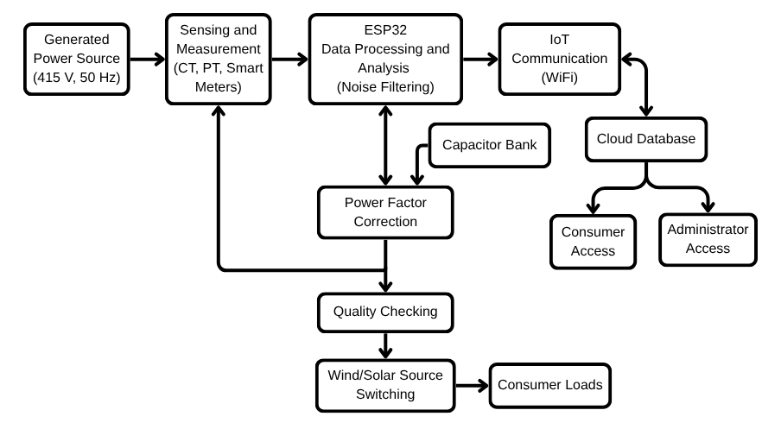
PRATHYUSHA ENGINEERING COLLEGE
AN AUTONOMOUS INSTITUTION
DEPARTMENT OF EEE
WORKFLOW

Slide 16
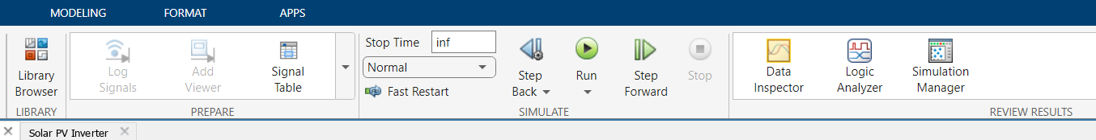
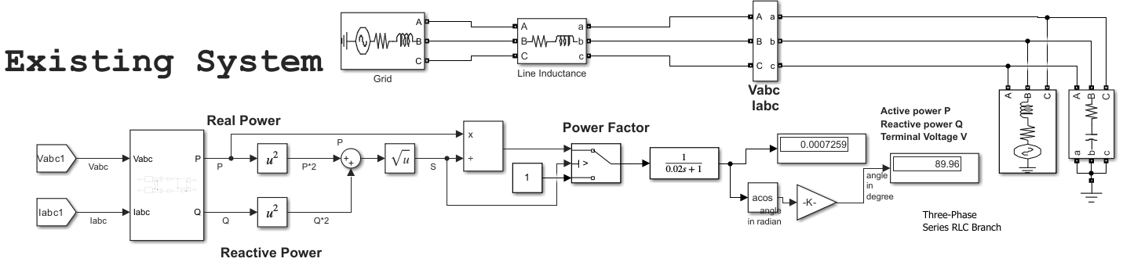
PRATHYUSHA ENGINEERING COLLEGE
AN AUTONOMOUS INSTITUTION
DEPARTMENT OF EEE
EXISTING SYSTEM SIMULATION

Slide 17
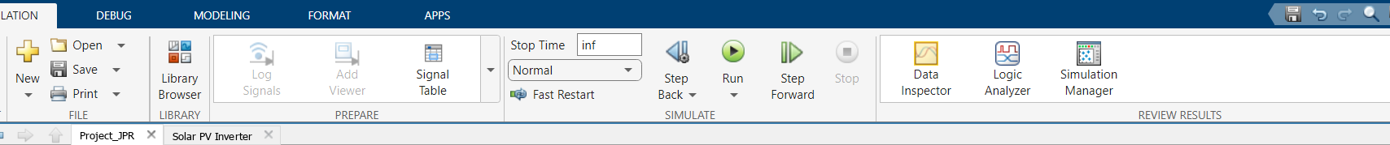
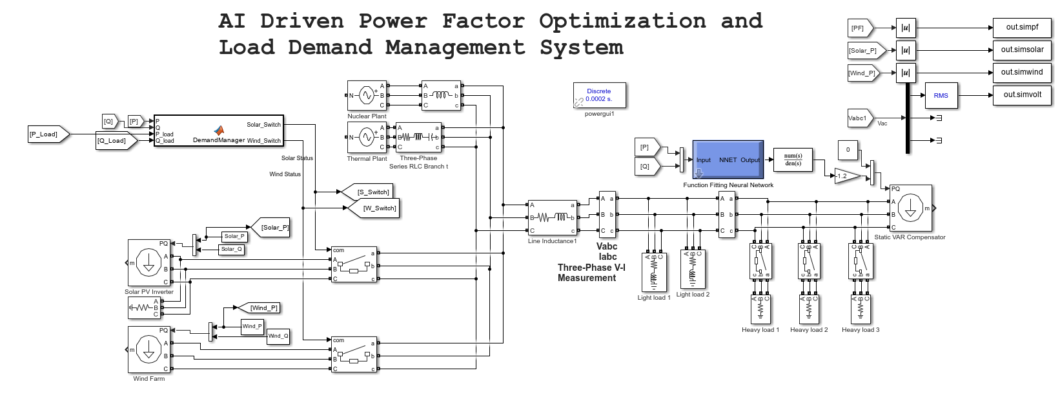
PRATHYUSHA ENGINEERING COLLEGE
AN AUTONOMOUS INSTITUTION
DEPARTMENT OF EEE
POWER FACTOR OPTIMIZATION AND LOAD DEMAND MANAGEMENT SYSTEM
iiiiiiiiiii

Slide 18
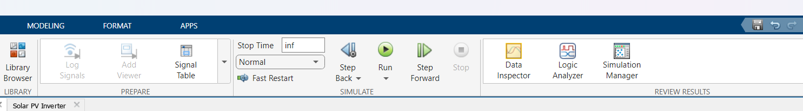
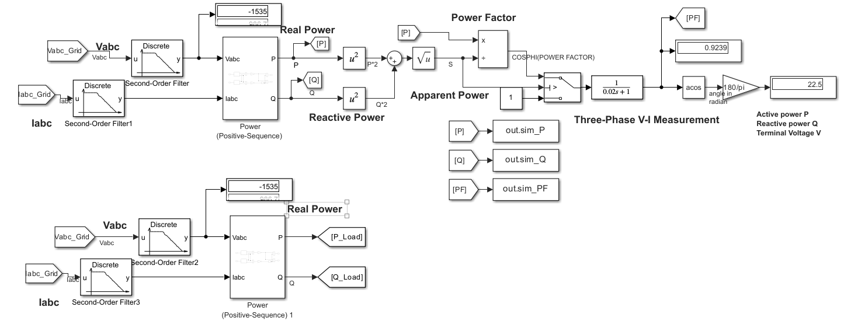
PRATHYUSHA
ENGINEERING COLLEGE
AN AUTONOMOUS INSTITUTION
DEPARTMENT OF EEE
POWER FACTOR ANALYSER

Slide 19
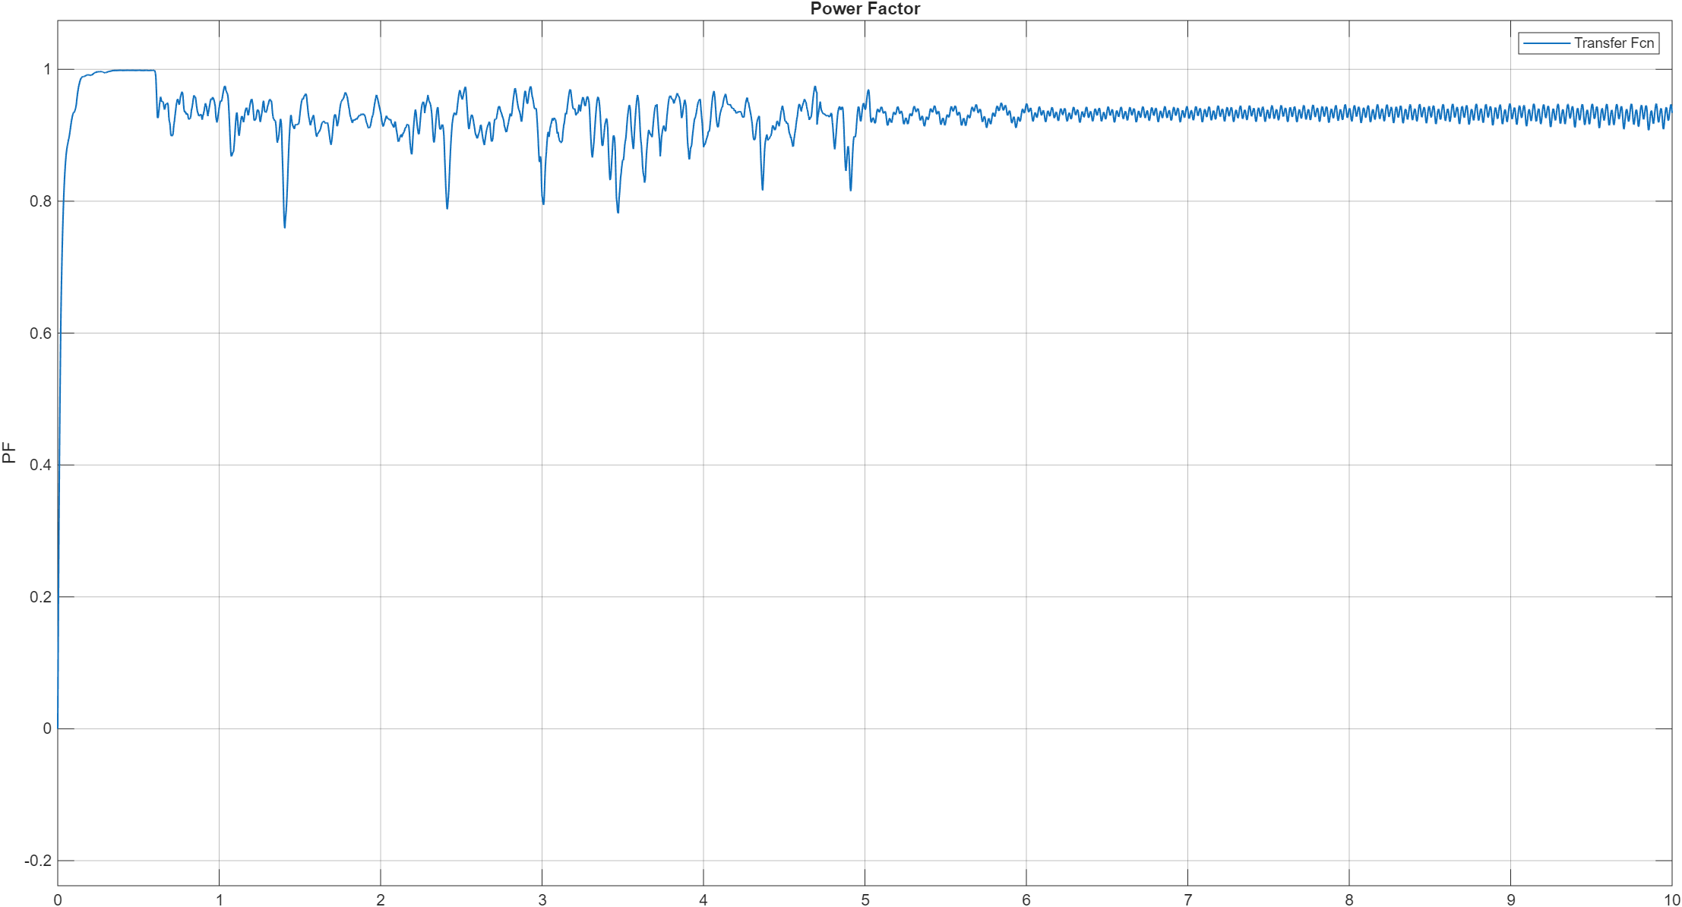
PRATHYUSHA ENGINEERING COLLEGE
AN AUTONOMOUS INSTITUTION
DEPARTMENT OF EEE
RESULT

Slide 20
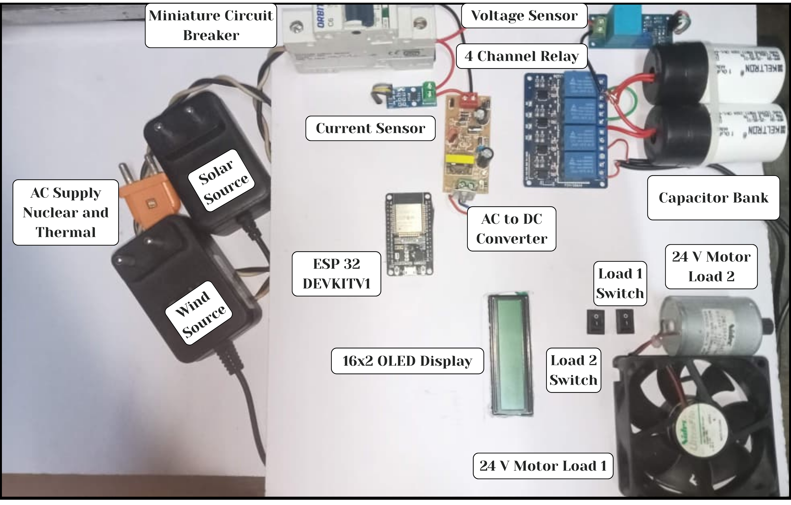
PRATHYUSHA ENGINEERING COLLEGE
AN AUTONOMOUS INSTITUTION
DEPARTMENT OF EEE
HARDWARE PROTOTYPE

Slide 21

PRATHYUSHA ENGINEERING COLLEGE
AN AUTONOMOUS INSTITUTION
DEPARTMENT OF EEE
WEBSITE INTERFACE - USER

Slide 22
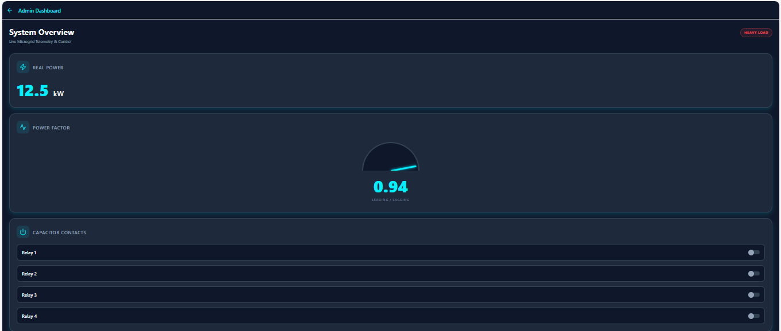
PRATHYUSHA ENGINEERING COLLEGE
AN AUTONOMOUS INSTITUTION
DEPARTMENT OF EEE
WEBSITE INTERFACE - ADMIN

Slide 23
PRATHYUSHA ENGINEERING COLLEGE
AN AUTONOMOUS INSTITUTION
DEPARTMENT OF EEE
CONCLUSION
Thus, our project successfully demonstrates a groundbreaking approach to contemporary power management by transitioning from traditional cloud-reliant systems to a deterministic, dual-core edge computing framework. By utilizing the parallel processing capabilities of the ESP32, the system effectively decouples high-speed neural network-based Power Factor optimization (Core 0) from intelligent load demand management and IoT telemetry (Core 1). The hardware prototype achieved its primary engineering goals like maintaining a near-unity power factor to eliminate utility penalties and ensuring an uninterruptible, "always-on" microgrid through a diode OR-ing bus that seamlessly integrates renewable solar and wind sources during AC mains failure. Ultimately, this self-regulating IoT solution delivers a scalable model for industrial efficiency, providing verified results of 15-25% peak demand reduction and sustained power quality for sustainable electrical systems.

Slide 24
PRATHYUSHA ENGINEERING COLLEGE
AN AUTONOMOUS INSTITUTION
DEPARTMENT OF EEE
THANK YOU

