Slide 1

Introduction to Computing
Using Java
Package

Slide 2
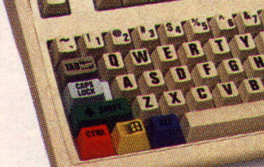
File System – Directory/ Folder
There are normally thousands of files accessible from your computer.
They are organized into directories.
  Layer-by-layer.
  Hierarchical.
  Tree-like structure.
Your may try pressing
Window-E together.

Slide 3
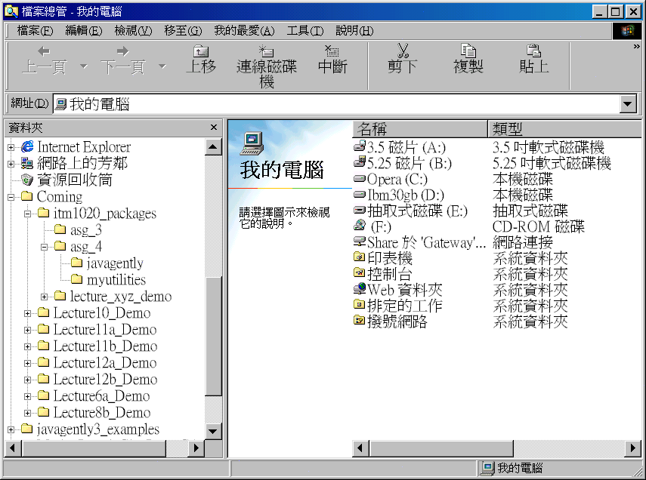
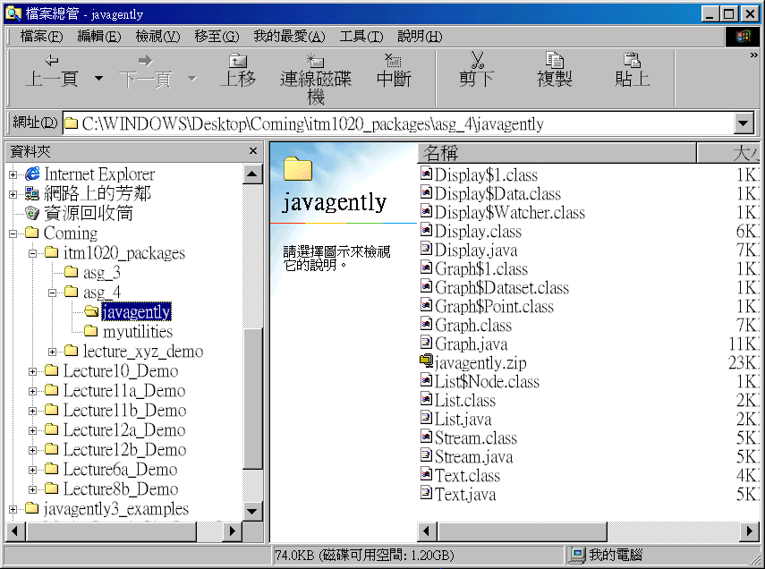
File System - Explorer
Backslash under MS
‘\’ as path separator
Directories
Files in a directory

Slide 4
Using Other Classes
A Java program/ application may consist of multiple classes.
As long as the classes are put into the same directory, they can be grouped and inter-used.
  e.g. AngryWife, PoorHusband, Family
Can we put classes into different directories and let them inter-operate?
I.e. use classes in other packages?

Slide 5
Java Package
By putting related classes into a directory, they are said to be in a package.
To use a class in a package, we can fully qualify the reference:
    java.util.Scanner s;
    s = new java.util.Scanner(...);
    double i = java.lang.Math.pi;

Slide 6
Java Package
This is what
“Fix Imports” of an IDE does!
Such full qualification is cumbersome!
Another choice is to use the import declaration:
  Import all classes in a package (*):
    import java.lang.*;
  Import a single class in a package:
    import java.util.Scanner;
Later on, the program will look like:
    Scanner s;
    s = new Scanner(...);
    double i = Math.pi;

Slide 7
Creating our own Package
To create our own package, put all the related classes together in a directory, say, myTools.
The Java source files in the package should look like:
    package myTools;
    class QuadraticSolver {
    ...
    }
public
Default: visible in its package
public : visible anywhere

Slide 8
Creating our own Package
Only the Java Byte Code (.class) files of the package are recognized by other packages.
If you have only the Java Source Files of the package, what should we do?
Compile the package into classes/ JAR in advance!!!

Slide 9
Using your own Packages
Using the Java Standard Class Library, a.k.a. the Java API is a simple matter.
Using your own packages involves one more step:
  Move/ copy your package under the working directory of your project.
  This implies multiple copies of your own package in different projects…

Slide 10
Advanced Package Sharing
We may put our own packages in a system directory, e.g. C:\Program Files\Java\.
Then, set the system environment variable CLASSPATH accordingly in C:\Autoexec.bat
  OR tune the IDE project settings.
Notice not to omit the default JDK class paths
(JDK packages and the current directory).
This allows package sharing without making multiple copies.

Slide 11
End Note
Readings and References
  Section 3.3 Packages

