Slide 1
Introduction to Computing Using Java
Recursion

Slide 2
What are Recursive Methods?
A method which invokes (calls) itself, either directly or indirectly.
An alternative to iteration (loop).
Naturally implements the "divide-and-conquer" problem solving methodology.
  Divide the problem into smaller pieces.
  Tackle each sub-task either directly or indirectly.
  Combine the solutions of the parts to form the solution of the whole.

Slide 3
Analogy: Mathematical Induction
We assert or show that a problem of scale 0 or scale 1 (or even say, –1796) has a solution.
This is the termination/ base condition.
We assume there is a solution for the problem of scale n – 1.
We are going to create the solution for the problem of scale n.
  In the process, we can make use of the assumption.

Slide 4
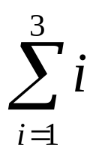



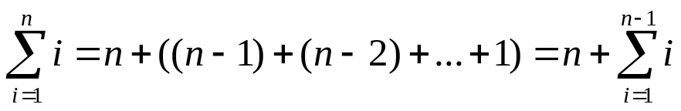
Example: Summation = 3 + 2 + 1
We assert the solution/ answer of is 1.
We assume we know the answer of
We want to find the answer of in general (for n >= 1):
  We make use of the result of the case of n – 1.
  We write:
  That is, we associate the solution for the case of n in terms of the solution for the case of n – 1.
Finally, we claim we have the solution for the problem for any n >= 1.

Slide 5
1. Example: Summation
Program Summation.java
1
2
3
4
5
6
7
8
9
10
11
12
13
14
15
16
class Summation {
public static int sum ( int n )
  {
  if (n <= 1)
  return n;
  else
  return n + sum(n-1) ;
  }
  public static void main( String[] args)
  {
  System.out.print("Enter a number? ");
  int number = new Scanner(System.in).nextInt();
  System.out.printf("Sum(%d) = %d\n",
  number, sum(number) );
  }
}
// The Termination Condition
// Calls itself, the recursive part
// The FIRST Call
Enter a number? 4
Sum(4) = 10

Slide 6
Example: Factorial 3! = 3 x 2 x 1
We assert the solution/ answer of 0! is 1.
We assume we know the answer of (n – 1)!
We want to find the answer of n! in general (for n >= 1):
  We make use of the result of the case of n – 1.
  We write: n! = n x (n – 1)!
  That is, we associate the solution for the case of n in terms of the solution for the case of n – 1.
Finally, we claim we have the solution for the problem for any n >= 0.

Slide 7
2. Example: Factorial
Program Factorial.java
1
2
3
4
5
6
7
8
9
10
11
12
13
14
15
16
class Factorial {
public static long factorial ( int n )
  {
  if (n < 0) throw new ArithmeticException("-ve!");
  else if (n <= 1) return 1;
  else return n * factorial(n-1);
  }
  public static void main( String[] args)
  {
  System.out.print("Enter n? ");
  int n = new Scanner(System.in).nextInt();
  System.out.printf("%d! = %d\n",
  n, factorial(n) );
  }
}
// The Termination Conditions
// Calls itself, the recursive part
// The FIRST Call
Enter n? 5
5! = 120

Slide 8
Summary
Recursive methods contain the following elements:
  Distinct cases governed by a selection structure.
  One or more of the cases have a simple, non-recursive solution. These are the terminating cases.
  Recursion is used to reduce the other cases to cases that are closer to the termination cases.
  Computation recurses until the terminating cases are reached and answers of the parts are returned and combined to form the answer of the whole.

