Slide 1
Introduction to Computing Using Java
Tutorial 8
StringBuilder and Package

Slide 2
Introduction to Computing Using Java
StringBuilder

Slide 3
StringBuilder
Strings are constants or String objects are immutable. In other words, their values cannot be changed after they are created.
In contrast, Java provides StringBuilder class which enables StringBuilder objects to be mutable.

Slide 4
StringBuilder
String yourName = new String("Mike");
String yourNameNew;
yourNameNew = yourName.concat("FUNG"); // yourName + "FUNG"
System.out.println("Your name is: " + yourName);
System.out.println("Your new name is: " + yourNameNew);
StringBuilder myName = new StringBuilder("Michael");
// append the specified string to this character sequence.
myName.append("FUNG");
System.out.println(myName);

Slide 5
StringBuilder
In Java, String.concat( ) instance method, String operator "+" and String operator "+=" creates a new String object as a result while StringBuilder.append( ) will not.
Therefore, the following timing experiments with String is a lot slower than that with StringBuilder.

Slide 6
StringBuilder
StringBuilder is more efficient than String.
public static void testString () {
String s = "";
int repeat = 50000;
long begin = System.currentTimeMillis();
for (int i = 0; i < repeat; i++)
s += "java";
long elapsed = System.currentTimeMillis() - begin;
System.out.println("The time for "
+ s.getClass().getName()
+ " is: " + elapsed
+ " millisecond");
}

Slide 7

StringBuilder
StringBuilder is more efficient than String.
public static void testStringBuilder () {
StringBuilder sb = new StringBuilder();
int repeat = 50000;
long begin = System.currentTimeMillis();
for (int i = 0; i < repeat; i++)
sb.append("java");
long elapsed = System.currentTimeMillis() - begin;
System.out.println("The time for "
+ sb.getClass().getName()
+ " is: " + elapsed
+ " millisecond");
}

Slide 8
Introduction to Computing Using Java
Package

Slide 9
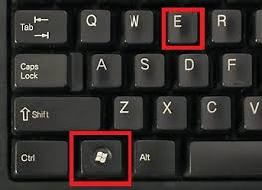
File System – Directory/ Folder
There are normally thousands of files accessible from your computer.
They are organized into directories.
Layer-by-layer.
Hierarchical.
Tree-like structure.
Your may try pressing Window-E together.

Slide 10
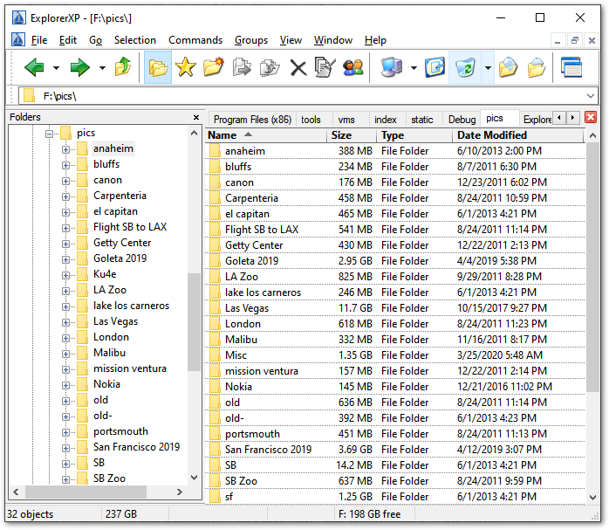
File System - Explorer
Backslash under MS
‘\’ as path separator
Directories
Files in a directory

Slide 11
Using Other Classes
A Java program/ application may consist of multiple classes.
As long as the classes are put into the same directory, they can be grouped and inter-used.
e.g. AngryWife, PoorHusband, Family
Can we put classes into different directories and let them inter-operate? I.e. use classes in other packages?

Slide 12
Java Package
By putting related classes into a directory, they are said to be in a package.
To use a class in a package, we can fully qualify the reference:
java.util.Scanner s;
s = new java.util.Scanner(...);
double i = java.lang.Math.pi;

Slide 13
Java Package
This is what “Fix Imports” of an IDE does!
Such full qualification is cumbersome!
Another choice is to use the import declaration:
Import all classes in a package (*):
import java.lang.*;
Import a single class in a package:
import java.util.Scanner;
Later on, the program will look like:
Scanner s;
s = new Scanner(...);
double i = Math.pi;

Slide 14
Creating our own Package
To create our own package, put all the related classes together in a directory, say, myTools.
The Java source files in the package should look like:
package myTools;
class QuadraticSolver {
...
}
public
Default: visible in its package
public : visible anywhere

Slide 15
Creating our own Package
Only the Java Byte Code (.class) files of the package are recognized by other packages.
If you have only the Java Source Files of the package, what should we do?
Compile the package into classes/ JAR in advance!!!

Slide 16
Using your own Packages
Using the Java Standard Class Library, a.k.a. the Java API is a simple matter.
Using your own packages involves one more step:
Move/ copy your package under the working directory of your project.
This implies multiple copies of your own package in different projects…

Slide 17
End Note
Readings and References
Section 3.3 Packages

Slide 18
Introduction to Computing Using Java
Exercises for Switch-case

Slide 19
Exercise 1: Coin sorter
Please implement a program to read the input from the command line and then output the according coin signal.
The corresponding relations between is:
input output
10 (10c)
20 (20c)
50 (50c)
100 ($1)
200 <$2>
500 (($5))
1000 ($10)

Slide 20
Exercise 1: Coin sorter
import …
int cents;
cents = Integer.parseInt( JOptionPane.showInputDialog( "Input some cents [10, 20, 50, 100, 200, 500, 1000]" );
switch (cents)
{
case 10: System.out.println("(10c)"); break;
case 20: System.out.println("(20c)"); break;
case 50: System.out.println("(50c)"); break;
case 100: System.out.println("($1)"); break;
case 200: System.out.println("<$2>"); break;
case 500: System.out.println("(($5))"); break;
case 1000: System.out.println("($10)"); break;
}

Slide 21
Exercise 2: Video Format Sorter
Please implement a program to read the input from the command line and then output the according video format.
The corresponding relations between is:
input output
720 SD 720
1080 HD 1080
2000 2K
4000 4K
8000 8K

Slide 22
Exercise 2: Video Format Sorter
import …
int vfmt;
vfmt = Integer.parseInt( JOptionPane.showInputDialog( "Input video format [720, 1080, 2000, 4000, 8000]" );
switch (vfmt)
{
case 720: System.out.println("SD 720"); break;
case 1080: System.out.println("HD 1080"); break;
case 2000: System.out.println("2K"); break;
case 4000: System.out.println("4K"); break;
case 8000: System.out.println("8K"); break;
default: System.out.println("Unknown video format"); break;
}

Slide 23
END

