Slide 1
CSCI 1130 Introduction to Computing Using Java
Tutorial 10
2D Array
1

Slide 2
Assignment 5: Photo Kiosk

Slide 3
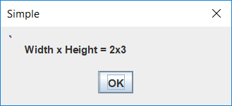
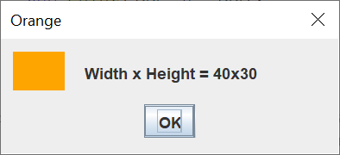
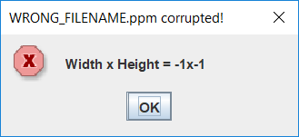
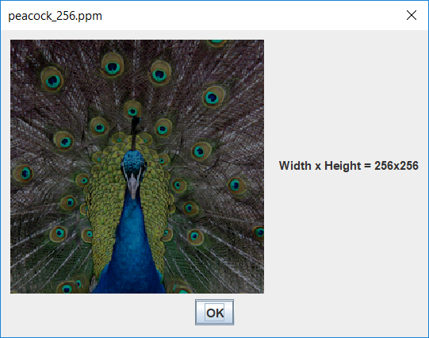
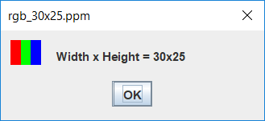
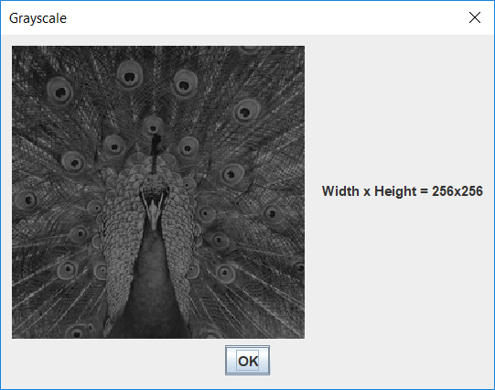
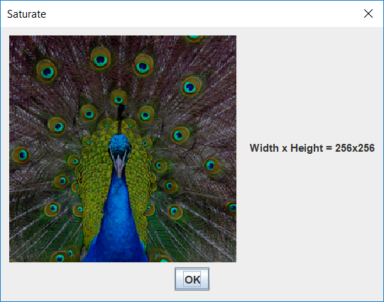

Program Flow
Shows a blank orange image
Shows peacock_256.ppm
Shows rgb_30_25.ppm
Shows grayscale of peacock_256.ppm
Saves grayscale.ppm
Shows saturate of peacock_256.ppm
Saves saturate.ppm

Slide 4
Aims
build an image processing app for PPM¹ images using Java;
practice using existing classes/objects and creating our own methods;
practice file I/O, String and 1D/2D array processing.

Slide 5

Background: PPM file format
Portable Pixel Map (PPM) is a simple image file which supports colour images in ASCII text format.
You can ignore the comment lines started with '#' in Asg5
P3
# "P3" means this is a RGB color image in ASCII
3 2
# "3 2" is the width and height of the image in pixels
255
# "255" is the maximum value for each color
# The part above is the header
# The part below is the image data: RGB triplets
255 0 0 # red
0 255 0 # green
0 0 255 # blue
255 255 0 # yellow
255 255 255 # white
0 0 0 # black
Reference: https://en.wikipedia.org/wiki/Netpbm_format#PPM_example

Slide 6
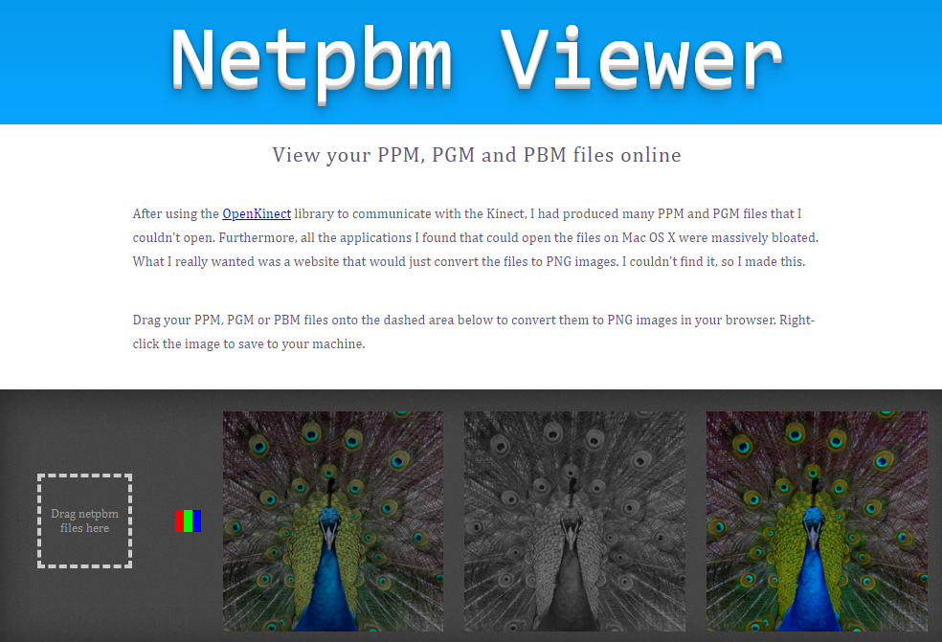
Online PPM Viewer (Demo)
Online NetPBM Viewer (paulcuth.me.uk/netpbm-viewer)

Slide 7

Background: YUV Color Space
A color space defined in terms of
Y : luminance component
U : blue chrominance component
V : red chrominance component
Y
Commonly used in different color image/video standard such as PAL, NTSC or SECAM with slight variants.
U
V
Reference: https://en.wikipedia.org/wiki/YUV

Slide 8
Background: RGB <=>YUV
A scaled and offset version of YUV is used in Asg 5, where RGB-YUV conversion are given by:
Y = (0.257 × R) + (0.504 × G) + (0.098 × B) + 16
U = -(0.148 × R) - (0.291 × G) + (0.439 × B) + 128
V = (0.439 × R) - (0.368 × G) - (0.071 × B) + 128
R = 1.164 × (Y - 16) + 1.596 × (V - 128)
G = 1.164 × (Y - 16) - 0.813 × (V - 128) - 0.391 × (U - 128)
B = 1.164 × (Y - 16) + 2.018 × (U - 128)
Reference:^{b} "Video Demystified", Keith Jack (ISBN 1-878707-09-4).

Slide 9
Submission remarks
Work under a NetBeans Java Application project PhotoKiosk. Name the package as photokiosk
Comment, indentation are under assessment
Include personal particulars & academic honesty declaration statement in each source file
Zip and Submit your whole NetBeans project folder as PhotoKiosk.zip, NOT just the .java files

Slide 10
Tutorial 9: 2D Array

Slide 11
Topics
Why do we need 2D array
2D array declaration
Accessing elements of a 2D array
Declaration using initializer list
Irregular (non-rectangular) 2D array
Further study of useful techniques and tools
Median Filter
11

Slide 12
Why 2D array?
Data sometimes comes naturally in the form of a table, which needs a 2-dimensional array to represent.
Examples:
Periodic table
6 assignments’ grades for 161 students
Each row is a different student
Each column is a different assignment
12

Slide 13
2D array declaration
A 2D array is declared and created like this:
int [ ][ ] m = new int[3][4];
Variable m is storing a reference to an array of arrays
m[0][0]
m[0][1]
m[0][2]
m[0][3]
m[0]
m
m[1][0]
m[1][1]
m[1][2]
m[1][3]
m[1]
m[2]
m[2][0]
m[2][1]
m[2][2]
m[2][3]
13

Slide 14
Accessing elements of a 2D array
2-dimensional array is indexed by two subscripts, one for the row and one for the column
We can access individual elements of a 2D array by specifying both row index i and column index j: m [ i ] [ j ]
Assign
row column
m[0][2] = 2;
14

Slide 15
Declaration using initializer list
Similar to 1D array, a 2-dimensional array can be created as a list of array initializers, one for each row in the array, for example:
int [ ] [ ] a = { { 1, 0, 2, 4 },
{ 2, 0, 4, 8 },
{ 4, 0, 9, 6 } };
Initializers can ONLY be applied during array variable declaration, NOT in assignment:
a = { { 1, 0, 0 }, { 2, 3, 4 } }; // ERROR!
15

Slide 16
Examples using 2D array - Matrix
(Dense) Matrix is can be represented by a 2D array
Operations:
Setup an identity matrix: I
Transpose: J^{T}
Scalar addition: J + a
Matrix addition: J + K
Matrix (dot product) multiplication: J x K
Convolution
Finding Determinant of a square matrix
…
16

Slide 17
Examples using 2D array - Matrix
Class Matrix:
Fields:
int rowM
int colN
double[ ] [ ] elements
Methods:
Constructor: Matrix(int m, int n) - create a m * n matrix
Constructor: Matrix(String fileName) - restore a matrix from a file
Instance methods: clone, toString, toFile
Instance methods: set, get – set or get the value of one element
Instance method:s add(double value), add(Matrix mat2), clear, identity, transpose, dotMultiply - matrix operations
17

Slide 18
Examples using 2D array - SquareMatrix
Class SquareMatrix extends Matrix :
Fields:
int SizeN
Methods:
Constructor: SquareMatrix(int n) - create a n * n square matrix
Constructor: SquareMatrix(String fileName) - restore a square matrix from a file
Instance methods: determinant, hasInverse – square matrix operations
Instance methods of its parent class Matrix
18

Slide 19
Examples using 2D array - Matrix
Firstly, we declare object variables of type (class) Matrix:
Matrix mat, mat1, mat2, mat3;
Then, create a new Matrix object:
mat = new Matrix(3, 4);
or
mat1 = new Matrix("mat.txt");
To invoke instance methods:
mat2 = mat.transpose();
mat3 = mat.dotMultiply(mat1);
19

Slide 20
Examples using 2D array - Matrix
Are you able to define and finish the class Matrix?
After the topic of inheritance, you may try finishing sub-class SquareMatrix as well.
20

Slide 21
Irregular 2D Array
A non-rectangular 2D array can be declared and created level-by-level:
int [ ] [ ] m = new int [3] [ ];
// m is an array of row array references
m[0] = new int[5]; // row 0 has 5 elements
m[1] = new int[2]; // row 1 has 2 elements
m[2] = new int[4]; // row 2 has 4 elements
m[0][0] = 9; // int elements as usual
m[2][3] = -7;
m[0] = null; // deleting the first row
m[1] = m[2]; // copying a reference
21

Slide 22
Irregular 2D Array
m[0][0]
9
m[0][1]
0
m[0][2]
0
m[0][3]
0
m[0][4]
0
m[0]
m
m[1][0]
0
m[1][1]
0
m[1]
m[2]
m[2][0]
0
m[2][1]
0
m[2][2]
0
m[2][3]
-7
m[0]
null
m
m[1]
m[2][0]
0
m[2][1]
0
m[2][2]
0
m[2][3]
-7
m[2]
22

Slide 23
Processing Irregular 2D Array
int [ ] [ ] m = new int [3] [ ];
// m is an array of row array references
m[0] = new int[5]; // row 0 has 5 elements
m[1] = new int[2]; // row 1 has 2 elements
m[2] = new int[4]; // row 2 has 4 elements
for (int row = 0; row < m.length; row++) // m.length = 3 here
{
for (int col = 0; col < m[row].length; col++) // row length varies
System.out.printf(“m[%d][%d] = %d “, row, col, m[row][col] = row*col);
System.out.println(); // an arbitrary value ^^^
}
23

Slide 24
Further Study Iterating an Array
An array is an indexed collection of items.
We may iterate a collection, i.e., going through the items in sequence without using an index:
double [ ] rainfall = new double [12];
for (double item : rainfall) // iterate through all elements
item = Math.random() * 100;
double sum = 0;
for (double item : rainfall) // item: rainfall[0], rainfall[1], …
sum += item;

Slide 25
Further Study Helper Class Array
Arrays is a utility class providing class methods:
import java.util.Arrays;
…
{
double[ ] monthJanFebMar = Arrays.copyOfRange(rainfall, 0, 2);
Arrays.sort(rainfall); // sort the array before binary search
int index = Arrays.binarySearch(rainfall, 56); // find a value
Arrays.fill(rainfall, 3, 11, 3.14159); // fill rainfall[3]…rainfall[11] with PI
}

Slide 26
Further Study Helper Class Array
Arrays is a utility class providing class methods:
import java.util.Arrays;
…
{
double[ ] monthJanFebMar = Arrays.copyOfRange(rainfall, 0, 2);
Arrays.sort(rainfall); // sort the array before binary search
int index = Arrays.binarySearch(rainfall, 56); // find a value
Arrays.fill(rainfall, 3, 11, 3.14159); // fill rainfall[3]…rainfall[11] with PI
}

