Slide 1
Introduction to Computing
Using Java
Primitive Data Type Boolean and Related Operators
3 Boolean & Rel Op
CSCI1130, CS&E, The Chinese University of HK

Slide 2
Boolean/Truth/Logic Processing
布林(布爾)/真值/邏輯運算
A proposition may be true, false or undetermined, e.g.
  true/false questions in examinations
  You are a boy
  Peter is 21 years old
  Principal of no less than HK$30,000
  It will rain tomorrow?
3 Boolean & Rel Op
CSCI1130, CS&E, The Chinese University of HK
Notes:
A Boolean value can only be true or false. There is nothing in between.

Slide 3
Boolean Values
int moneyAtHand = 3000;
boolean noMoneyAtHand = false;
accountMichael.deposit(3000);
moneyAtHand = moneyAtHand - 3000;
noMoneyAtHand = true;
noMoneyAtHand = moneyAtHand <= 0;
The only values a boolean type field can take is either true or false.
3 Boolean & Rel Op
CSCI1130, CS&E, The Chinese University of HK

Slide 4
Expressions
Up to now we have seen
  arithmetic expressions that use the operators
+ - * / % ++ --
  assignment expressions that use the operators
= += -= …
Boolean expressions use relational and logical
operators.
The result of a Boolean expression is either true or false.
Boolean expressions allow us to write programs that decide whether to execute some code or not.
These decisions changes the flow of the program execution.
3 Boolean & Rel Op
CSCI1130, CS&E, The Chinese University of HK
4

Slide 5
Relational Operators
Relational operators compare two arithmetic expressions
and evaluate to a boolean result.
==
!=
>
<
>=
<=
=
LHS is equal to RHS
LHS is not equal to RHS
LHS is greater than RHS
This is NOT a relational operator!
LHS is less than RHS
LHS is greater than or equal to RHS
LHS is less than or equal to RHS
Assignment/Storage Operation! LHS is a locker!
3 Boolean & Rel Op
CSCI1130, CS&E, The Chinese University of HK
Notes:
Double equal signs indicate that the LHS is equal to the RHS
exclamation mark means LHS is not equal to the RHS.
And other operators, greater than, less than, greater than or equal, less than or equal.
We should notice that a single equal sign is not a relational operator because it is for variable assignments. Let’s look at an example.

Slide 6

The last Java program in the world
boolean buttonPressed = false;
...
if (buttonPressed = true) {
nuclear.launch();
}
What’s the problem?
Solution 1: Use (buttonPressed == true)
Solution 2: Use (buttonPressed)
3 Boolean & Rel Op
CSCI1130, CS&E, The Chinese University of HK
Notes:
Suppose a bad guy writes a Java program to control a nuclear bomb. He uses a button to control the bomb, when the button is pressed, the nuclear bomb will launch.
But here he made something wrong.
The problem is that when it checks the value of buttonPressed and finds whether it’s true or false, he uses a single equal sign, which is actually an assignment expression, instead of a relational expression. And this will assign the value “true” to the value “buttonPressed”, then goes into the next statement, and trigger the bomb.
(Demo: )
if (s = 1) {
... something...
}
You should be careful when you use a single equal sign in the if statement
When you put a Boolean value into the if statement, don’t use something like equals true or equals false. You just get rid of it, and if you want to take the negation, use the exclamation mark.

Slide 7
Relational Operators
How do they look like?
  For numerics:
  3 > 7
  –1 != 1
  oldWeight + oldHeight >= 190.34 * newHeight
  18 = = Age
  For characters: (Depending on the ASCII value)
  'Z' > 'A'
  'A' > '0' ??? true ??? 65 > 48
  'a' > 'A' ??? true ??? 97 > 65
Result must be true or false
3 Boolean & Rel Op
CSCI1130, CS&E, The Chinese University of HK
Notes:
ascii is short for American Standard Code for Information Interchange
‘A’ is 65
‘Z’ is 90
‘a’ is 97
‘0’ is 48

Slide 8
Relational operators
These relational operators have lower precedence than the arithmetic operators.
Thus, arithmetic expressions are evaluated first, then the Boolean expressions.
That is, Java does the “math” first, then the comparison.
3 Boolean & Rel Op
CSCI1130, CS&E, The Chinese University of HK
8

Slide 9
Relational operators
Examples:
int x = 15; int y = 100;
System.out.println(x System.out.println(x System.out.println(x System.out.println(x System.out.println(x
System.out.println(x boolean isBigger = x
> y);
< 15);
Calculate firstly
<= 15)
== y);
!= 5);
* -y > 0);
> y;
3 Boolean & Rel Op
CSCI1130, CS&E, The Chinese University of HK
9

Slide 10
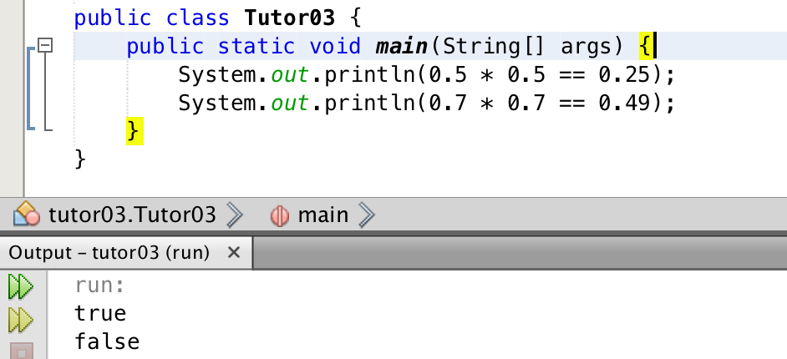
Floating point comparison
True or false? (inexact bit storage)
  0.5 * 0.5 == 0.25
  0.7 * 0.7 == 0.49
3 Boolean & Rel Op
CSCI1130, CS&E, The Chinese University of HK

Slide 11
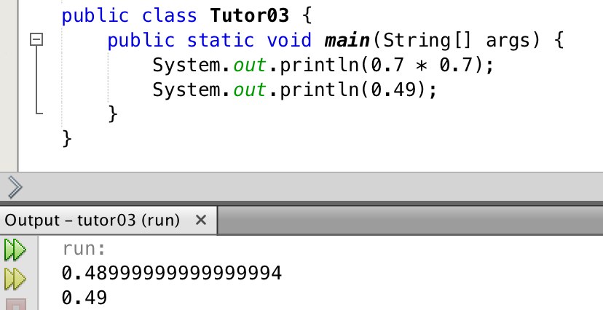
Floating point comparison
True or false? (inexact bit storage)
  0.5 * 0.5 == 0.25 true
  0.7 * 0.7 == 0.49 ??? false ???
Why false?
  Numerical error
How to compare floating point?
  Math.abs(f1-f2) < threshold (e.g. 0.0000001)
  Threshold: a very small value
3 Boolean & Rel Op
CSCI1130, CS&E, The Chinese University of HK
Notes:
To compare two floating point values, it’s better to compare their absolute difference with a very small value, for example, this one (0.0000001). You can use the Math.abs(), which is an absolute value function in Math,

Slide 12
Logical operators
Logical operators combine boolean values and evaluate to a boolean result.
Operator | Name | Example | Result
! | Logical NOT | !a | true if a is false, false if a is true
&& | Logical AND | a && b | true if both a and b are true, false otherwise
|| | Logical OR | a || b | true if a or b, or both are true, false otherwise
3 Boolean & Rel Op
CSCI1130, CS&E, The Chinese University of HK
12

Slide 13
Boolean Expression
boolean iAmDry;
/*
* sunnyDay and noSweat → iAmDry
*/
iAmDry = sunnyDay && noSweat;
--- 8< ---------------------------
What if it’s NOT sunny? [iAmDry=false]
What if I DO sweat? [iAmDry=false]
3 Boolean & Rel Op
CSCI1130, CS&E, The Chinese University of HK

Slide 14
Logical AND
iAmDry | noSweat
sunnyDay | and (&&) | true | false
 | true | true | false
 | false | false | false
3 Boolean & Rel Op
CSCI1130, CS&E, The Chinese University of HK

Slide 15
Logical OR
phoneRing | callComing
SMSalert | or (||) | true | false
 | true | true | true
 | false | true | false
3 Boolean & Rel Op
CSCI1130, CS&E, The Chinese University of HK

Slide 16
Other Boolean Operators
The not (!) operator gives you the negation (反話).
  iAmCareless = !iAmCareful;
The xor (^) exclusive-or operator gives you false when the truth values of both operands are equal, true otherwise.
  normalDay = workingDay ^ HOLIDAY;
  true <- false ^ true
  true <- true ^ false
  false <- false ^ false
  false <- true ^ true
3 Boolean & Rel Op
CSCI1130, CS&E, The Chinese University of HK
Notes:
iAmCareless is the opposite value of iAmCareful.
The working day and the holiday is exclusive here if it is a normal day, because normally, you don’t work on holiday, or normally, you don’t enjoy your holiday on the working days.
But there are some exceptions, because some students may skip classes on the working day and enjoy their holiday, which means the working day is abnormal, and some unlucky students have to work on holiday, which is also abnormal.

Slide 17
Truth Tables
Truth tables list all possible combination of values for the variables in an expression.
a | b | a && b | a || b | !a | a ^ b
true | true | true | true | false | false
true | false | false | true | false | true
false | true | false | true | true | true
false | false | false | false | true | false
3 Boolean & Rel Op
CSCI1130, CS&E, The Chinese University of HK
17

Slide 18
Logical operators
Example:
age > 26 | hasLicense | (age > 26) && hasLicense
boolean canRentCar
= (age
> 26) && hasLicense;
3 Boolean & Rel Op
CSCI1130, CS&E, The Chinese University of HK
18
Notes:
Here is an example of the truth table. The expression is, you can rent a car, as long as you are older than 26, and you has a drive license.
We can list all possible values here, and there are 4 possible values of (age > 26) and (hasLicense).

Slide 19
Logical operators
Example:
age > 26 | hasLicense | (age > 26) && hasLicense
true | true | true
true | false | false
false | true | false
false | false | false
int age = 16;
boolean hasLicense = true;
boolean canRentCar = (age > 26) && hasLicense;
3 Boolean & Rel Op
CSCI1130, CS&E, The Chinese University of HK
19

Slide 20
Logical operators: Exercise 1
It is time to buy a new phone when at least one of the following situations occurs:
  your current phone is broken
  your current phone is at least 3 years old
int phoneAge; | // in years
boolean isBroken; … | // code initializes | variables
boolean needPhone = ;
3 Boolean & Rel Op
CSCI1130, CS&E, The Chinese University of HK
20
Notes:
(Actually for some of us, we always have excuses to buy a new mobile phone)

Slide 21
Logical operators: Exercise 1
It is time to buy a new phone when at least one of the following situations occurs:
  your current phone is broken
  your current phone is at least 3 years old
int phoneAge; | // in years
boolean isBroken; … | // code initializes | variables
boolean needPhone = (isBroken == true)
|| (phoneAge >= 3);
boolean needPhone = (isBroken) || (phoneAge >= 3);
3 Boolean & Rel Op
CSCI1130, CS&E, The Chinese University of HK
21

Slide 22
Logical Operators: Exercise 2
Assume x, y, and z are int variables that have been initialized.
boolean areAllEqual = ;
3 Boolean & Rel Op
CSCI1130, CS&E, The Chinese University of HK
22

Slide 23
Logical Operators: Exercise 2
Assume x, y, and z are int variables that have been initialized.
boolean areAllEqual = (x == y) && (y == z);
3 Boolean & Rel Op
CSCI1130, CS&E, The Chinese University of HK
23
Notes:
There is no need to write x == z, because it is redundant.

Slide 24
Logical operators
Examples:
int x = 15;
int y = 100;
System.out.println(x > y && x >= 15);
System.out.println(x < 15 || x > 15);
System.out.println(x == y && y == 100);
System.out.println(x != 5 && x < y);
System.out.println(x + y > 100 || y <= 10);
&& is evaluated after relational operators.
|| is evaluated after &&.
3 Boolean & Rel Op
CSCI1130, CS&E, The Chinese University of HK
24

Slide 25
Boolean AND (&)
iAmDry | noSweat
sunnyDay | and (&) | true | false
 | true | true | false
 | false | false | false
3 Boolean & Rel Op
CSCI1130, CS&E, The Chinese University of HK

Slide 26
Boolean OR ( | )
phoneRing | callComing
SMSalert | or (|) | true | false
 | true | true | true
 | false | true | false
3 Boolean & Rel Op
CSCI1130, CS&E, The Chinese University of HK

Slide 27
Short Circuit AND (&&)
iAmDry | noSweat
sunnyDay | and (&&) | true | false
 | true | true | false
 | false | false | false
3 Boolean & Rel Op
CSCI1130, CS&E, The Chinese University of HK

Slide 28
Short Circuit OR ( || )
phoneRing | callComing
SMSalert | or (||) | true | false
 | true | true | true
 | false | true | false
3 Boolean & Rel Op
CSCI1130, CS&E, The Chinese University of HK

Slide 29
Short Circuit Boolean Operators
( && | | )
iAmDry = sunnyDay && noSweat
If sunnyDay is false, Java will not check the truth value of noSweat as the result must be false.
phoneRing = SMSalert || callComing;
If SMSalert is true, Java will not check the truth value of callComing as the result must be true.
This is called short circuit boolean evaluation.
3 Boolean & Rel Op
CSCI1130, CS&E, The Chinese University of HK
Notes:
Demo 2:
bool isSmallerThan(int a, int b) {
System.out.format(“is %d smaller than %d?\n”, a, b);
return a < b;
}
if (1 < 2 || isSmallerThan(2, 3)) …
if (1 < 2 | isSmallerThan(2, 3)) …
Demo 3: It’s very useful when you are checking whether a value is NULL before you just

Slide 30
Boolean Algebra
Double negative: !!a ≡ a
de Morgan’s Law:
!(a && b) ≡ !a || !b
!(a || b) ≡ !a && !b
3 Boolean & Rel Op
CSCI1130, CS&E, The Chinese University of HK
30
Notes:
the negation of A and B is identical to negated A or negated B.

Slide 31
Complex Boolean Expression
iAmDry = sunnyDay && noSweat;
phoneSilent = lowBattery && callForwarded;
badMood = !(iAmDry && phoneSilent);
/* by De Morgan’s Law: & ←→ || */
badMood = !iAmDry || !phoneSilent;
/* in expanded form: */
badMood = ! (sunnyDay && noSweat) |
! (lowBattery && callForwarded);
3 Boolean & Rel Op
CSCI1130, CS&E, The Chinese University of HK

Slide 32
de Morgan’s Law (version 1)
Truth table: Consider all possible combinations of values of boolean a and b.
!(a && b) == (!a || !b)
a | b | a && b | !(a && b) | !a | !b | !a || !b
T | T
T | F
F | T
F | F
3 Boolean & Rel Op
CSCI1130, CS&E, The Chinese University of HK
32

Slide 33
de Morgan’s Law (version 1)
Truth table: Consider all possible combinations of values of boolean a and b.
!(a && b) == (!a || !b)
equal
a | b | a && b | !(a && b) | !a | !b | !a || !b
T | T | T | F | F | F | F
T | F | F | T | F | T | T
F | T | F | T | T | F | T
F | F | F | T | T | T | T
3 Boolean & Rel Op
CSCI1130, CS&E, The Chinese University of HK
33

Slide 34
de Morgan’s Law (version 2)
Truth table: Consider all possible combinations of
values of boolean a and b.
!(a || b) == (!a && !b)
a | b | a || b | !(a || b) | !a | !b | !a && !b
T | T
T | F
F | T
F | F
3 Boolean & Rel Op
CSCI1130, CS&E, The Chinese University of HK

Slide 35
de Morgan’s Law (version 2)
Truth table: Consider all possible combinations of values of boolean a and b.
equal
!(a || b) == (!a && !b)
a | b | a || b | !(a || b) | !a | !b | !a && !b
T | T | T | F | F | F | F
T | F | T | F | F | T | F
F | T | T | F | T | F | F
F | F | F | T | T | T | T
3 Boolean & Rel Op
CSCI1130, CS&E, The Chinese University of HK

Slide 36
de Morgan’s Law
In Java:
!((age < 12) || (age >= 65))
In English: It is not the case that age less than 12 or age greater than or equal to 65. !!!?
Simplify using de Morgan’s Law:
!(age < 12) && !(age >= 65)
Then reverse the meaning of the relational expressions:
(age >= 12) && (age < 65)
That is, when age is at least 12 and less than 65.
3 Boolean & Rel Op
CSCI1130, CS&E, The Chinese University of HK

Slide 37
de Morgan’s Law
In English:
Words neither rhyme nor alliterate.
In Java:
!wordsRhyme !wordsAlliterate
___
&&
Words don’t rhyme and they don’t alliterate
Apply de Morgan’s Law:
!(wordsRhyme || wordsAlliterate)
It’s not the case words rhyme or alliterate.
3 Boolean & Rel Op
CSCI1130, CS&E, The Chinese University of HK

Slide 38
Precedence
() [highest]
!
&
|
&&
|| [lowest]
3 Boolean & Rel Op
CSCI1130, CS&E, The Chinese University of HK

Slide 39
More About Expression
Assignment is also an expression!
  USdollar = (HKdollar = 123.45) * rate;
  [double = double * double]
Left to right evaluation
  1 – 2 – 3 = (1 – 2) – 3 ≠ 1 – (2 – 3)
Short forms for number types
  Age = Age + 1; ≡ Age++;
  Age = Age - 1; ≡ Age--;
Short forms for number types
  Age = Age + 15; ≡ Age += 15;
  USdollar = USdollar – 1.7; ≡ USdollar -= 1.7;
3 Boolean & Rel Op
CSCI1130, CS&E, The Chinese University of HK

Slide 40
Mixing Numeric and Boolean Expressions
int temperature = 38;
boolean goHome = (temperature > 40) | (temperature < 0);
System.out.println("goHome? " + goHome);
int diceOne = 5, diceTwo = 6, diceThree = 6;
boolean triple = (diceOne == diceTwo) &
(diceTwo == diceThree);
boolean small = (diceOne + diceTwo + diceThree <= 10) &
! triple;
boolean big = (diceOne + diceTwo + diceThree >= 11) &
! triple;
3 Boolean & Rel Op
CSCI1130, CS&E, The Chinese University of HK

Slide 41
Prime Number Checker
Get an integer input from user through console (use Scanner), then check that whether this input number is a prime number or not?
boolean isPrime = true;
Scanner scan = new Scanner(System.in);
int num = scan.nextInt();
int temp = 0;
Boolean & Rel Op
CSCI1130, CS&E, The Chinese University of HK
Notes:
Note: You will learn about the Scanner in the next tutorial

Slide 42
Prime Number Checker
for(int i = 2; i <= num / 2; i++)
{
temp = num % i;
if(temp == 0)
{
isPrime = false;
break;
}
}
Boolean & Rel Op
CSCI1130, CS&E, The Chinese University of HK

Slide 43
Exercise: MPF Contribution
http://www.mpfa.org.hk/eng/mpf_system/system_features/contributions/index.jsp
Write a Java program to calculate the monthly mandatory contribution of an employee, given input the relevant monthly salary.
3 Boolean & Rel Op
CSCI1130, CS&E, The Chinese University of HK

Slide 44
Introduction—MPF
Mandatory Provident Fund (強積金制度)
Relevant month salary | Monthly mandatory contribution (employee)
Lower than $7,100 | No need to pay
$7,100 to $30,000 (inclusive) | Relevant salary*5%
Larger than $30,000 | $1,500
3 Boolean & Rel Op
CSCI1130, CS&E, The Chinese University of HK

