Slide 1
Assignment 1 Submission Guideline

Slide 2
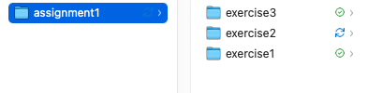
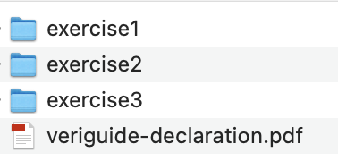
Overall
Create one file folder for each exercise, and zip them all into one assignment1.zip file for submission.

Slide 3
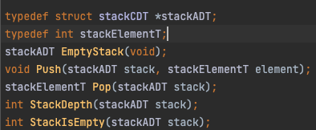
Exercise 1
In the exercise 1 folder, you need to include two files: stack.h and stack.c. You can find them in the given directories.
For stack.h, you should use the following one (also given to you):

Slide 4
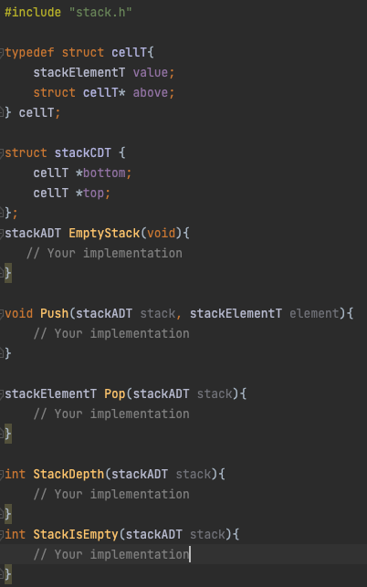
Exercise 1
You should do your implementation in stack.c as:

Slide 5
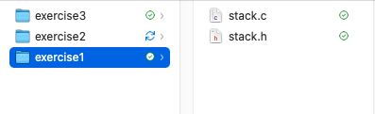
Exercise 1
Submission sample:

Slide 6
Exercise 2
In the exercise 2 folder, you need to include two files: stack.h and stack.c
For stack.h, you should use the following one (also given to you):

Slide 7
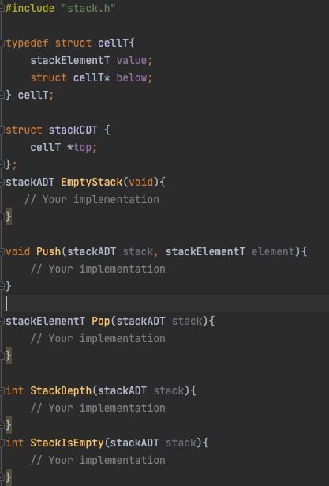
Exercise 2
You should include your implementation in stack.c as:

Slide 8
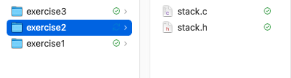
Exercise 2
Submission sample:

Slide 9

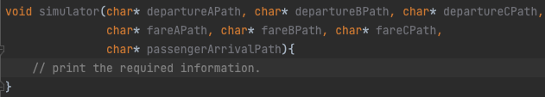
Exercise 3
In exercise 3, you need to include a BusTerminus.h and BusTerminus.c file including a simulator() function.
In BusTerminus.h, you shoud define a simulator function as:
The implementation should be in BusTerminus.c:

Slide 10
Exercise 3
The reason to implement BusTerminus.h and BusTerminus.c is to help grade your assignments. During grading, we will
call your simulator() function with some cases to test your implementation. In real application, maybe you can implement
the simulator in the main function, but in this assignment please make sure to implement the simulator function in
simulator() in BusTerminus.c.

Slide 11
Exercise 3
The input arguments are: departure time file path for bus A, B, and C, fare txt file path for bus A, B, and C, and passenger
arrival text file path.
E.g
we will call the function like:
simulator(“./departA.txt”, “./departB.txt”, “./departC.txt”, “./fareA.txt”, “./fareB.txt”, “./fareC.txt”, “./passenger.txt” )

Slide 12
Exercise 3
Some details:
When rounding an odd bus fare, please round down to the smaller integer. E.g., 3.5 -> 3.
If two passengers arrive at the same time, they will be enqueued following the order in the txt file. In other words,
we need to enqueue them and update the lengths of queues one by one.

Slide 13
Exercise 3
Example Input:
departA
480 540 600 630
departB
480 500 520 540 600
departC
480 510 540 570 600 610
fareA
10 10 8 8
fareB
9 9 9 8 8
fareC
10 10 9 9 9 9
Passenger
460 1 A 460 2 B A 461 0 A C 479 1 C 481 1 C 483 1 C 490 0 A C 490 0 A C 500 1 A C 500 2 B 550 0 C B 580 1 A B C 600 2 A B 610 0 B C

Slide 14
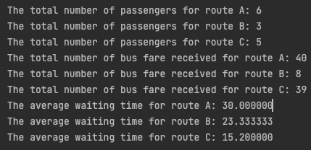
Exercise 3
Example output:

Slide 15
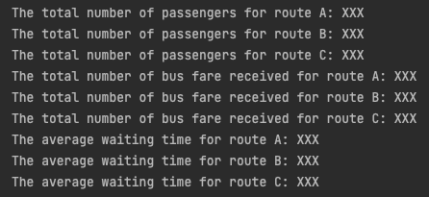
Exercise 3
The output format of your code should be:

Slide 16
Exercise 3
You should also include other files used in this exercise in the folder, such as stack.h, stack.c, queue.h, queue.c and etc.
We provide you the implementation in the class.

Slide 17
Veriguide Declaration
You should copy all your source code in a word document, and submit this document to the veriguide system.
Then you can download a declaration form, please sign it and submit it with your assignment solution.
You may access the veriguide system through CUSIS.

