Slide 1
CSCI 3150 Introduction to Operating Systems
Tutorial One: Understanding inode and directory_mapping
TA: CHEN Zizhan
chenzz@cse.cuhk.edu.hk

Slide 2
Goal
In the Assignment 2, you will be asked to do some exercises related to inode and directory.
This tutorial will help you understand Assignment 2.

Slide 3
Inode
In the simple file system (SFS), an inode is defined based on the following structure:
typedef struct _inode_ /* The structure of inode, each file has only one inode */
{
int i_number; /* The inode number */
time_t c_time; /* Creation time of the file*/
int f_type; /* 0 for regular file, 1 for directory*/
int f_size; /* The size of the file (bytes)*/
int blk_number; /* The number of data blocks occupied by this file*/
int direct_blk[2]; /*Two direct data block pointers */
int indirect_blk; /*One indirect data block pointer */
int sub_f_num; /* Number of files under a directory (0 for regular file)*/
} inode;

Slide 4
read_t()
The description of read_t() is listed below:
int read_t( int i_number, int offset, void *buf, int count);
Description: read_t() attempts to read up to count bytes from the file starting at offset (with the inode number i_number) into the buffer starting at buf. It commences at the file offset specified by offset. If offset is at or past the end of file, no bytes are read, and read_t() returns zero. On success, the number of bytes read is returned (zero indicates end of file), and on error, -1 is returned.

Slide 5
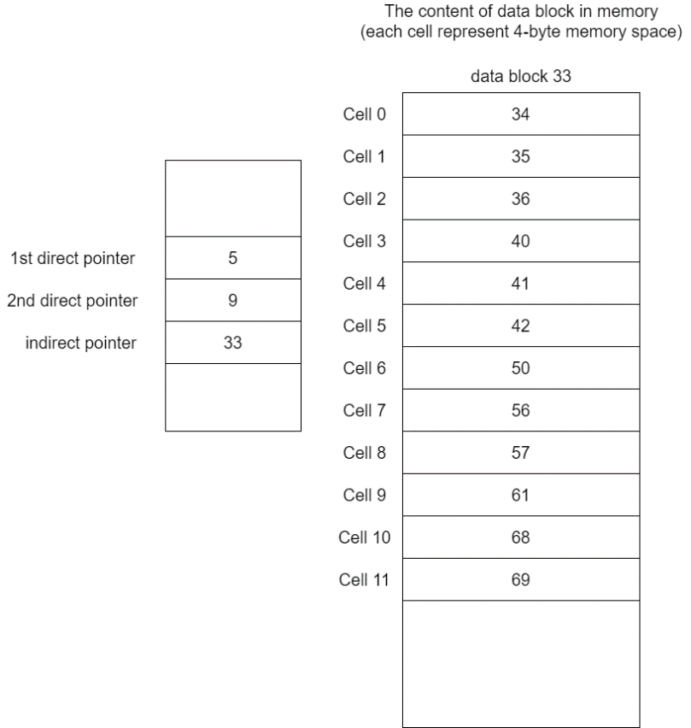
Question
Suppose there is a file with SFS and we have read the contents of its inode and related data blocks into the memory as shown below.

Slide 6
Question
 | read_t (i_number, offset, buf, count) | The data block numbers in sequence that will be read from (only list the data blocks that contain file data)
Example 1 | read_t(inum, 133, buff, 400);
Example 2 | read_t(inum, 133, buff, 9000);

Slide 7
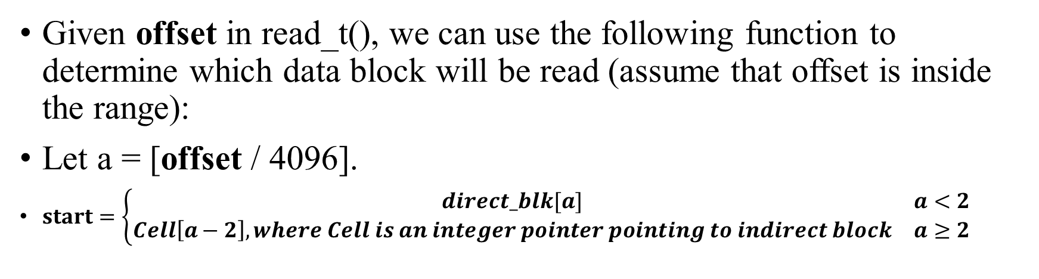
Determine the first data block to be read
Given offset in read_t(), we can use the following function to determine which data block will be read (assume that offset is inside the range):
Let a = [offset / 4096].
$start=\left\{\begin{matrix}direct_blk[a] & a<2 \\ Cell\left[a−2\right],where Cell is an integer pointer pointing to indirect block & a≥2\end{matrix}\right.$
Note that [x] returns the integer part of a floating point number x. E.g., [3.2]=3, [3.5]=3 and [3.9]=3.

Slide 8
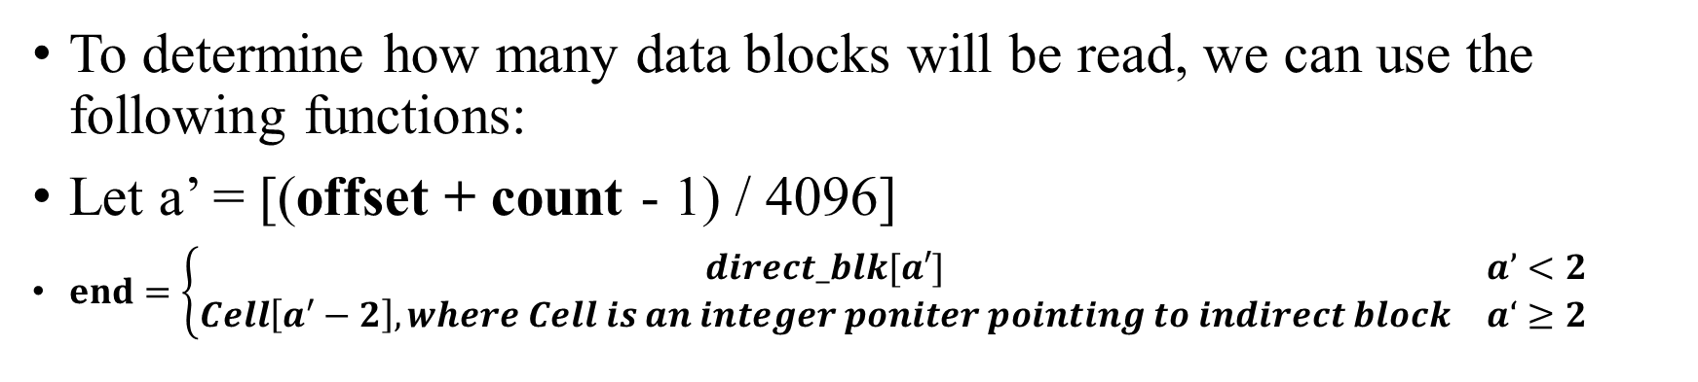
Determine the last data block to be read
To determine how many data blocks will be read, we can use the following functions:
Let a’ = [(offset + count - 1) / 4096]
$end=\left\{\begin{matrix}direct_blk[a′] & a’<2 \\ Cell\left[a^{′}−2\right],where Cell is an integer poniter pointing to indirect block & a‘≥2\end{matrix}\right.$
Q: why we -1 when calculating the a’?
A: Let’s assume the data block size is 10 bytes, we read 10 bytes for offset 0. What will happen?
If not -1, a=[0]=0, a’=[(0+10)/10]=1, then we start at direct_blk[0] and end at direct_blk[1]. However, in fact, only data block 0 should be read.
This is why we -1. After -1, a=[0]=0, a’=[(0+10-1)/10]=0, then we start at direct_blk[0] and end at direct_blk[0], which matches the fact.

Slide 9
Example 1:read_t(i_number, 133, buf, 400);
First, we calculate the a:
a = [133 / 4096] = 0
Because a < 2, read_t() starts at direct_block. The block number can be obtained by direct_blk[0] = 5.
Then we calculate a’:
a’ = [(133 + 400 - 1) / 4096] = 0
Because a’ < 2, read_t() ends at direct_block. The data block number is direct_blk[0] = 5.
Thus, only data block 5 will be read.

Slide 10
Example 2: read_t(i_number, 133, buf, 9000);
Calculate a:
a = [133 / 4096] = 0
Because a < 2, read_t() starts at direct_blk. The block number can be obtained by direct_blk[0] = 5.
Then we calculate a’:
a’ = [(133 + 9000 - 1) / 4096] = 2
Because a’ ≥ 2, read_t() ends at indirect_blk. The block number is Cell[(2-2)] = Cell[0] = 34.
Thus, read_t() will read data blocks 5, 9, and 34.
Note that data block 33 should not be included in the final answer, Why?
A: data block 33 is the indirect block, which contains metadata (i.e., Cells), not file data.

Slide 11
Directory
The directory is a special type of file. It also has the inode and data blocks.
The only difference is that the data blocks do not store file data, instead they store a list of special metadata called dir_mapping, which is the mapping of file name and inode number.
An example structure can be found below:
typedef struct dir_mapping /* Record file information in directory file */
{
char f_name[20]; /* The file name of the file */
int i_number; /* The inode number of the file*/
} DIR_NODE;

Slide 12
Traverse the directory
Each directory file should at least contain two mapping items, namely “.” and “..”, for itself and its parent directory, respectively (the parent of the root directory is itself).
When we look for a specific file under a directory, we traverse dir_mapping one by one, comparing the file name with dir_mapping.f_name. Once dir_mapping.f_name matches the file name, the corresponding dir_mapping.i_number will be returned.

Slide 13
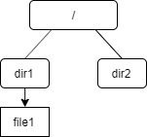
Example
For example, there is a simple directory below:
“/” is the root directory. “dir1” and “dir2” are two directory files. “file1” is a regular file.
Assume the inode numbers of “/”, “dir1”, “dir2”, “file1” are 0, 1, 2 and 3, respectively. Moreover, each directory file only occupies one data block (4 KB for one data block), and the data block numbers allocated to “/”, “dir1” and “dir2” are 0, 1 and 2, respectively.

Slide 14
“/” - the root directory
The root directory’s inode number is 0, and from inode 0, we can find that its data block number is 0.
It contains two files “dir1” and “dir2”, whose inode numbers are 1 and 2, respectively.
Because the root directory does not have parent directory, its parent directory is itself. The file contents of “/” (that is stored in data block 0) are:
f_name i_number
. 0
.. 0
dir1 1
dir2 2

Slide 15
dir1
we can obtain its inode number is 1 from the above in “/”; from inode 1, we can find its data block number is 1. The file contents of dir1 (that is stored in data block 1) are () :
f_name i_nubmer
. 1
.. 0
file1 3

Slide 16
Path traveling
Suppose a user provides the following absolute path:
/dir1/file1
In order to obtain the inode number of file1, the sequence of the inode numbers and data block numbers we need to pass (starting from the root directory) is as follows:
inode 0 -> data block 0 -> inode 1 -> data block 1 -> inode 3
Starting from the root directory, the inode number is 0. Then we read the data block of “/”, whose data block number is 0. We compare the file names with “dir1” one by one, and we find its inode number is 1.
Then we read the inode number 1, and get the data block 1; we compare the file name with “file1” and find that its inode number is 3. Finally we reach inode number 3 and read the data blocks of “file1”.

