Slide 1
Questionnaire / 问卷设计
Last updated
2024-05-17 16:57
Total feedback
104

Slide 2
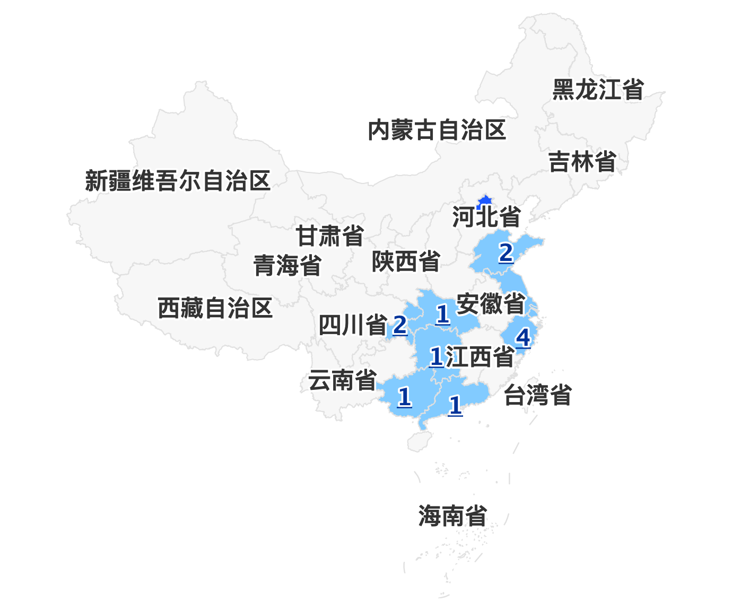
位置分布

Slide 3
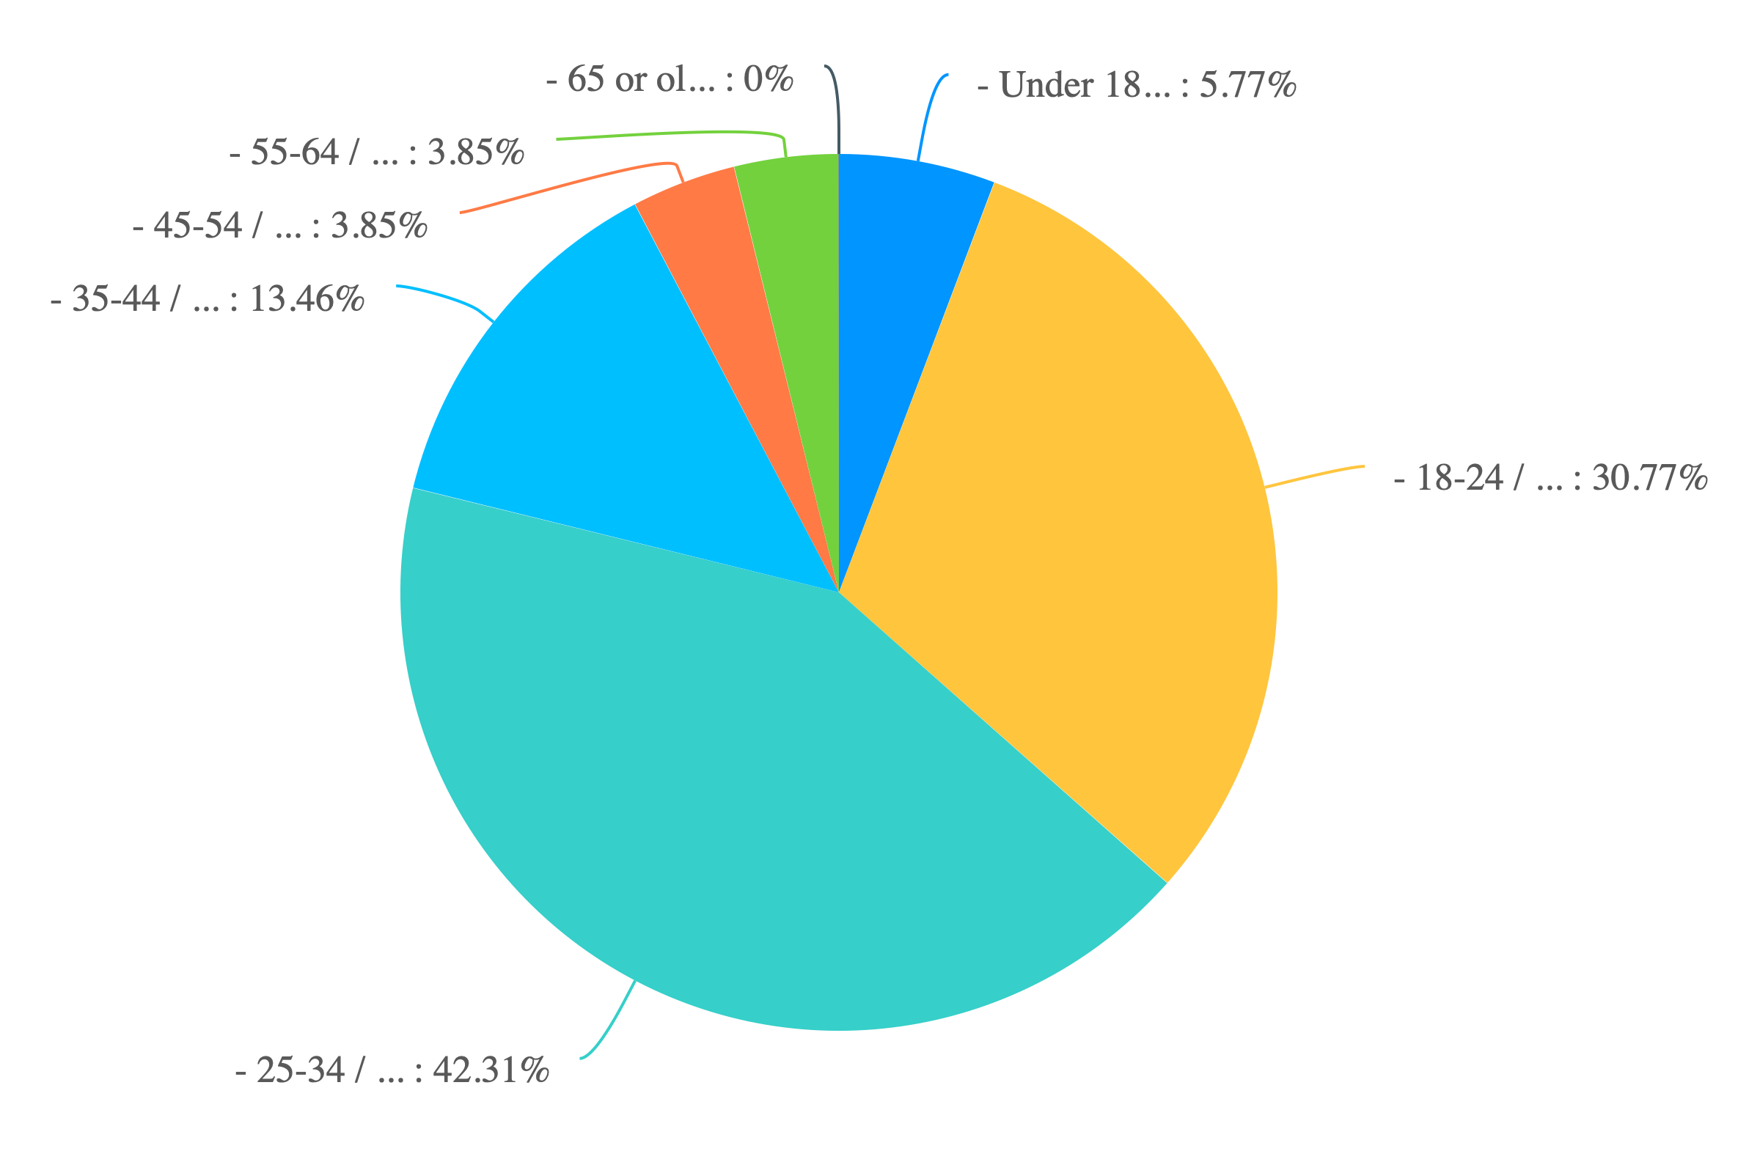
1. Age / 年龄:

Slide 4
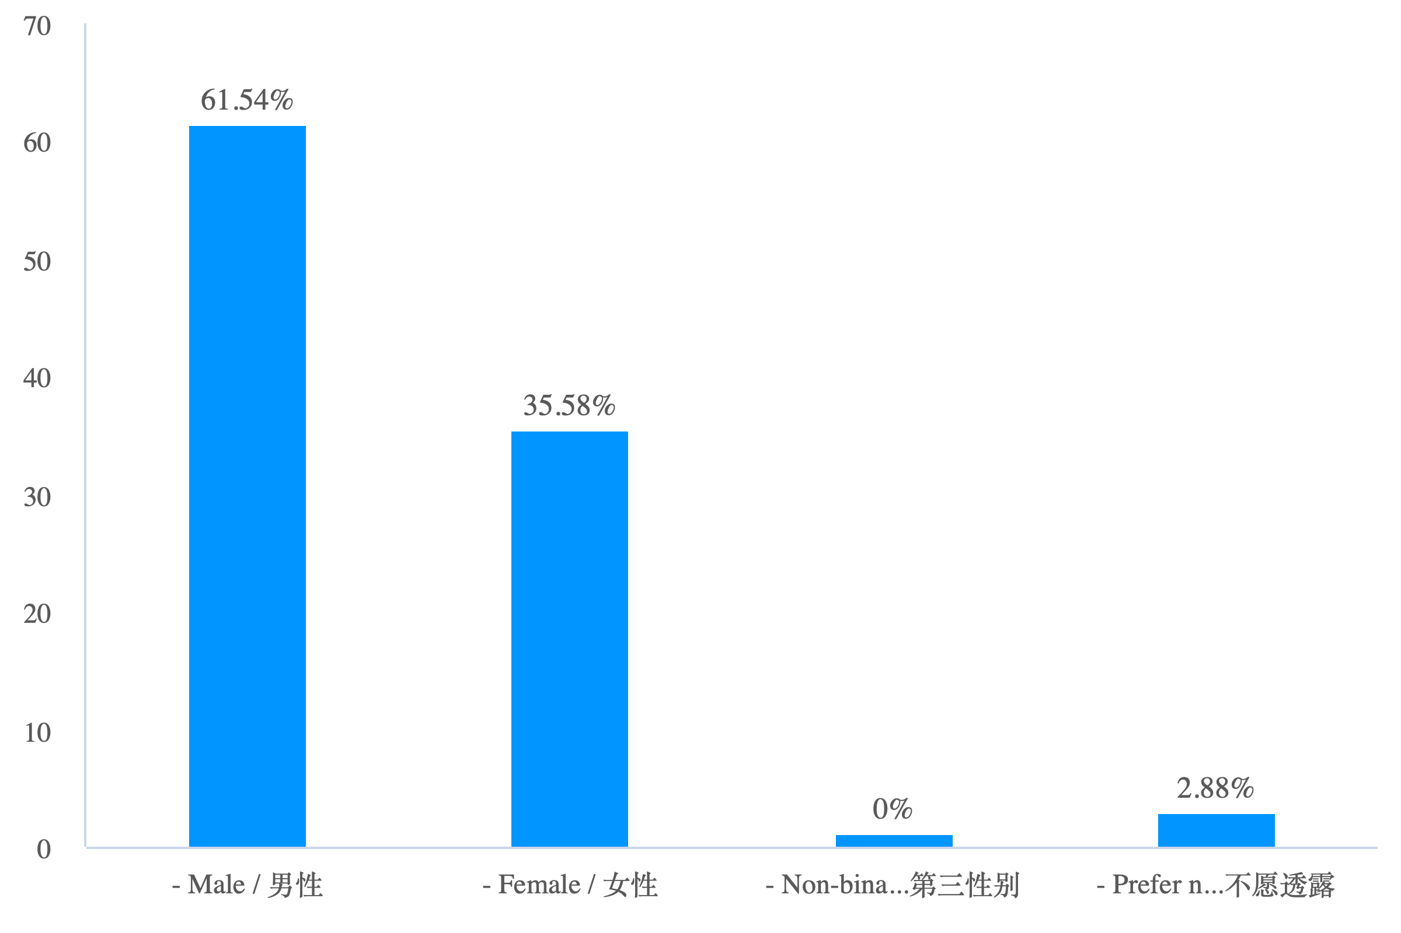
2. Gender / 性别:

Slide 5
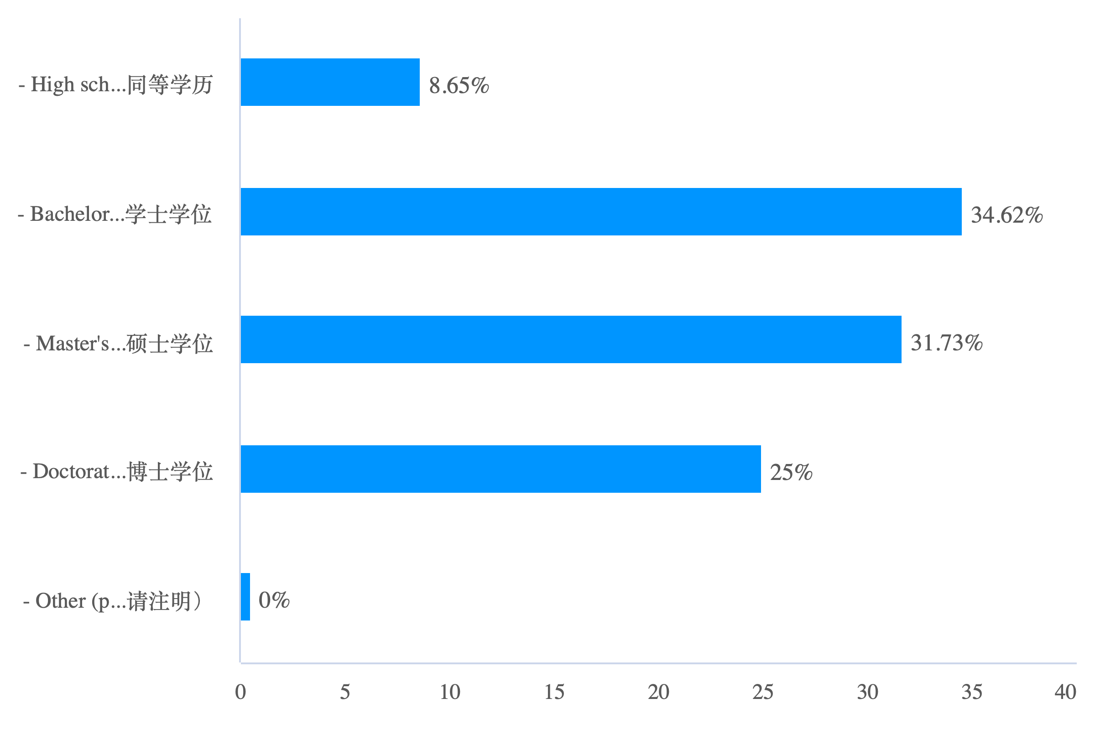
3. Education / 教育水平:

Slide 6
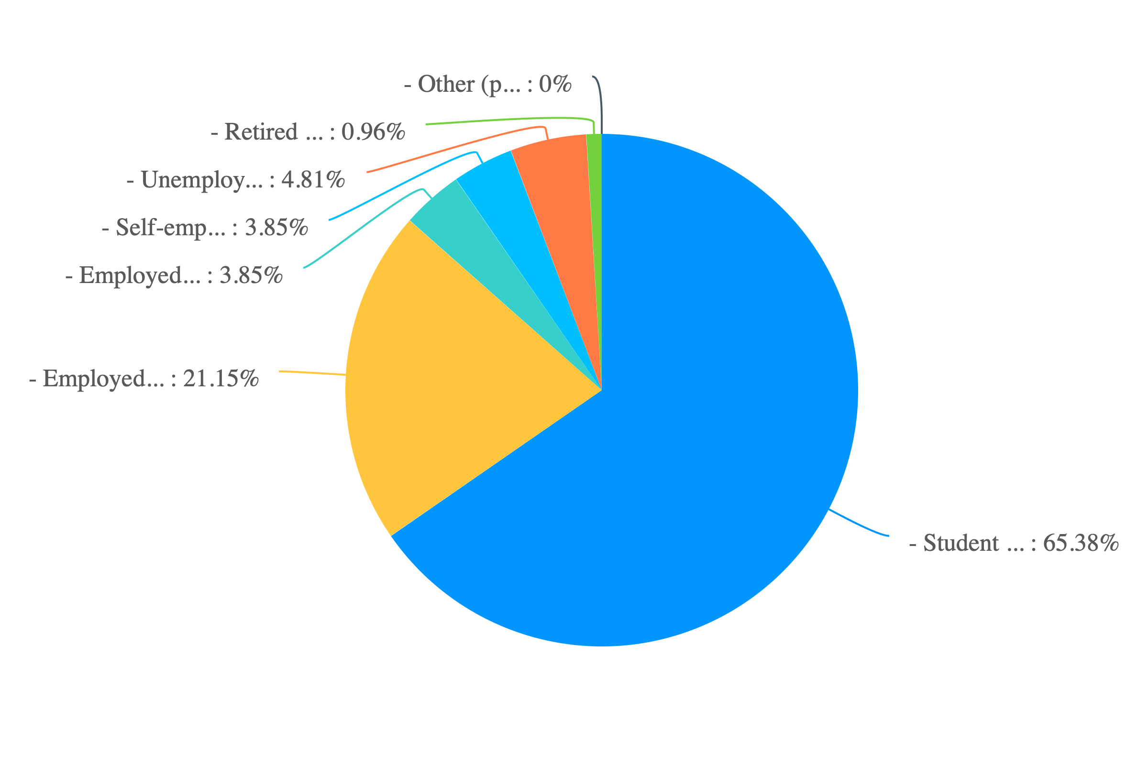
4. Occupation / 职业:

Slide 7
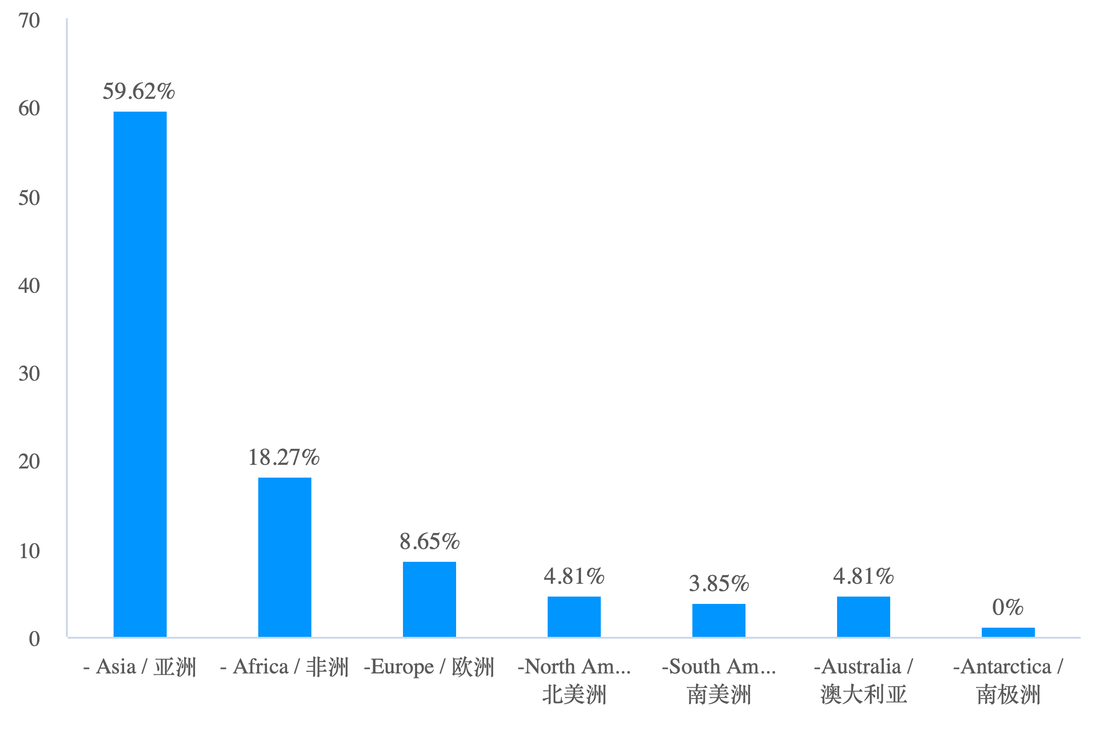
5.Continent / 大陆:

Slide 8
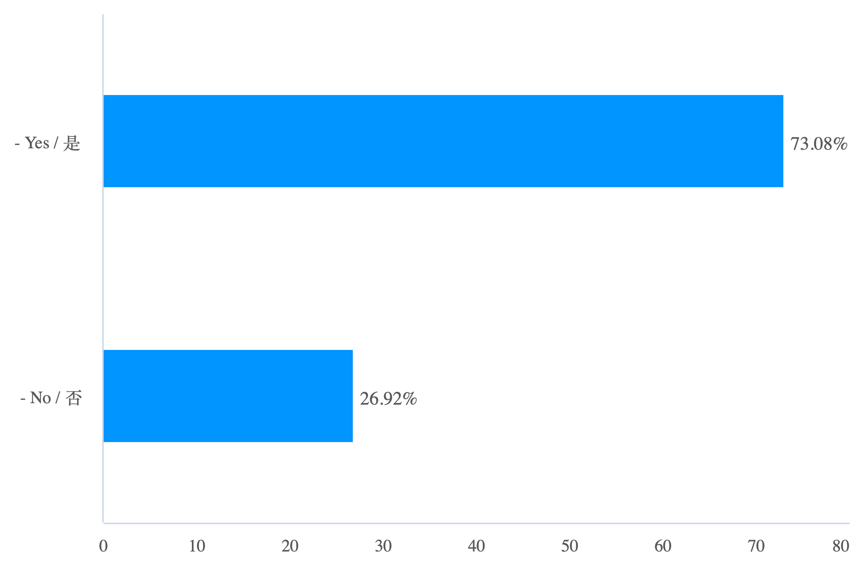
Part. 2 Experience with Recommendation LLMs / 对推荐 LLM 的体验: 1. Have you ever used recommendation systems powered by language models (e.g., Amazon recommendations, Netflix recommendations, Spotify Discover Weekly)? / 您是否曾使用过由语言模型驱动的推荐系统（例如，亚马逊推荐、Netflix 推荐、Spotify Discover Weekly）?

Slide 9
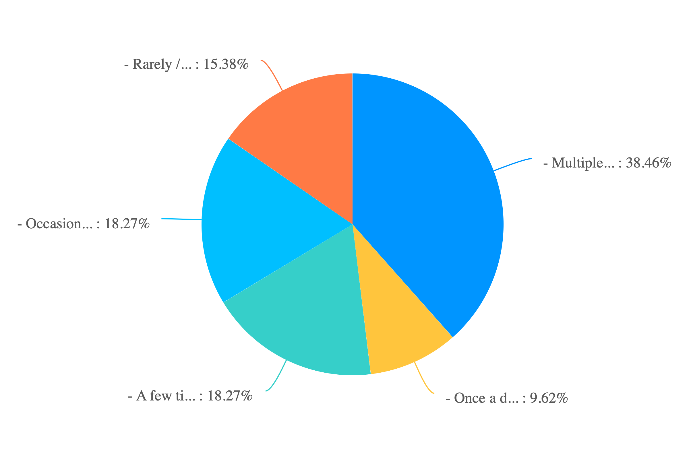
2. How often do you interact with recommendation systems in your daily life? / 您在日常生活中与推荐系统的互动频率是多少?:

Slide 10
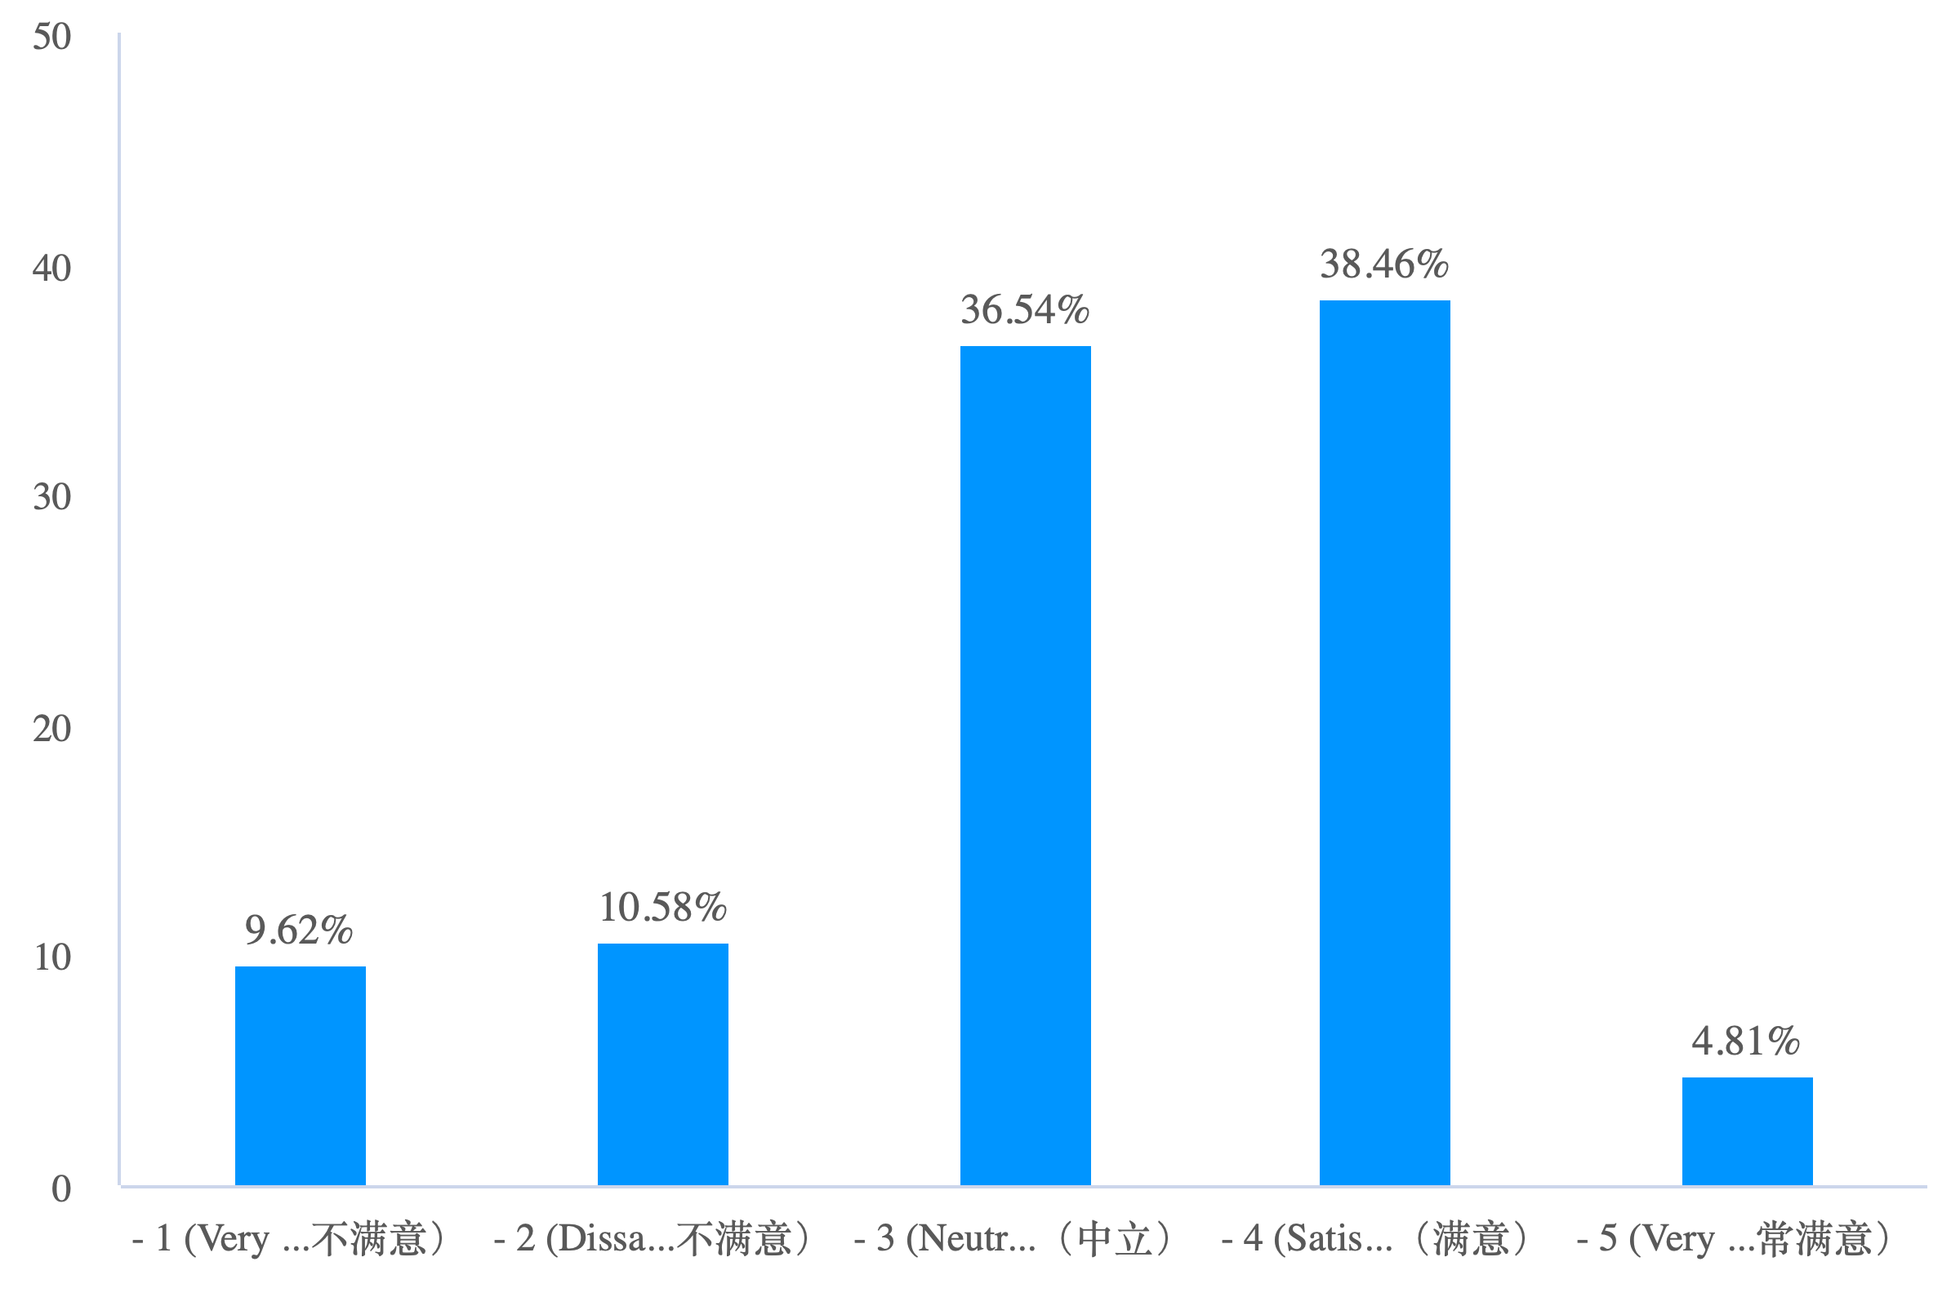
Part 3. Satisfaction and Preferences / 满意度和偏好: 1. On a scale of 1 to 5, how satisfied are you with the recommendations provided by LLMs? / 您对推荐 LLM 提供的推荐满意度如何?请用1至5的评分进行选择。

Slide 11
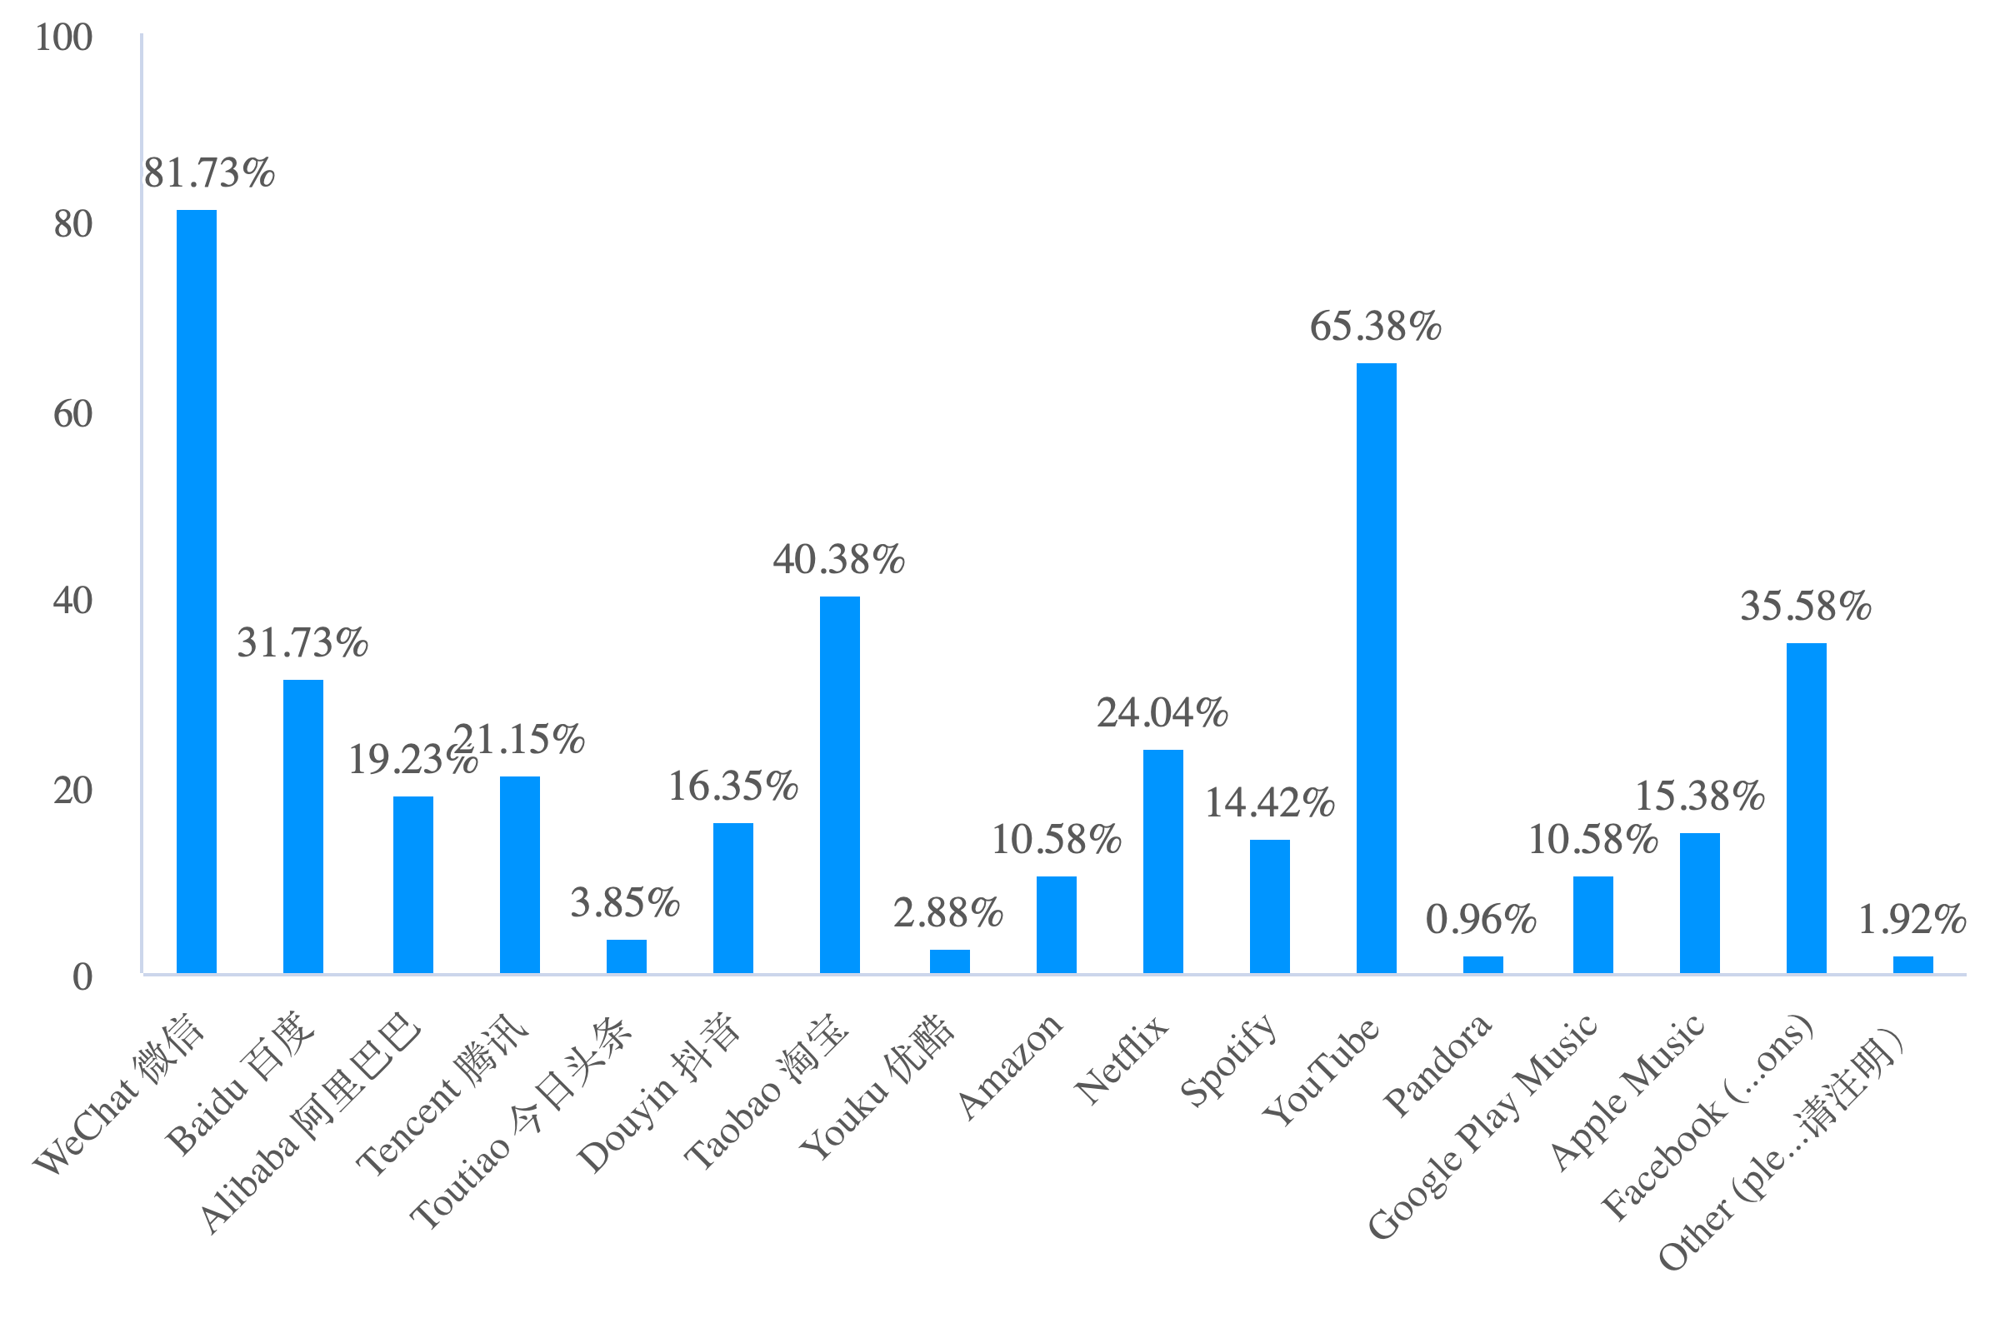
3. Which recommendation LLMs do you use most frequently? (Select all that apply) / 您最经常使用的推荐 LLM 是哪个?（可多选）

Slide 12
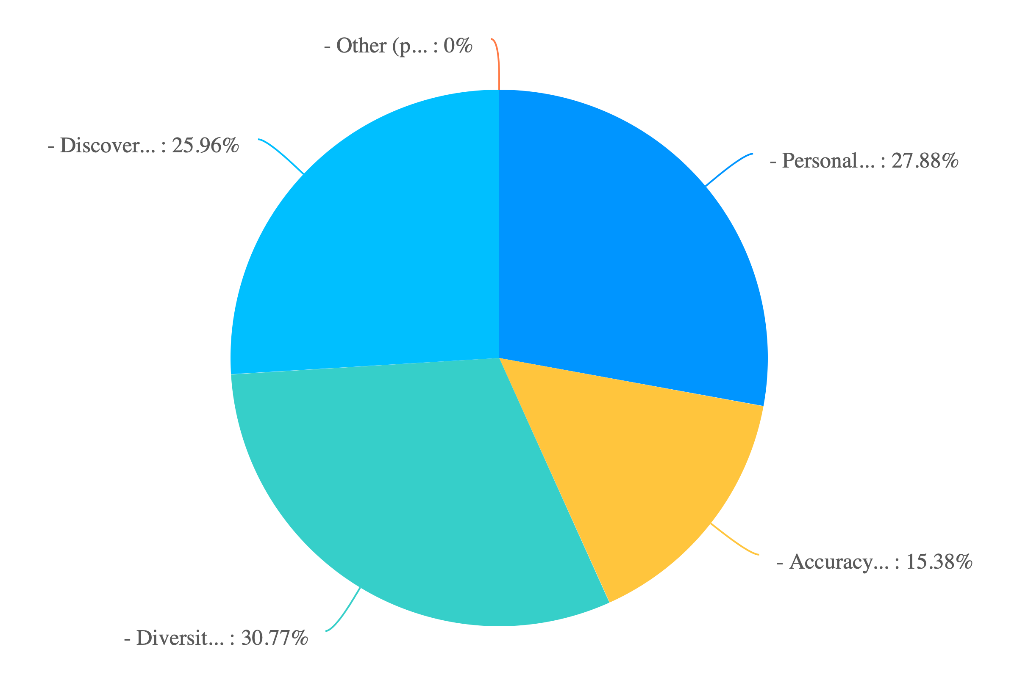
2. What do you like most about the recommendations provided by LLMs? / 您最喜欢推荐 LLM 提供的推荐的是什么? (Please select one)

Slide 13
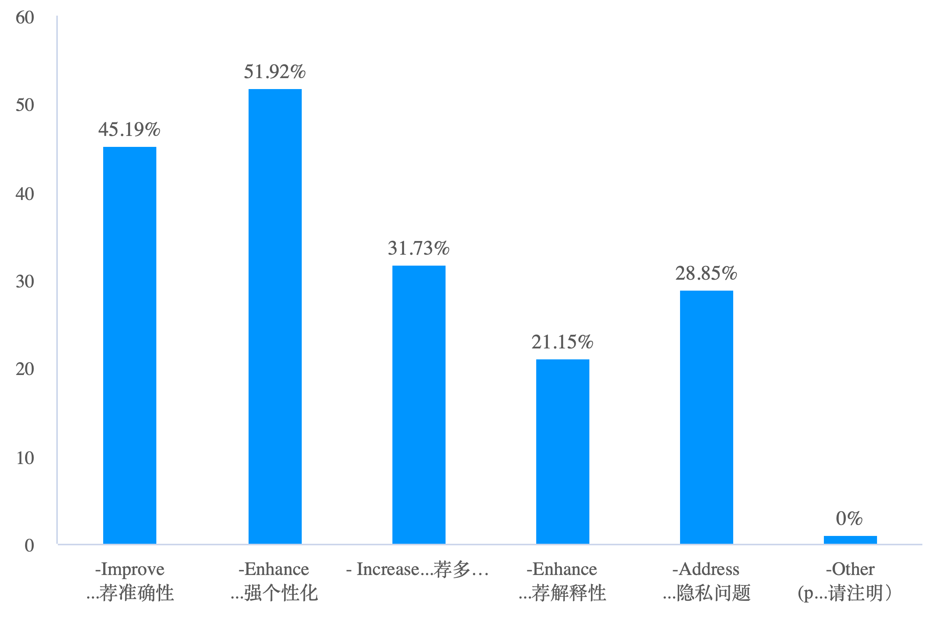
3.What improvements would you suggest for LLM-based recommendation systems? / 您对基于 LLM 的推荐系统有什么改进建议? (Please select one or multiple) (可多选）

Slide 14
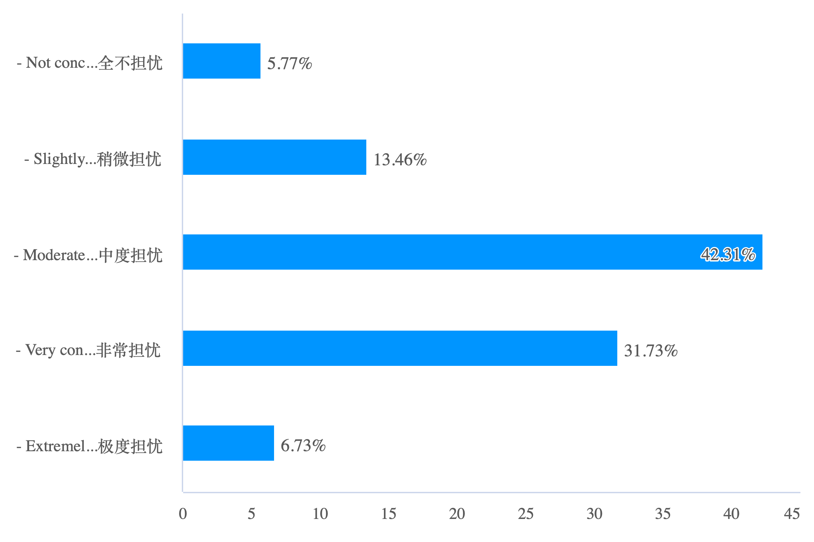
Part 4. Privacy and Trust / 隐私和信任: 1. How concerned are you about the privacy of your data when using recommendation LLMs? / 在使用推荐 LLM 时，您对个人数据的隐私担忧程度如何?

Slide 15
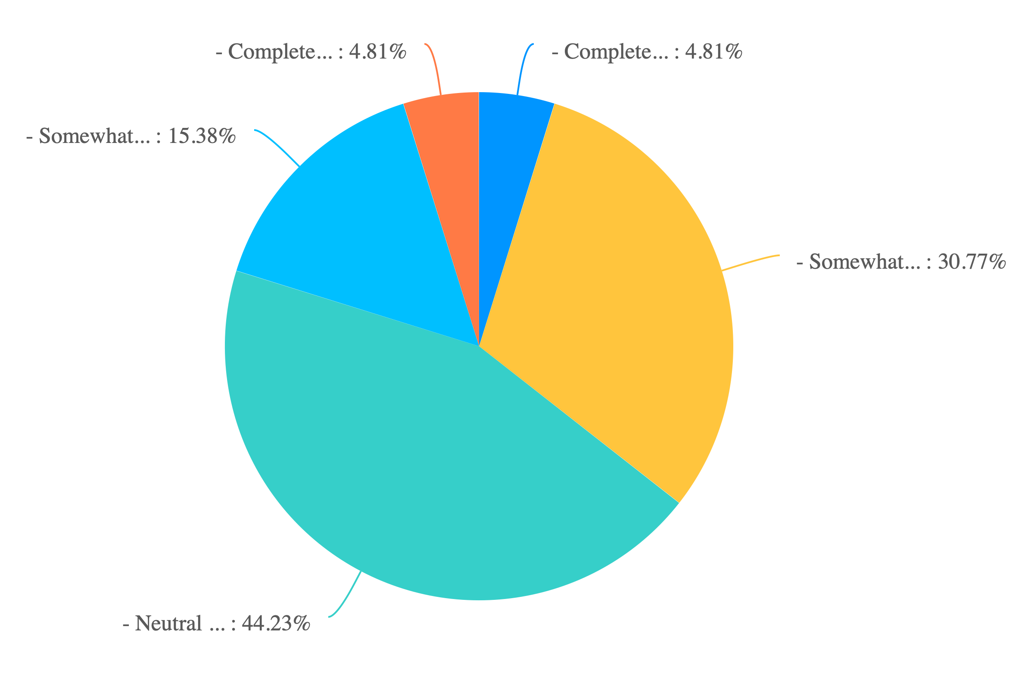
2. To what extent do you trust the recommendations provided by LLMs? / 您对推荐 LLM 提供的推荐有多少信任?

