Slide 1
Tools for Automation of Tasks
Presenter: Cynthia North
Date: April 14, 2020

Slide 2
Goals
To automate the deployment of a web application (CPD,SLICE) in our operational Unix environments.
The web application is not containerized (Dockerized e.g.)
Automation of customizing a Windows based workstation
Each time a developer's workstation is replaced
Each time a new developer is added to the team and needs to set up his/her environment

Slide 3
Configuration Management Tools at a Glance
 | Chef | Puppet | Ansible | Salt
Availability | √ | √ | √ | √
Setup | Not very easy | Not very easy | Easy | Not very easy
Management | Not very easy | Not very easy | Easy | Easy
Scalability | Highly scalable | Highly scalable | Highly scalable | Highly scalable
Configuration Language | DSL (Ruby) | DSL (PuppetDSL) | YAML (Python) | YAML (Python)
Interoperability | High | High | High | High
DSL = Domain specific language
YAML = YAML “ain’t” markup language

Slide 4
Configuration Management Tool Features
Availability – Multiple server instances possible in all tools.
Setup
Ansible is the only tool that requires no agent on clients
Ansible logs into clients via SSH
Management
Both Ansible and Saltstack use YAML for management. See configuration language.
Ansible has immediate remote execution – may not be applicable in our situation.
Configuration Language – concentrating on Ansible
YAML is easy to learn.
Python is built into most Unix and Linux deployments.
Interoperability
Ansible main server/master must be on Linux/Unix machine.
Ansible can control either Unix or a Windows based platform.
Scalability
Probably not an issue – we are not managing large numbers of servers

Slide 5
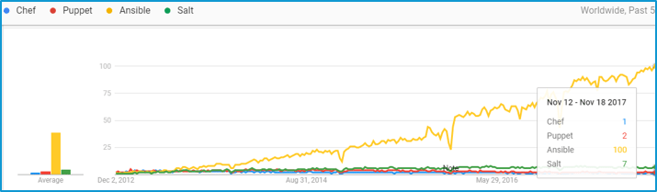
Comparison of tool usage over five years

Slide 6
What about Vagrant and Docker?
Vagrant is a tool for building and managing vm (virtual machine) environments.
There's a configuration file (in Ruby) that specifies what vm image to start with, what additional tasks to run, how the network should be configured, and so on.
One place Vagrant really shines is setting up test environments.
Docker is a tool for building and deploying applications by packaging them into lightweight containers.
At first glance it seems similar to Vagrant, but the use case is actually quite different.
With containers, you generally don't want an entire distribution installed, but rather just a single service per container.
Think of Docker as something a little closer to package management, rather than a virtual machine.
BOTTOM LINE – Docker and Vagrant do not seem to be what we are looking for.

Slide 7
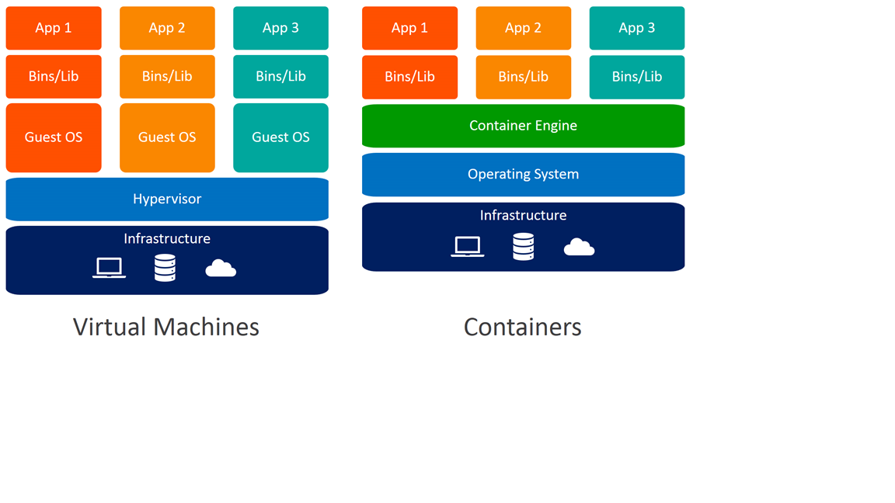
Virtual Machine versus Container

Slide 8
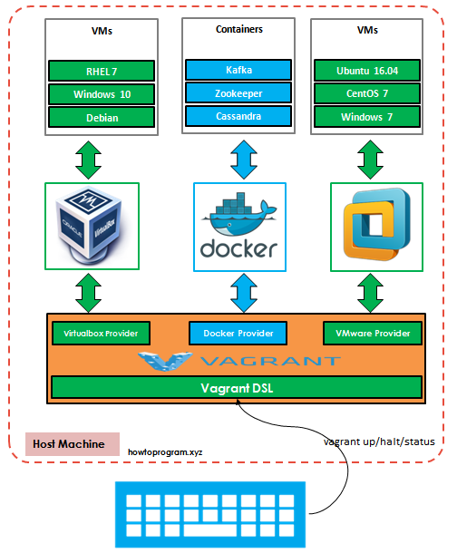
Vagrant in Conjunction with Docker

Slide 9
In summary
Ansible is open source software that automates software provisioning, configuration management, and application deployment.
The key features of Ansible are:
Agentless - There is no software or agent to be installed on the client that communicates back to the server.
Idempotent -No matter how many times you call the operation, the result will be the same.
Simple and extensible - Ansible is written in Python and uses YAML for playbook language, both of which are considered relatively easy to learn.
Popularity – Lots of resources available both online and in print

Slide 10
Matching Goals to the Tools
Goal 1 - Automate the deployment of a web application in our operational Unix environments
Ansible is a good tool for automating tasks in a Unix environment
See "Ansible in action" link on the References page
Shows complete instructions for deploying a web application with Ansible
There is a link to a web application that was deployed on a VPS using Ansible
http://maqoola.co/ which uses:
MySQL database
Nginx web server
PHP

Slide 11
Matching Goals to the Tools (continued)
Goal 2 - Automation of customizing a Windows based workstation
Ansible is mediocre at customizing a Windows environment
Need to SSH remotely from a Unix server to do the work
Possible use of Windows package manager Chocolatey for managing workstations
Has an Ansible module
Allows you to run via Ansible:
win_shell to run post-install Powershell config scripts
win_file to distribute pre-customized config files
win_regedit for application-specific registry changes
Instead of Ansible, maybe set up a cloud Windows development machine
Snapshots could be deployed on several different machines at any time.

Slide 12
References
https://medium.com/@ahmadfarag/ansible-in-action-f2f17706931
Ansible in Action
https://gist.github.com/jaceklaskowski/bd3d06489ec004af6ed9
Deployment tool comparison
http://devo.ps/blog/vagrant-docker-and-ansible-wtf/
Vagrant, Docker, and Ansible Discussion
https://www.edureka.co/blog/chef-vs-puppet-vs-ansible-vs-saltstack/
Chef vs Puppet vs Ansible vs Saltstack: Which Works Best For You?
https://www.reddit.com/r/ansible/
Ansible for simple IT automation
https://howtoprogram.xyz/2016/07/24/vagrant-docker-provider-tutorial/
Vagrant Docker provider tutorial

