Slide 1

Notification Platform
Raveendra Seetharam

Slide 2
Goal
Functional Req :
Design a "Notification Platform" that enables multiple services to send notifications to end-users through various channels such as Email, SMS, and Push Notifications for both real time and non-real time processing
Non Real time notification for time based notifications
Hosted in AWS
Cost optimization
Non Functional Req:
Scalability & High Availability: Describe how the system will handle increasing loads and ensure highavailability.
Security: Explain how you will secure the platform, including authentication, authorization and data encryption.
Monitoring & Logging:
Describe how you will monitor the system's health and performance.
Explain how logging will be implemented for troubleshooting purposes.
Future support
Agentic AI behavior and Analytics, Multiple language support, Bi direction conversation
Auditing and Reporting

Slide 3
Design Considerations
Event Driven Architecture
Decoupled architecture for asynchronous processing
IoT based Pub/Sub Architecture for low latency real time event processing
MulNotification via multil modal channels such as Email, SMS and Push notification (Extendable to support other channels)
High priority message handling (Currently assuming that all messages are independent of each other, No Segmentation)
Cost optimization using as many serverless services as possible
Durable, fault tolerant, automatic failover handling and Performant
Highly available, Scalable support for upto 1Billion messages notification/month
Audit and Retry of failed messages
Time-sensitive notification such as notification during weekday from 9-5.
Notification based on Time zone of the end user (EST, CST and PST etc)
Extendable architecture to handle bidirectional Text and Push notification communication.
Multi language support as per user requirement using AWS translator
Using AWS managed services for less operational and management overhead.
Secure and compliant with PCI, HIPPA standards

Slide 4
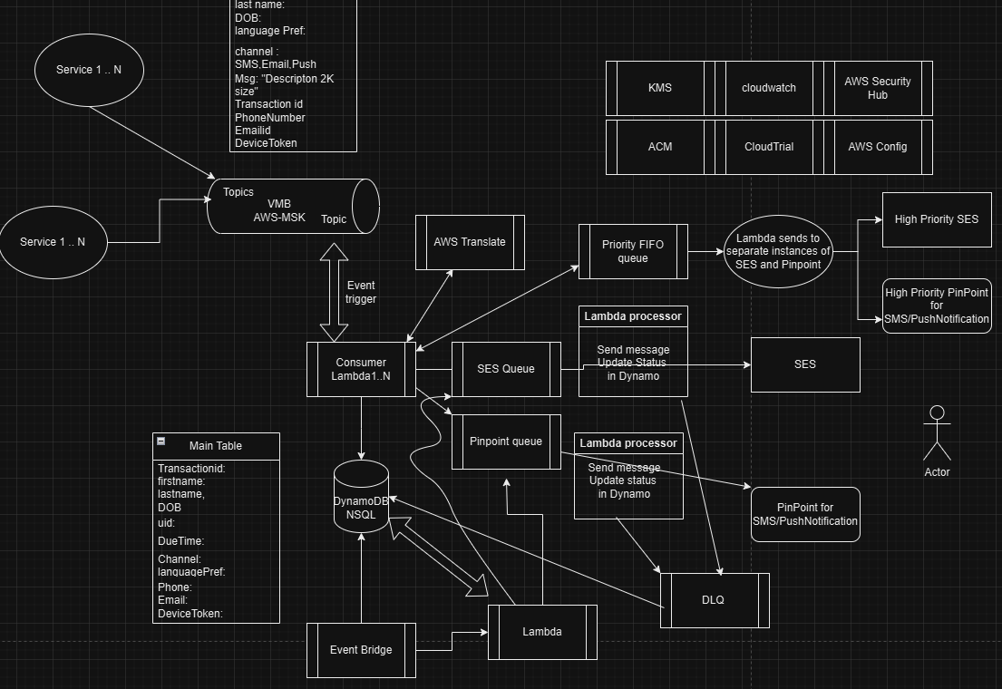
Full Architecture Block diagram

Slide 5
How client connect to the broker?
Clients connect to the secure MSK end point with client credentials (obtained from a JWT provider such as AWS Congnito ) on TLS/SSL connection.
Client is configured SASL_SSL mechanism, certificates are stored in client verifies the Broker, mutual authentication is also possible.
Broker authenticates the client’s client id and client secret with a trusted connection provider. The scopes in the JWT authorizes for specific topics only.
Connection duration is pre-determined which allows additional security.

Slide 6
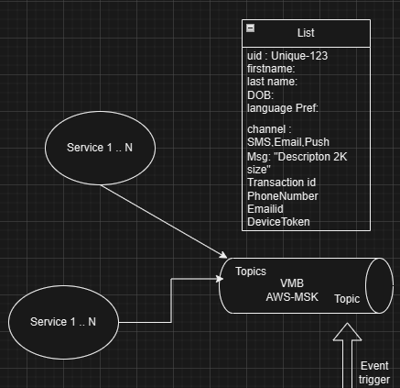
Consumer design discussion in Detail
Services subscribe to topics
Publish events to Topics
VMB processes in real time
VMB scales and fine grained partition
Topic isolation, provides centralized architecture
AWS MSK VMB Vs Kinesis stream
Low Latency (2-10ms), data is immediately available on the topic.
Pub/sub event driven architecture
Kafka clients can authenticate with JWT tokens.
Strict ordering within partition controlled by PK
Fine grained scaling based on brokers and partitions
Handle millions of msgs/sec
One centralized bus for the enterprise
Can be cost effective for x-large,variable workloads
Retention period is configurable based on available
storage capacity
Note: Lambda concurrency limit, Kafka Instance type,
EBS storage, lambda execution time and cold start to be
Considered.
Kinesis is serveless can be used as an option.
Both provide robust Security(at rest and in transit).

Slide 7
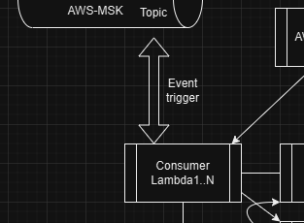
Consumer Design
Integrate lambda with AWS-MSK
Setup lambda to listen on specific top
RBAC for lambda access
Lambda scales with traffic
Setup concurrency limit (upto 1000)
Pay as you go model
Lambda vs EKS cluster
Cost of EKS pods with Kinesis (KCL) exceeds 32000$
with 1000 shards and 3 pods (calculations at the end)

Slide 8
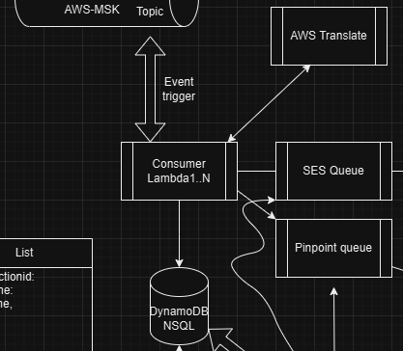
Consumer processing message
Consumer handles real time processing and
Non real time processing
Does language translation.
Based on the channel type it put the messages
In SES queue or Pinpoint queue.
Consumer updates every record in the
Main_Notification_Table

Slide 9
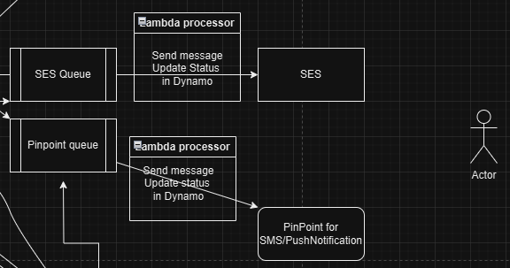
Notification delivery to end user
SES Queue further trigger lambdas to
Pull messages from the queue sends
for email notification
Pinpoint queue triggers further lambdas
To pull messages to send to PinPoint
for SMS or Push notification
SES is used to handle scaling and volume
Lambdas update the DB with status. If success
It updates the record with Status = SUCCESS
If failure, it updates with Status = Retry
Retry_count = 1,2,3,4. If all try are failure
then updates Status = Permanent Failure
Updates Failure_tracking_table with reason
for failure for each retry attempt.
For failure scenarios BackOff Retry logic is used.

Slide 10
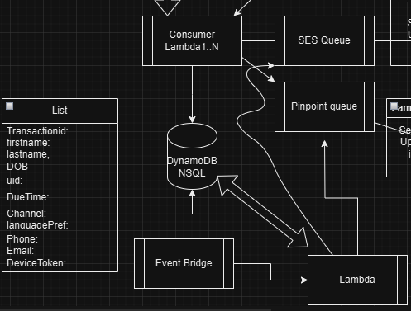
DB Design
NSQL Database
Faster lookups
Tables:
Main_Notification_Table
Retry_Table : offloads retry logic from Main table
Preprocessed_dueforschedule_Table: Offload preprocessing from Main table.
History_Notification_Table: Contains both pass and failure
status along with all retry attempts. Used for auditing purpose.
States:
Success, Retry (last failed attempt),Permanent_Failure,
Due_for_scheduling (Time based scheduling),in_progress
On Retry_table
Use GSI to improve query performance, get all records with
retry_timestamp<=current_timestamp, status = retry
Eventbridge to triggle lambdas.
Trigger One lambda to query Retry_table every 3 mins
Trigger second lambda at 5AM to query Main_Notification_Table for records
With status=due_for_scheduling, with start_time<=Current_time and
End_time >= curent_time, store results in Preprocessed_dueforschedule_Table
Trigger Third lambda every 30 mins to batch process Preprocessed_dueforschedule_Table

Slide 11
Security,Compliance and Auditing
IAM authentication : Manage permissions for users, groups and services via Policies, roles providing least privileged access
Kafka client authentication via client credentials/JWT tokens with customization. If clients are inside AWS they can leverage user roles.
Kafka ACL’s manage who can subscribe, publish.
Broker is configured to accept only SSL connection.
External clients authenticate and authorize via client credentials and communicate via SSL/TLS connection.
Data protection via Encryption in transit using SSL/TLS and at rest using AWS KMS Key (AWS owned or Customer managed key)
Cloudwatch monitoring for metrics monitoring
Cloud Trial for tracking all APIs for auditing purpose
AWS Config to track config changes, auditing and cost control
Integrating AWS config with Security hub to improve security posture
Further isolation can be provided with Privatelinks, VPC end points, VPC peering.

Slide 12
Monitoring and Logging
Infrastructure Monitoring: Real time monitoring using Cloudwatch metrics, cloudwatch Alarms and Dashboards.
AWS X-Ray : For real time detailed Tracing and debugging (execution time, cold start latency issues, errors), Service maps to identify bottlenecks or failures
MSK metrics: CPU utilization, memory, Network throughput, Bytes/sec data flow in and out, partition count etc
Application Monitoring : X-Ray and Cloudwatch metrics
Logging : Cloudwatch logs, VPC Logs, Lambda function logs
Consider Error logging level in Production and Higher logging level (Info, Warn) in lower environments
Future : For cost effective log analysis setup a separate monitoring dashboard via S3-Athena-quicksight or use ELK stack (aggregating logs from different sources and use Kibana for dashboard). They provide single pane of glass view for monitoring and analytics.
For long term log retention use Glaciar archival storage.

Slide 13
For Future
In the current design messages are independent of each other, Segmentation of messages is not currently supported.
Agentic AI (Crew AI) to be incorporated for decision making (which is currently handled by Lambda),personalized notification, reinforced learning in action generation etc

