Slide 1
CSD-380 • DEVOPS • MODULE 1.2
The Technology Value Stream
Lead Time, Process Time, and the path from months-long deployments to the DevOps ideal
Business
idea
Code
Test
Production
Customer
value
Rakesh Shrestha
Bellevue University
Primary source: The DevOps Handbook, Chapter 1, pp. 8–11.

Slide 2
What Is the Technology Value Stream?
FROM IDEA → VALUE
1. Start with a business idea
2. Turn it into working software
3. Deliver customer value
A business objective, concept, idea, or hypothesis enters the value stream and becomes committed work in Development.
The idea becomes user stories and code. Changes are checked into version control, integrated, and tested.
Value is created when the service or feature is running successfully in production and can provide useful feedback.
My takeaway: “done” should mean more than finishing the coding. The work matters when it actually reaches the customer.
Source: Kim, Humble, Debois, Willis, & Forsgren, The DevOps Handbook, Ch. 1, pp. 8–9.
2

Slide 3
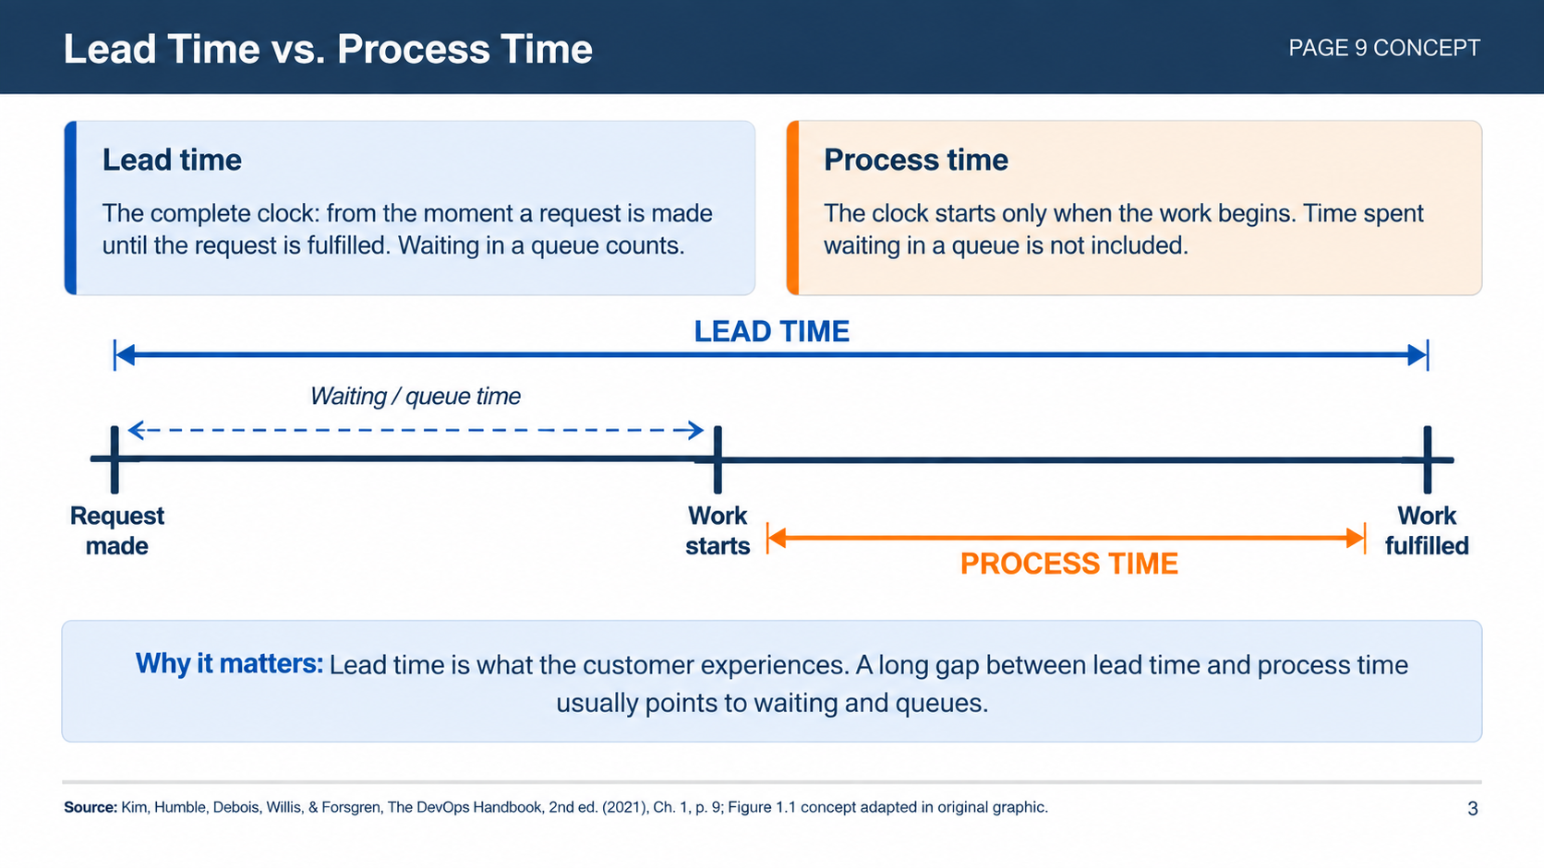

Slide 4
The Common Scenario: Deployment Lead Times Requiring Months
PAGE 10
Why can a software change take months to reach production?
Scarce test environments
Long environment lead times
Manual testing
Multiple approvals
Integration testing has limited capacity or availability.
Getting test or production environments ready takes too long.
Important verification depends heavily on people and handoffs.
Required approval steps create additional waiting and queues.
THREE-MONTH DEPLOYMENT LEAD TIME
The human cost is not just “waiting.” Long lead times create heroics, late integration problems, and days or weeks of investigation when something breaks.
Source: Kim, Humble, Debois, Willis, & Forsgren, The DevOps Handbook, 2nd ed. (2021), Ch. 1, pp. 9–10; Figure 1.2 on p. 10 credits Damon Edwards, “DevOps Kaizen” (2015).
4

Slide 5
What Happens When Lead Time Gets Too Long?
THE REAL PROBLEM
Large batch
Long wait
Manual steps
Late discovery
Rework
The pattern
The key lesson
Changes accumulate → teams wait for integration or testing → approvals and handoffs add more delay → defects are found late → fixing them takes much longer.
The issue is not simply that people need to work faster. The system itself is creating queues, large batches, delayed feedback, and expensive rework.
Reducing lead time means reducing waiting—not just asking people to move faster.
Source: Kim, Humble, Debois, Willis, & Forsgren, The DevOps Handbook, Ch. 1, pp. 9–10.
5

Slide 6
Our DevOps Ideal: Deployment Lead Times of Minutes
PAGE 10
The goal is a small, repeatable path from code change to production.
Small code
change
Automated
build + test
Validate
Deploy
Running in
production
DEPLOYMENT LEAD TIME:
MINUTES
Small batches
Fast feedback
Loosely coupled
Frequent, small changes reduce the size of failures and make problems easier to correct.
Automated and exploratory testing helps the team find problems while they are still small.
Modular architecture lets small teams work more independently and contain failures.
Source: Kim, Humble, Debois, Willis, & Forsgren, The DevOps Handbook, Ch. 1, pp. 10–11.
6

Slide 7
Months vs. Minutes: The Big Difference
SIDE BY SIDE
COMMON SCENARIO — MONTHS
DEVOPS IDEAL — MINUTES
Batch size
Large / long-lived changes
Small / frequent changes
Testing
Manual and delayed
Automated + exploratory
Approvals
Multiple gates create queues
Fast, reliable path
Architecture
Tightly coupled / monolithic
Modular / loosely coupled
Failure
Large and discovered late
Small and detected quickly
Customer value
Arrives slowly
Can arrive continuously
The goal is not speed by itself. It is a value stream that is faster, safer, and more predictable.
Source: Kim, Humble, Debois, Willis, & Forsgren, The DevOps Handbook, Ch. 1, pp. 9–11.
7

Slide 8
What I Would Take Away From This
MY TAKEAWAY
1. Look for the waiting
2. Keep changes small
3. Build feedback in
Fast automated feedback gives developers a chance to catch problems before they become expensive production problems.
If process time is much smaller than lead time, I would look first for queues, approvals, handoffs, and other delays instead of assuming the team is simply too slow.
Smaller changes are easier to test, integrate, and fix. They also make it easier to see what caused a problem.
For me, the biggest point is simple: if software takes months to deploy, the answer is usually not “work harder.” We need to improve the system the work is moving through.
Source: Kim, Humble, Debois, Willis, & Forsgren, The DevOps Handbook, 2nd ed. (2021), Ch. 1.
8

Slide 9
References
REFERENCES & SOURCE CREDITS
• Kim, G., Humble, J., Debois, P., Willis, J., & Forsgren, N. (2021). The DevOps handbook: How to create world-class agility,
reliability, & security in technology organizations (2nd ed.). IT Revolution.
• Edwards, D. (2015). DevOps Kaizen. Source credited for Figure 1.2 in The DevOps Handbook (2nd ed.), Chapter 1, p. 10.
Primary assignment source: The DevOps Handbook, Chapter 1, especially pages 9–10.
CSD-380 • Module 1.2 • Rakesh Shrestha

