Slide 1
Week9 presentation for Individual Project
IET Yinghan Xu

Slide 2
Functionality
Don’t like too complicated images. Recall a memory of completely simple-image game.
Background, Player, Interaction=>All simple
Ninja (Designed like MatchStick Men)
Jump/Attack/Difficulty level (More time: barrier/dart/speed up)

Slide 3
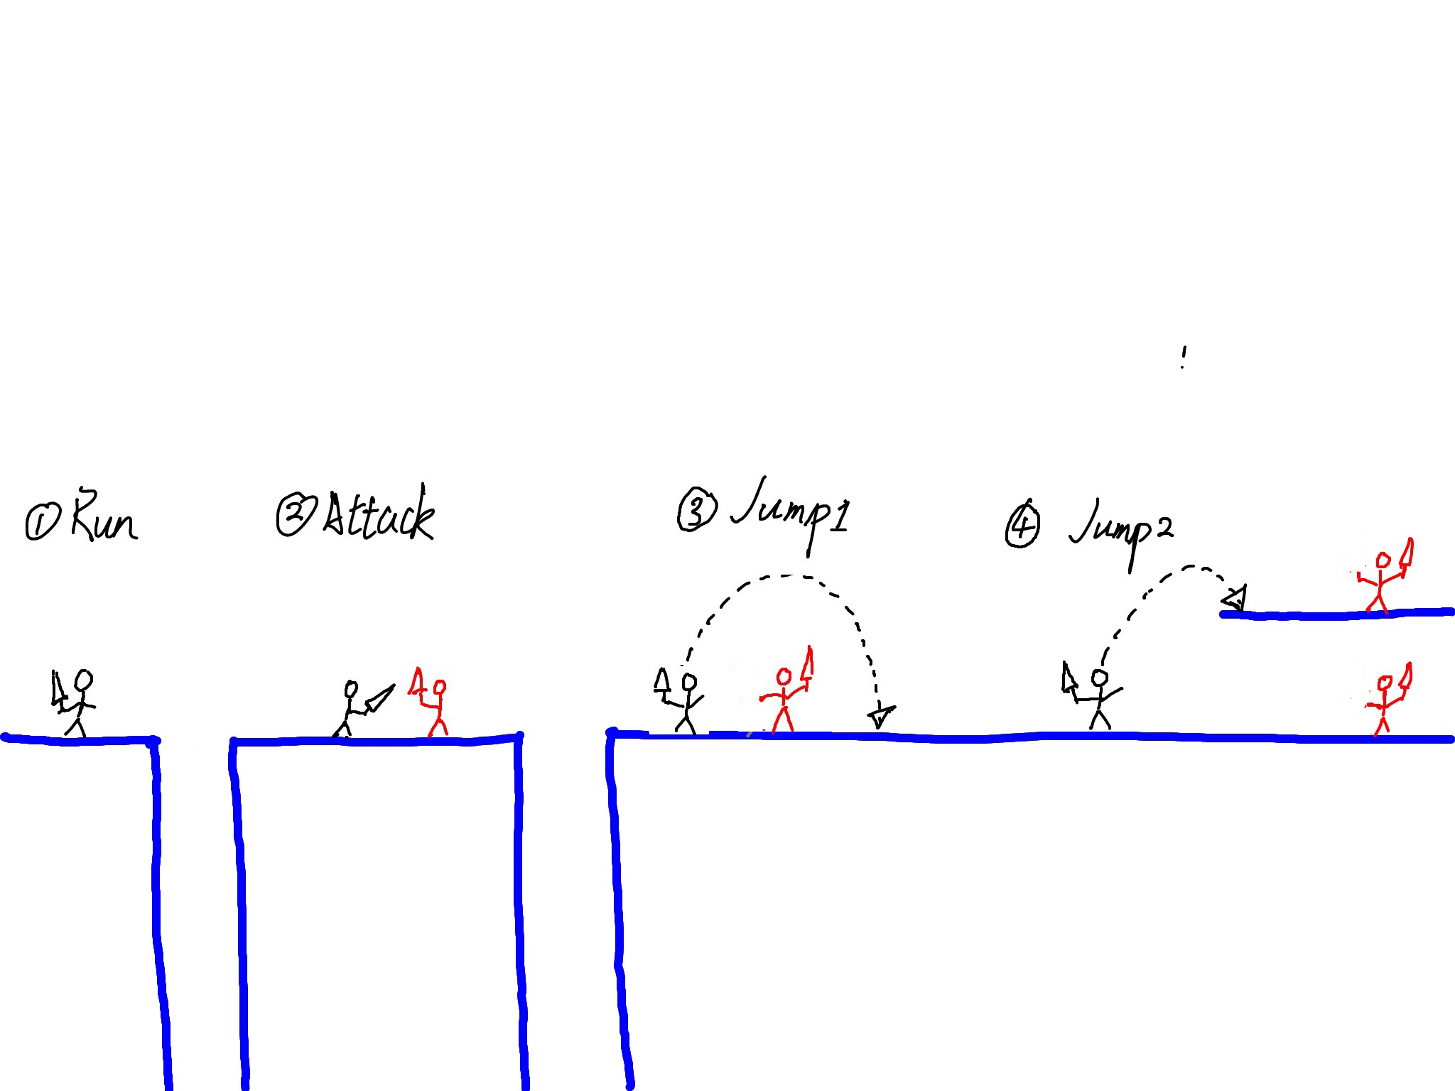

Slide 4
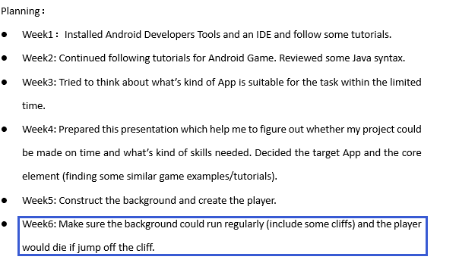
Previous plan
A little delay in this place

Slide 5
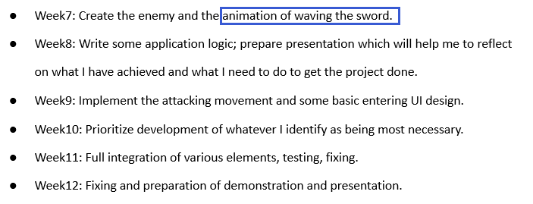
Previous plan
After arriving the animation part, I found that in order to create a flow animation and fit well with the screen, I need to draw these animation by myself.

Slide 6
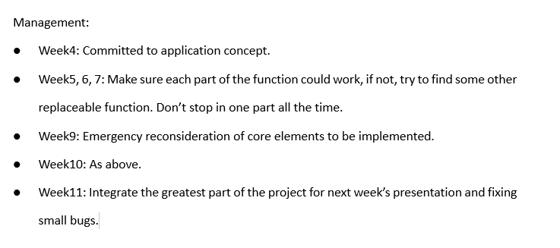
How to manage the progress

Slide 7
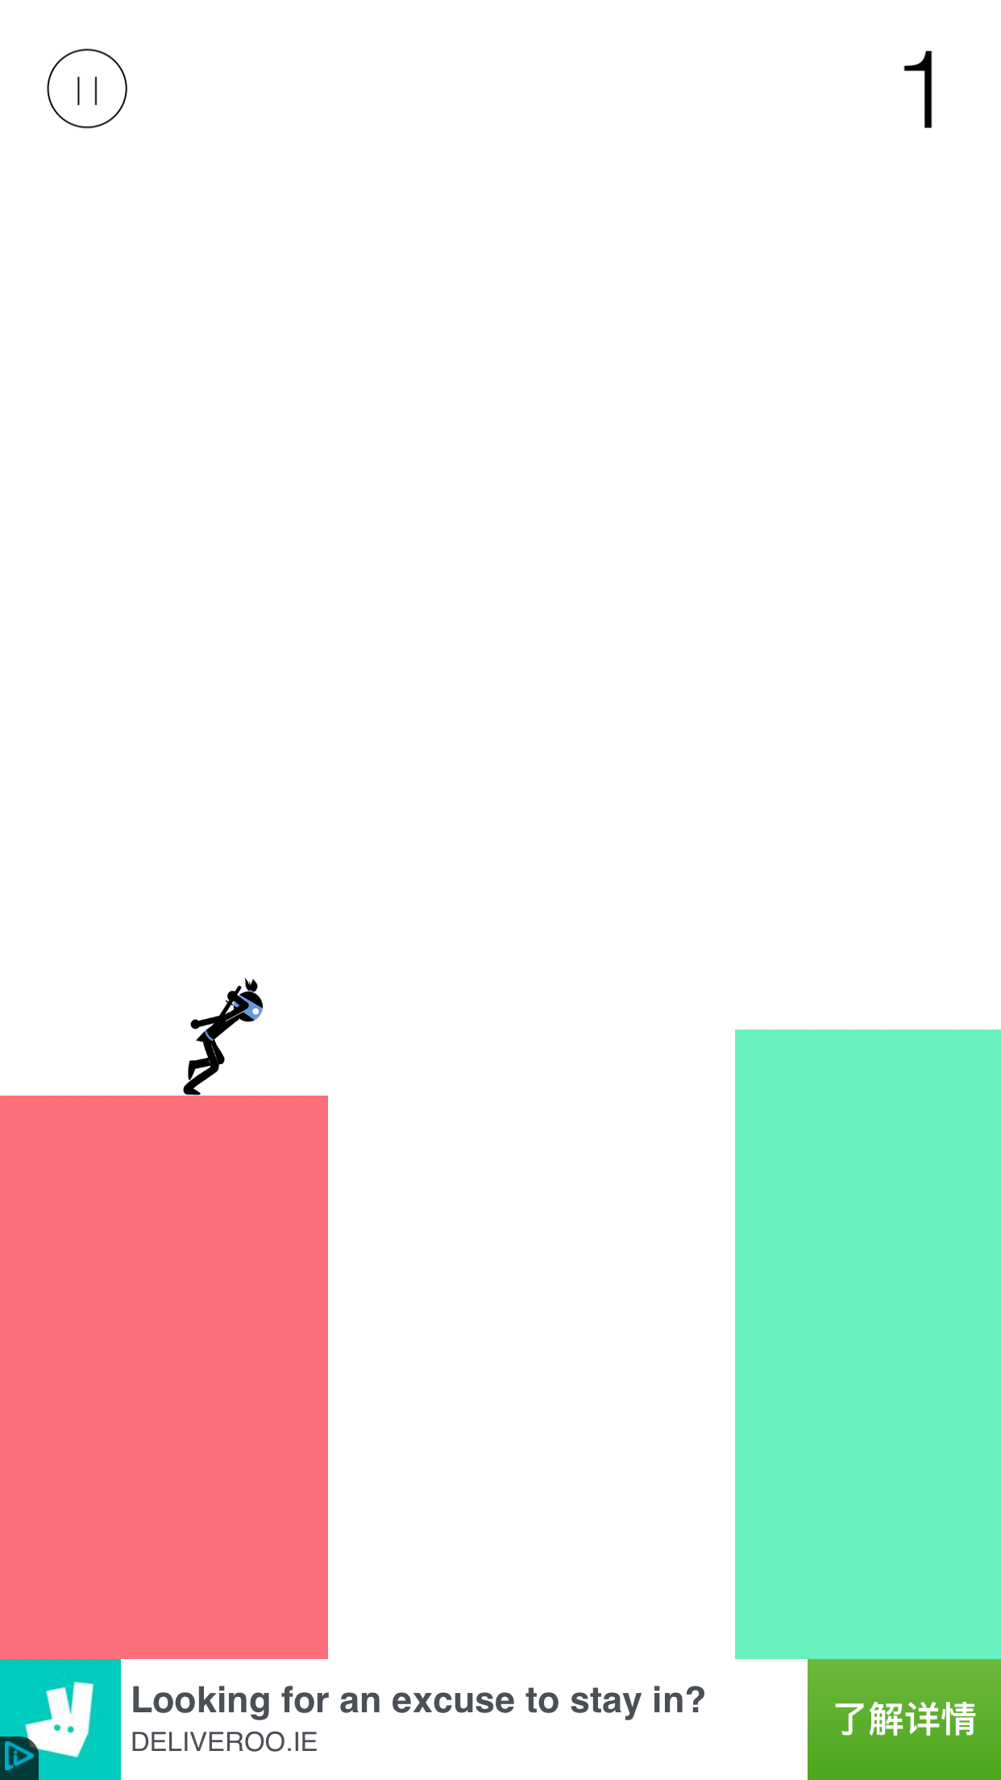
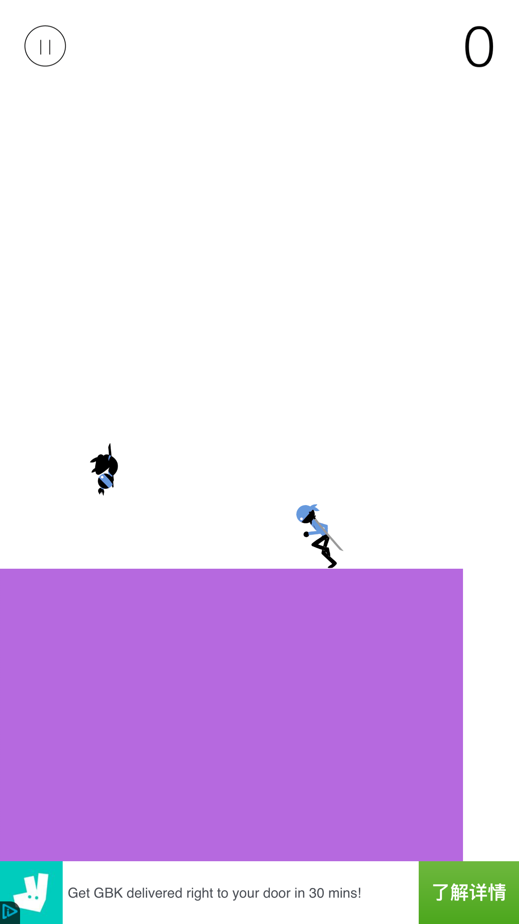
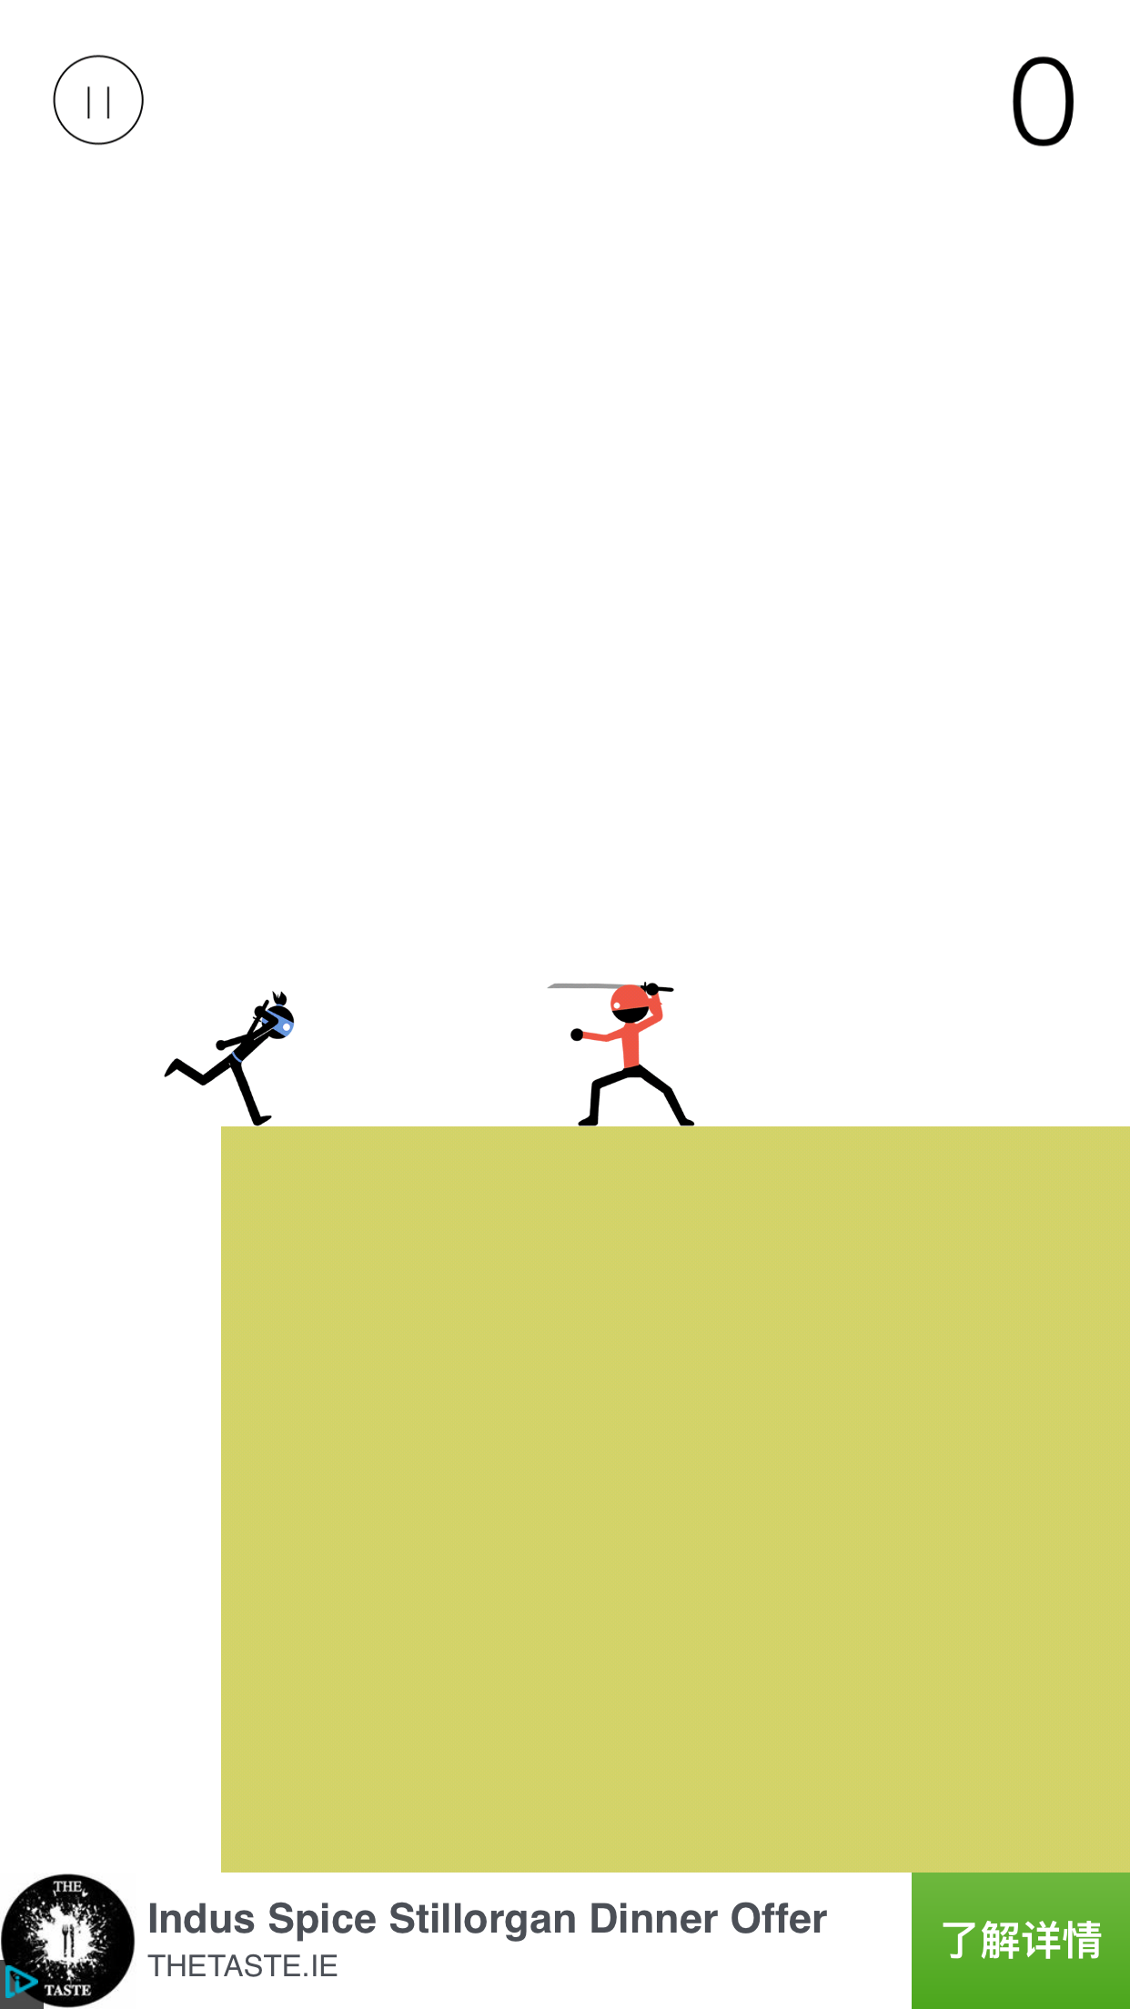
The game on the iphone

Slide 8
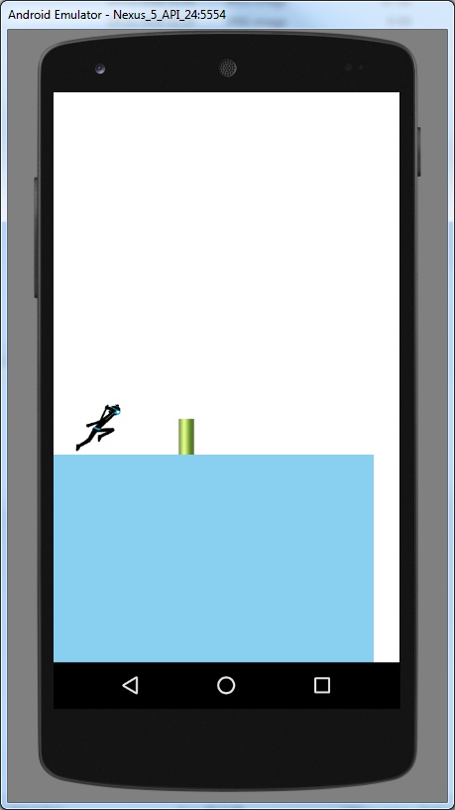
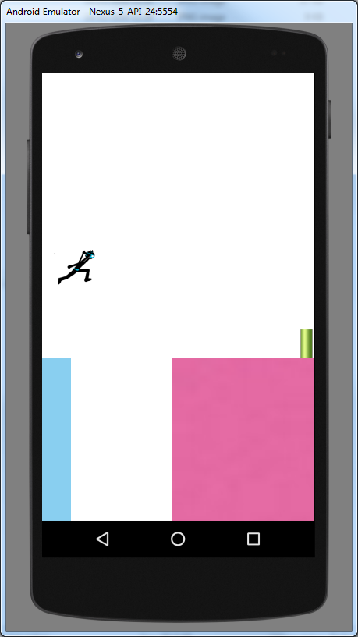
What I have done

Slide 9
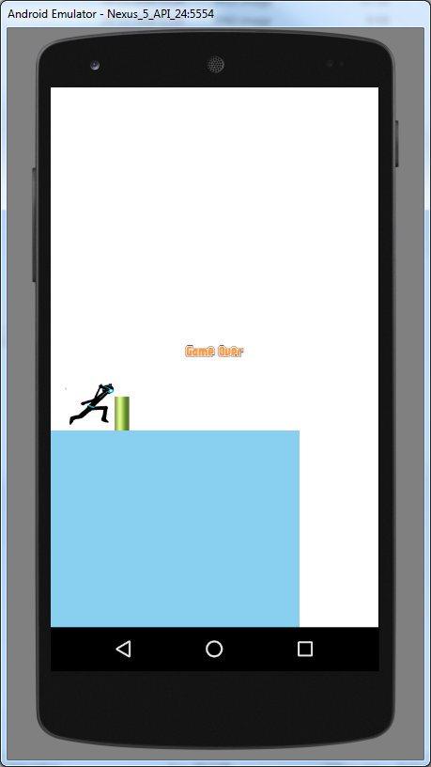
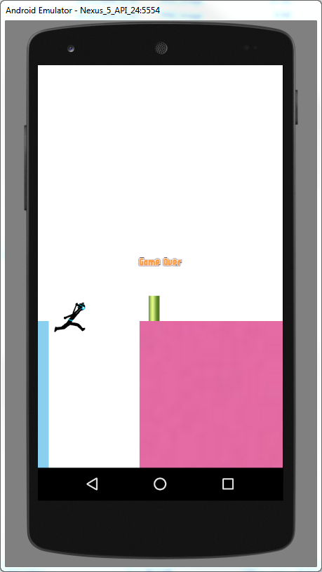

Slide 10
What I would focus on in the next few weeks
The attacking collisions
Animation flow/coherence (make it more real)

Slide 11
Questions?

