Slide 1
Week4 Presentation
IET Xu Yinghan
yixu@tcd.ie

Slide 2
Functionality
Don’t like too complicated images. Recall a memory of completely simple-image game.
Background, Player, Interaction=>All simple
Ninja (Designed like MatchStick Men)
Jump/Attack/Difficulty level (More time: barrier/dart/speed up)

Slide 3
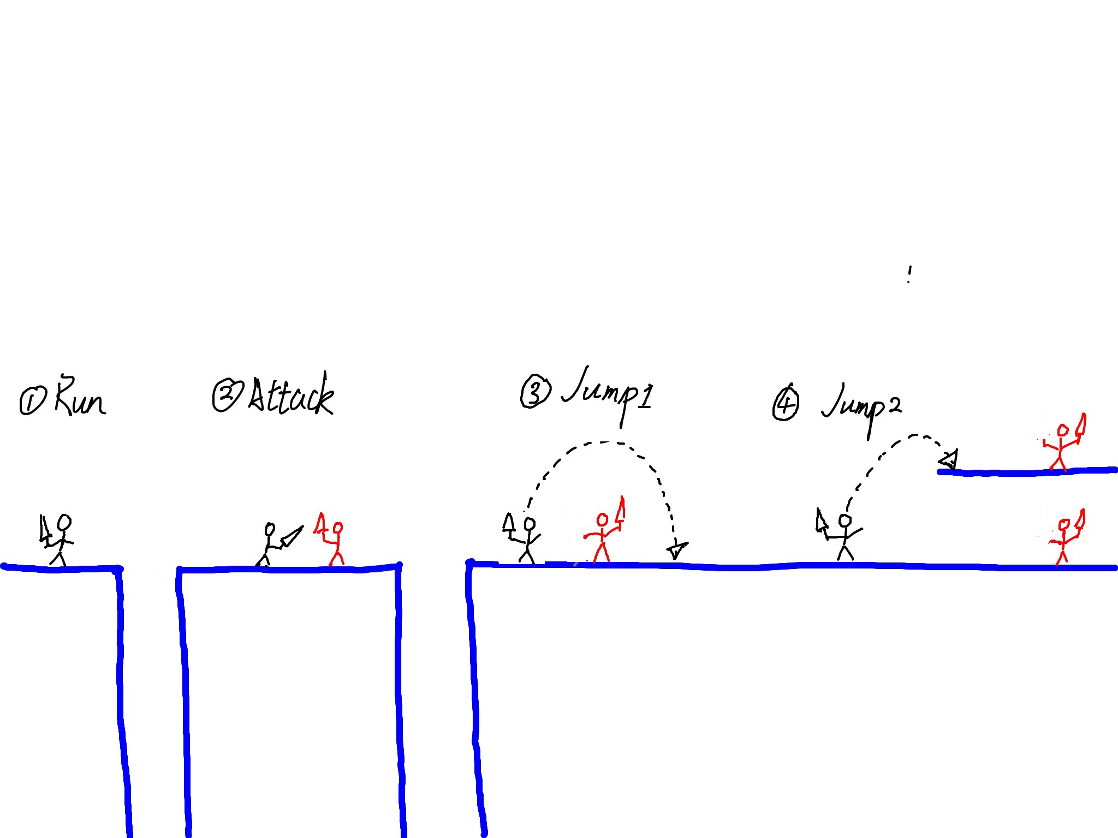
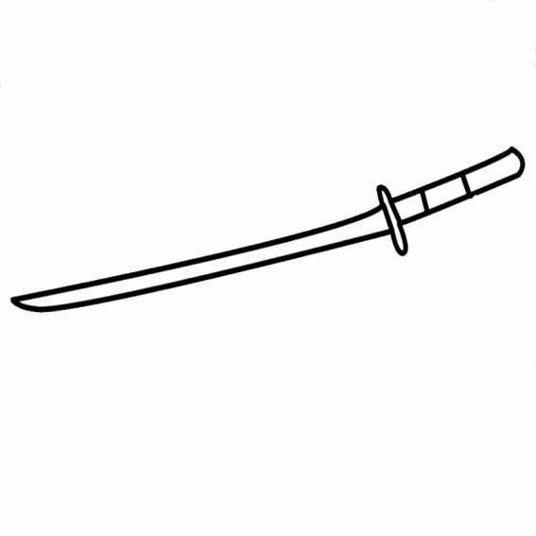
Appearance and Interaction

Slide 4
Testing
Depend on how complicated the game is. (Several module or not)
Security/Privacy/Safety
Do not need to consider in this game

Slide 5
Planning
Week1：Installed Android Developers Tools and an IDE and follow some tutorials.
Week2: Continued following tutorials for Android Game. Reviewed some Java syntax.
Week3: Tried to think about what’s kind of App is suitable for the task within the limited time.
Week4: Prepared this presentation which help me to figure out whether my project could be made on time and what’s kind of skills needed. Decided the target App and the core element (finding some similar game examples/tutorials).

Slide 6
Week5: Construct the background and create the player.
Week6: Make sure the background could run regularly (include some cliffs) and the player would die if jump off the cliff.
Week7: Create the enemy and the animation of waving the sword.
Week8: Write some application logic; prepare presentation which will help me to reflect on what I have achieved and what I need to do to get the project done.

Slide 7
Week9: Implement the attacking movement and some basic entering UI design.
Week10: Prioritize development of whatever I identify as being most necessary.
Week11: Full integration of various elements, testing, fixing.
Week12: Fixing and preparation of demonstration and presentation.

