Slide 1
Week12 presentation for Individual Project
IET Yinghan Xu

Slide 2
Functionality
Don’t like too complicated images. Recall a memory of completely simple-image game.
Background, Player, Interaction=>All simple
Ninja (Designed like MatchStick Men)
Jump/Attack/Difficulty level (More time: barrier/dart/speed up)

Slide 3
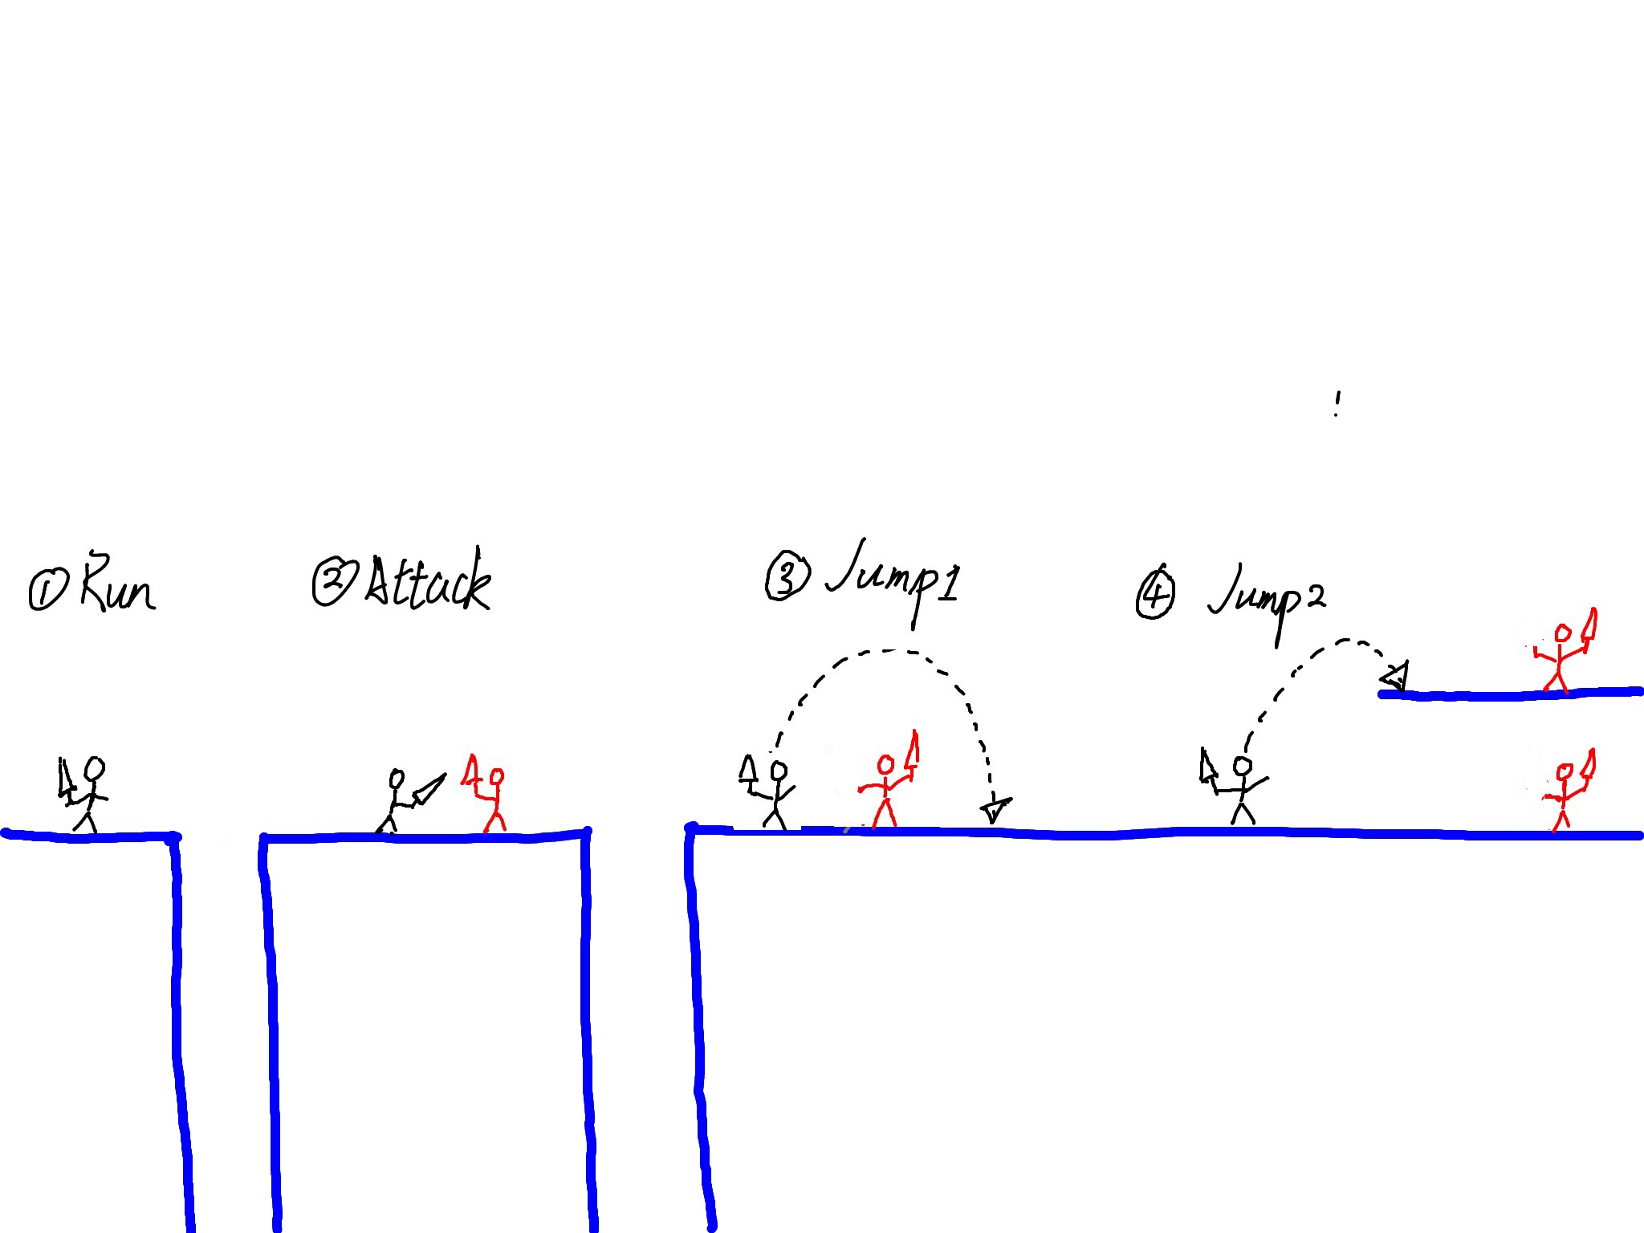
Planning result

Slide 4
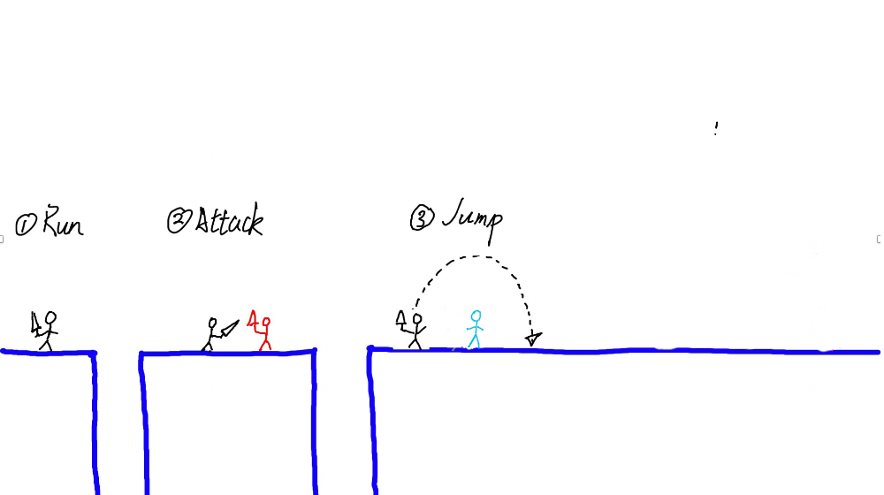
Final result

Slide 5
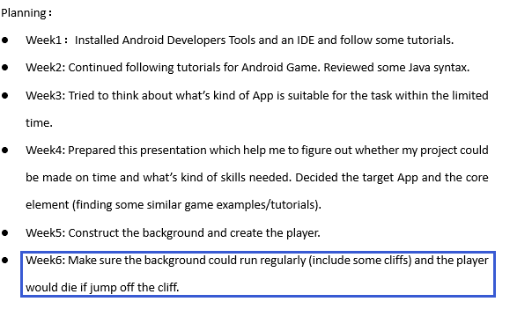
Previous plan
A little delay in this place

Slide 6
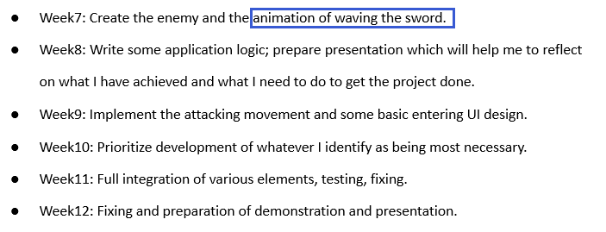
Previous plan
After arriving the animation part, I found that in order to create a flow animation and fit well with the screen, I need to draw these animation by myself.

Slide 7
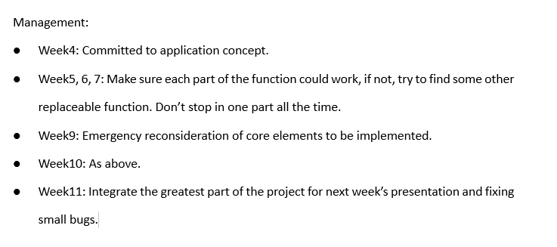
How to manage the progress

Slide 8
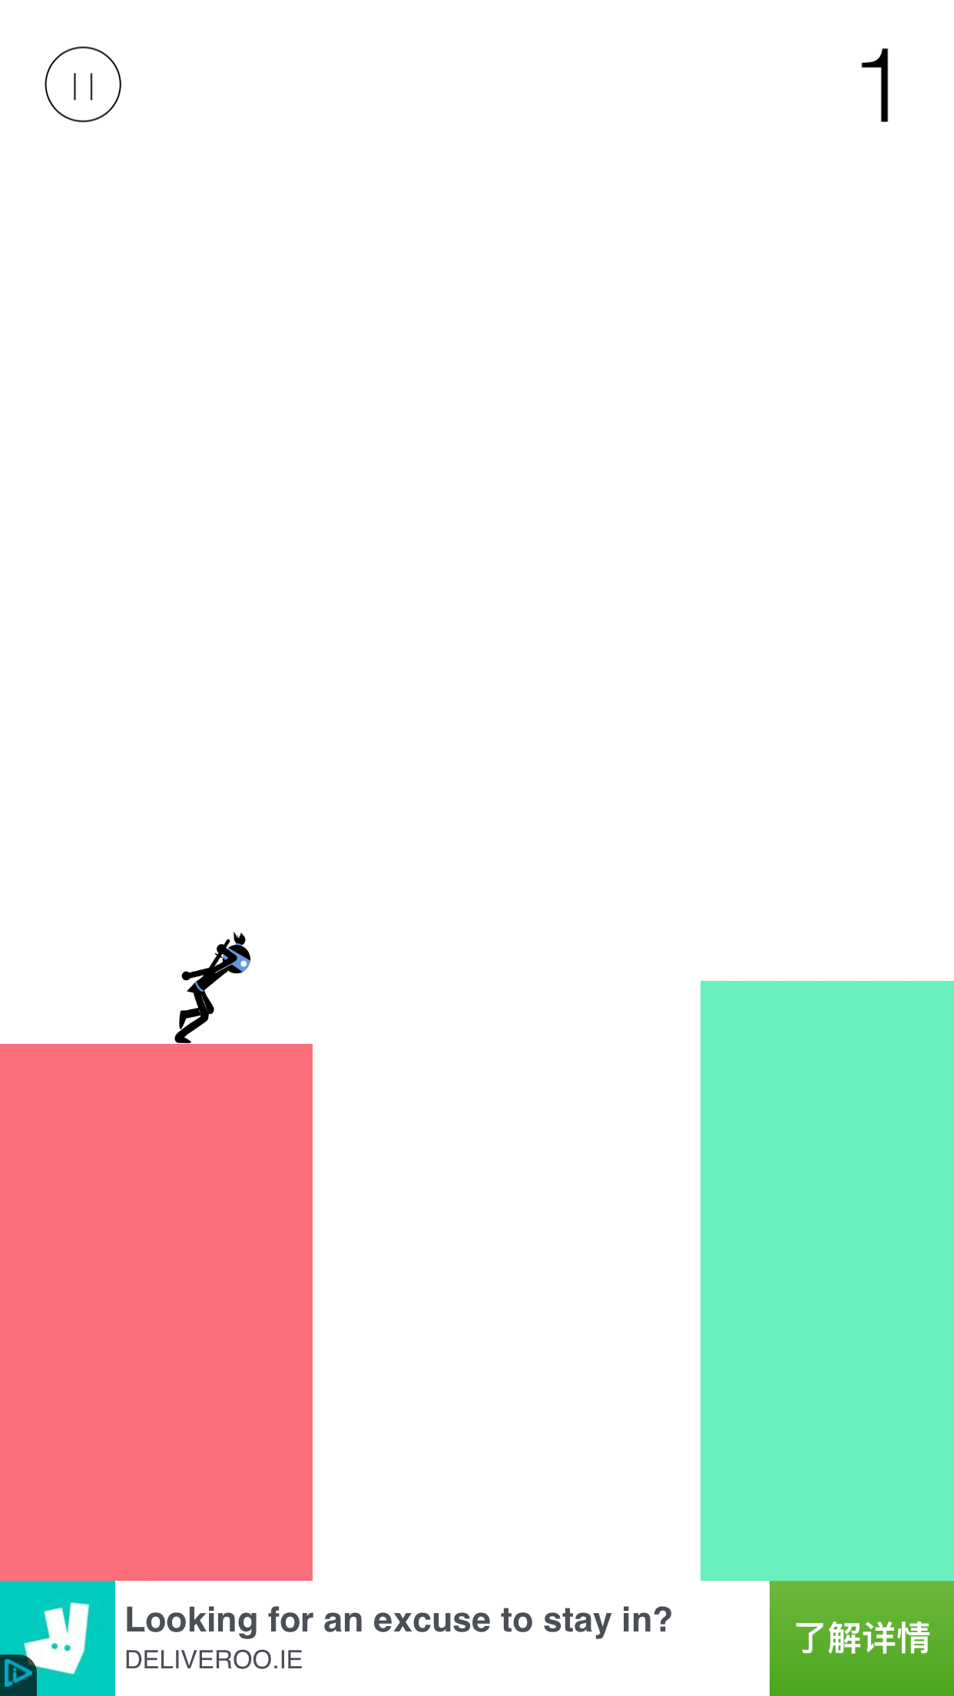
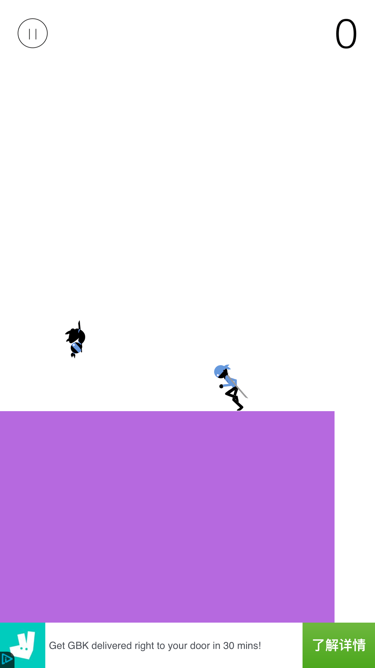
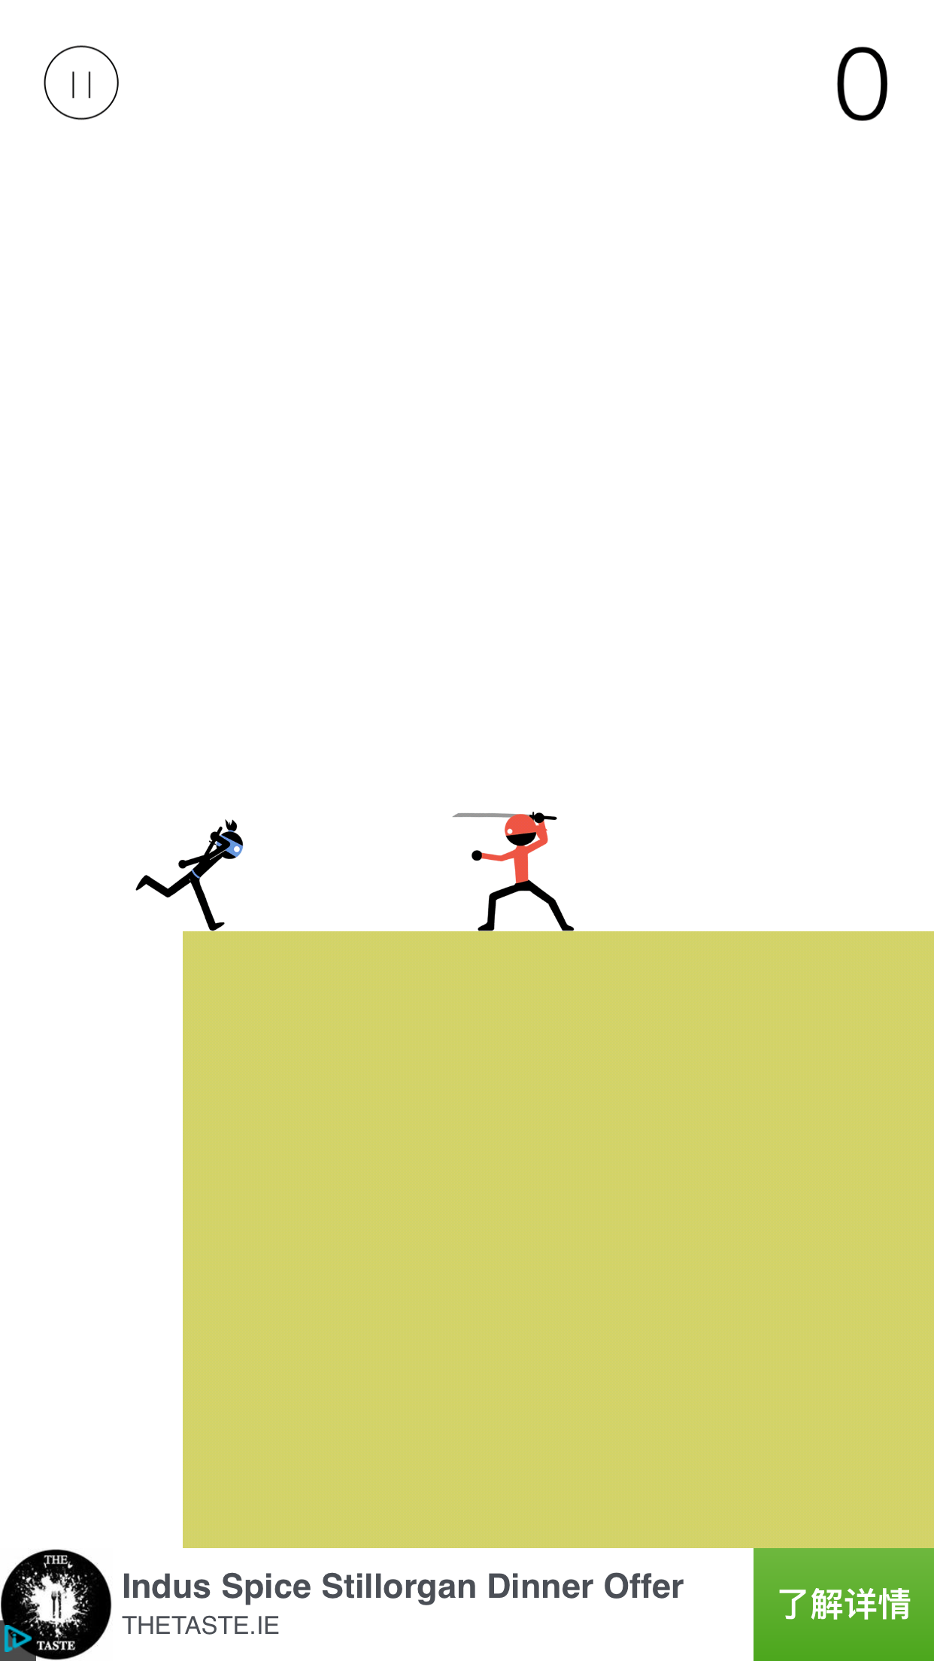
The game on the iphone

Slide 9
What I have done

Slide 10
Challenges
Know nothing about Android
Time is limited and many projects there

Slide 11
What I have learned
How to manage the time (Might try to spend a long time focusing on solving the specific problem; Separate the whole project into different modules)
Problems I might face in a project (Time limitation, knowledge limitation, requirement changing) → how to solve them (Planning for a project, presentation, the whole requirement, the emergency solution prepared)

Slide 12
Questions?

