Slide 1
Week4 Presentation
IET Xu Yinghan
yixu@tcd.ie

Slide 2
Functionality
Don’t like too complicated images. Recall a memory of completely simple-image game.
Background, Player, Interaction=>All simple
Ninja (Designed like MatchStick Men)
Jump/Attack/Difficulty level (More time: barrier/dart/speed up)

Slide 3
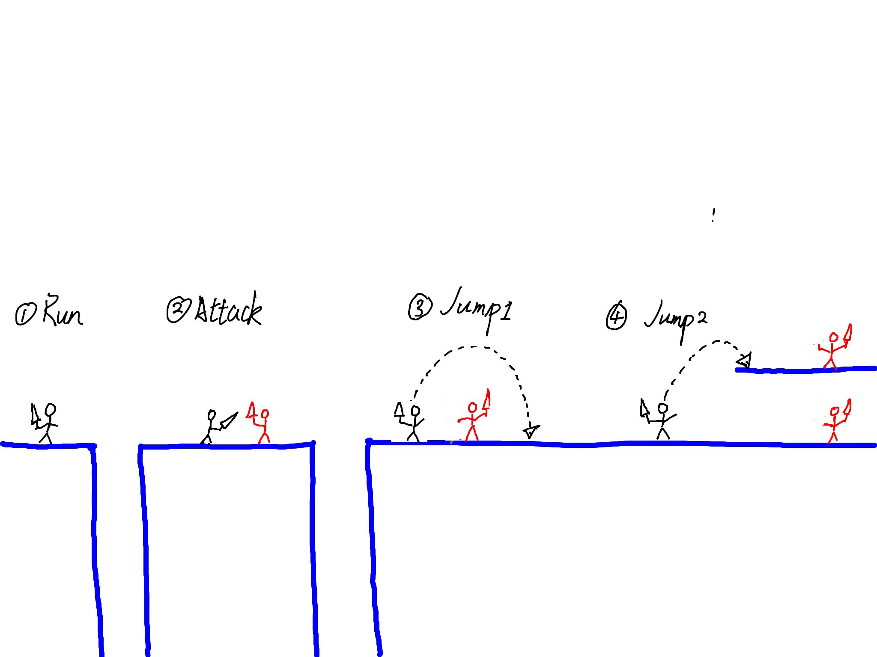
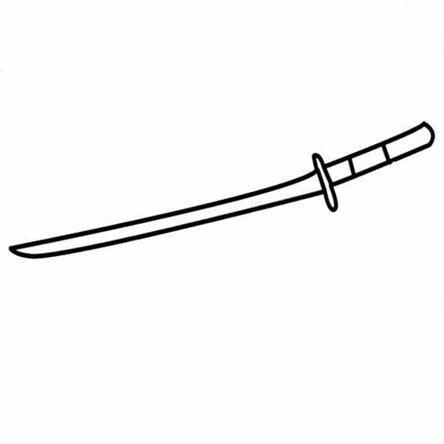
Appearance and Interaction

Slide 4
Testing
Depend on how complicated the game is. (Several module or not)
Security/Privacy/Safety
Do not need to consider in this game

Slide 5
Planning
Based on the small game like Super Mario.
Management
When am I going to reconsider what I’ve been working on and to start again?

