Slide 1


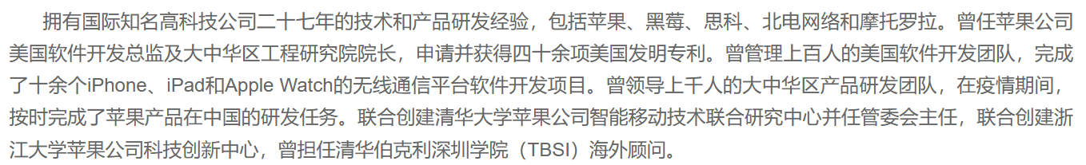

Slide 2
Teaching Assistants
南林娜，软件学院研一
赵雅梦，软件学院研一

Slide 3

Chapter 1
Software and Software Engineering
Introduction

Slide 4
Nature of Software – Defining Software
Software is:
Instructions (computer programs) that when executed provide desired features, function, and performance;
Data structures that enable the programs to adequately manipulate information.
Documentation that describes the operation and use of the programs.

Slide 5
What is Software?软件和硬件的区别
Software is developed or engineered it is not manufactured in the classical sense.不是工厂
Software doesn't "wear out“ but it does deteriorate.生命周期、变坏
Although the industry is moving toward component-based construction, most software continues to be custom-built.定制化

Slide 6
Software Application Domains
System software.
Application software.
Engineering/Scientific software.
Embedded software.
Product-line software.
Web/Mobile applications.
AI software (robotics, neural nets, game playing).

Slide 7
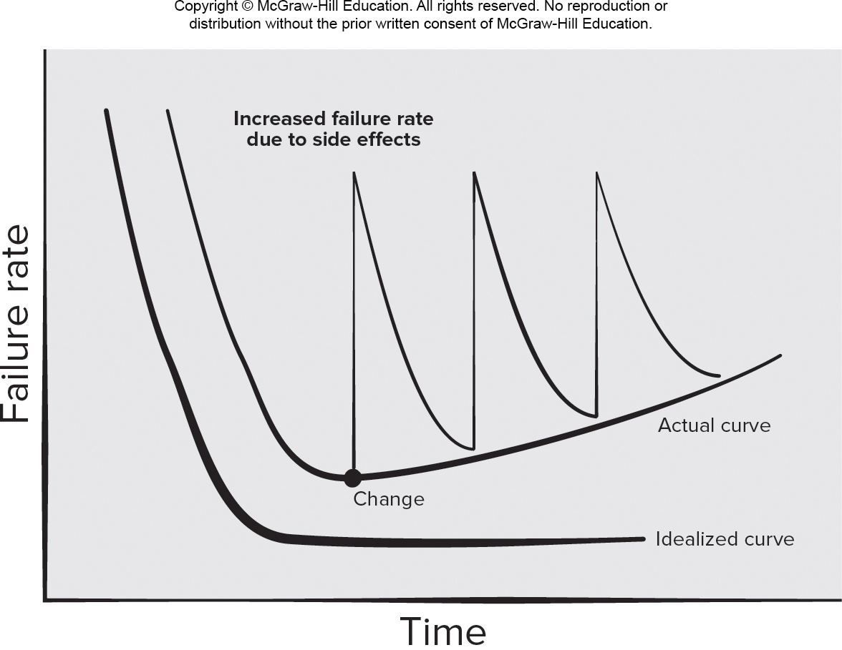
Wear versus Deterioration
Access the text alternative for slide images.

Slide 8
Legacy Software 不讲
Why must software change?
Software must be adapted to meet the needs of new computing environments or technology, e.g. cloud computing
Software must be enhanced to implement new business requirements, e.g. e-commerce
Software must be extended to make it interoperable with other more modern systems or databases, e.g. AI framework
Software must be re-architected to make it viable within a network environment, e.g. data center virtualization

Slide 9
Defining the Discipline
The IEEE definition:
Software Engineering:
The application of a systematic, disciplined, quantifiable approach to the development, operation, and maintenance of software; that is, the application of engineering to software.
The study of approaches as in (1).

Slide 10
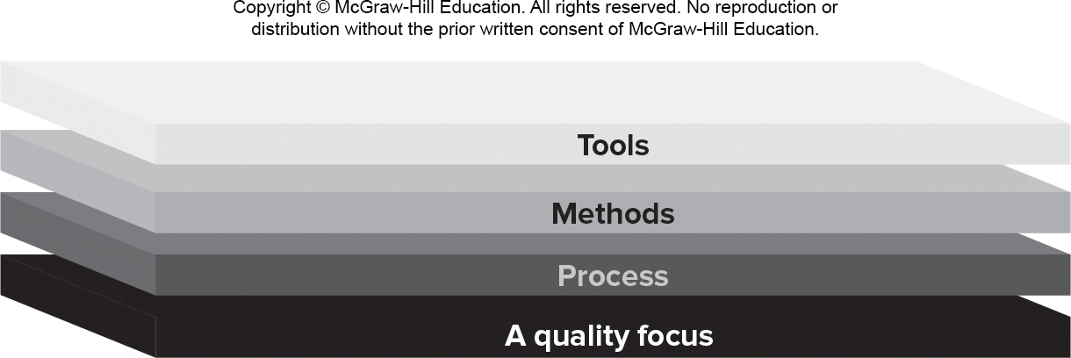
Software Engineering Layers

Slide 11
Process Framework Activities 5个阶段
Communication – Understand the problem.
Planning – Tasks, Dependencies, Schedule, Resources
Modeling.
Analysis of requirements.
Design.
Construction:
Code generation.
Testing.
Deployment.打包部署

Slide 12
Umbrella Activities 每一个阶段都要做的事 略讲
Umbrella activities help a software team manage and control the process, quality, change and risk.
Software project tracking and control. 项目跟踪
Risk management.风险控制
Software quality assurance.质量保证
Technical reviews. 技术审核
Measurement – KPIs (Key Performance Indicators).
Software configuration management. 版本控制
Reusability management.模块化
Work product preparation and production.部署

Slide 13
Process Difference Requiring Adaptation 不讲
Overall flow of activities, actions, and tasks and the interdependencies among them.
Degree to which actions and tasks are defined within each framework activity.
Degree to which work products are identified and required.
Manner which quality assurance activities are applied.
Manner in which project tracking and control activities are applied.
Overall degree of detail and rigor with which the process is described.
Degree to which the customer and other stakeholders are involved with the project.
Level of autonomy given to the software team.
Degree to which team organization and roles are prescribed.

Slide 14
Essence核心关键of Software Engineering Practice
Polya suggests:
Understand the problem (communication and analysis).
Plan a solution (modeling and software design).
Carry out the plan (code generation).
Examine result for accuracy (testing & quality assurance).

Slide 15
Understand the Problem
Who has a stake in the solution to the problem?
That is, who are the stakeholders?
What are the unknowns?
What data, functions, and features are required to properly solve the problem?
Can the problem be compartmentalized?
Is it possible to represent smaller problems that may be easier to understand?
Can the problem be represented graphically?
Can an analysis model be created?

Slide 16
Plan a Solution
Have you seen similar problems before?
Are there patterns that are recognizable in a potential solution? Is there existing software that implements the data, functions, and features that are required?
Has a similar problem been solved?
If so, are elements of the solution reusable?
Can subproblems be defined?
If so, are solutions readily apparent for the subproblems?
Can you represent a solution in a manner that leads to effective implementation?
Can a design model be created?

Slide 17
Carryout the Plan
Does the solution conform to the plan?
Is source code traceable to the design model?
Is each component part of the solution provably correct?
Has the design and code been reviewed, or better, have correctness proofs been applied to algorithm?

Slide 18
Examine the Result
Is it possible to test each component part of the solution?
Has a reasonable testing strategy been implemented?
Does the solution produce results, that conform to the data, functions, and features that are required?
Has the software been validated against all stakeholder requirements?

Slide 19
Hooker’s General Principles
The Reason It All Exists – provide value to users.
K I S S (Keep It Simple, Stupid!) – design simple as it can be.
Maintain the Vision – clear vision is essential.
What You Produce, Others Will Consume.
Be Open to the Future - do not design yourself into a corner.
Plan Ahead for Reuse – reduces cost and increases value.
Think! – placing thought before action produce results.

Slide 20
How it all Starts – SafeHome Begins
Every software project is precipitated by some business need—
The need to correct a defect in an existing application;
The need to the need to adapt a ‘legacy system’ to a changing business environment;
The need to extend the functions and features of an existing application, or
The need to create a new product, service, or system.

Slide 21
End of Main Content

Slide 22
Accessibility Content: Text Alternatives for Images

Slide 23
Wear versus Deterioration – Text Alternative
Return to parent-slide containing images.
A graph showing wear versus deterioration is plotted for failure rate versus time. An idealized curve shows that failure-rate reduces as time increases. The displayed curve has a hyperbolic shape which falls from a high y-value to a near constant y-value as x increases. The actual curve shows that failure-rate reduces and reaches a minimum but rises again with a reduced slope as time increases. When a change is implemented there is sudden spike in the curve resulting in higher failure rate which then falls back towards the actual curve as time increases. The failure rate increases due to side-effects.
Return to parent-slide containing images.

