Slide 1

Chapter 2
Process Models
Part 1 - The Software Process

Slide 2
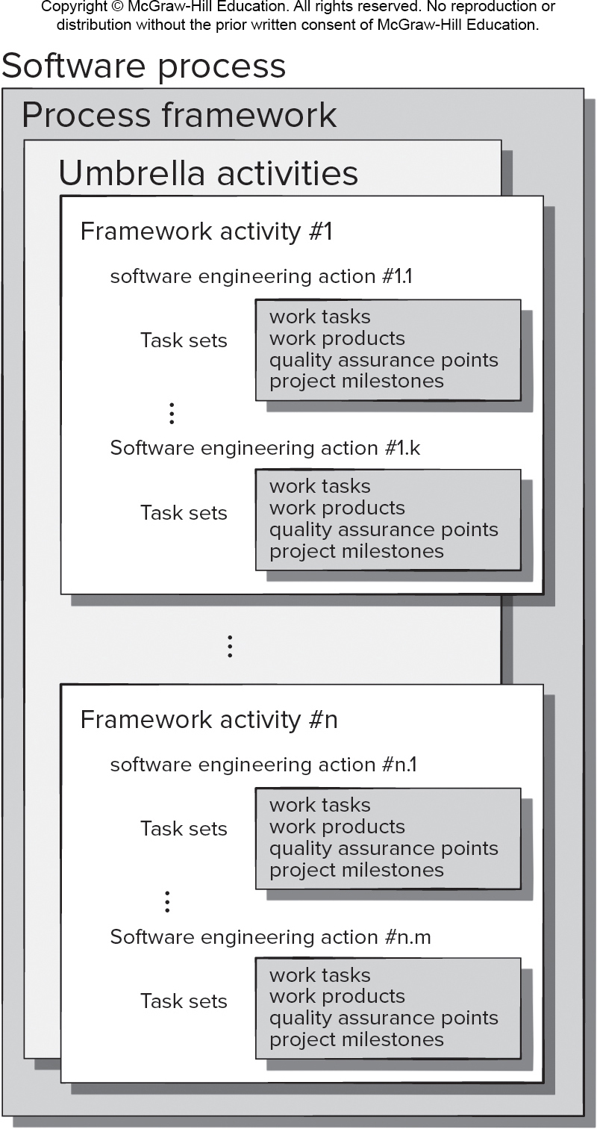
Generic Process Model
Access the text alternative for slide images.

Slide 3
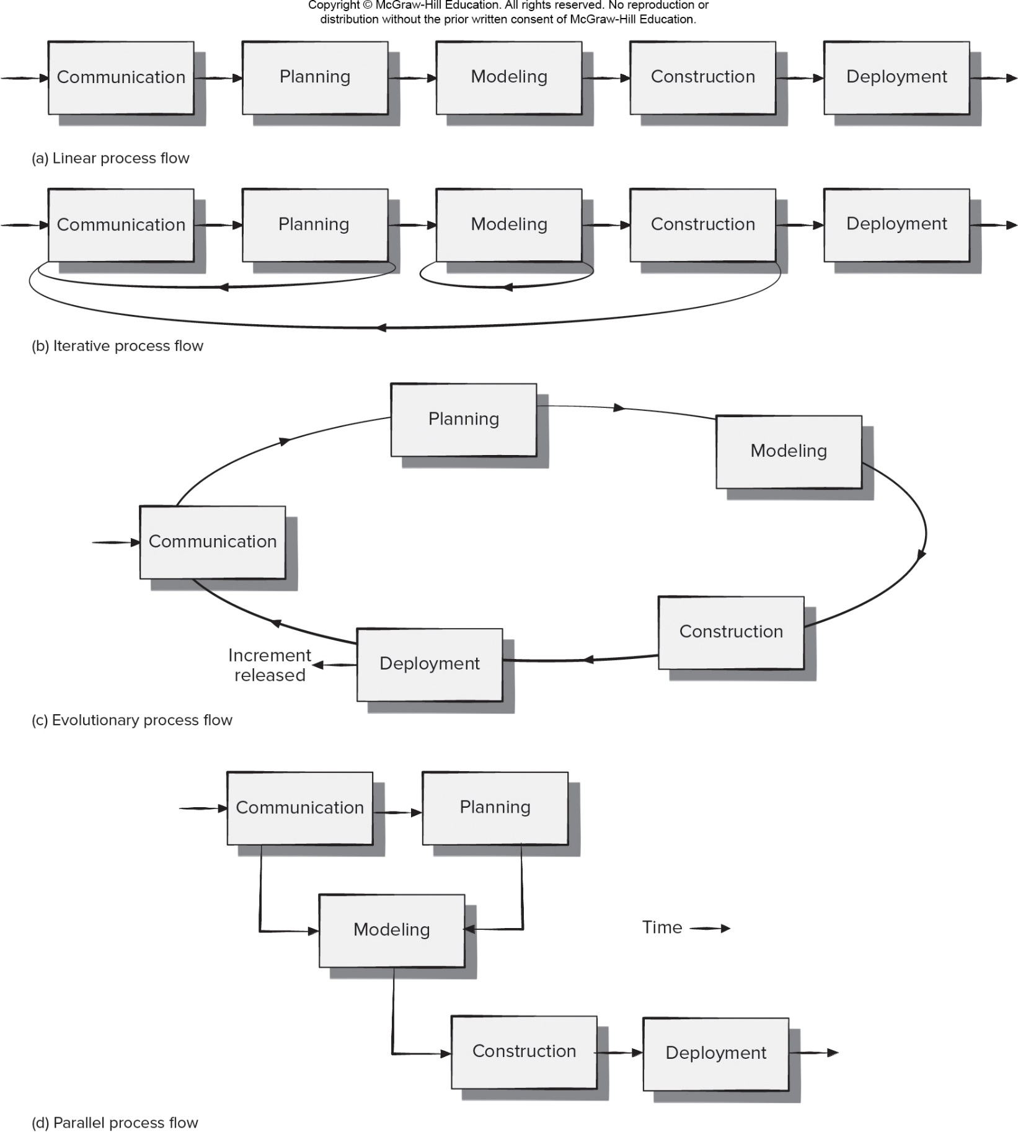
- Process Flow
Access the text alternative for slide images.

Slide 4
Identifying a Task Set
A task set defines the actual work to be done to accomplish the objectives of a software engineering action.
A task set is defined by creating several lists:
A list of the tasks to be accomplished.
A list of the work products to be produced.
A list of the quality assurance filters to be applied.

Slide 5
- Process Assessment and Improvement
The existence of a software process is no guarantee that software will be delivered on time, or meet the customer’s needs, or that it will exhibit long-term quality characteristics.
Any software process can be assessed to ensure that it meets a set of basic process criteria that have been shown to be essential for successful software engineering.
Software processes and activities should be assessed using numeric measures or software analytics (metrics).

Slide 6
Prescriptive Process Models 1
Prescriptive process models advocate an orderly approach to software engineering.
That leads to a two questions:
If prescriptive process models strive for structure and order, are they appropriate for a software world that thrives on change?
If we reject traditional process models and replace them with something less structured, do we make it impossible to achieve coordination and coherence in software work?

Slide 7
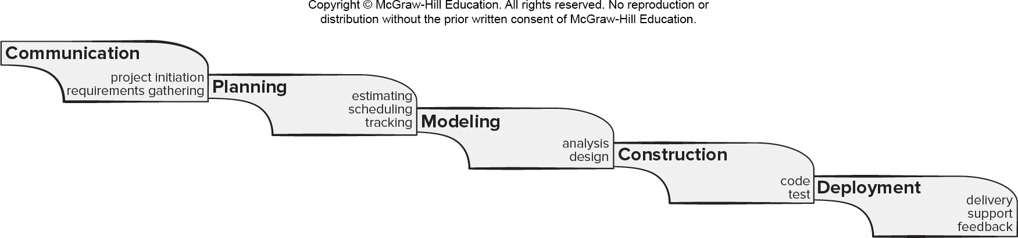
Waterfall Process Model 瀑布 不适合现在的软件开发
Pros
It is easy to understand and plan.
It works for well-understood small projects.
Analysis and testing are straightforward.
Cons
It does not accommodate change well.不灵活
Testing occurs late in the process.
Customer approval is at the end.
Access the text alternative for slide images.

Slide 8
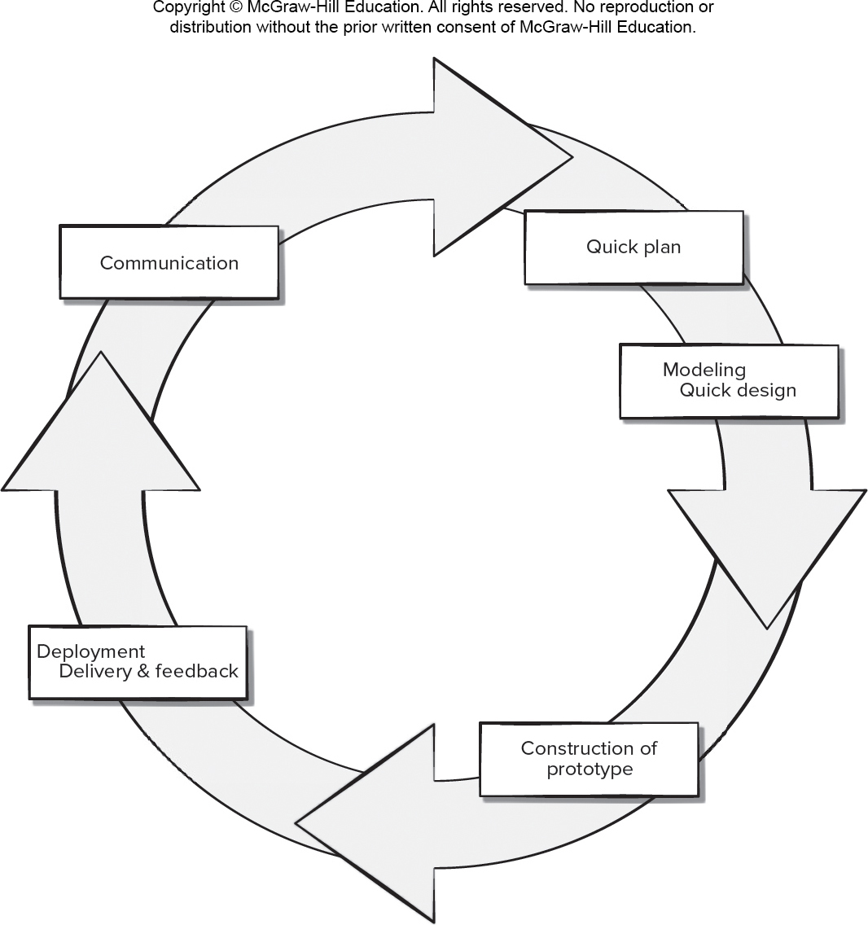
Prototyping Process Model 原型 快速
Pros
Reduced impact of requirement changes.
Customer is involved early and often.
Works well for small projects.
Reduced likelihood of product rejection.
Cons
Customer involvement may cause delays.
Temptation to “ship” a prototype.
Work lost in a throwaway prototype.
Hard to plan and manage.
Access the text alternative for slide images.

Slide 9
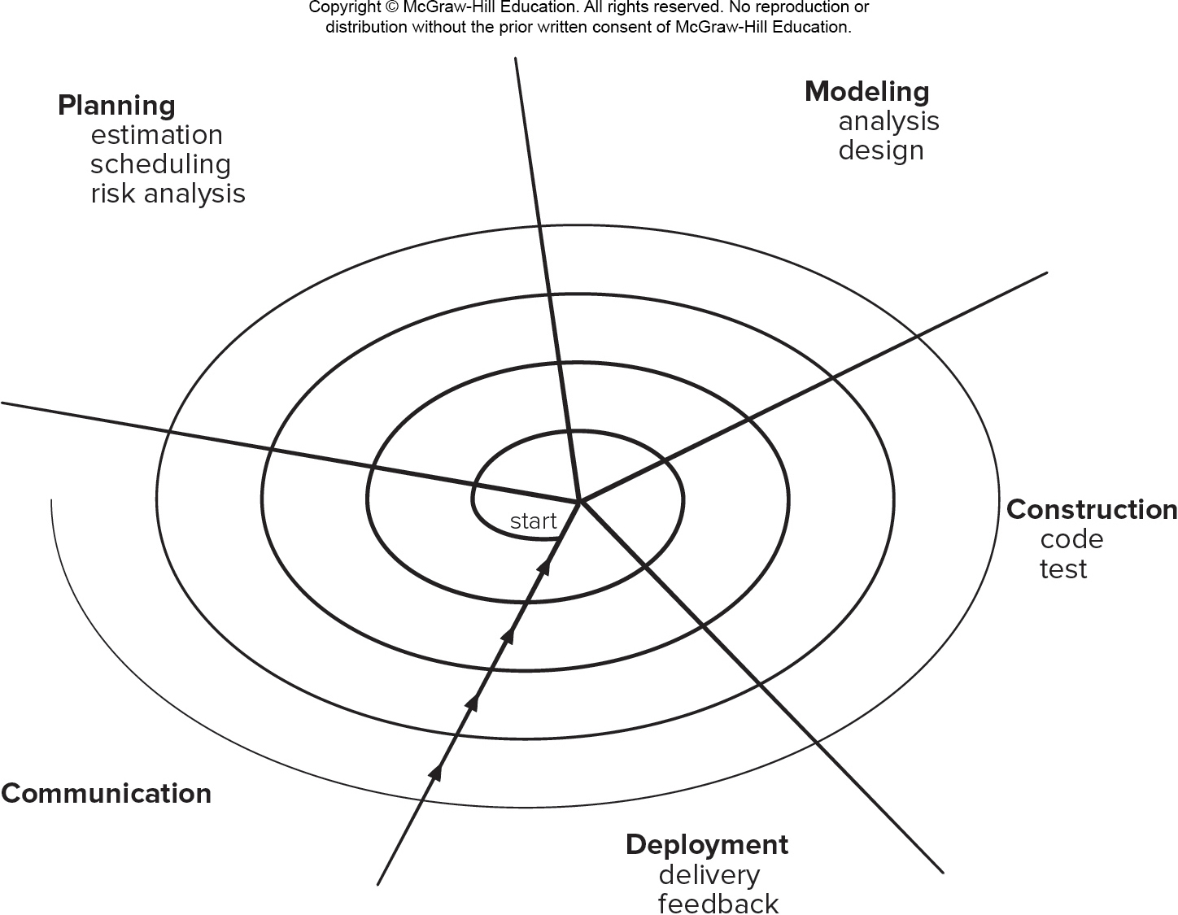
Spiral Process Model 循环 叠加
Pros
Continuous customer involvement.
Development risks are managed.
Suitable for large, complex projects.
It works well for extensible products.
Cons
Risk analysis failures can doom the project.
Project may be hard to manage.
Requires an expert development team.
Access the text alternative for slide images.

Slide 10
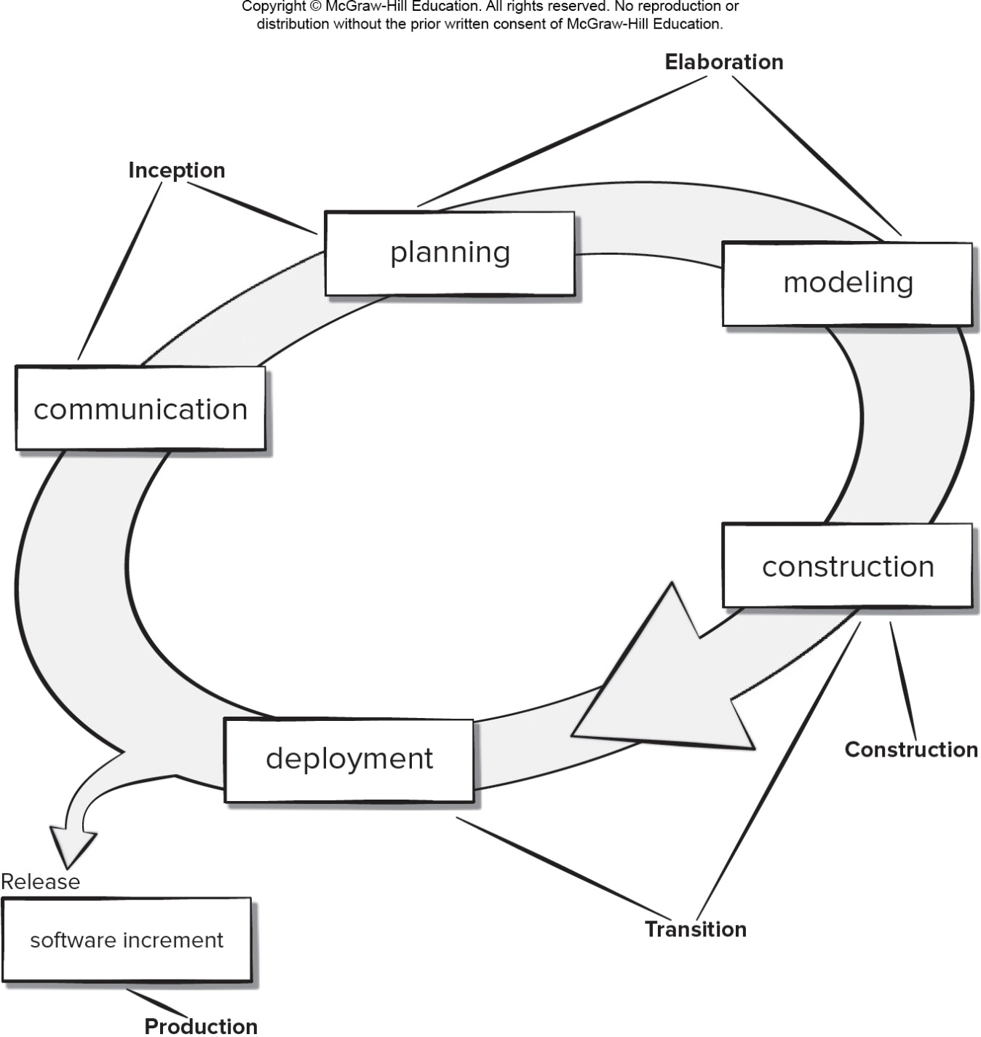
Unified Process Model
Pros
Quality documentation emphasized.
Continuous customer involvement.
Accommodates requirements changes.
Works well for maintenance projects.
Cons
Use cases are not always precise.
Tricky software increment integration.
Overlapping phases can cause problems.
Requires expert development team.
Access the text alternative for slide images.

Slide 11
Prescriptive Process Models 2
Prescriptive process models advocate an orderly approach to software engineering.
That leads to a two questions:
If prescriptive process models strive for structure and order, are they appropriate for a software world that thrives on change?
If we reject traditional process models and replace them with something less structured, do we make it impossible to achieve coordination and coherence in software work?

Slide 12
Homework
Form teams of 4 students each team and name your teams
Select a real problem your team wants to resolve with Software
Start discussing the problem within your team
Provide the name of your team, team members and the selected problem to Teaching Assistants
Send your questions from this class to Teaching Assistants

Slide 13
End of Main Content

Slide 14
Accessibility Content: Text Alternatives for Images

Slide 15
Generic Process Model – Text Alternative
Return to parent-slide containing images.
An illustration displays the generic process model. The model has three levels, software process, process framework, and umbrella activities. The umbrella activities contain framework activities numbered from 1 to n. The framework activity 1 reads, software engineering action 1. Task sets include work tasks, work products, quality assurance points, project milestones. The software engineering action 1.k has task sets as work task, work products, quality assurance points, and project milestones. The framework activity number n reads, software engineering action n.1. Task sets include work tasks, work products, quality assurance points, project milestones. The software engineering action n.m has task sets as work task, work products, quality assurance points, and project milestones.
Return to parent-slide containing images.

Slide 16
Process Flow – Text Alternative
Return to parent-slide containing images.
The diagram displays four types of process flows. A) Linear process flow. In the process flow each process flow is followed by a single process. The displayed process is as follows: communication, planning, modeling, construction and deployment. B) Iterative process flow. In the process flow each process is followed by a single process, however a process can loop back to any process in the flow. The displayed process is as follows: communication, planning, modeling, construction and deployment. Planning loops back to communication, modeling loops back to modeling and construction loops back to communication. C) Evolutionary process flow. In the process flow each process is followed by a single process the last process gives a result and loops back to the first process. The displayed process is as follows: communication, planning, modeling, construction and deployment. Deployment results in increment released and loops back to communication. D) Parallel process flow. In the process flow one or more processes can lead to the next process. The displayed processes are as follows: communication, planning, modeling, construction and deployment. The process is as follows: Communication leads to planning. Communication and planning lead to modelling. Modelling leads to construction which leads to deployment.
Return to parent-slide containing images.

Slide 17
Waterfall Process model – Text Alternative
Return to parent-slide containing images.
The diagram displays the waterfall process model. The displayed process is as follows: communication, planning, modeling, construction and deployment. Sub-processes under each process are as follow. Communication: project initiation and requirements gathering; Planning: estimating, scheduling and tracking; Modeling: analysis and design; Construction: code and test; Deployment: delivery, support and feedback.
Return to parent-slide containing images.

Slide 18
Prototyping Process Model – Text Alternative
Return to parent-slide containing images.
An illustration displays prototyping process model. The components in the cycle are communication, quick plan, modeling quick design, construction of prototype, development delivery and feedback.
Return to parent-slide containing images.

Slide 19
Spiral Process Model – Text Alternative
Return to parent-slide containing images.
An illustration displays spiral process model. The spiral model starts with communication; leads to planning which includes estimation, scheduling, and risk analysis; modeling include analysis and design; construction include code and test; and development which include delivery, and feedback.
Return to parent-slide containing images.

Slide 20
Unified Process Model – Text Alternative
Return to parent-slide containing images.
An illustration displays unified process model. The components in the cycle are communication, planning, modeling, construction, and deployment. The communication and planning form inception; planning and modeling form elaboration; construction forms construction; and construction and deployment form transition. Deployment releases software increment and production.
Return to parent-slide containing images.

