Slide 1

Chapter 5
Human Aspects of Software Engineering
Part One - The Software Process

Slide 2
Traits of Successful Software Engineers
Sense of individual responsibility.
Acutely aware of the needs of team members and stakeholders（用户、公司决策者）.
Brutally honest about design flaws and offers constructive criticism.
Resilient under pressure.
Heightened sense of fairness.
Attention to detail.
Pragmatic adapting software engineering practices based on the circumstances at hand.

Slide 3
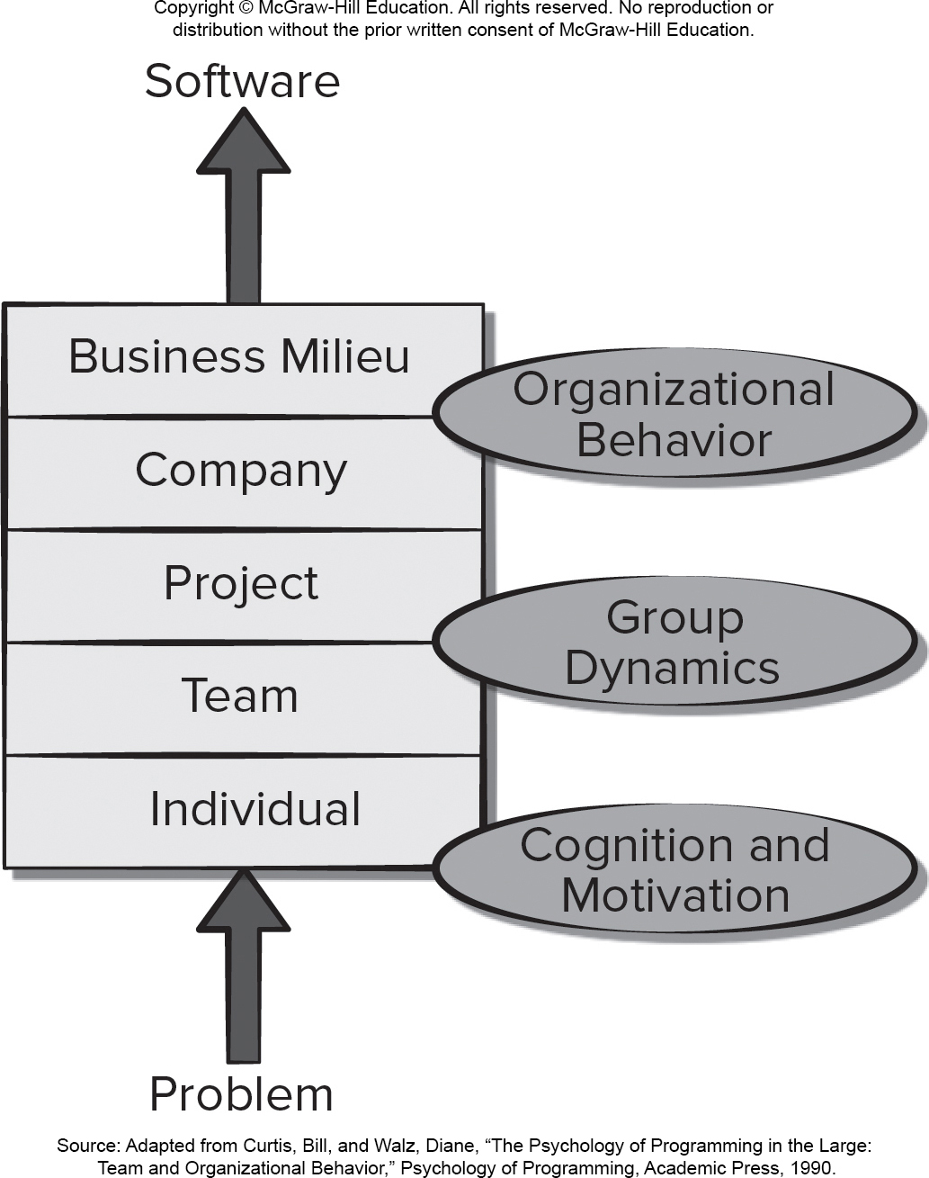
Behavior Model for Software Engineering 不讲
Source: Adapted from Curtis, Bill, and Walz, Diane, “The Psychology of Programming in the Large: Team and Organizational Behavior,” Psychology of Programming, Academic Press, 19 90.
Access the text alternative for slide images.

Slide 4
Effective Software Team Attributes
Sense of purpose.使命感
Sense of involvement.参与感
Sense of trust.
Sense of improvement.
Diversity of team member skill sets.多样化

Slide 5
Symptoms of Team Toxicity 不讲
A frenzied work atmosphere where team members waste energy and lose focus on work objectives.
High frustration that causes friction among team members.
Fragmented or poorly coordinated software process model that becomes a roadblock to accomplishment.
Unclear definition of team roles resulting in a lack of accountability and resultant finger-pointing.
Continuous and repeated exposure to failure that leads to a loss of confidence and poor morale.

Slide 6
Project Factors Affecting Team Structure不讲
Difficulty of the problem to be solved.
Resultant program size in lines of code or function points.
Time that the team will stay together (team lifetime).
Degree to which the problem can be modularized.
Required quality and reliability of the system to be built.
Rigidity of the delivery date.
Degree of communication required for the project.

Slide 7
Agile Teams 敏捷团队
Stress individual competency coupled with group collaboration as critical success factors.
People trump process and politics can trump people.
Agile teams as self-organizing and have many structures.
Adaptive team structures.
Significant autonomy.
Communication among developers and stakeholders is important (consider adding customer rep to team).
Planning is kept to a minimum and constrained only by business requirements and organizational standards.

Slide 8
Impact of Social Media
Social processes around software development are highly dependent on engineers’ abilities to connect with individuals who share similar goals and complementary skills.
Value of social networking tools grows as team size increases or when a team is geographically dispersed.
Privacy and security issues should not be overlooked when using social media for software engineering work.
Benefits of social media must be weighed against the threat of uncontrolled disclosure of proprietary information.

Slide 9
Team Decision Making Complications
Problem complexity.
Uncertainty and risk associated with the decision.
Work associated with decision has unintended effect on another project object (law of unintended consequences).
Different views of the problem lead to different conclusions about the way forward.
Global software teams face additional challenges associated with collaboration, coordination, and communication difficulties.

Slide 10
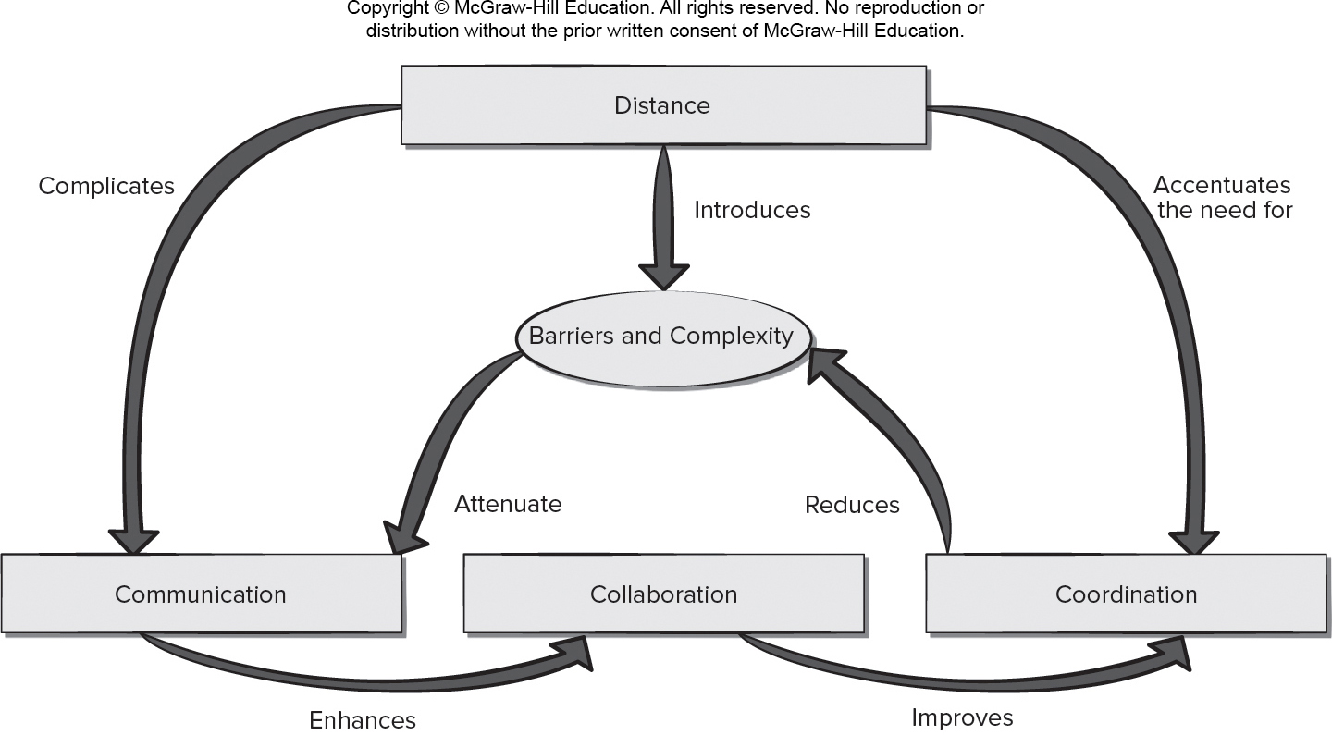
Factors Affecting Global Software Development Teams
Access the text alternative for slide images.

Slide 11
End of Main Content

Slide 12
Accessibility Content: Text Alternatives for Images

Slide 13
Behavior Model for Software Engineering – Text Alternative
Return to parent-slide containing images.
An illustration displays the behavior model for software engineering. The model levels from bottom to top are: individual, team, project, company, and business milieu. A problem is introduced to an individual results as a software after passing all the levels. Individual level consists of cognition and motivation. Project and team have group dynamics. The company and business milieu are within the organizational behavior.
Return to parent-slide containing images.

Slide 14
Factors Affecting Global Software Development Teams – Text Alternative
Return to parent-slide containing images.
An illustration displays factors affecting global software development teams. The factors are distance, barriers and complexity, communication, collaboration, and coordination. The distance introduces barriers and complexity, it complicates communication, and accentuates the need for coordination. Communication enhances collaboration, and collaboration improves coordination. Coordination reduces barriers and complexity and that attenuates the communication.
Return to parent-slide containing images.

