Slide 1
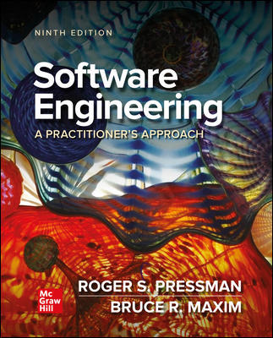
Chapter 17
Software Quality Assurance
Part Three – Quality and Seccurity

Slide 2
Quality Management
Phil Crosby once said:
The problem of quality management is not what people don't know about it. The problem is what they think they do.
Everybody is for it. (Under certain conditions, of course.)
Everyone feels they understand it. (Even though they wouldn't want to explain it.)
Everyone thinks execution is only a matter of following natural inclinations. (After all, we do get along somehow.)
Most people feel that problems in these areas are caused by other people. (If only they would take the time to do things right.)

Slide 3
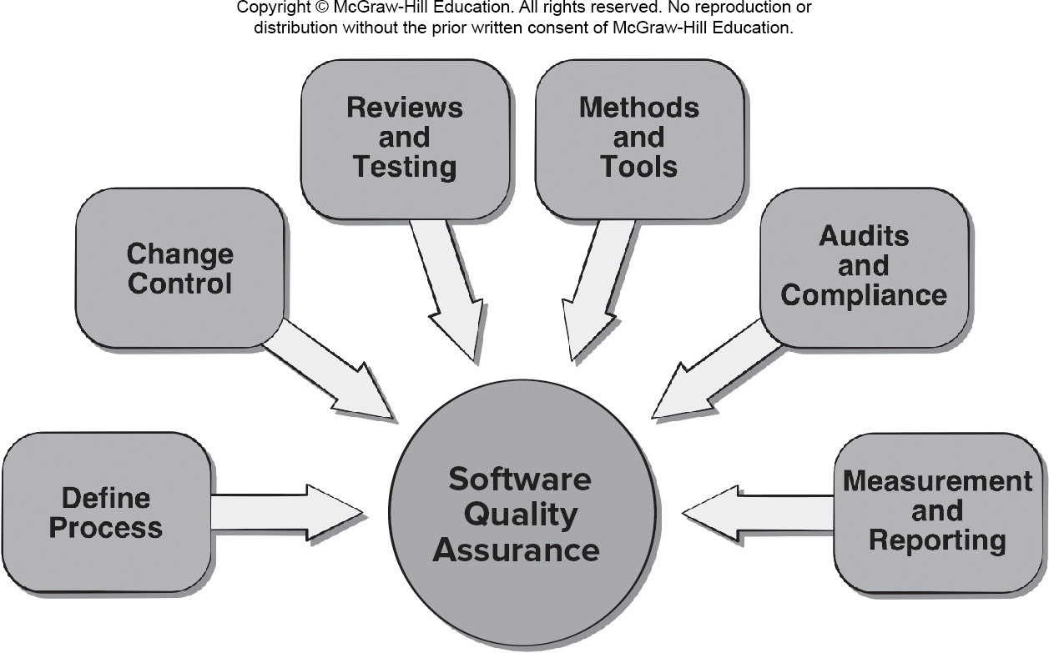
Software Quality Assurance SQA
Access the text alternative for slide images.

Slide 4
Elements of S Q A
Standards.
Reviews and Audits.
Testing.
Error/defect collection and analysis.
Change management.
Education.
Vendor management.
Security management.
Safety.
Risk management.

Slide 5
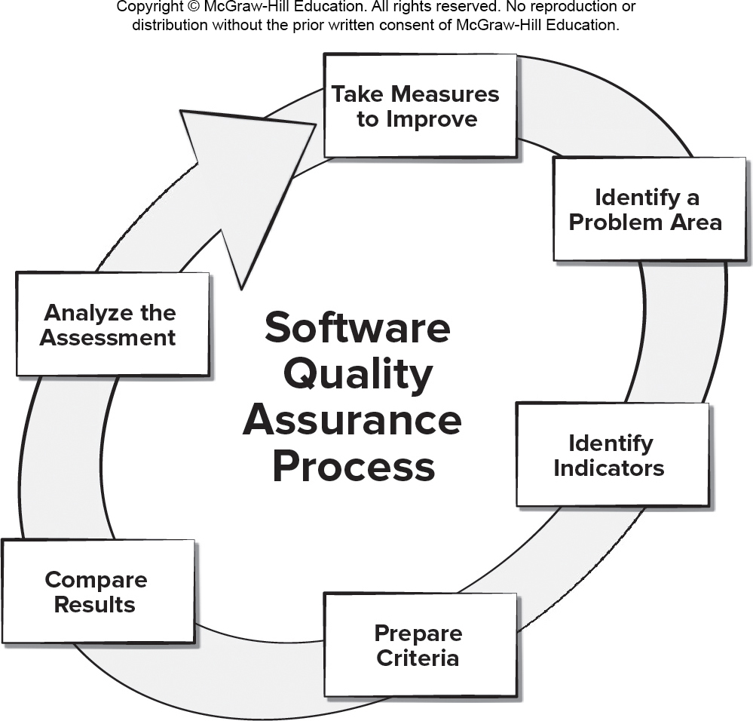
Data Driven S Q A
Access the text alternative for slide images.

Slide 6
Role of S Q A Group 1
Prepares an S Q A plan for a project which identifies:
Evaluations to be performed.
Audits and reviews to be performed.
Standards that are applicable to the project.
Procedures for error reporting and tracking.
Documents to be produced by the S Q A group.
Amount of feedback provided to the software project team.
Participates in the development of the project’s software process description.
Reviews the process description for compliance with organizational policy, internal software standards, externally imposed standards (for example, I S O-9001), and other parts of the software project plan.

Slide 7
Role of S Q A Group 2
Reviews software engineering activities to verify compliance with the defined software process.
Identifies, documents, and tracks deviations from the process and verifies that corrections have been made.
Audits designated software work products to verify compliance with those defined as part of the software process.
Reviews selected work products; identifies, documents, and tracks deviations; verifies that corrections have been made.
Periodically reports the results of its work to the project manager.
Ensures that deviations in software work and work products are documented and handled according to a documented procedure.
Records any noncompliance and reports to senior management.
Noncompliance items are tracked until they are resolved.

Slide 8
S Q A Goals
Requirements quality. The correctness, completeness, and consistency of the requirements model will have a strong influence on the quality of all work products.
Design quality. Every element of the design model should be assessed to ensure that it exhibits high quality and that the design itself conforms to requirements.
Code quality. Source code and related work products must conform to local coding standards and exhibit characteristics that will facilitate maintainability.
Quality control effectiveness. A software team should apply limited resources in a way that has the highest likelihood of achieving a high quality result.

Slide 9
Formal S Q A
Assumes that a rigorous syntax and semantics can be defined for every programming language.
Allows the use of a rigorous approach to the specification of software requirements.
Applies mathematical proof of correctness techniques to demonstrate that a program conforms to its specification.
Although formal methods are interesting to some software engineering researchers, most commercial developers rarely use of formal methods.

Slide 10
Statistical S Q A
Information about software errors and defects is collected and categorized.
An attempt is made to trace each error and defect to its underlying cause (for example, design error, violation of standards, non-conformance to specifications, poor communication with the customer).
Using the Pareto principle (80 percent of the defects can be traced to 20 percent of all possible causes), isolate the 20 percent (the vital few).
Once the vital few causes have been identified, move to correct the problems that caused the errors and defects.

Slide 11
Six Sigma for Software Engineering 1
The term “six sigma” is derived from six standard deviations from the mean - 3.4 instances (defects) per million occurrences - implying an extremely high quality standard.
The three cores steps:
Define customer requirements and deliverables and project goals via well-defined methods of customer communication.
Measure the existing process and its output to determine current quality performance (collect defect metrics).
Analyze defect metrics and determine the vital few causes.

Slide 12
Six Sigma for Software Engineering 2
For an existing process the needs improvement:
Improve the process by eliminating the root causes of defects.
Control the process to ensure that future work does not reintroduce the causes of defects.
For a new process being developed:
Design the process to: (1) avoid the root causes of defects and (2) to meet customer requirements.
Verify that the process model will, in fact, avoid defects and meet customer requirements.

Slide 13
Software Reliability and Availability
A simple measure of reliability is mean-time-between-failure (M T B F):
M T B F = M T T F + M T T R
M T T F is mean-time-to-failure
M T T R is mean-time-to-repair, respectively.
Software availability is the probability that a program is operating according to requirements at a given point in time and is defined as
Availability = [M T T F/(M T T F + M T T R)] × 100%

Slide 14
AI and Reliability Models
Software reliability is the probability of failure-free software operation for a specified time period in a specified environment.
Bayesian inference is a method of statistical inference in which Bayes’ theorem is used to update the probability for a hypothesis (such as system reliability) being correct as more evidence or information becomes available.
Bayesian inference can be used to estimate probabilistic quantities using historic data even when some of the information is missing.
Making use of predictive data analytics tools such as a regression model involving M T B F can been used to estimate where and what types of defects might occur in future prototypes.
Genetic algorithms can be used to grow reliability models by discovering relationships using historic system data to predict future software component failures.

Slide 15
Software Safety
Software safety is a software quality assurance activity that focuses on the identification and assessment of potential hazards that may affect software negatively and cause an entire system to fail.
If hazards can be identified early in the software process, software design features can be specified that will either eliminate or control potential hazards.

Slide 16
I S O 9001:2015 Standard
I S O 9001:2015 is the quality assurance standard that applies to software engineering.
The requirements delineated by I S O 9001:2008 address topics such as:
Management responsibility, quality system, contract review, design control, document and data control, product identification and traceability, process control, inspection and testing, corrective and preventive action, control of quality records, internal quality audits, training, servicing, and statistical techniques.
For an organization to become registered to I S O 9001:2015, it must establish procedures to address each of the requirements listed and able to demonstrate these policies and being followed.

Slide 17
S Q A Plan Contents
Purpose and scope of the plan.
Description of all software engineering work products that fall within the purview of S Q A.
Applicable standards and practices that are applied during the software process.
S Q A actions and tasks (including reviews and audits) and their placement throughout the software process.
Tools and methods supporting S Q A actions and tasks.
Software configuration management procedures.
Methods for safeguarding and maintaining S Q A records.
Organizational roles and responsibilities.

Slide 18
End of Main Content

Slide 19
Accessibility Content: Text Alternatives for Images

Slide 20
Software Quality Assurance – Text Alternative
Return to parent-slide containing images.
An illustration displays software quality assurance. The software quality assurance is displayed in a circle at the center with the components displayed around with arrows pointing to it. The components are define process, change control, reviews and testing, methods and tools, audits and compliance, and measurement and reporting.
Return to parent-slide containing images.

Slide 21
Data Driven S Q A – Text Alternative
Return to parent-slide containing images.
A circular model displays a data driven software quality assurance process. The process starts with: analyze the assessment, and then take measures to improve it. After identifying a problem area, identify the indicator and prepare a criteria. Then compare the results. The process then repeats from analyze the assessment.
Return to parent-slide containing images.

