Slide 1
绪 论
电路理论（Electric Circuit Theory）
电路分类（Electric Circuit Categories）
电路简史（Brief History）

Slide 2
1. Electric Circuit Theory
电路中发生的是电磁过程。
电路理论起源于物理学中电磁学的一个分支。
电路理论是研究电路的基本规律及其计算方法的工程学科。
电路理论包括电路分析(analysis)和网络综合(synthesis)两类问题。
电路理论基础的任务是研讨各种电路所共有的基本规律和基本分析计算方法。电路理论研究的对象是电路模型（而非实际电路）。

Slide 3
作为电路理论的基础和入门， 本课主要讨论电路分析的基本规律（电路元件的伏安关系VCR、 基尔霍夫定律和电路定理）和电路的各种计算方法，为学习后续课程打下基础。
学习本课程， 应深入地理解电路的基本规律及有关物理概念，学会分析计算电路的方法，并充分了解这些规律、概念、方法的适用范围和使用条件，以便用所学的电路基础理论知识去解决今后学习和工作中所遇到的电路问题。

Slide 4
2. 电路分类
从不同角度可以做不同的分类。
电路理论中，为了理论研究方便，将电路分类为：
集总电路与分布电路
时变电路与时不变电路
线性电路与非线性电路
连续时间与离散时间电路
…
本课程讨论集总、线性、时不变、连续时间电路的分析方法。

Slide 5
3. Brief History
The first electric circuit was invented by Alessandro Volta in 1800. He discovered he could produce a steady flow of electricity using bowls of salt solution connected by metal strips. Later, he used alternating discs of copper, zinc, and cardboard that had been soaked in a salt solution to create his voltaic pile (an early battery). By attaching a wire running from the top to the bottom, he caused an electric current to flow through his circuit. The first practical use of the circuit was in electrolysis, which led to the discovery of several new chemical elements. Georg Ohm discovered some conductors had more resistance than others, which affects their efficiency in a circuit. His famous law states that the voltage across a conductor divided by the current equals the resistance, measured in ohms. Resistance causes heat in an electrical circuit, which is often not wanted.

Slide 6
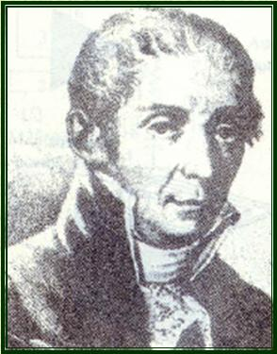
Alessandro Volta, Italian physicist, known for his pioneering work in electricity. Volta was born in Como and educated in the public schools there. In 1774 he became professor of physics at the Royal School in Como, and in the following year he devised the electrophorus, an instrument that produced charges of static electricity.
In 1776-77 he applied himself to chemistry, studying atmospheric electricity and devising experiments such as the ignition of gases by an electric spark in a closed vessel. In 1779 he became professor of physics at the University of Pavia, a chair he occupied for 25 years. By 1800 he had developed the so-called voltaic pile, a forerunner of the electric battery, which produced a steady stream of electricity.
Alessandro Volta（伏特）
(1745-1827)
Italian physicist

Slide 7
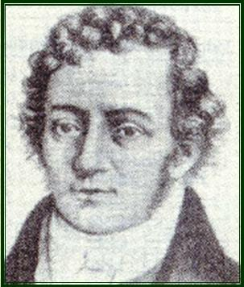
Andre Marie Ampere
(1775-1836)
Andre Marie Ampere is best known for defining a way to measure the flow of current, which was named after him, the ampere. He also laid the foundation for the science of electrodynamics.
Ampere was a French physicist and science teacher who lived from 1775-1836. Among his accomplishments was figuring out a way to measure the strength of a magnetic field in relation to an electric current, known as Ampere's theorem. Ampere's law is a rule that deals with the mutual interaction of current-carrying wires.
Andre-Marie Ampere（安培）
(1775－1836)
French Mathematician and physicist

Slide 8
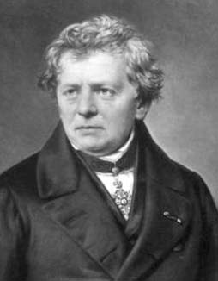
Georg Simon Ohm
(1787 - 1854)
Born in Erlangen, Germany, his later work as a physicist resulted in the 1827 discovery of the mathematical law of electric-current called "Ohm's Law." The ohm, a unit of electrical resistance, is equal to that of a conductor in which a current of one ampere is produced by a potential of one volt across its terminals.
Georg Simon Ohm (欧姆）
(1789-1854)
German physicist

Slide 9
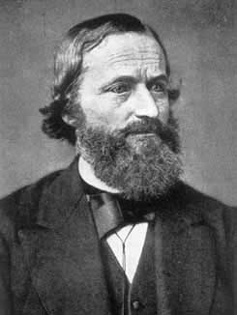
In 1845 Kirchhoff first announced Kirchhoff's laws, which allow calculation of the currents, voltages, and resistances of electrical networks. Extending the theory of the German physicist Georg Simon Ohm, he generalized the equations describing current flow to the case of electrical conductors in three dimensions. In further studies he demonstrated that current flows through a conductor at the speed of light. He was a physicist who made important contributions to the theory of circuits using topology and to elasticity. Kirchhoff's laws, finally announced in 1854, allow calculation of currents, voltages and resistances of electrical circuits extending the work of Ohm. In 1857, he worked on conduction in telegraph wires. He discovered that the velocity of transmission is the same as the speed of light.
Gustav Robert Kirchhoff
（基尔霍夫）
1824－1887
Germany physicist

Slide 10
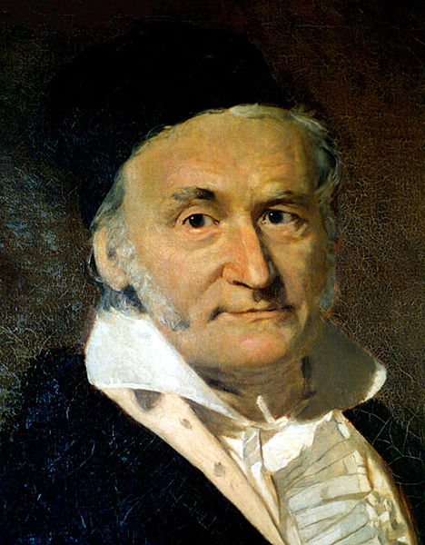

Gauss's law states that:
The electric flux through any closed surface is proportional to the enclosed electric charge.
Gauss's law has a close mathematical similarity with a number of laws in other areas of physics, such as Gauss's law for magnetism and Gauss's law for gravity. In fact, any "inverse-square law" can be formulated in a way similar to Gauss's law: For example, Gauss's law itself is essentially equivalent to the inverse-square Coulomb's law, and Gauss's law for gravity is essentially equivalent to the inverse-square Newton's law of gravity.
Gauss's law is something of an electrical analogue of Ampère's law, which deals with magnetism.
Carl Friedrich Gauss (1777–1855)
painted by Christian Albrecht Jensen
German mathematician and physical scientist

Slide 11
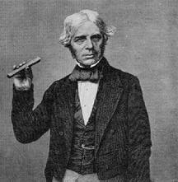
English bookbinder who became interested in electricity. He obtained an assistantship in Davy's lab, then began to conduct his own experiments. He wrote a review article on current views about electricity and magnetism in 1821, for which he reproduced Oersted's experiment. He was one of the greatest experimenters ever. Because he was self trained, however, he had no grasp of mathematics and could therefore not understand a word of Ampère's papers. In the course of his experiments, Faraday discovered that a suspended magnet would revolve around a current bearing wire, leading him to propose that magnetism was a circular force. He also discovered magnetic optical rotation, invented the dynamo (a device capable of converting electricity to motion) in 1821, discovered electromagnetic induction in 1831, and devised the laws of chemical electrodeposition of metals from solutions in 1857.
Faraday, Michael (1791-1867)

Slide 12
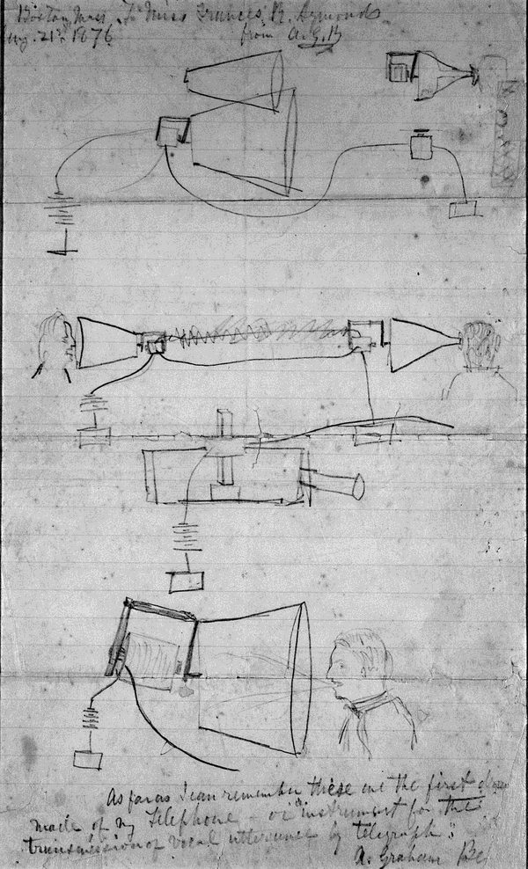
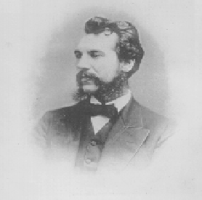
Alexander Graham Bell（1847－1922）
Alexander Graham Bell's design sketch of the telephone.

Slide 13
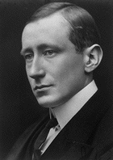
马可尼：G.Marconi (1874-1937)，意大利人，人类无线电通信的创始人。1894年和俄国的波波夫分别发明了无线电，开创了人类通讯的新纪元。没有受过正规大学教育的20岁的马可尼利用赫兹的火花振荡器作为发射器，通过电键的开、闭产生断续的电磁波信号。1895年他发射的信号传送距离可达1km以上，1897年发射的信号可在20km之外接收到，从此开始了无线电通信的时代。由于马可尼在无线电通信方面所做出的贡献，他获得了1909年度的诺贝尔物理学奖。
马可尼1901年向新来临的20世纪奉献上的珍贵礼品是一项科技创新与发明——成功地进行了首次无线电通讯，无线电技术的大发展从而成为20世纪的热门事情。1906年，美国物理学家费森登发明无线电广播，使无线电波进入千家万户，预示着一个信息时代的肇始。
Guglielmo Marconi（1874－1937）
Italy physicist

Slide 14
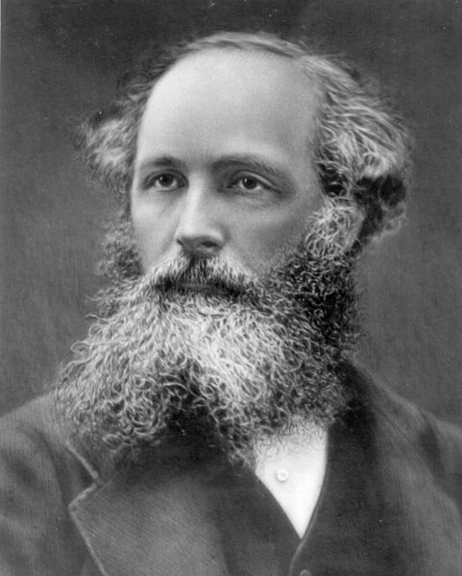
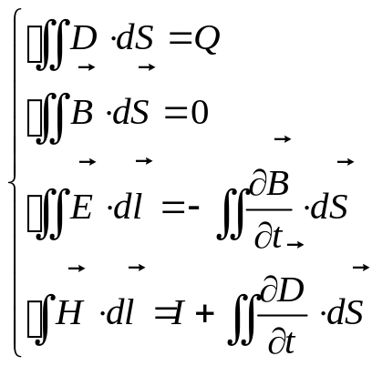
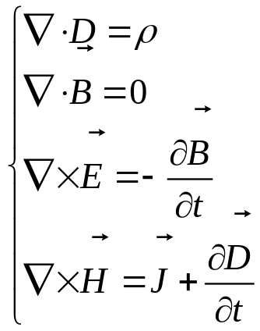
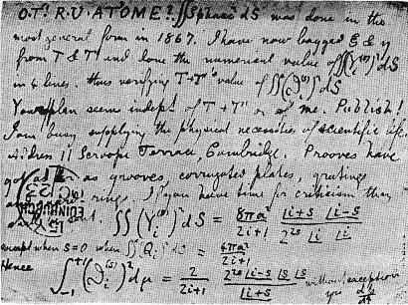
或
James Clerk Maxwell（1831～1879）
英国理论物理学家与数学家
A postcard from Maxwell to Peter Tait

Slide 15
......

