Slide 1
面向对象软件方法学
张波

Slide 2


Textbook and Reference
Mark Priestley, 2000, Practical object-oriented design with UML (面向对象设计的UML实践), Tsinghua University Press, Reprint. Originally published: McGraw-Hill, 2000. ISBN 7302040982.
Erich Gamma, Richard Helm, Ralph Johnson and John Vlissides, 2002, Design Patterns: Elements of Reusable Object-Oriented Software, 机械工业出版社.
张波, Qt中的C++技术，2012年,机械工业出版社

Slide 3
Outline of this lecture
Chapter 1 Introduction
Why do we need modeling?
What kinds of modeling methods available?
Why do we need UML?
Fundamental elements of UML
  Views
  Diagrams
Chapter 2 Modeling with Objects
Properties, Navigibility, Message Passing,
Strength of OOP

Slide 4
Introduction to UML
Software development
Wide sense / narrow sense
The process of software development
Requirement
Specification
Source
Code

Slide 5
A more complex process
Requirement Specification
Structure Chart
Source Code

Slide 6
Model
Definition: the intermediate descriptions (documents) produced in the process.
Features:
  Abstract view of a system.
  Easy to understand.
  A valuable means for communication.

Slide 7
Classes of methodologies
Structured methods
  Models
  a collection of data +
  functions external to the data
  Notations: data flow diagrams
Object-oriented methods
  Models: see the following example
  Notations
  ➔ Unified Modeling Language (UML)

Slide 8
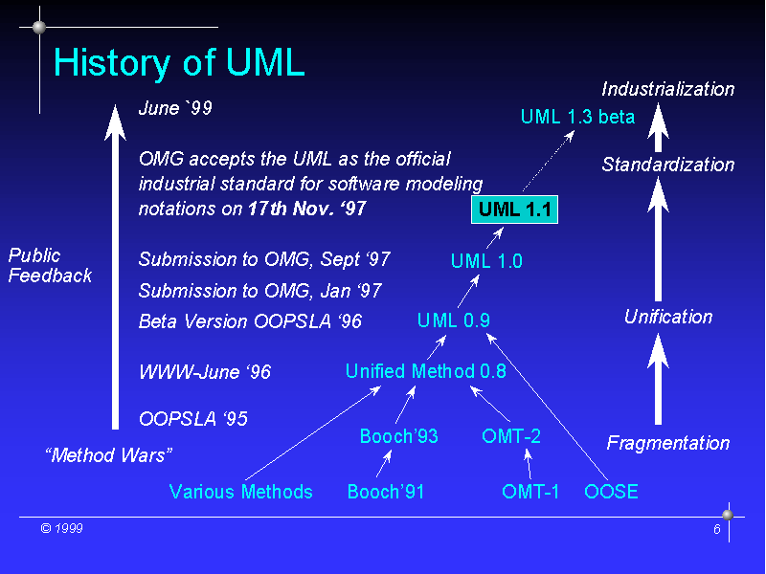
Rumbaugh
Jacobson
17/6/25
Taken from http://ias.uni-klu.ac.at/projects/uml/OTG99/sld006.htm

Slide 9
A brief Introduction to UML
The dominant language in OO modeling
It can be used with a wide range of software processes
Views
Models/Diagrams

Slide 10

Views
Design
View
Implementation
View
Use Case
View
Process
View
Deployment
View

Slide 11
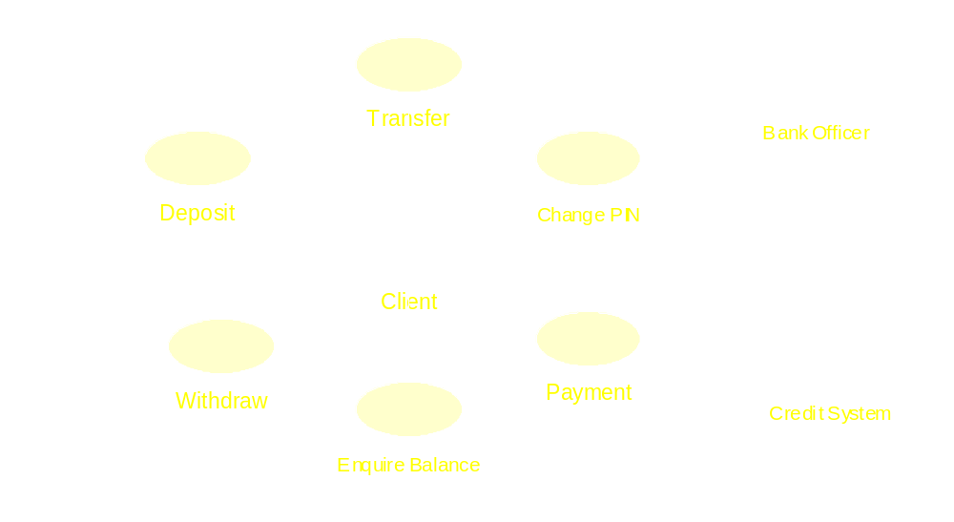
An example of the use case view

Slide 12
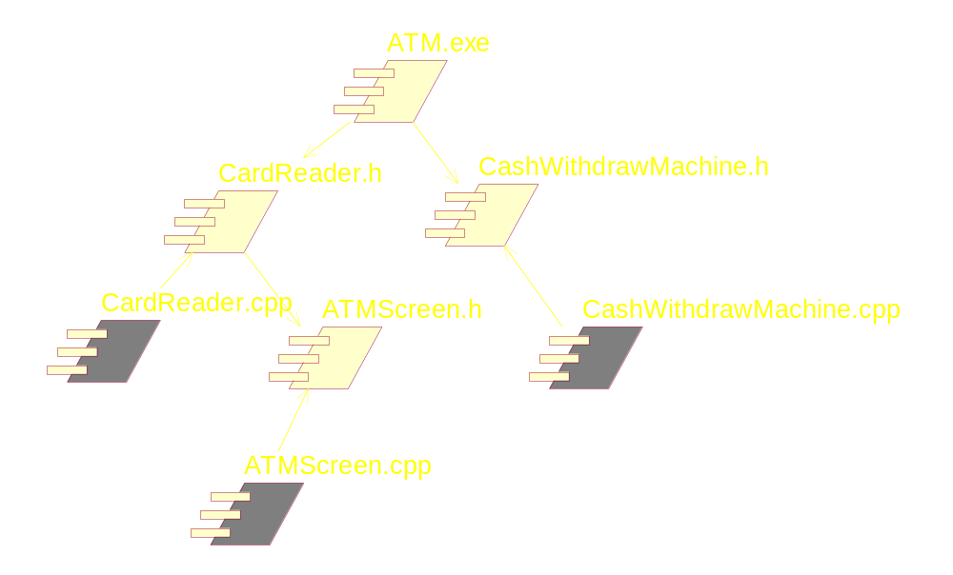
An example of the implementation view

Slide 13
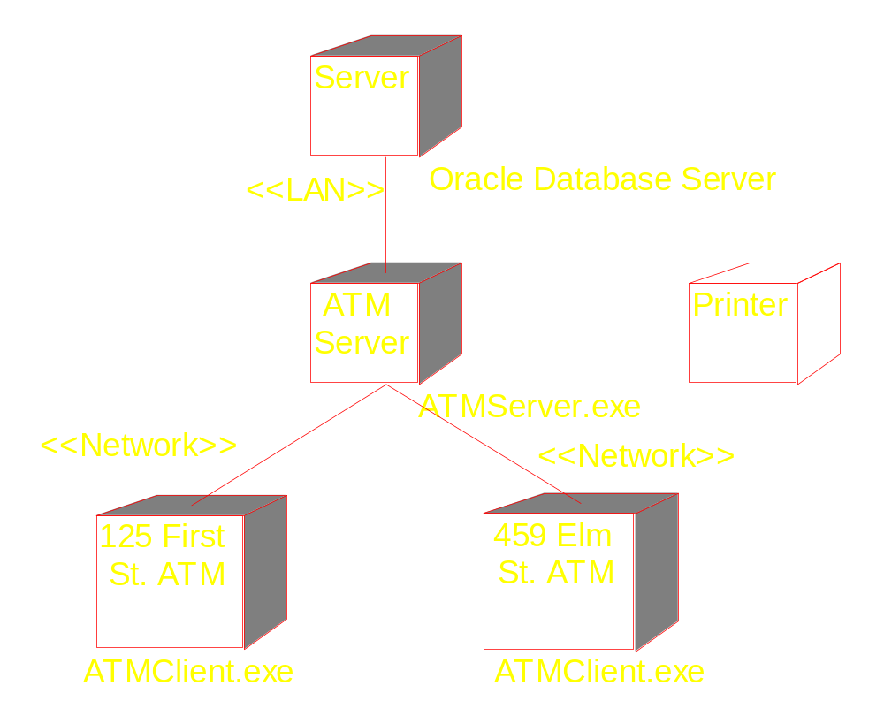
An example of deployment view

Slide 14
Diagrams
A diagram presents certain aspect of the underlying system model.
Diagrams are just like programs, but more abstract (object structure).
Do not be overwhelmed by the details of the diagrams.
Some types of diagrams can be used in both use case and design views

Slide 15
UML’s diagram types
Diagram | View
1 Use case diagram | Use case view
2 Object diagram | Use case & design view
3 Sequence diagram | Use case & design view
4 Collaboration diagram | Use case & design view
5 Class diagram | Design view
6 Statechart diagram | Design view
7 Activity diagram | Design view
8 Component diagram | Implementation view
9 Deployment diagram | Deployment view

Slide 16
The software development process
Linear or waterfall model
Analysis
Designing
Development
Testing
Deployment

Slide 17
Iterative model
Detailed Analysis
Deployment
Designing
Testing
Development

Slide 18
Chapter 2:
Modeling with Objects
The object model
  Data + Operations
  Execution of a program: a dynamic network of intercommunicating objects.
  Nodes (object) + links (sending messages)
  The semantic foundation for UML’s design models
The stock control example

Slide 19
Objects
Design: how to split up a system’s data and overall functionality.
A frequently used rule: real-world objects
myScrew:Part
name=“screw” number=28834 cost=0.02

Slide 20
Object Properties
State: the aggregate of the data values contained in an object’s attributes
Behavior
shown in the class diagram
Identity: address in memory
Object names: a convenient alias for its identity.
  Sometimes these corresponds to object names in program source, but not always, such as objects in a vector.

Slide 21
Avoiding data replication
Data in the previous object model is replicated
  Waste storage
  Difficult to consistently update all objects
Links

Slide 22
:Part
:CatalogueEntry
Name=“screw”
Number=28834
Cost=0.02
:Part
Information: attributes & links

Slide 23
#include <iostream>
using namespace std;
class CatalogueEntry {
public:
CatalogueEntry(string p_name, long p_number, double p_cost){
name = p_name ;
number = p_number;
cost = p_cost ;
}
string getName() { return name;};
long getNumber() { return number; };
double getCost() { return cost;};

Slide 24
private:
string name;
long number;
double cost;
};
class Part {
public:
Part(CatalogueEntry * e){
entry = e;
}
private:
CatalogueEntry * entry;
}

Slide 25
int main()
{
CatalogueEntry *screw = new
CatalogueEntry("screw",28834,0.02);
Part * screw1 = new Part(screw);
}

Slide 26
Navigability
:Part
:CatalogueEntry
Name=“screw”
Number=28834
Cost=0.02
entry

Slide 27
Message Passing
0.02:=cost( )
0.02:=getCost( )
:CatalogueEntry
Name=“screw”
Number=28834
Cost=0.02
client
:Part

Slide 28
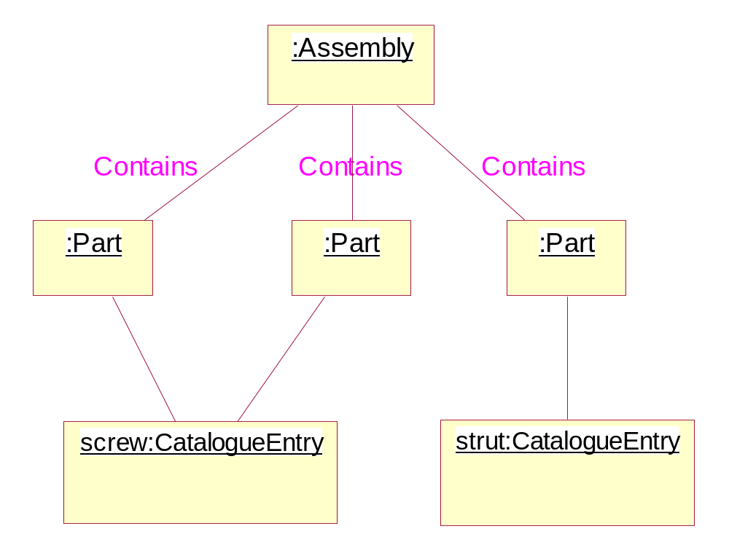
A simple structure

Slide 29
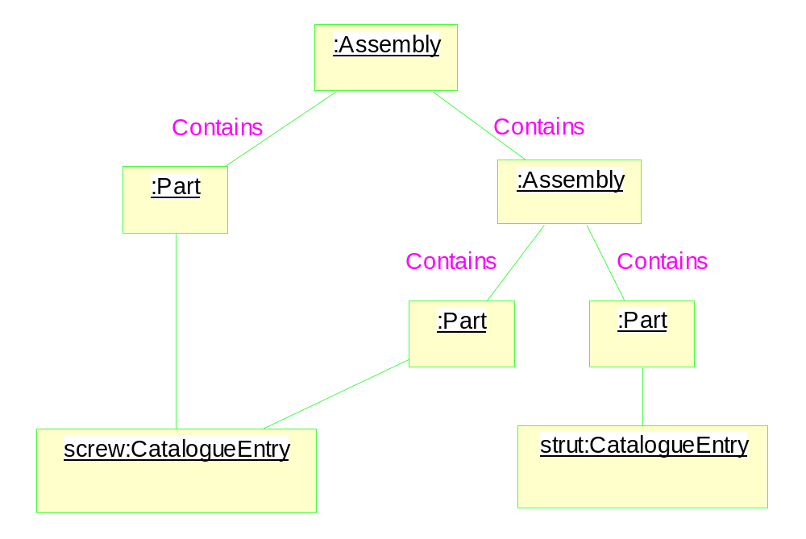
A more realistic structure
Impossible for implementation!

Slide 30
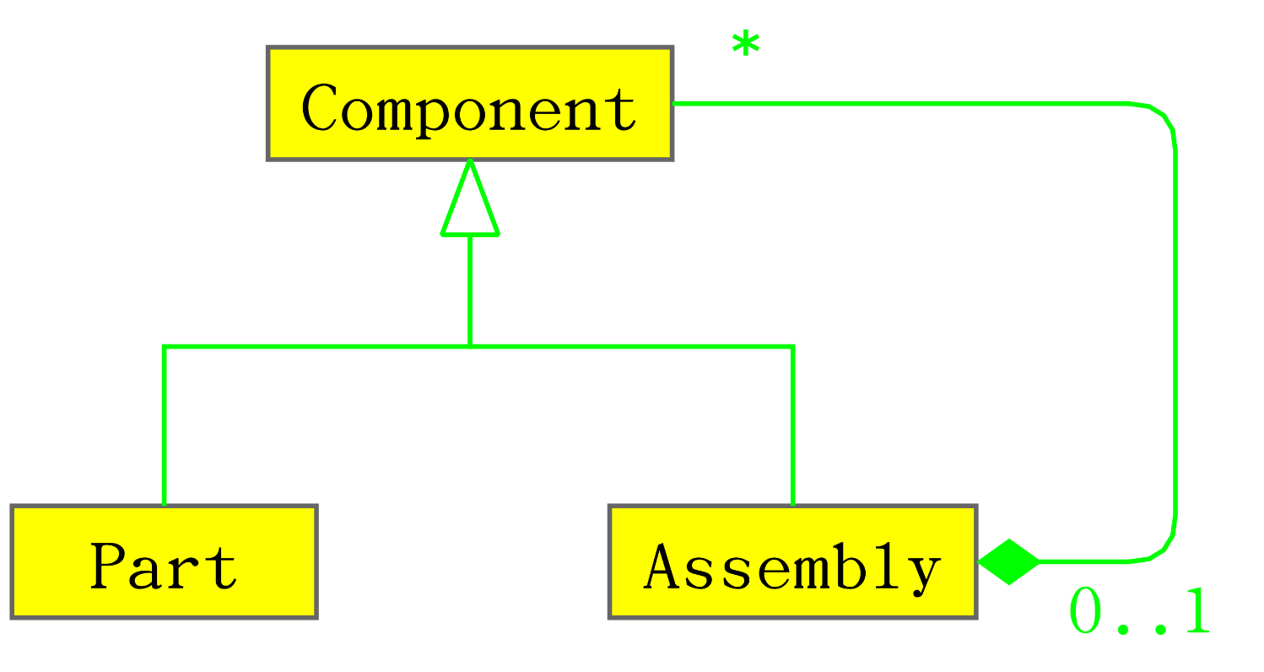
Use of abstract class

Slide 31
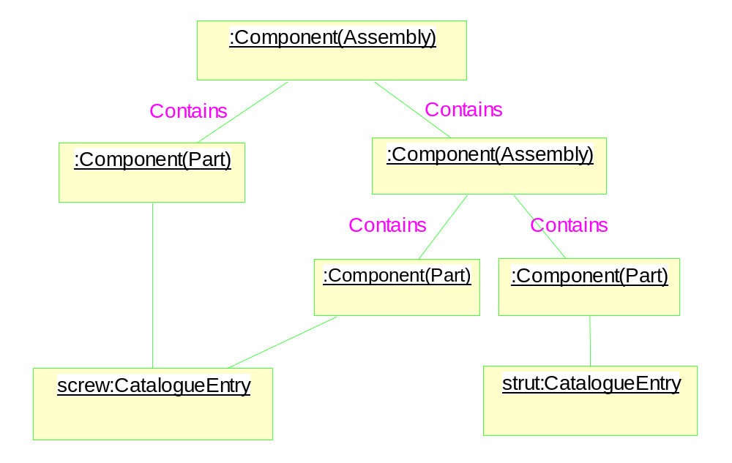
Object diagram

Slide 32
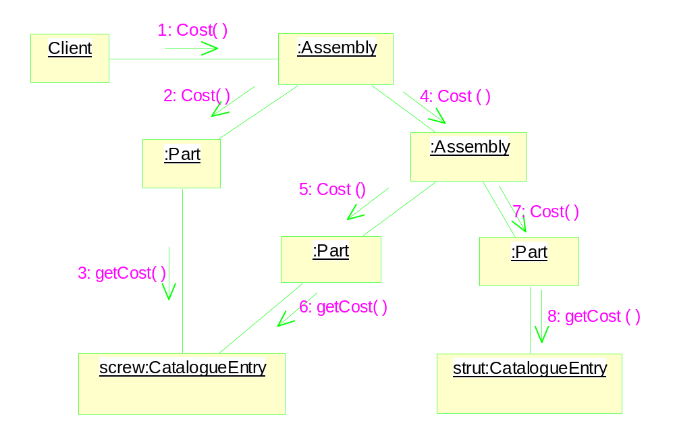
Late Binding & Polymorphism

Slide 33
Class Diagrams
Object diagrams: can only show a small subset of a program’s possible states.
We need to describe the software system in a more abstract level: class diagrams.
  Similar to object diagram
  Types of the attributes are shown
  Association (linkage counter)
  Inheritance

Slide 34
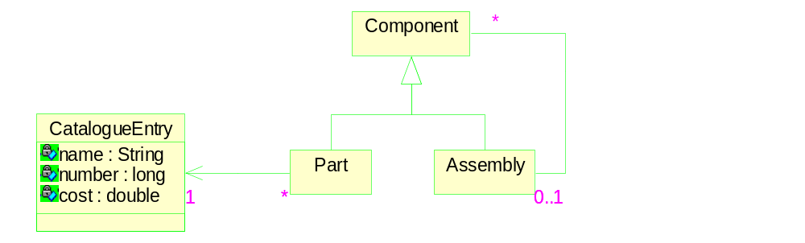
An example of class diagram

Slide 35
The applicability of the object model
Often: object (real world) ➔ object model
Exceptions: the example above
Message passing
  Real world events are often treated as messages.
  Objects + events ➔ Objects + messages
Strength of OO
  Localization of data and operations with objects
  In most cases, the following mapping holds
  real world object ➔ object model

