Slide 1
Class diagram
An example: how to draw a class diagram
Operations
Associations, association generalization
Aggregation
Composite objects
Association classes

Slide 2
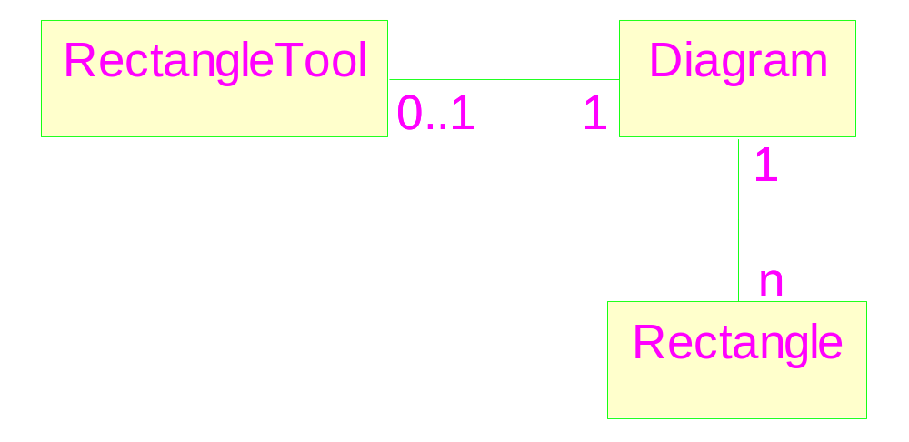
Classes and associations
There is direct correspondence between class associations and object links.
Multiplicity: Demo

Slide 3
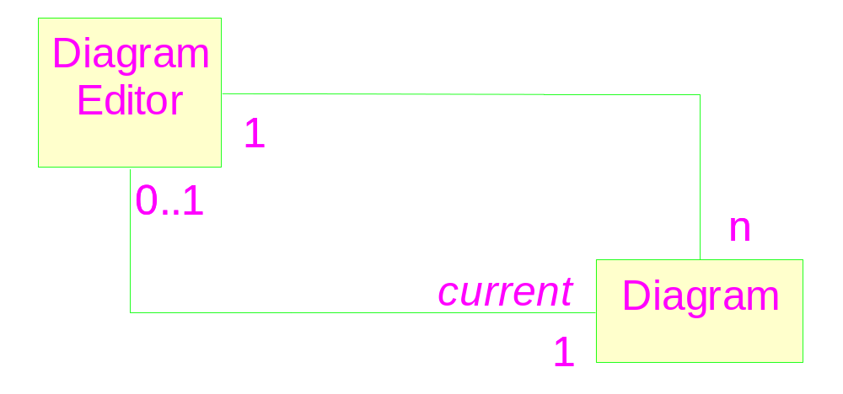
Multiple associations

Slide 4
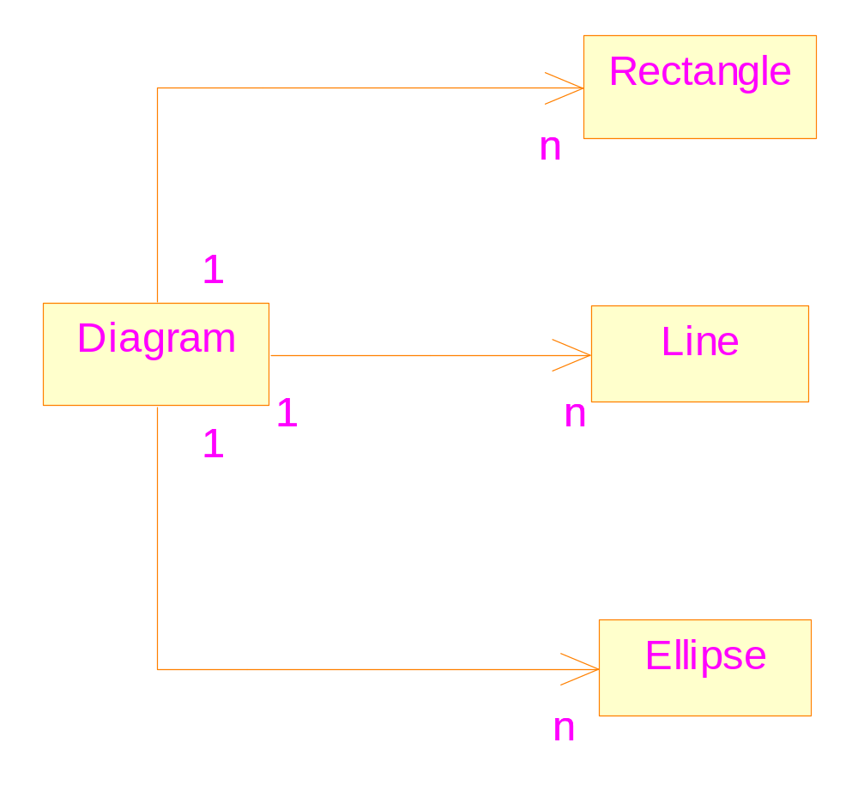
Class Generalization
Direct implementation would lead to redundant Vectors
Notes:
Also,leading to redundant codes: suppose you want to save all information of the
Elements into a file.

Slide 5
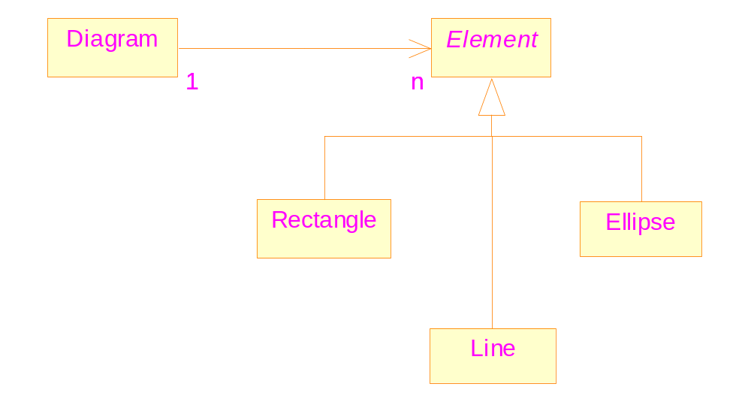
A more reasonable design
Common
Features
Does not introduce new relationship between objects

Slide 6
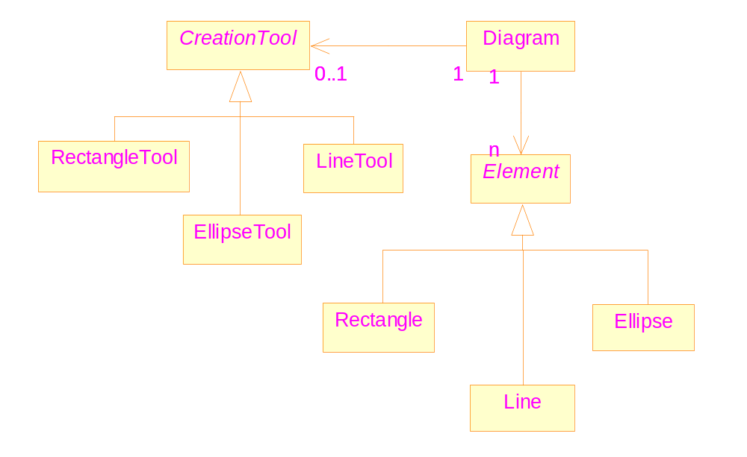
Similar for Creation Tools

Slide 7
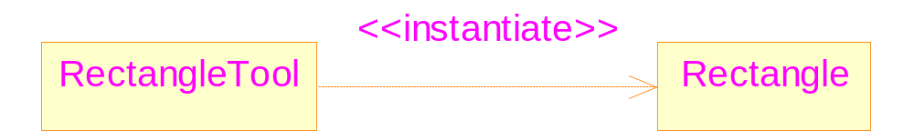
The instantiate relationship
Consider the relationship between RectangleTool and Rectangle
The associate relationship is not applicable, since the connection is not permanent
The instantiate relationship
Notes:
The relationship is temporary; indicates a “create” operation

Slide 8
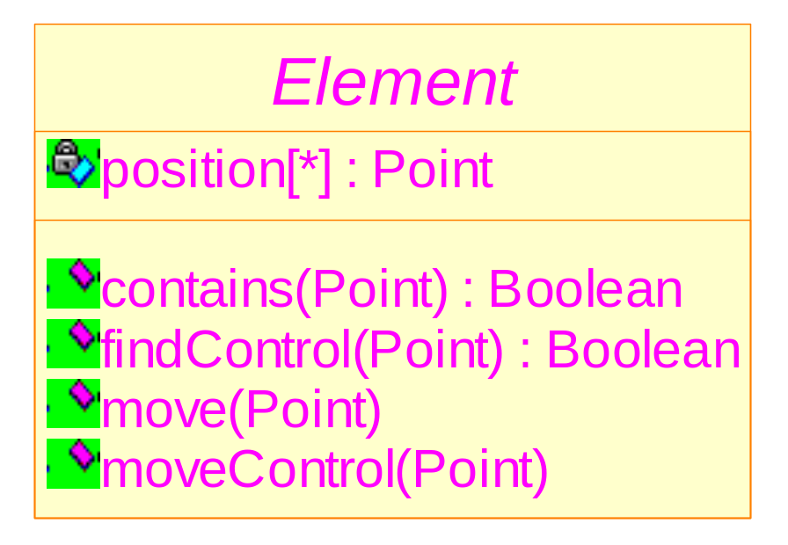
Attributes and Operations
Variable number of data elements.
Format of operations.

Slide 9
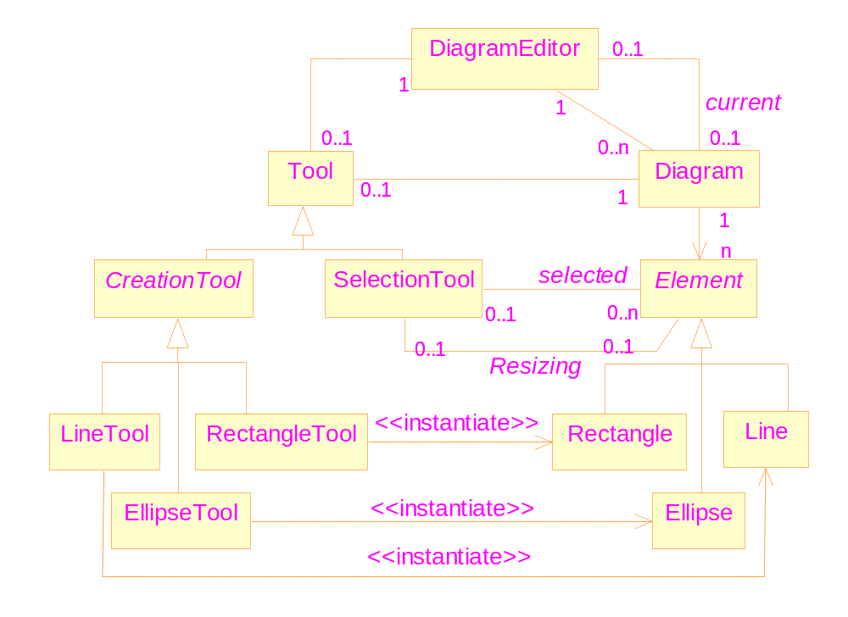
The complete class diagram
Diagram Editor Demo
Notes:
Detail of the quiz: according to numbers of multiplicity, explain the design intention.

Slide 10
Multiplicity
Definition: the number of times a given entity can occur in some context.
Notation: number ranages
  E.g., 0..9
  * ➔ infinity
  Abbreviation, e.g., 1..1 ➔ 1
  Could be a list, e.g., 0, 3..*

Slide 11
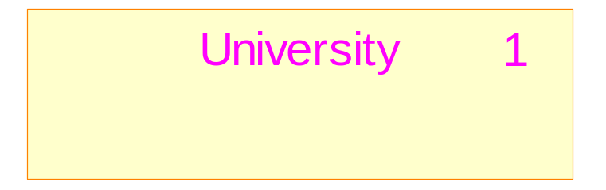
Class multiplicity
Definition: the number of instances of the class that can exist.
The relationship of “instance of” is rarely shown.
Default: 0..*
Notation for singleton class

Slide 12
Attributes of classes
Attributes format
  In the early stages: name
  Common format: name: type
  Complete format: name: type = default_value
Other classes should not be used as the attribute types ➔ association
Instance scope
Class scope: underlined
Multiplicity of attributes

Slide 13
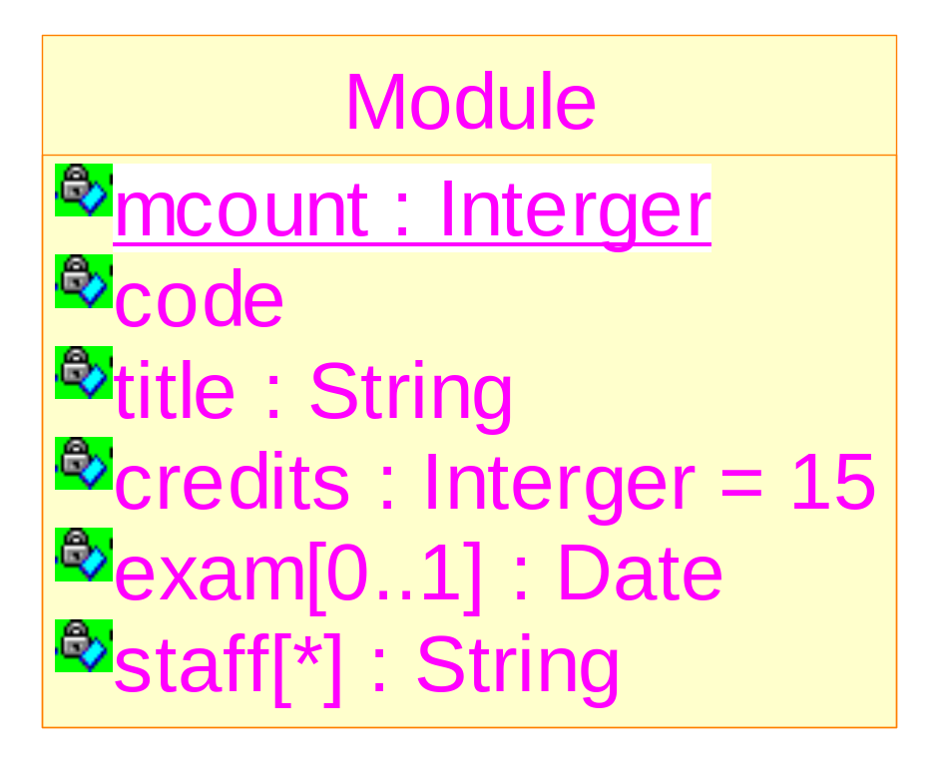
An example of class attributes

Slide 14
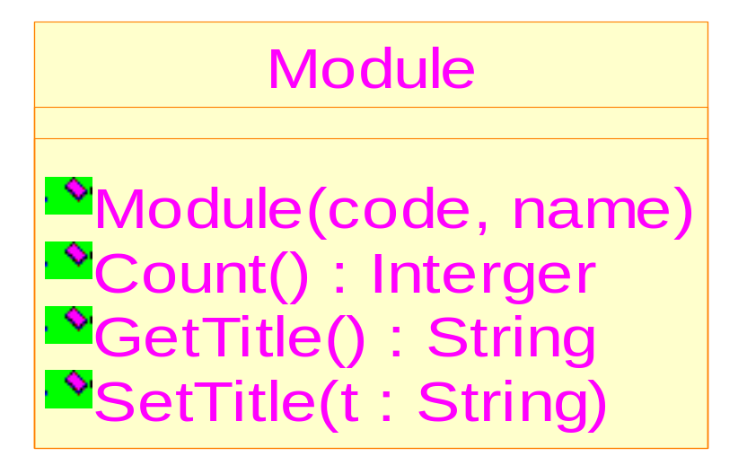
Operations of classes
Format:
  name(p:parameter_type,…): return_type
  The types are optional
Instance scope and class scope

Slide 15
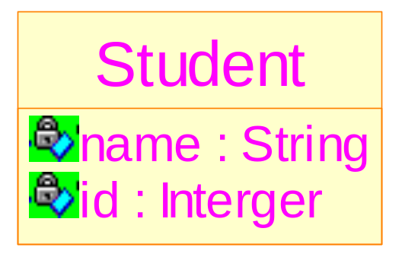
Object identity
It is an intrinsic feature of objects
Even two objects have the same set of values for all attributes, they have two different identity
It is different from the identifying attribute of a class

Slide 16
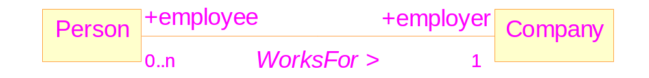
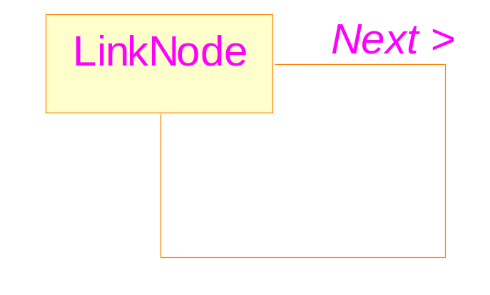
Associations
Associations, role names, multiplicity
Self-associations

Slide 17
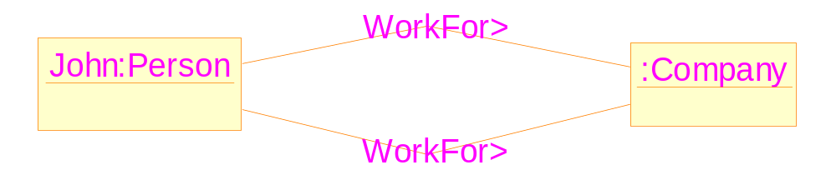
Links do not have identity
The problem: John is employed as a lecture and a bar attendant by a company
An illegal diagram in UML

Slide 18
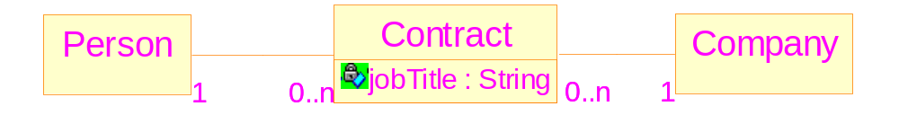
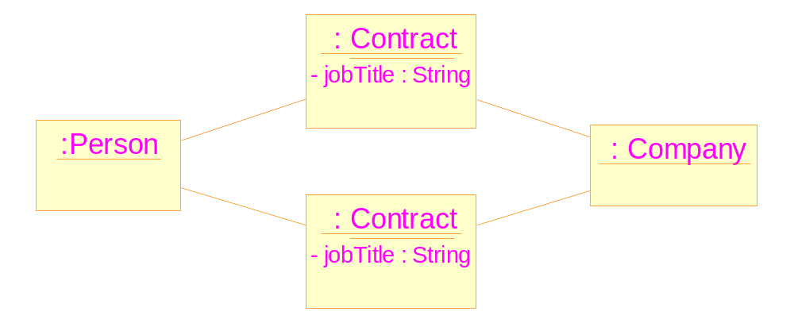
Possible solution

Slide 19
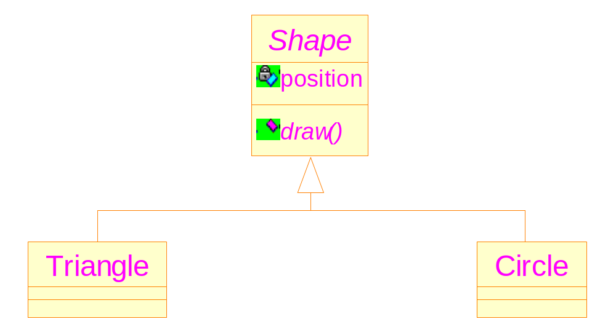
Generalization and specialization
Super-classes (ancestors)
Subclasses (descendants)
Generalization/specialization
Abstract classes
Notes:
在较老的UML版本中有Abstract operations，较新版本删除了它。

Slide 20
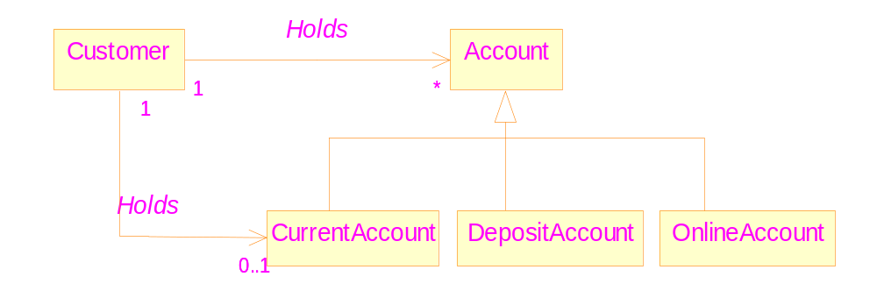
Association Generalization
An example: a customer can hold at most one Current Account.
Notes:
If without the generalization: (1) two associations have the same name. (2) There are two paths from the Customer class to the CurrentAccount class. Thus, a customer may holds two current accounts, according to the diagram.

Slide 21
Aggregation
Is just a kind of association
  Most often it is used to describe part/whole relationship.
Properties when objects are linked to instances of their own class.
  Anti-symmetry: no self-connection
  Transitivity: if A is a part of B, and B is a part of C, then A is also a part of C.

Slide 22
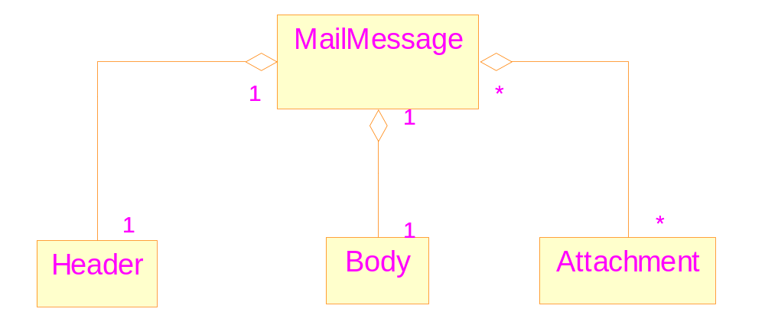
A “normal” aggregation relationship
Notes:
Put a diamond in the “whole” end.

Slide 23
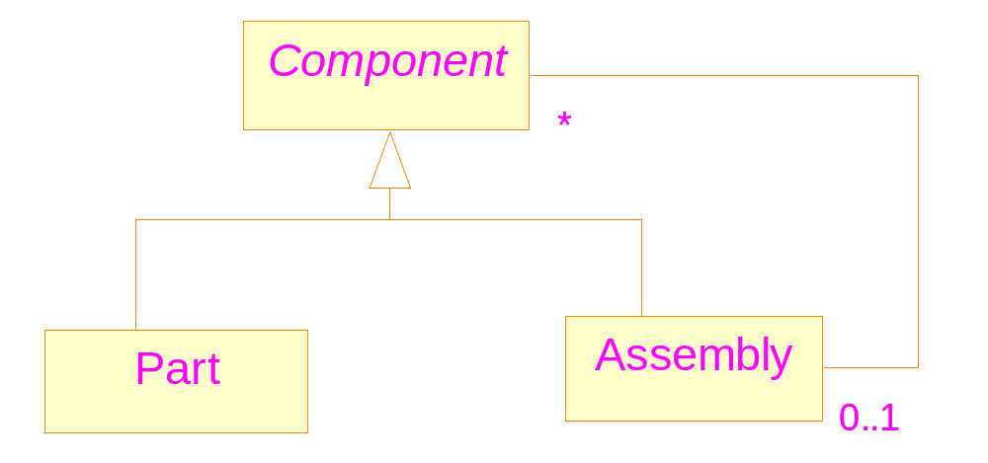
If without aggregation

Slide 24
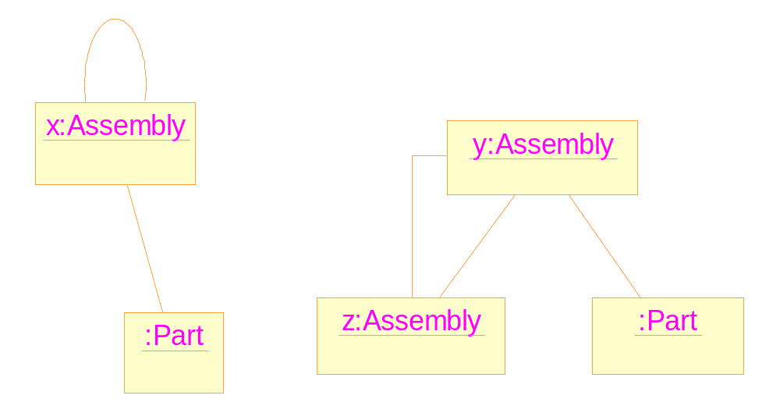
…leading to meaningless object diagrams
Cyclical object structures

Slide 25

Solve the problem with aggregation
The two cyclical structures can be ruled out

Slide 26
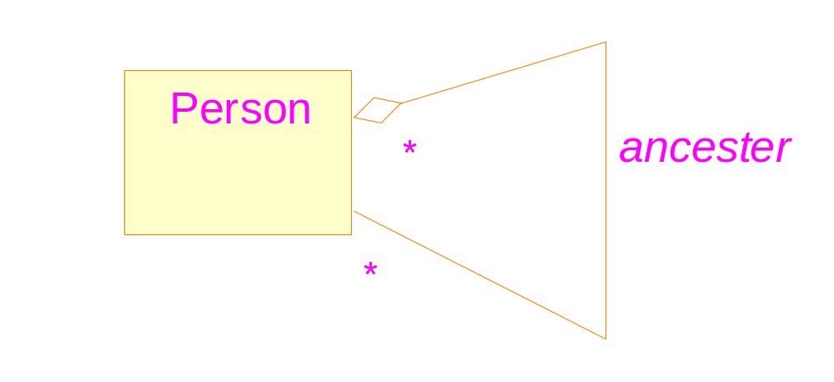
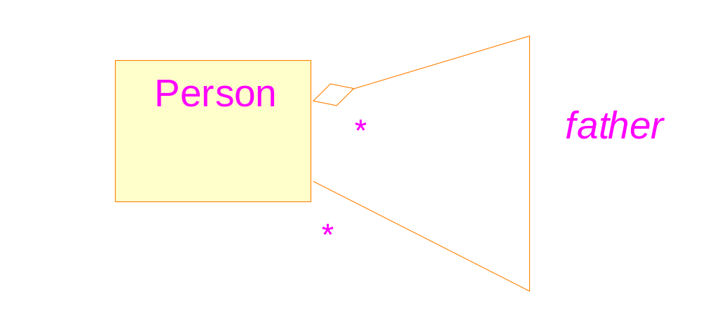
Aggregation: not necessarily be part/whole relationship
correct
Two properties must be observed
wrong

Slide 27
Composite objects
Composite: a strong form of association
  A “part” can only belong to one composite object
  When a composite object is destroyed, all its dependent parts must be destroyed at the same time
  UML notation: solid(black-color filled) diamonds

Slide 28
An example of composition

Slide 29
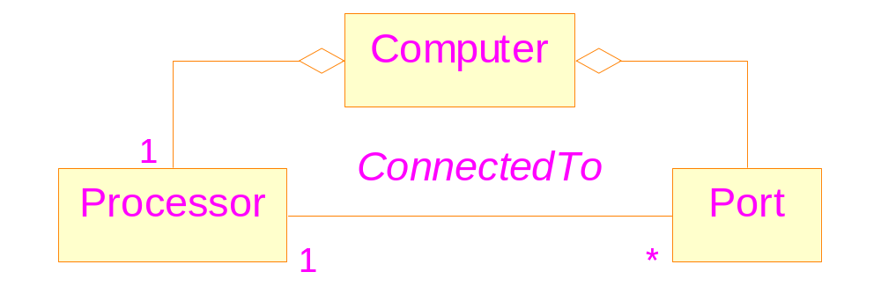
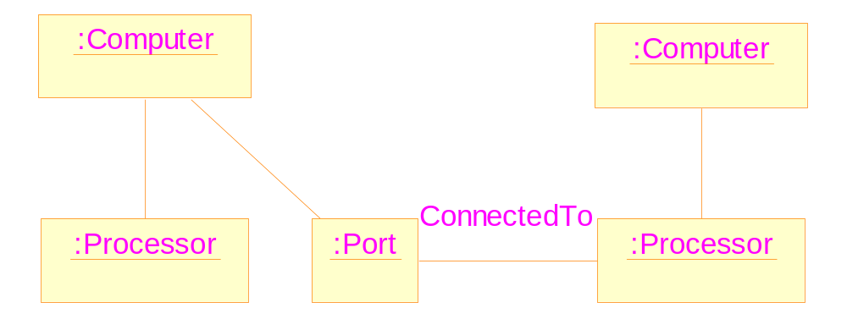
A situation where composition is not applicable
Structure of
a computer

Slide 30
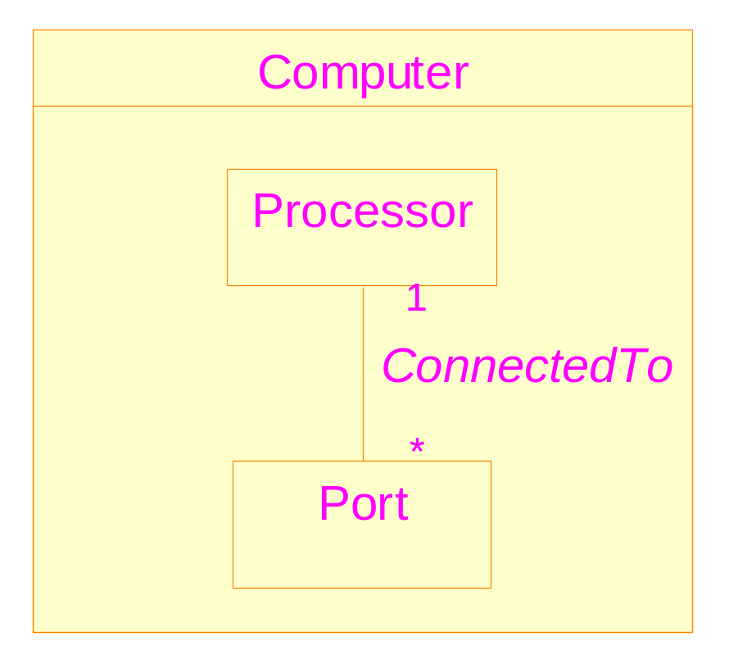
Another way to express the composition relationship
Associations inside a composite object can only link
objects which are part of the same composite

Slide 31
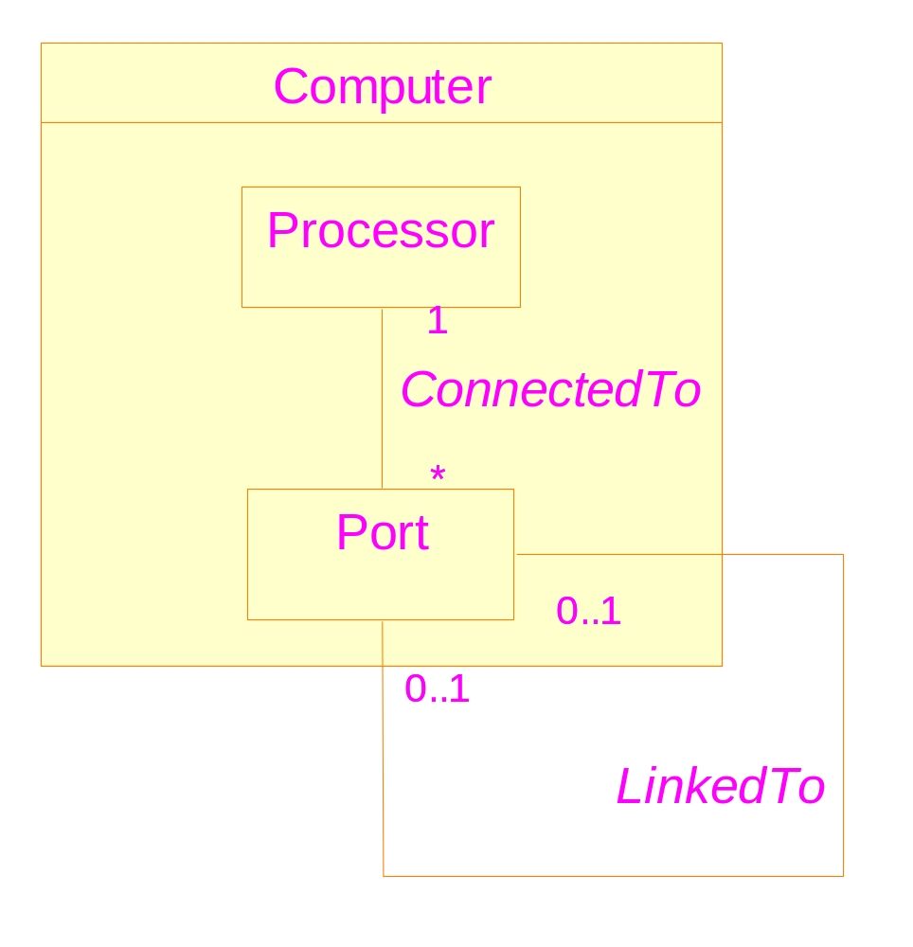
To model a computer network

Slide 32
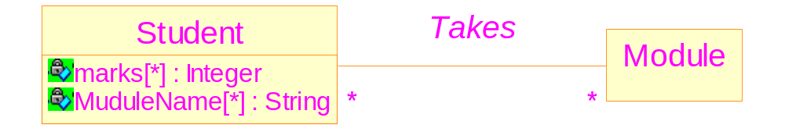
Association classes: the problem
The problem: to record all the marks gained by students on all the modules that they are taking
Drawbacks:
  The marks attribute is not intrinsic for Student

Slide 33
Association classes
Associating data values with links
UML notation: a dashed line to a link
Applicability: to model attributes which are not intrinsic to the linked classes, but intrinsic to the link itself.

Slide 34
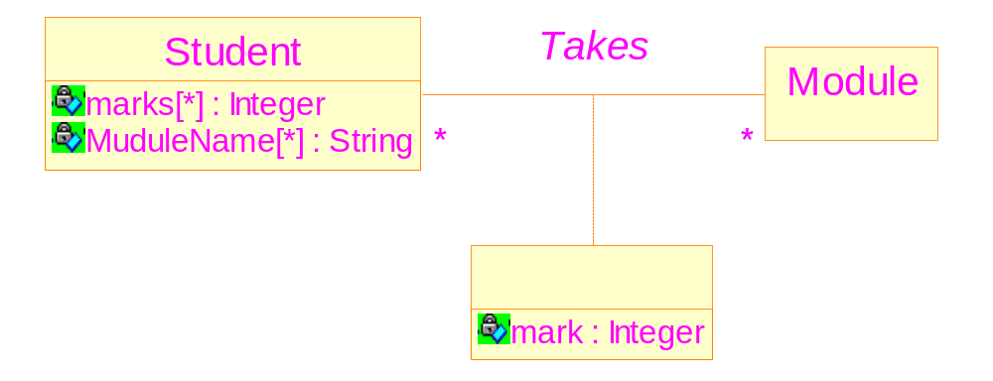
UML notation for association classes

Slide 35
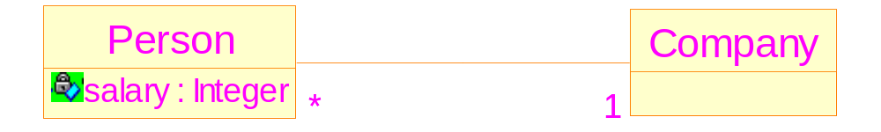
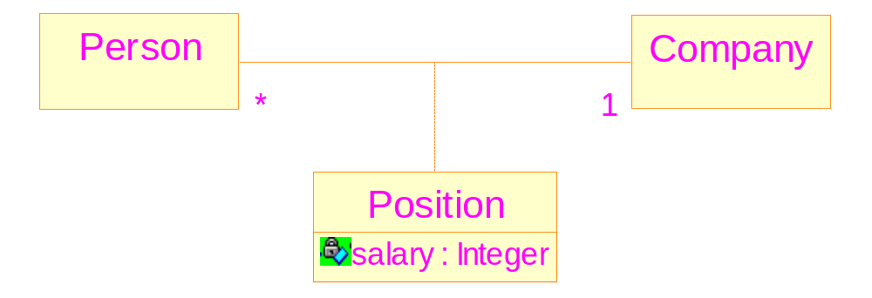
Another example of using association class
Not preferred
More accurate

Slide 36
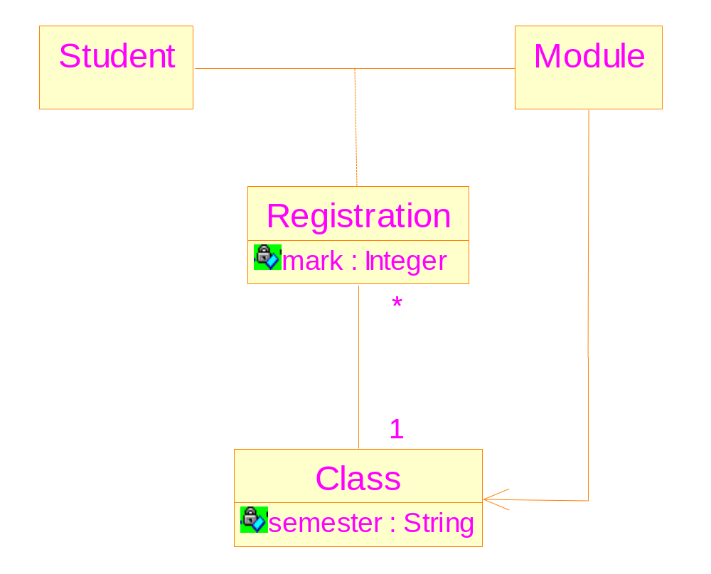
An association class can have associations with other classes

