Slide 1
Outline
Introduction
Description of a pattern
Roles of design pattern
A case study: designing a document editor
Composite pattern (document data)
Strategy pattern (document formatting)
Decorator pattern (interface elements)

Slide 2
The concept of design pattern
“Each pattern describes a problem which occurs over and over again in our environment, and then describes the core of the solution to that problem, in such a way that you can use this solution a million times over, without ever doing it the same way twice”

Slide 3

++
--
==
!=
*
stack::
iterator
stack
Sort( )
vector::
iterator
vector
map::
iterator
map
Common interface

Slide 4
#include <iostream>
#include <vector>
#include <list>
#include <math.h>
using namespace std;
template <class Container>
void Display_Container(Container c)
{
Container::iterator it;
for (it=c.begin(); it!=c.end(); it++)
cout << *it << " ";
cout << endl;
}

Slide 5
template <class Container>
void Sort(Container & c)
{ Container::iterator it1, it2;
Container::value_type temp;
for (it1=c.begin(); it1!=c.end(); it1++) {
for (it2=it1; it2!=c.end(); it2++) {
if ( *it1 > *it2 ) {
temp = *it1;
*it1 = *it2;
*it2 = temp;
}
}
}
}

Slide 6
int main()
{ vector <int> v;
list <double> l;
for (int i=10; i>=0; i--) {
v.push_back(i);
l.push_back( sin(i*3.14) );
}
Display_Container(v); Display_Container(l);
Sort( v ); Sort( l );
Display_Container(v); Display_Container(l);
return 0;
}

Slide 7
Description of a pattern
Pattern name (singleton)
The problem
  Not the basic data structures, nor the entire system
  Not domain specific
The solution
The consequence ( discussion)
  Space and time trade-offs
  Language and implementation issues
  Impact on a system’s flexibility, extensibility, and portability.

Slide 8
Roles design patterns play
Application programs
  Use design patterns to reduce the class dependencies, platform dependencies, etc.
Toolkit
  Use design pattern for code reuse
  For example: containers, iterators and algorithms in C++ STL.
Frameworks
  Emphasize design reuse
  Use of patterns in a framework makes learning the usage of the framework easier

Slide 9
When not to use design patterns
Drawbacks of using design patterns
  Complicate the design
  Degrade the performance of the system, in terms of space and time requirements.
Only use design patterns if you want:
  Flexibility
  Extensibility
  portability

Slide 10
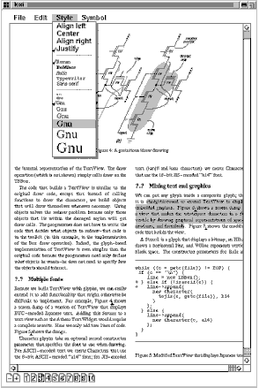
A case study: designing a document editor

Slide 11
Design problems
A WYSIWYG document editor
Design problems
  Document structure
  Formatting
  Embellishing the user interface
  Multiple look-and-feel standards
  User Operations
  Spelling checking and hyphenation

Slide 12
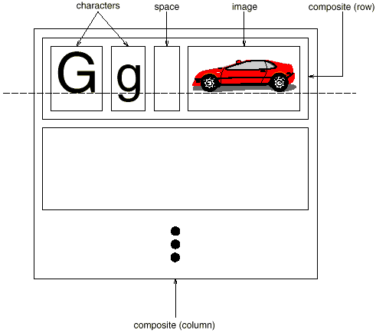
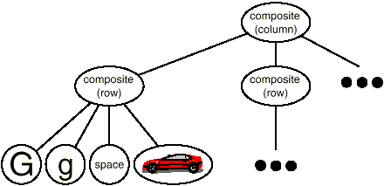
Document structure
The document has a tree-like structure

Slide 13
Features
A substructure may contain other substructures (recursive).
Text and graphics are treated uniformly.
  A figure can be embedded into a line of text
  Characters can be embedded into a figure
Single element and a group of elements are treated uniformly (move, set font, etc).

Slide 14

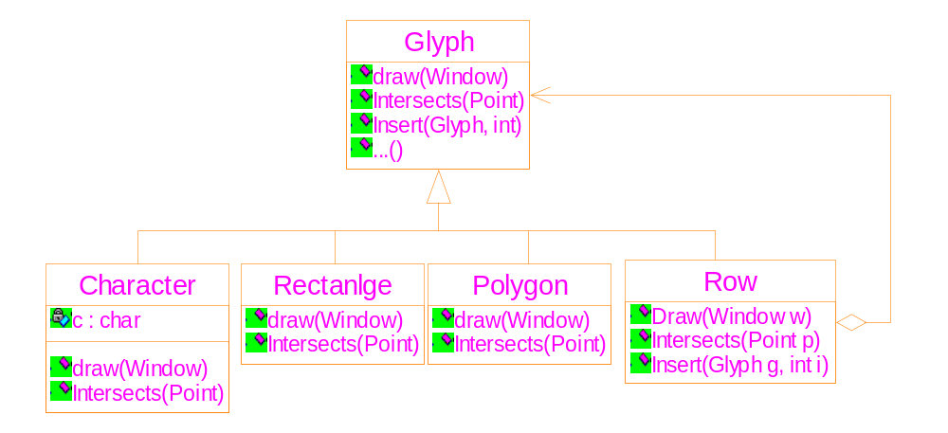
1. The abstract class: a common interface
2. The aggregation association: describes the tree

Slide 15
The common interface
class Glyph {
public:
virtual void Draw( Window * )=0;
virtual void Bounds( Rect & )=0;
virtual bool Intersects( const Point &)=0;
virtual void Insert(Glyph *, int)=0;
virtual void Remove(Glyph *)=0;
virtual Glyph * Child (int)=0;
virtual Glyph * Parent( )=0;
}

Slide 16
The composite pattern
Applicability
  Part-whole hierarchies
  Single object and composite object are treated uniformly
Structure
Participants
  Component
    common interface
    default behaviors
    accessing and managing its child components
    Accessing a component’s parent

Slide 17
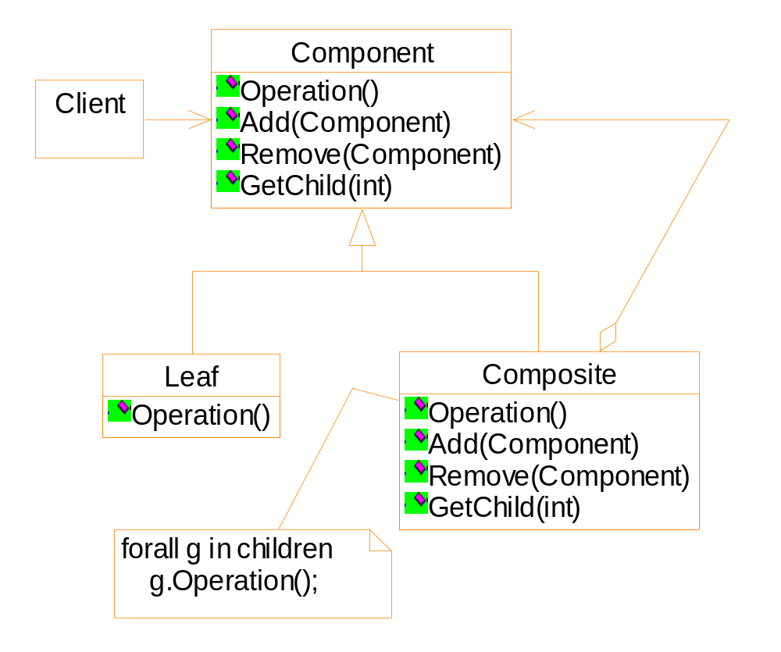
1. The abstract class: a common interface
2. The aggregation association: describes the tree

Slide 18
Composite pattern
Collaborations:
  The composite object iteratively call the leaf’s operation
Consequences:
  Extensibility: it is easier to add new kinds of components
  Disadvantage: it is hard to constraint the composite objects such that they can only include certain kinds of components.

Slide 19
Exercise
Suppose there is a programming language that contains only three kinds of statements:
  Assignment: Identifier_A = Identifier_B;
  If statement: If (Identifier_A == Identifier_B ) { statement1; statement2; … };
  If-else statement:
  If ( Identifier_A == Identifier_B ) {
  statement1; statement2; … }
  else {
  statement3; statement4; … }
  }

Slide 20
Exercise
Write a formatting program, which takes a program of the previous language as input, and formats it such that:
  A new-line character occurs only after a complete statement, or the ‘{‘ character;
  Statements of the if or if-else statements are indented by 4 characters
  See the sample code below.

Slide 21
A = B ;
if ( C == D ) {
E = F ;
if ( G == H ) {
tmp1 = tmp2 ;
tmp3 = tmp4 ;
}
else {
var5 = var6 ;
}
A = 100 ;
}
B = 200 ;

Slide 22
Exercise
Requirements
  Draw the class diagram
  What operations should be defined in the root class?
  Suppose the do-while statement is appended into the programming language, how to revise your class diagram and your implementation?
  How to apply the following constraint: the if-else statement can not appear within a do-while statement?

Slide 23
/* The test program */
A = B ;
if ( C == D ) { E = F ;
if ( G == H ) {
tmp1 = tmp2 ; tmp3 = tmp4 ;
}
else {
var5 = var6 ; } A = 100 ;
}
B = 200 ;

Slide 24
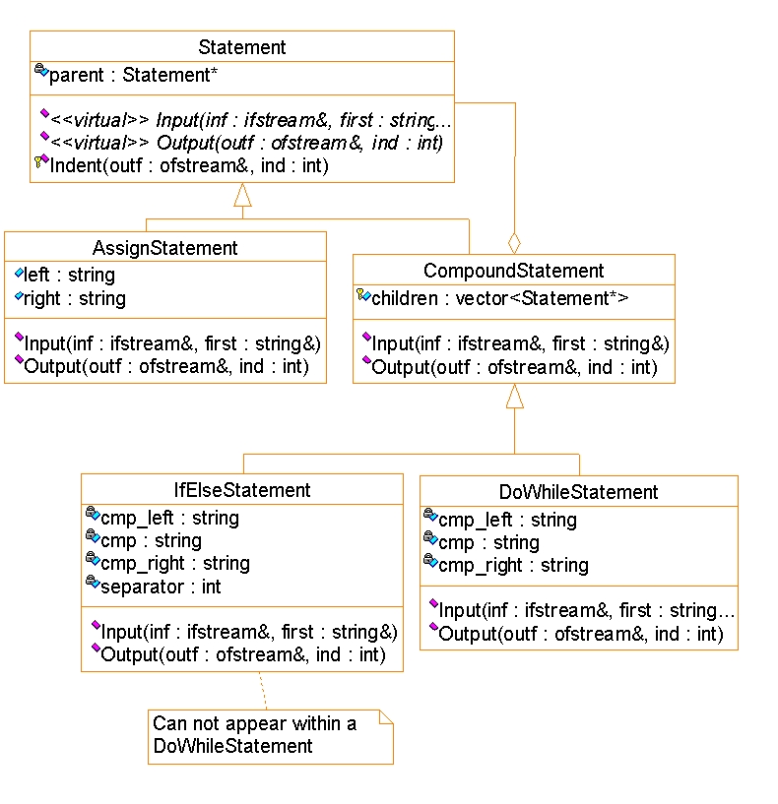

Slide 25
Document Formatting
Restricted definition: break a collection of glyphs into lines.
Trade-off between formatting quality and formatting speed.
➔ different algorithms may be used.
This is also true for the Lyx.
Algorithms should be isolated from the data.
➔ A separate class hierarchy for algorithms

Slide 26
Composition and compositor
Composition
  Initially, it contains the un-formatted objects (characters, figures, etc).
  The formatting algorithms insert structural objects ( Rows, Columns, etc) into it.
Compositor
  Different formatting algorithms are encapsulated into the class
  Interface
    void SetComposition ( Composition* )
    virtual void Compose( )
Notes:
Composition可以理解为作品，compositor可以理解为作者

Slide 27
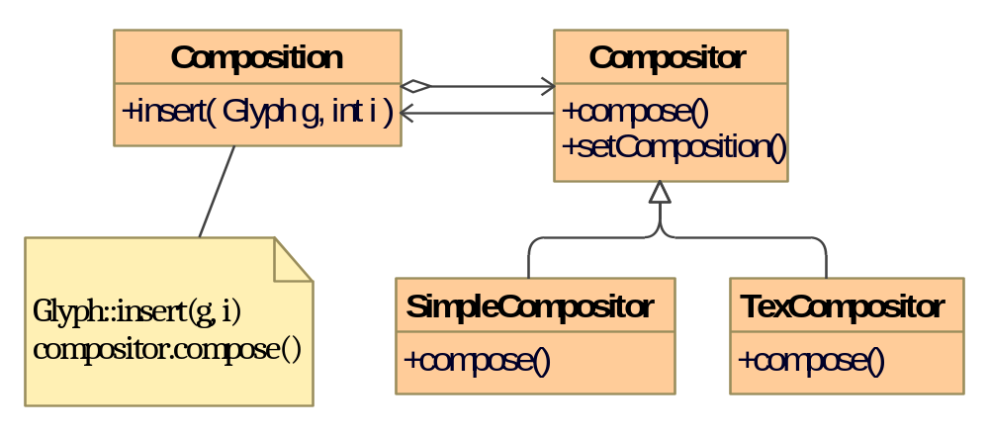

Slide 28
Strategy pattern
Applicability
  You need different variants of an algorithm.
  Some algorithms use data that clients should not know about.
  Essential point: separator the algorithms from the data.
Structure

Slide 29
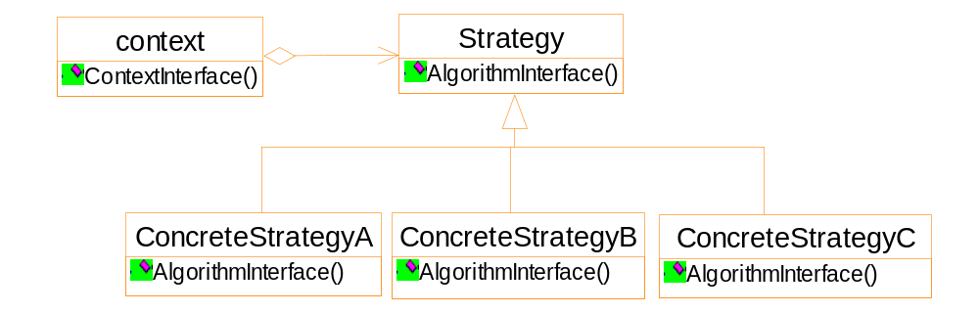
General structure of the strategy pattern

Slide 30
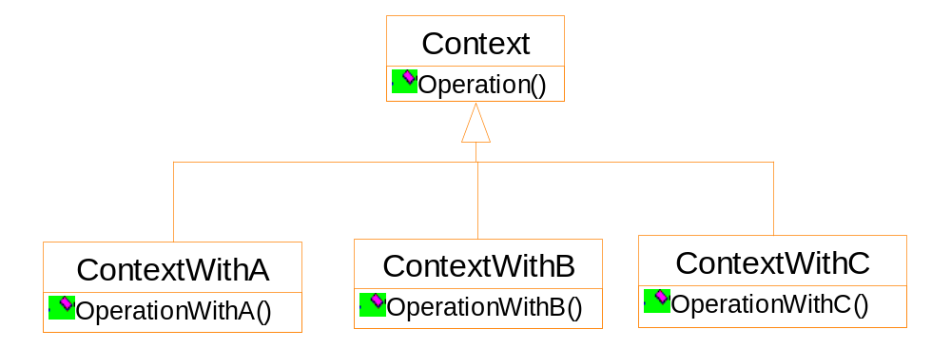
Notes:
Sub-classing the context class can also
implement different algorithms
Drawback: you can not easily change the
algorithms dynamically.

Slide 31
Decorator pattern
Intention
“Attach additional responsibilities to an object dynamically. Decorators provide a flexible alternative to sub-classing for extending functionality.”
It is some individual objects (not an entire class) to which the functionality is extended.
E.g, borders, scrolling bars.

Slide 32
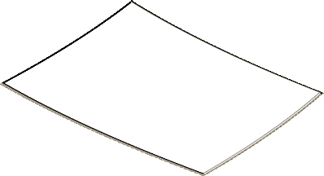
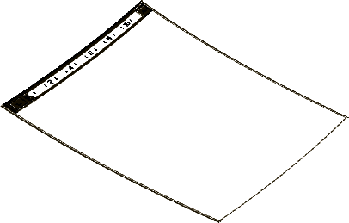
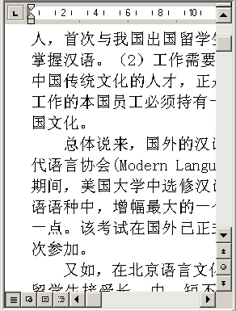
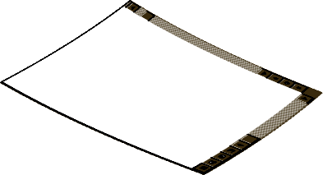
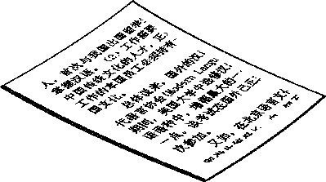
Many user interfaces can be attached to the
text viewer at run-time.

Slide 33
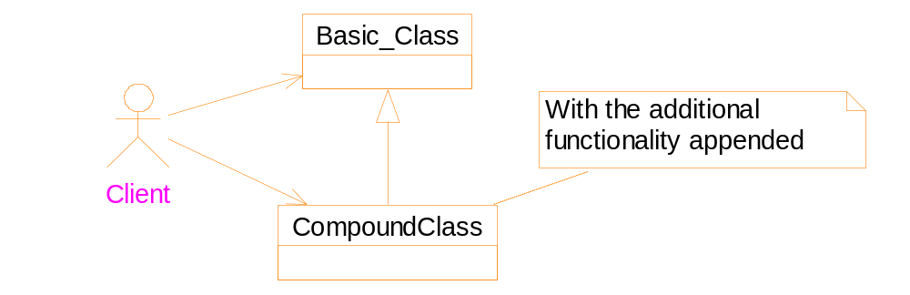
Solutions for appending additional functionalities
-- by class inheritance
Drawbacks:
You can not extend or remove the functionality
at run-time.
2. If there are many decorative functionalities,
number of subclasses will explode.

Slide 34
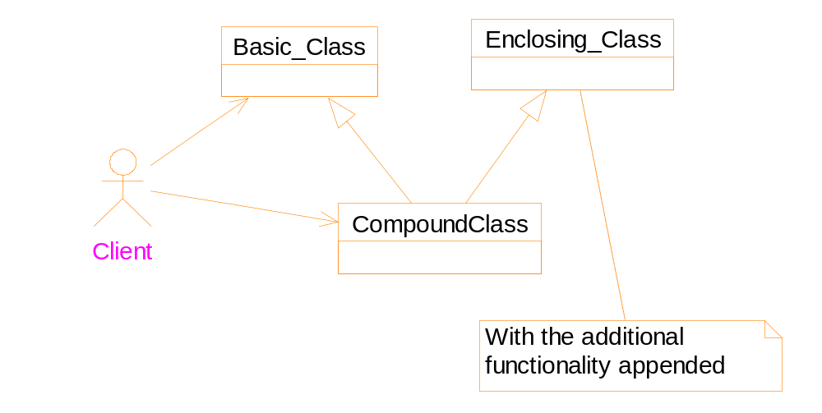
Solutions for appending additional functionalities
-- by mixin class
Drawbacks: similar to that of the solution of
class inheritance

Slide 35
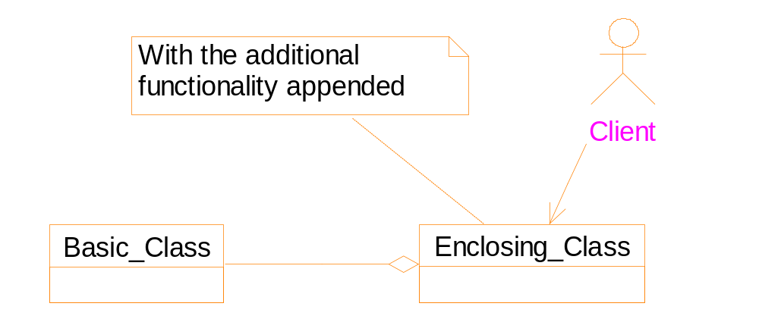
Solutions for appending additional functionalities
-- by class composition (#1)
Drawbacks:
Interface of the two classes are different
Difficult to recursively decorate

Slide 36
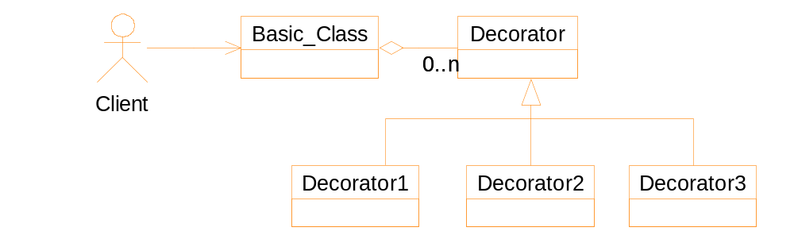
Solutions for appending additional functionalities
-- by class composition (#2)
Drawbacks: the Basic_class must take care
of the interface elements

Slide 37
Decorator pattern
The basic class is enclosed by a decorator class
The decorator class conforms to the interface of the basic class.
Implementation of the interface:
  Forwards requests to the basic class
  Perform any additional actions before or after the forwarding
Consequence: decorators can be nested recursively.

Slide 38
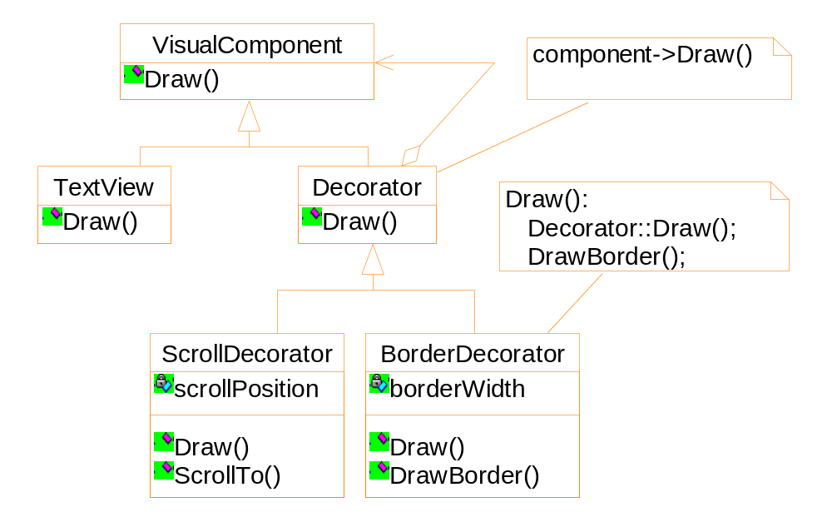
Application of the decorator pattern to the example

Slide 39
aBorderDecorator
component
aScrollDecorator
component
aTextView
An example: object diagram

Slide 40



Decorator 2
Decorator 1
Kernel

Slide 41
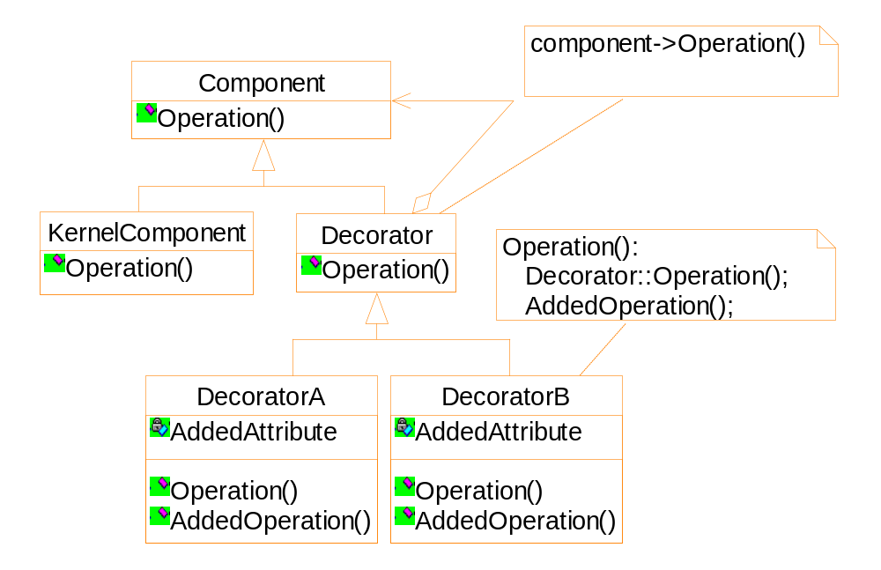
General structure of the decorator pattern

Slide 42
Applicability
To add or remove responsibilities at run-time
The component class does not have to know anything about its decorators.
Comparison between decorator pattern and composite pattern
  Decorator pattern is a degenerate composite pattern
  Intentions are different
    Decorator: for adding additional functionalities
    Composite: for object aggregation

Slide 43
Implementation
Keeping the component class lightweight
Otherwise, the decorators will be too heavyweight to use

Slide 44
An example
I/O stream class
  Basic functionality: convert objects into bytes to store into a file or a memory block.
  Additional functionalities:
    Data compression
    Convert to 7-bit ASCII characters

Slide 45
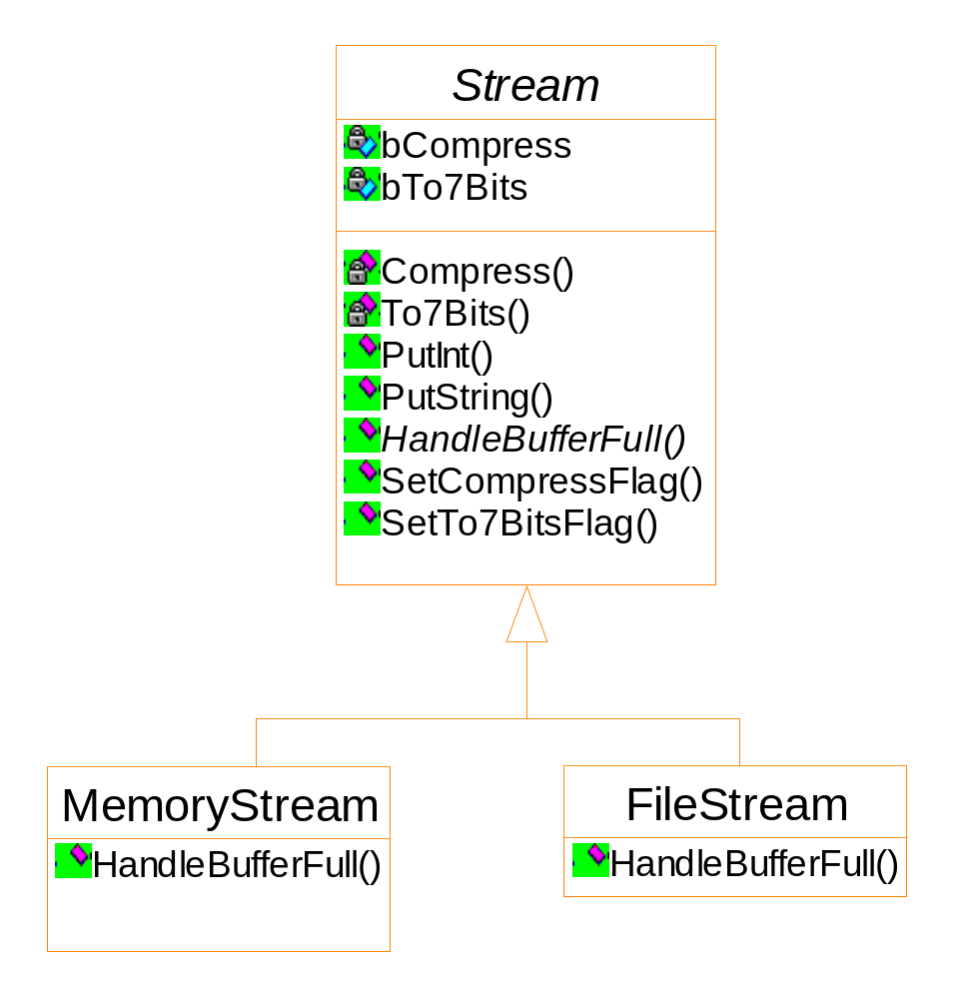
Solution 1: using flags ➔ Fat root class
Notes:
Drawback: All objects of Stream have the attributes “bCompress”, “bTo7Bits”, and
the operations specific to the data compression and data conversion, even what
you want is a pure MemoryStream object, which does not have the additional
functionalities and attributes.

Slide 46
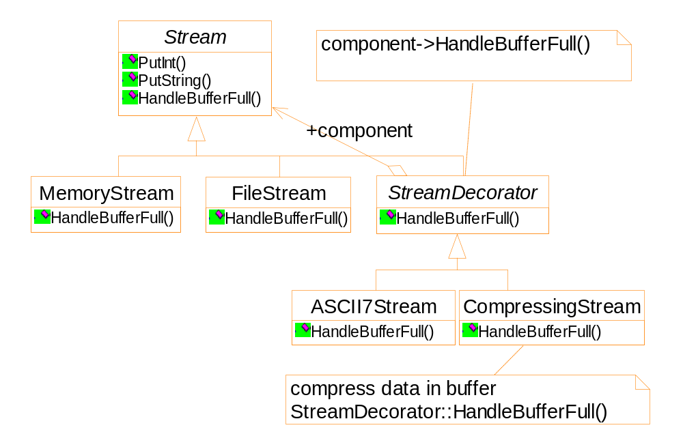
Solution 2:using decorator pattern

Slide 47
Code segments to use the decorator pattern
Stream * fStream = new FileStream("test.cpp");
Stream * mStream = new MemoryStream();
Stream * fcStream = new CompressingStream(
new FileStream("test.cpp") );
Stream * f7Stream = new ASCII7Stream ( new FileStream("test.cpp") );
Stream * fc7Stream = new CompressingStream(
new ASCII7Stream ( new FileStream("test.cpp") ));
fc7Stream->PutInt(12);
fc7Stream->PutString("hello");

Slide 48
A Java example
import java.io.*;
import java.util.zip.*;
public class GZIPCompress {
public static void main ( String [ ] args )
throws IOException {
BufferedReader in =
new BufferedReader (
new FileReader( args[0] ) );

Slide 49
BufferedOutputStream out =
new BufferedOutputStream (
new GZIPOutputStream (
new FileOutputStream(args[1] ) ));
System.out.println("Compressing file...");
int c;
while ( (c = in.read()) != -1 )
out.write(c);
in.close();
out.close();

Slide 50
System.out.println("Verifying file...");
BufferedReader in2 =
new BufferedReader (
new InputStreamReader (
new GZIPInputStream (
new FileInputStream( args[1] ) )));
String s;
while ( (s = in2.readLine()) != null )
System.out.println(s);
}
}

