Slide 1
The Command Pattern
Menu:New
Delete
…
Create a new dialog.
Delete an element
Open a dialog.
Print a dialog.
Copy to clipboard
Paste from clipboard
…
Button:
…
keyboard: Delete
…
User interface
Operations

Slide 2
Requirements
Multiple widgets can be mapped onto the same operation
We do not want the close coupling between the classes that implement the operations and the interface classes.
We want to support the Undo/Redo functionality

Slide 3
MFC solution
MFC solved the first two requirements by the message mapping mechanism
  How to implement the undo/redo?
  Operation ⇔ Function coupling can not solve the problem!
We abstract the concept that varies to form a class.

Slide 4
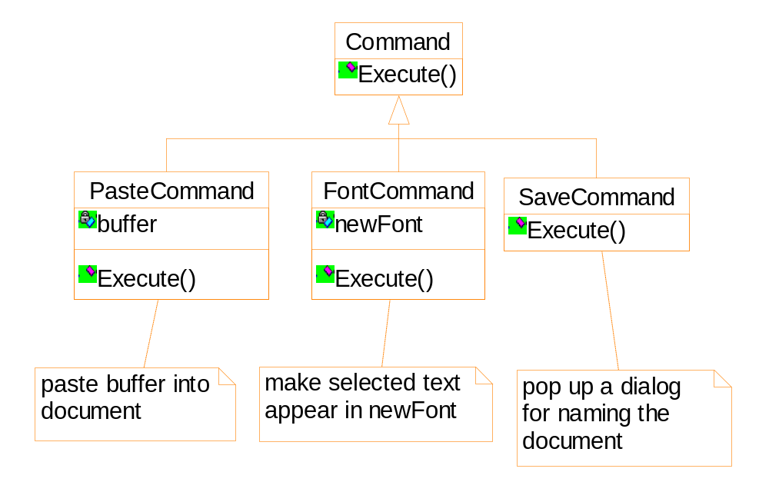
Operation details of the commands are recorded

Slide 5
Undo
Undo information must also be stored
  E.g. changing font of the selected text
  range of the text
  original font(s) of the text
  E.g. deleting the selected objects
  Information of all the objects should be stored!
Undoability
  Meaningless commands should not be undone
  Whether a command is meaningless should be determined at run-time
  Add Command::Reversible
Notes:
Whether a command is meaningless should be determined at run-time:
You change the selected text to “Times New Roman, 12 point”.
If the selected text is already in that form, the command can not be undone.
Otherwise, the command is undoable.

Slide 6
Command history
Unexecute()
past
present

Slide 7
Command history
Unexecute()
past
present

Slide 8
Command history
Execute()
past
present

Slide 9
Command history
new command
past
present

Slide 10
Command history
past
present

Slide 11
Applicability
Support undo
Support context-sensitive menus
Support command macros
Support logging changes to recover a crashed system
Support the concept of transaction in an information system

Slide 12
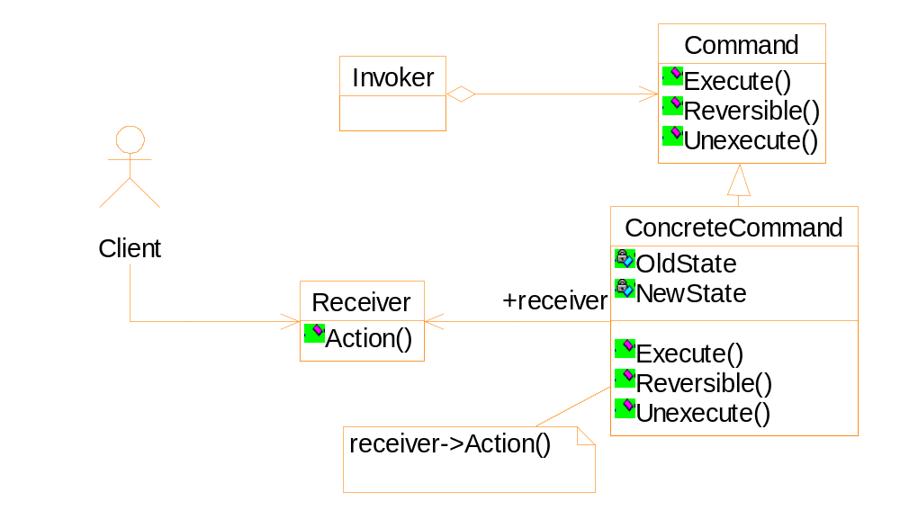
Structure of the Command pattern

