Slide 1
Overview
Decorator pattern (interface)
Command pattern (document editing)

Slide 2
Outline
Abstract factory pattern
  The pattern
  Implementation(singleton,make)
Iterator & visitor pattern
  Iterator
  Proxy pattern
  Pre-order traversing

Slide 3
Abstract Factory Pattern
Motivation
some application need to change their interface style at run-time
First step
  Abstract widget classes
  Concrete sub-classes

Slide 4

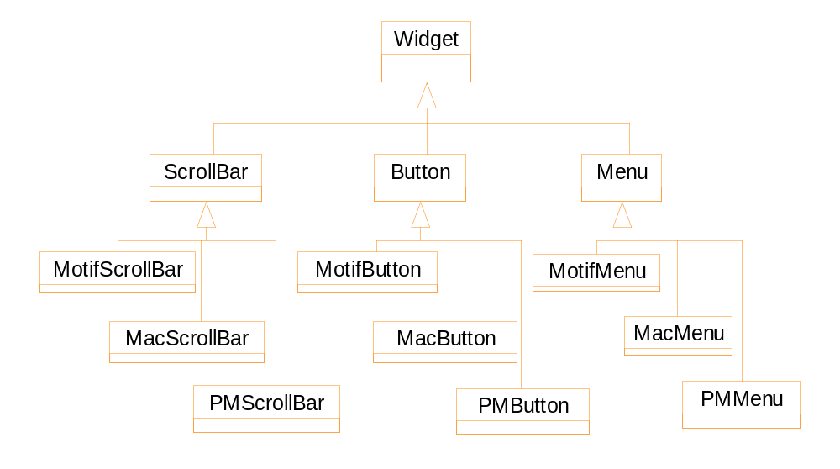
Abstract widget classes & their subclasses

Slide 5
Create objects directly
switch (Style) {
case Motif:
ScrollBar * sb = new MotifScrollBar;
Button * bn = new MotifButton;
Menu * mn = new MotifMenu; break;
case Mac:
ScrollBar * sb = new MacScrollBar;
Button * bn = new MacButton;
Menu * mn = new MacMenu; break;
case PM:
ScrollBar * sb = new PMScrollBar;
Button * bn = new PMButton;
Menu * mn = new PMMenu; break;
}

Slide 6
Problems of the previous solution
Lengthy: each time we create some widgets, we must use a switch statement
May cause problems: you create a Mac-style button, but the current style is Motif.
Difficult to switch styles: how to track the old widgets to destroy them?

Slide 7
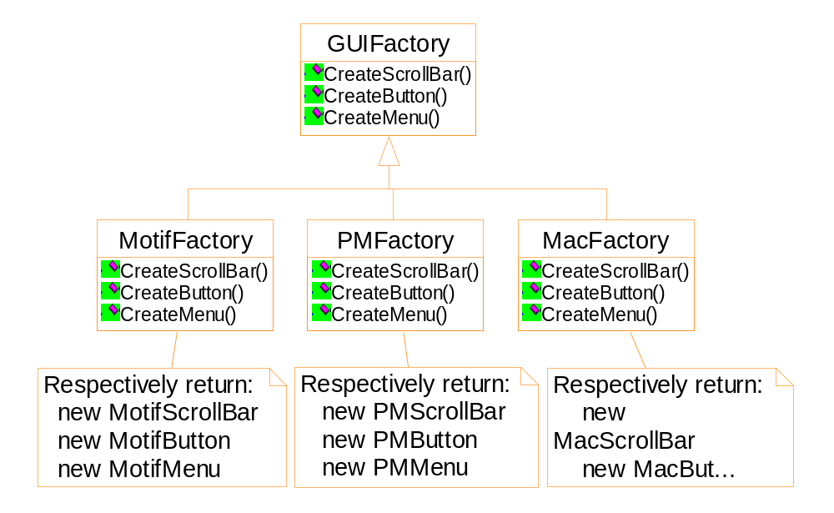
Factory classes and their products

Slide 8
Create objects from an abstract factory
switch (Style) {
case Motif:
guiFactory = new MotifFactory( ); break;
case Mac:
guiFactory = new MacFactory( ); break;
case PM:
guiFactory = new PMFactory( ); break;
}
ScrollBar * sb = guiFactory->CreateScrollBar( );
Button * bn = guiFactory->CreateButton( );
Menu * mn = guiFactory->CreateMenu( );

Slide 9
Implementation
Factory: as a singleton
Defining extensible factories
  Suppose we want append a widget “ListBox” to the previous Factory
  Solution 1: change the interface of the Factory class.
  Solution 2: define a single operation “Make” to produce all products.

Slide 10
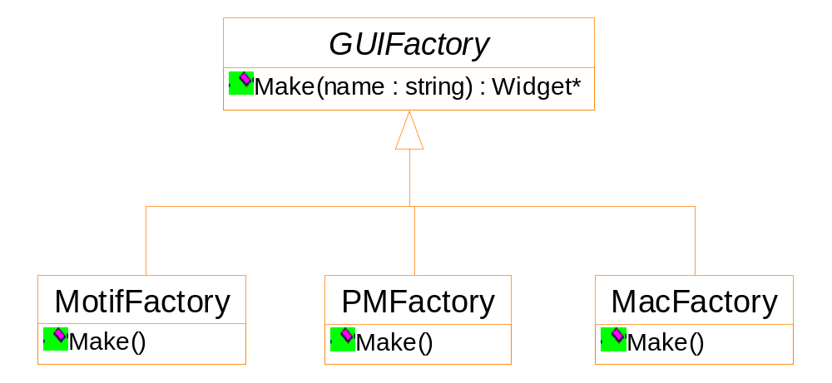
Make the Factory class extensible

Slide 11
To append a new type of widget
Widget * MotifFactory::Make(string name)
{
if ( name == "ScrollBar" ) return new MotifScrollBar();
// other widgets ...
// to append a new widget
if ( name == "ListBox" ) return new MotifListBox();
}
//...
ScrollBar * sb = dynamic_cast<ScrollBar*> (guiFactory->Make("ScrollBar") );
ListBox * lb = dynamic_cast<ListBox*> (guiFactory->Make(“ListBox”);

Slide 12
Iterator & visitor pattern
Lexi: spelling check and hyphenation
  We are only interested in the text of the document
  The text is scattered through out the hierarchy structure
  Different types of glyphs may store their children in different data structures ( array, linked list, etc.)
  Potentially there are many possible textual analysis requirements.

Slide 13
Accessing the information by iterators
For the glyph class
  We do not want to change it to accommodate the traverse/analysis functionality
We want different kinds of traversals
  pre-order, post-order, in-order, etc.
For example: List
  ListIterator
  ReverseListIterator

Slide 14
template <class Item>
class List {
List( long size=DEFAULT_LIST_CAPACITY);
long count() const;
Item & Get( long index) const;
void print();
}
template <class Item>
class Iterator {
public:
virtual void First() = 0;
virtual void Nex() = 0;
virtual bool IsDone() const=0;
virtual Item CurrentItem() const = 0;
protected:
Iterator();
}

Slide 15
template <class Item>
class ListIterator: public Iterator<Item> {
public:
ListIterator (const List<Item> * aList):
_list(aList), _current (0)
{ };
virtual void First() { _current = 0; }
virtual void Next() { _current ++; }
virtual bool IsDone() const {
return _current >= _list->Count();
}
virtual Item CurrentItem() const {
if (IsDone () ) throw IteratorOutOfBounds;
return _list->Get( _current );
}

Slide 16
private:
const List<Item> * _list;
long _current;
}
void PrintEmployees(ListIterator<Employee*>&i)
{
for (i.First(); !i.IsDone(); i.Next() ) {
i.CurrentItem()->Print();
}
}
List<Employee*> * employees;
ListIterator<Employee*> forward( employees );
ReverseListIterator<Employee*>
backward( employees);
PrintEmployees( forward );
PrintEmployees( backward );

Slide 17
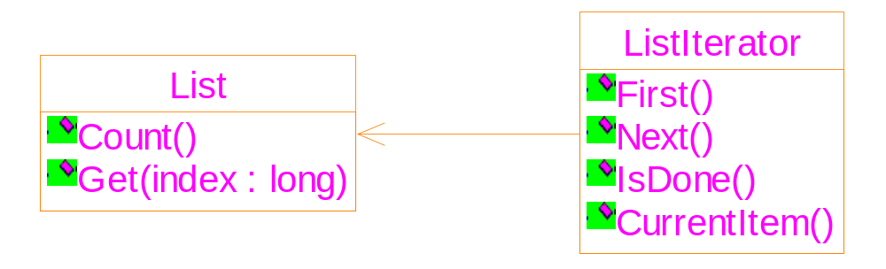
Container and iterator are closely coupled
void PrintEmployees(ListIterator<Employee*>& i)

Slide 18
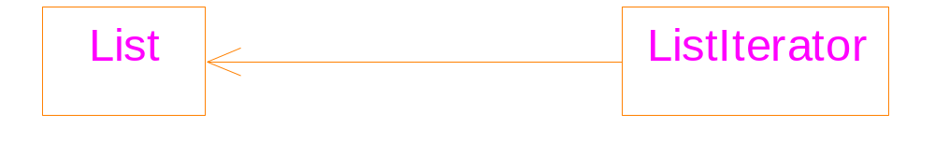
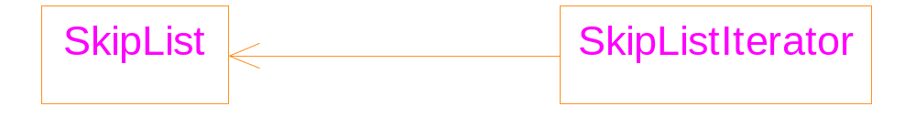
Independent iterators
void PrintEmployees(ListIterator<Employee*>& i)
void PrintEmployees(SkipListIterator<Employee*>& i)
Or function template

Slide 19
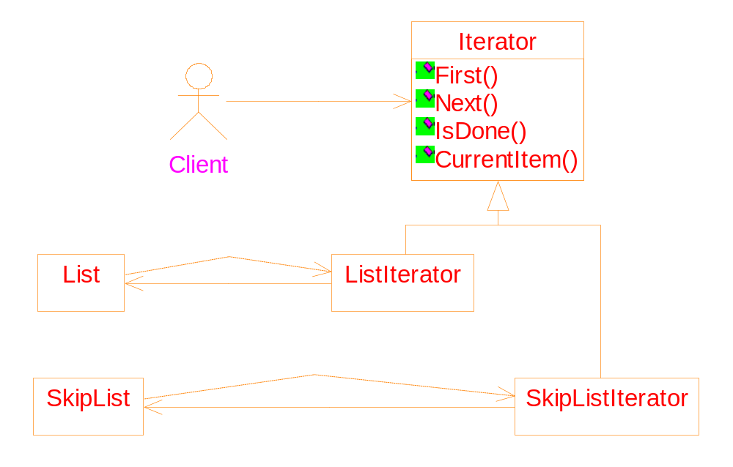
Iterators with common ancestor
void PrintEmployees(Iterator<Employee*>& i)

Slide 20
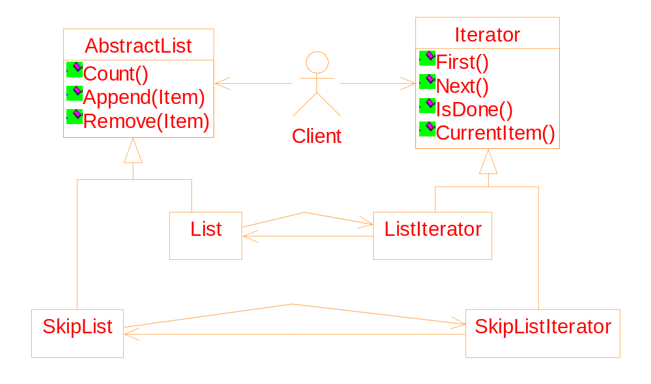
Let lists also have a common ancestor
Write code that works for both List and SkipList

Slide 21
Suppose we want that an item can be inserted into a list only when the list does not contain any item which is identical to the item.
// pseudo-code
void ConditionalInsert(AbstractList * list, Item I)
{
Create an iterator it for the list;
for ( it->First(); ! it->IsDone; it->Next() )
if ( it->CurrentItem == I ) break;
if ( ! it->IsDone() )
return ; // the item already exist.
list->Append( I );
}

Slide 22
How can we
do it?
// pseudo-code
void ConditionalInsert(AbstractList * list, Item I)
{
Create an iterator it for the list;
for ( it->First(); ! it->IsDone; it->Next() )
if ( it->CurrentItem == I ) break;
if ( ! it->IsDone )
return ; // the item already exist.
list->Append( I );
}

Slide 23
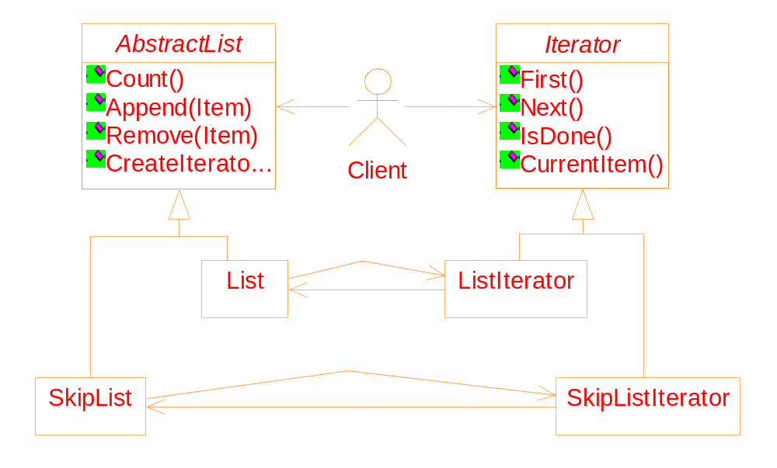
CreateIterator( ): Applying the polymorphism mechanism.
Benefits: More concise interface; greater opportunity to re-use code.

Slide 24
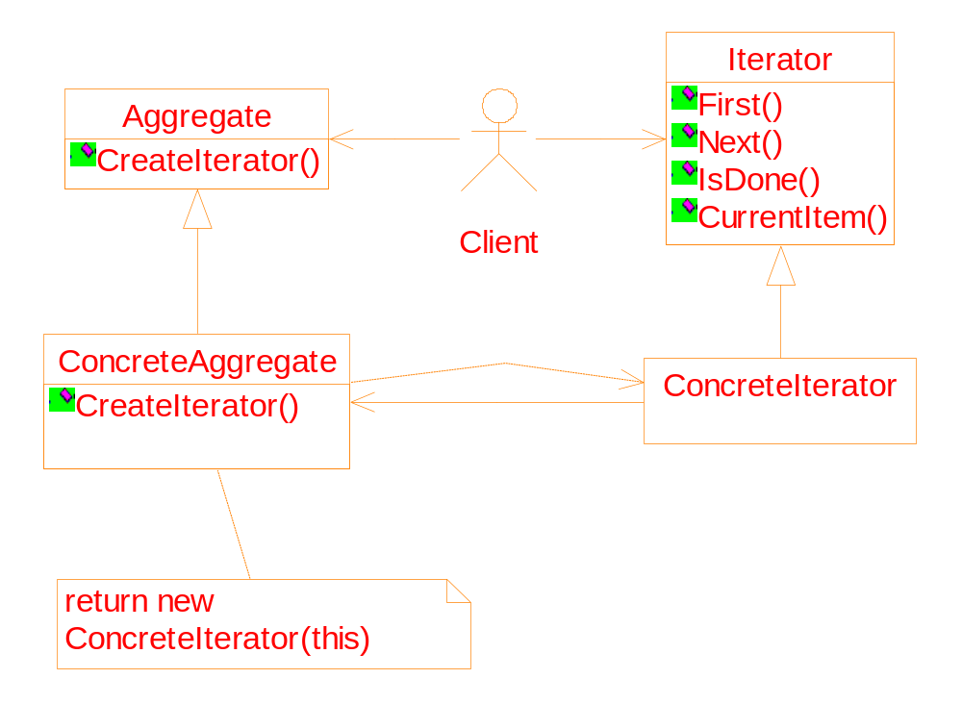
General structure of the iterator pattern

Slide 25
Implementation:
Making sure iterators get deleted
// pseudo-code
void ConditionalInsert(AbstractList * list, Item I)
{
Iterator * it = list->CreateIterator();
for ( it->First(); ! it->IsDone; it->Next() )
if ( it->CurrentItem == I ) break;
if ( ! it->IsDone )
return ; // the item already exist.
list->Append( I );
// We forget deleting it ➔ memory leakage
}

Slide 26
Use the Proxy pattern to solve the problem
Encapsulate each pointer into an object
Within the object, overloading the -> and * operators
Declare the object as a stack variable
When the object goes out of a scope, its destructor deletes the pointer

Slide 27
template <class Item>
class IteratorPtr {
public:
IteratorPtr( Iterator<Item> * i) : _i(i) {}
~IteratorPtr() { delete _i; }
Iterator<Item>* operator->() { return _i; }
Iterator<Item>& operator*() { return * _i; }
private:
// to avoid multiple deletions of _i
IteratorPtr(const IteratorPtr & );
IteratorPtr& operator=(const IteratorPtr&);
private:
Iterator<Item>* _i;
}

Slide 28
// pseudo-code
void ConditionalInsert(AbstractList * list, Item I)
{
IteratorPtr it( list->CreateIterator() );
// syntax of using an IteratorPtr object is as the
// same as the Iterator*
for ( it->First(); ! it->IsDone; it->Next() )
if ( it->CurrentItem == I ) break;
if ( ! it->IsDone )
return ; // the item already exist.
list->Append( I );
// the "Iterator*" will be deleted automatically
}

