Slide 1
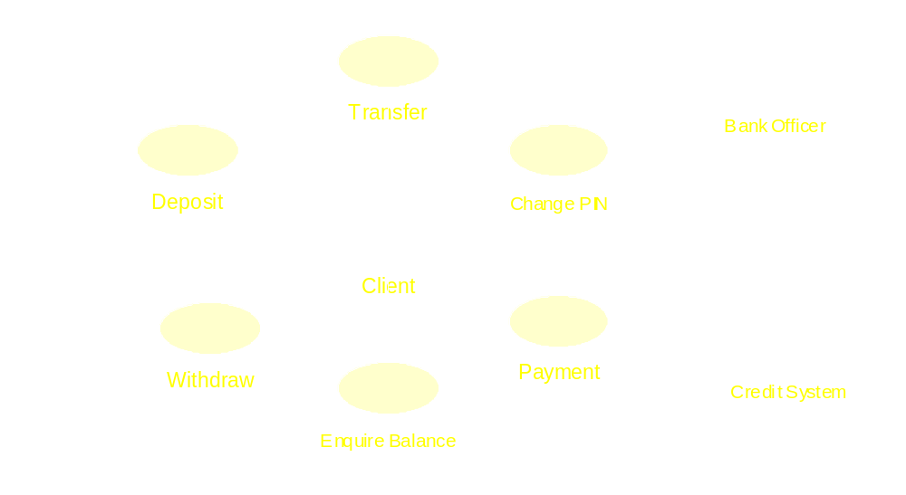
An example of the use case view

Slide 2
Diagrams
A diagram presents certain aspect of the underlying system model.
Diagrams are just like programs, but more abstract (object structure).
Do not be overwhelmed by the details of the diagrams.
Some types of diagrams can be used in both use case and design views

Slide 3
UML’s diagram types
Diagram | View
1 Use case diagram | Use case view
2 Object diagram | Use case & design view
3 Sequence diagram | Use case & design view
4 Collaboration diagram | Use case & design view
5 Class diagram | Design view
6 Statechart diagram | Design view
7 Activity diagram | Design view
8 Component diagram | Implementation view
9 Deployment diagram | Deployment view

Slide 4
private:
string name;
long number;
double cost;
};
class Part {
public:
Part(CatalogueEntry * e){
entry = e;
}
private:
CatalogueEntry * entry;
}

Slide 5
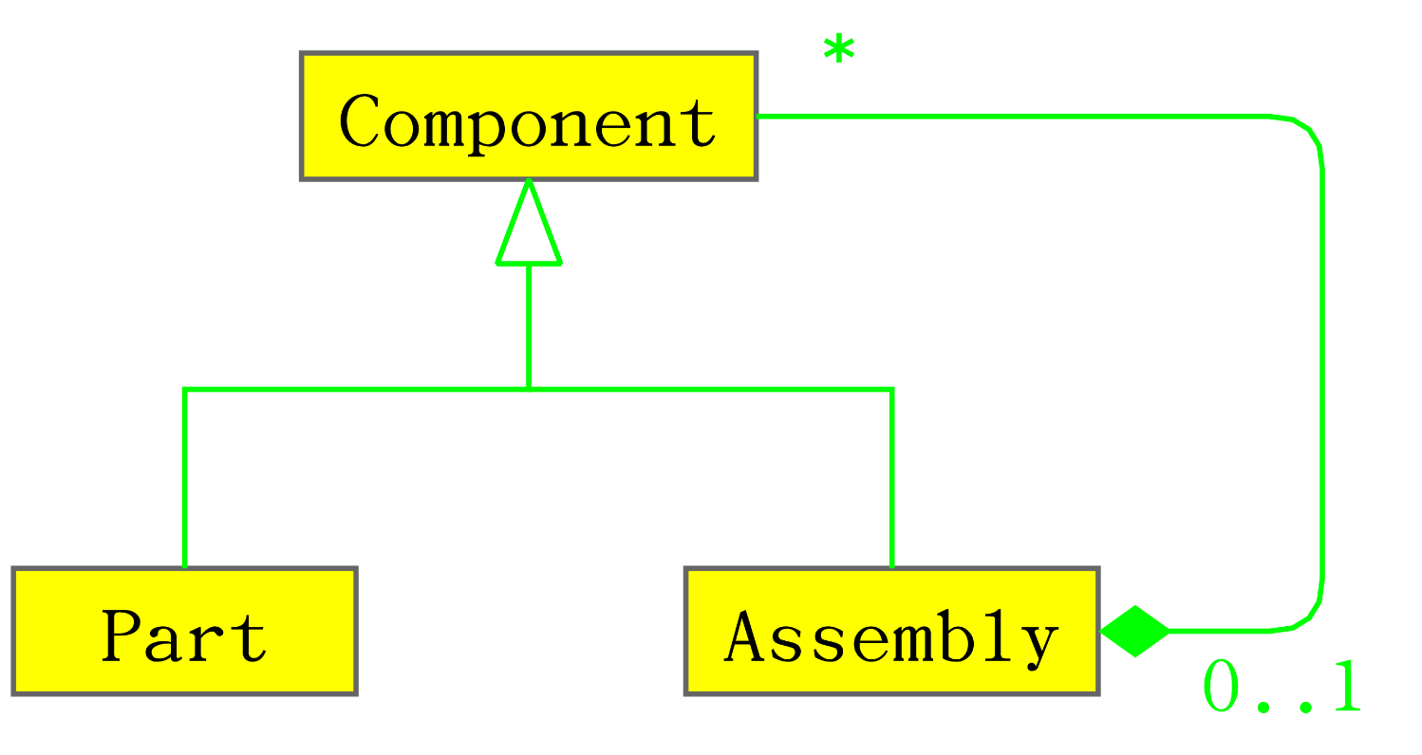
Use of abstract class

Slide 6
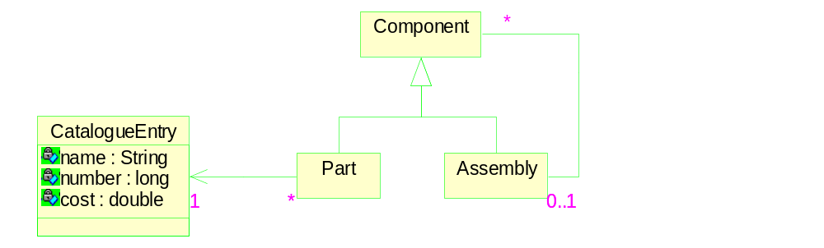
An example of class diagram

