Slide 1
Outline
The builder pattern
The factory method pattern
The prototype pattern

Slide 2

Builder pattern: Motivation
The problem: convert RTF document into plain text, TeX and TextWidget formats.
A segment of RTF document

Slide 3

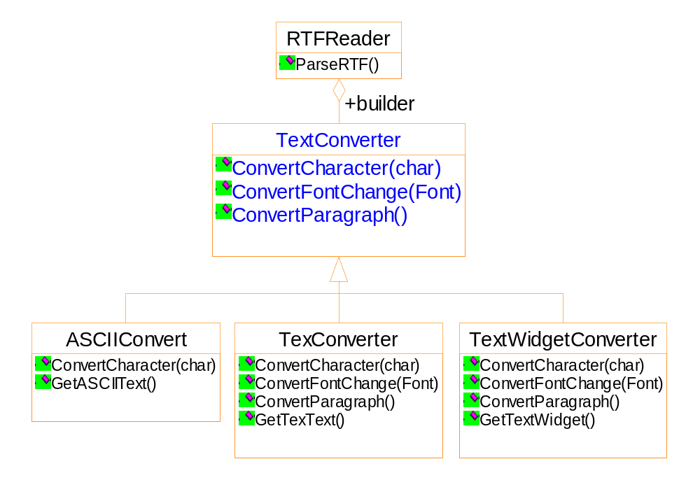

Slide 4
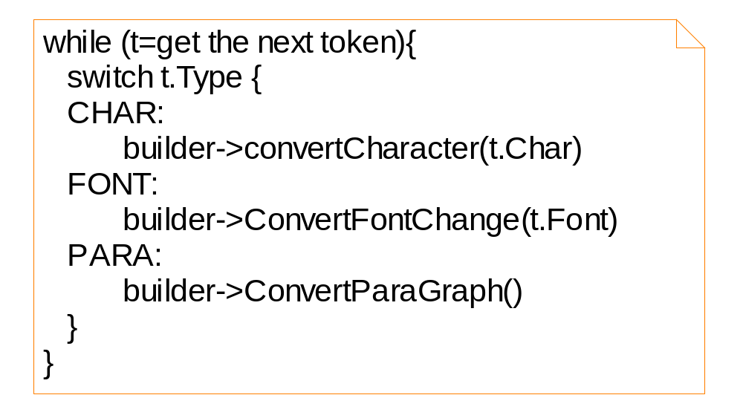

Slide 5
Features of the solution
Separate the converter from the reader
Hiding the details of creating and assembling a complex object
Re-use of the parsing algorithm

Slide 6
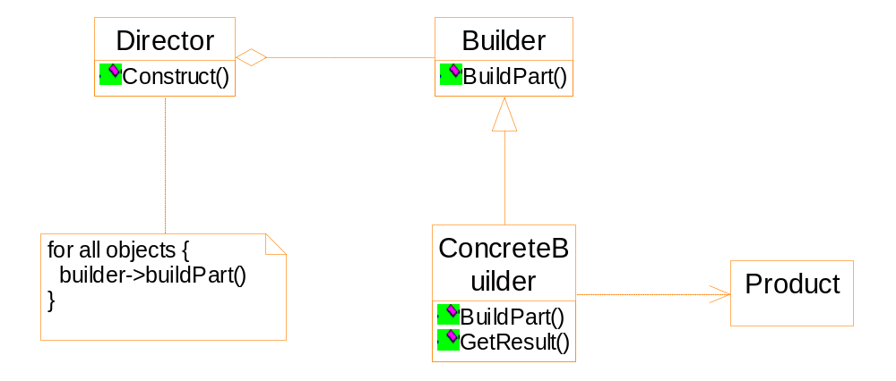
General structure of the Builder pattern

Slide 7
Participants
Builder
  specifies the abstract interface
Concrete Builder
  Constructs and assembles the parts
  Possibly by interacting with other objects
  Retrieving the product
Director
  Calling the builder to construct the product

Slide 8
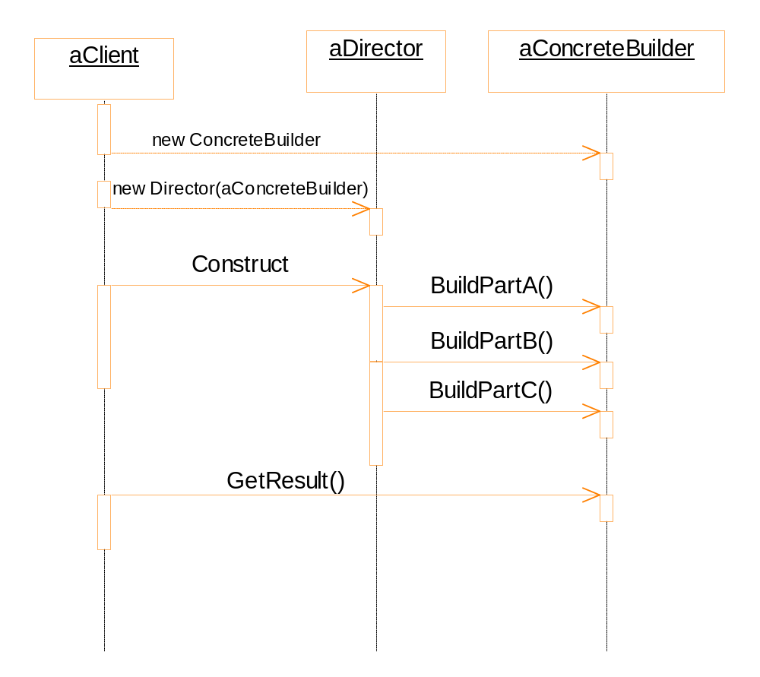

Slide 9
Comparison of Builder pattern and Abstract Factory pattern
Builder pattern
  The builder class is responsible to assemble the product, possibly by calling other classes.
  The builder class manufactures and assembles the product step-by-step.
Abstract factory pattern
  The client of the abstract factory pattern is responsible to assemble the product.
  The factory class manufactures all the parts in one shot.
  建造者模式
    构建器类负责组装产品，可能通过调用其他类。
    建筑商级逐步依次 一个一个 制造和组装产品。
  抽象工厂模式
    抽象工厂模式的客户负责组装产品。
    工厂级一次性制造所有零件。

Slide 10
Factory method: an example
The multiple document framework
  Open multiple documents
  Active document
  Window: tile, cascade
  Close all

Slide 11
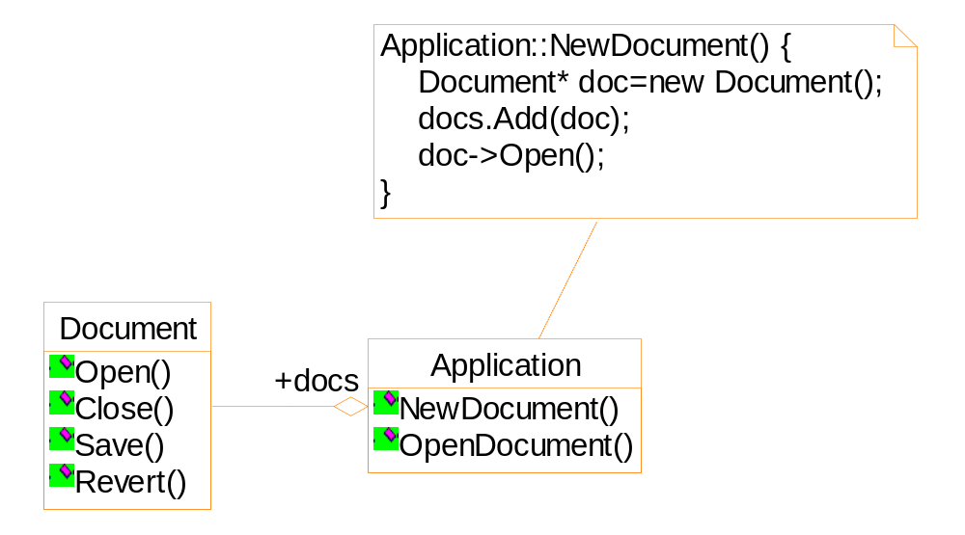
Suppose we want to create a drawing application...

Slide 12
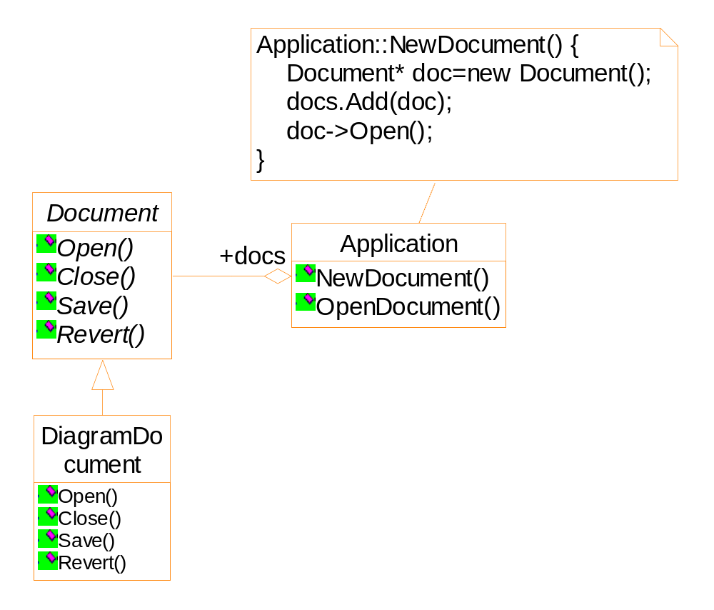
Framework
There is no chance that an object of DiagramDocument can be integrated into the framework.

Slide 13
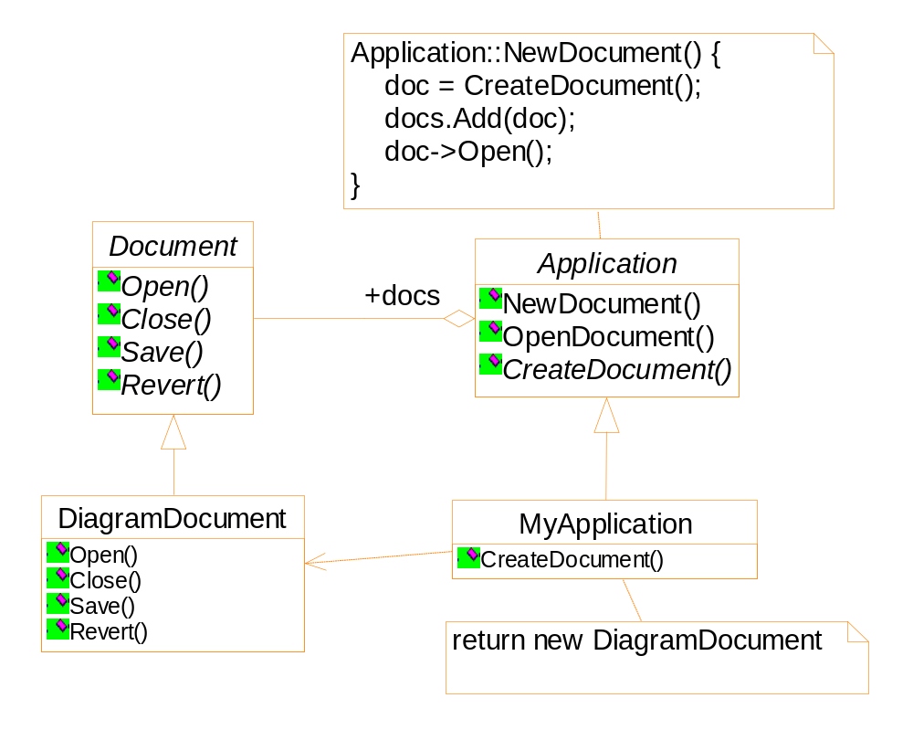
Framework

Slide 14
Applicability
A class can’t anticipate the class of object it must create.
A class wants its subclass to specify the objects it creates.

Slide 15
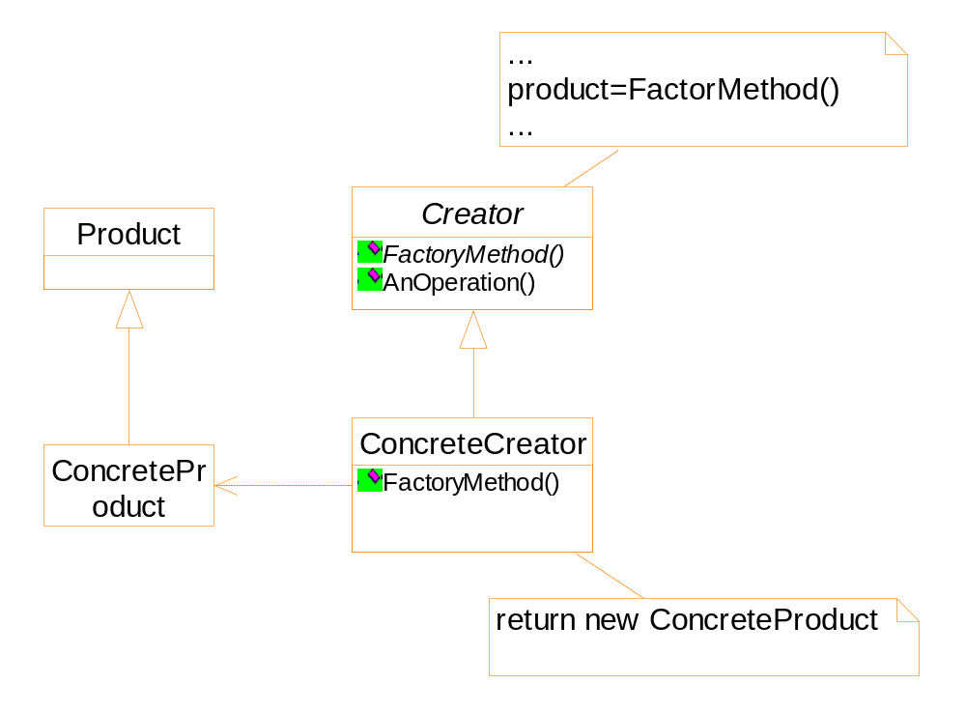
Structure

Slide 16
Analysis of the problem
Implementation of the interaction is complex
Some information should be stored and updated during the manipulation
e.g. angle of the element
Difference elements behave differently
e.g. resize of a line and a line of text

Slide 17
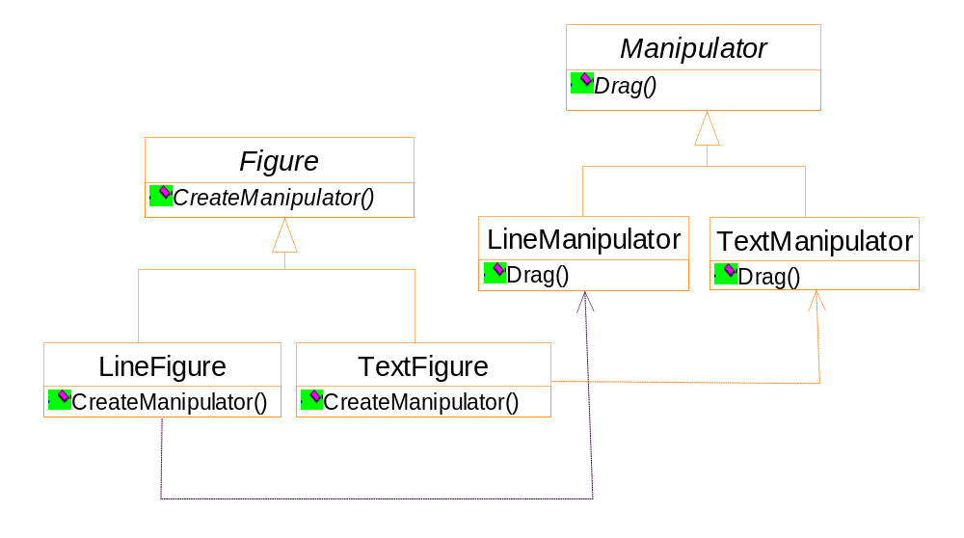
Possibly, the hierarchy is partially parallel

Slide 18
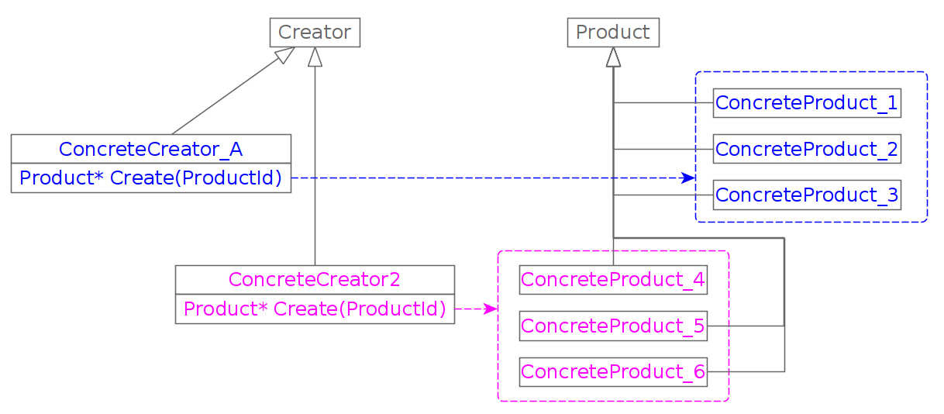
Implementation: parameterized parameter

Slide 19
class Creator {
virtual Product * Create(ProductID id) {
if (id==MINE) return new MyProduct;
if (id==YOURS) return new YourProduct;
...
}
};
class MyCreator: public Creator {
virtual Product * Create(ProductID id) {
if (id==YOURS) return new MyProduct;
if (id==MINE) return new YourProduct;
if (id==THEIRS) return new TheirProduct;
...
return Creator::Create(id);
}
}

Slide 20
Implementation
Template could be used to avoid sub-classing of the creator class

Slide 21
class Creator {
public:
virtual Product * CreateProduct() = 0;
};
template <class TheProduct>
class StandardCreator: public Creator{
public:
virtual Product* CreateProduct() {
return new TheProduct;
}
}
StandardCreator<ProductA> aCreator;
StandardCreator<ProductB> bCreator;

Slide 22
Prototype
A creational pattern in which new objects are created based on an existing prototype object.
Applicability
  It is expensive to construct an object from the scratch.
  Want an object which is the copy of an existing one.
An editor for music scores
  Customizing a general framework
  There are tools for adding new graphic objects
  There are tools for manipulating graphic objects

Slide 23
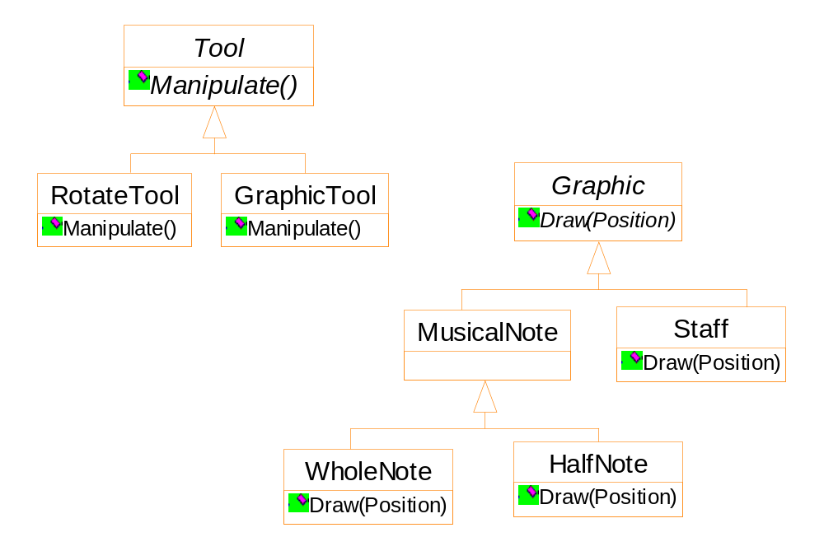
Framework
GraphicTool does not know how to create the score objects

Slide 24
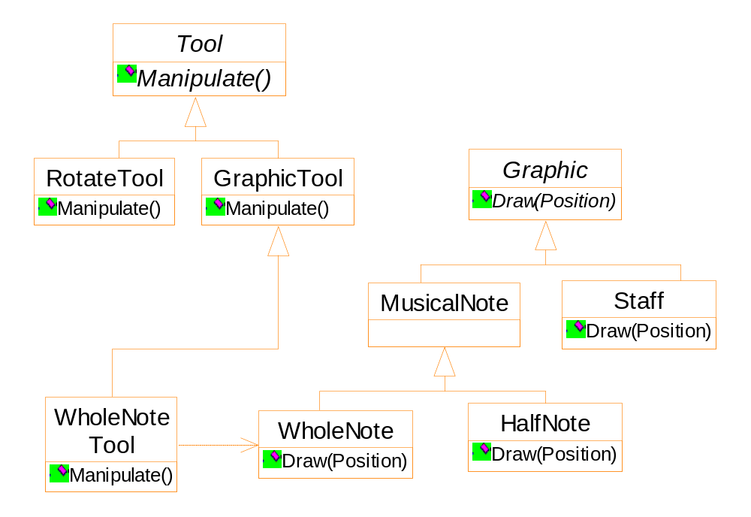
Framework
One Possible solution is using the Factory Method pattern

Slide 25
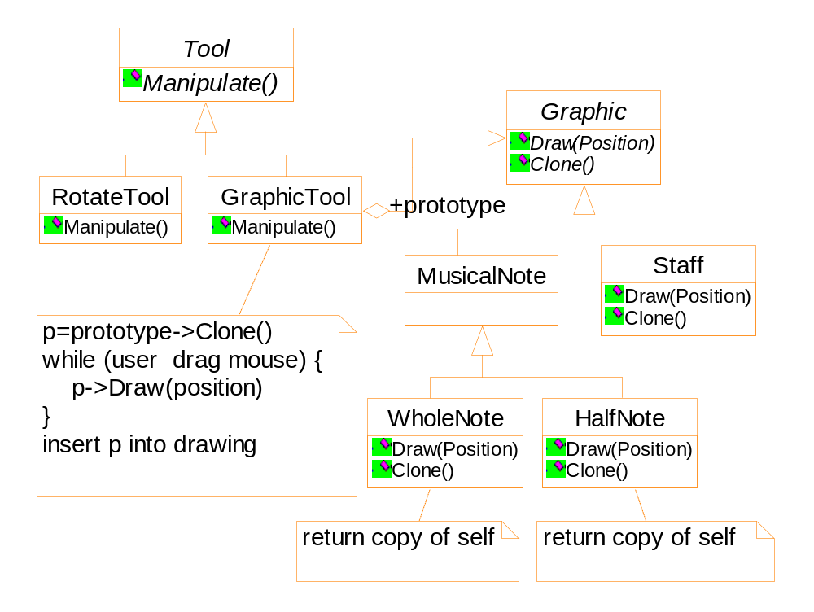
by class composition

Slide 26
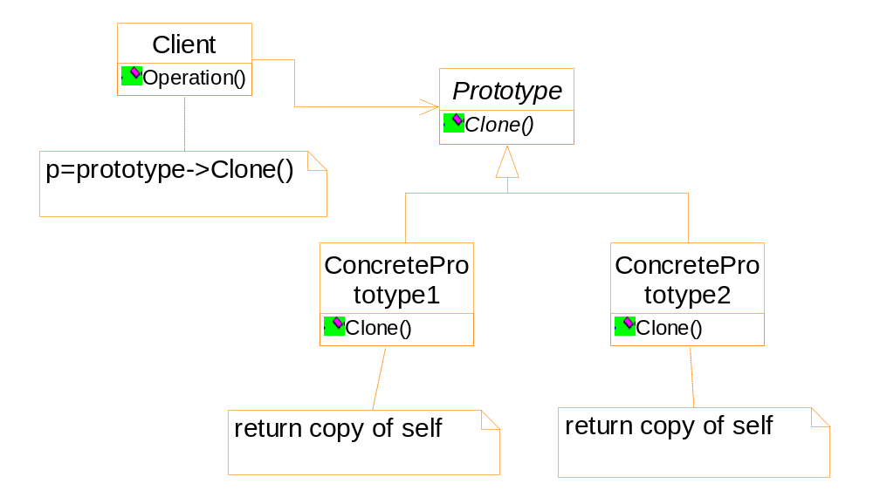
prototype

Slide 27
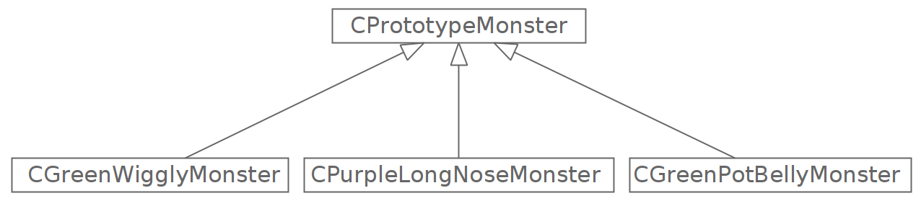




Slide 28
Implementation
Using a prototype manager
Register, browse and un-register of a prototype
Implementing the clone operation
  Shallow copy
  pointers point to the same memory block
  Deep copy

