Slide 1
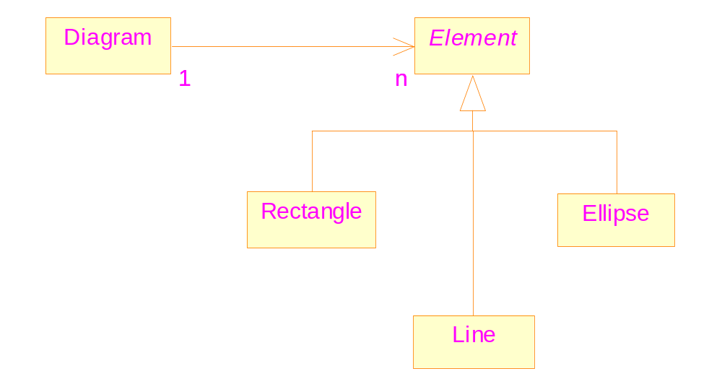
A more reasonable design
Common
Features
Does not introduce new relationship between objects

Slide 2
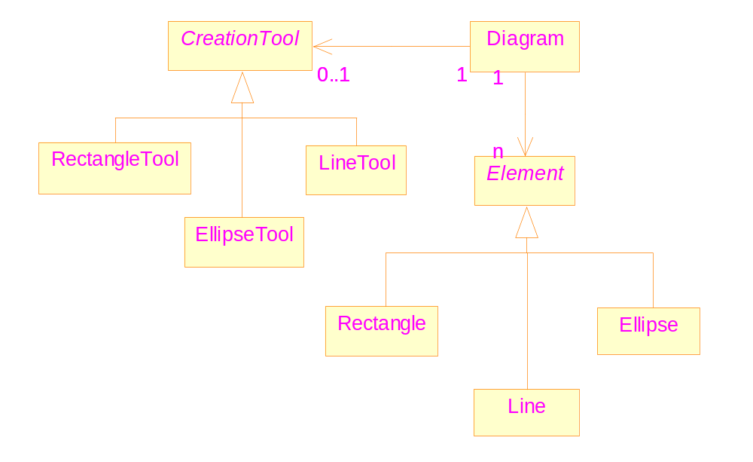
Similar for Creation Tools

Slide 3
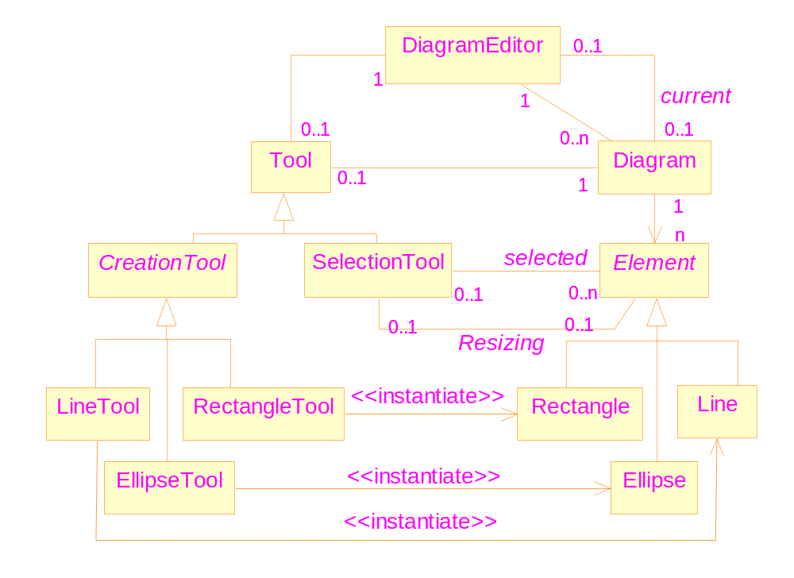
The complete class diagram
Diagram Editor Demo

Slide 4
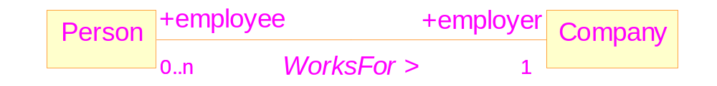
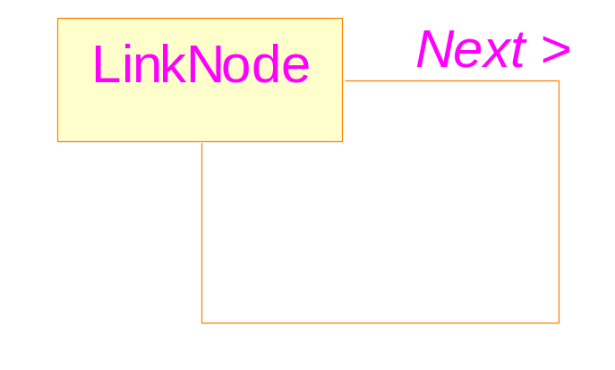
Associations
Associations, role names, multiplicity
Self-associations

Slide 5
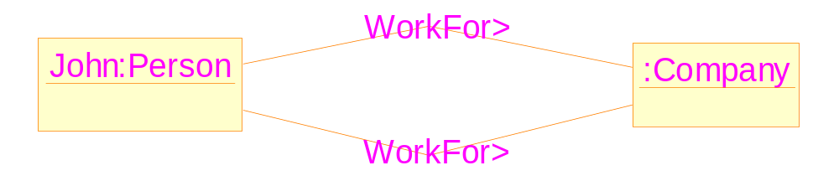
Links do not have identity
The problem: John is employed as a lecture and a bar attendant by a company
An illegal diagram in UML

Slide 6
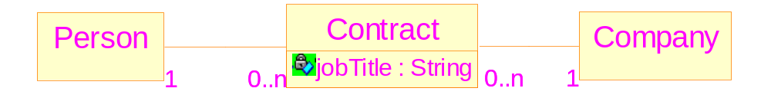
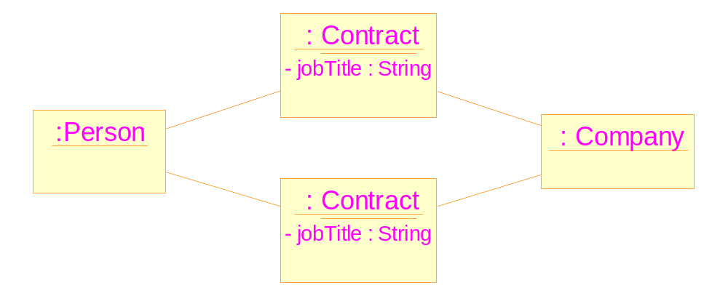
Possible solution

Slide 7
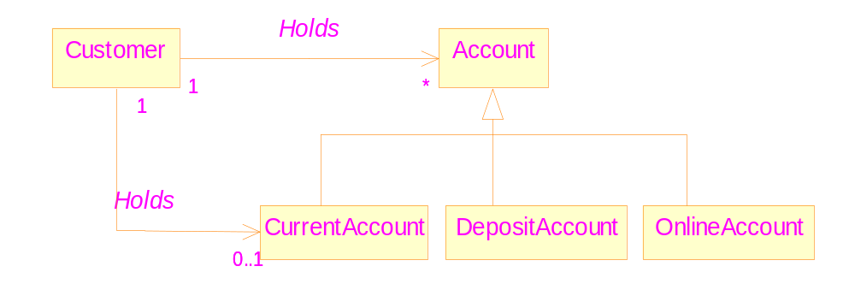
Association Generalization
An example: a customer can hold at most one Current Account.

Slide 8
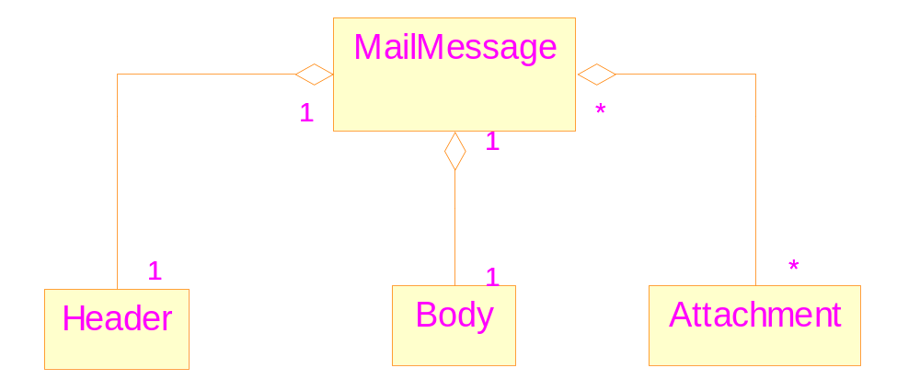
An usual aggregation relationship

Slide 9
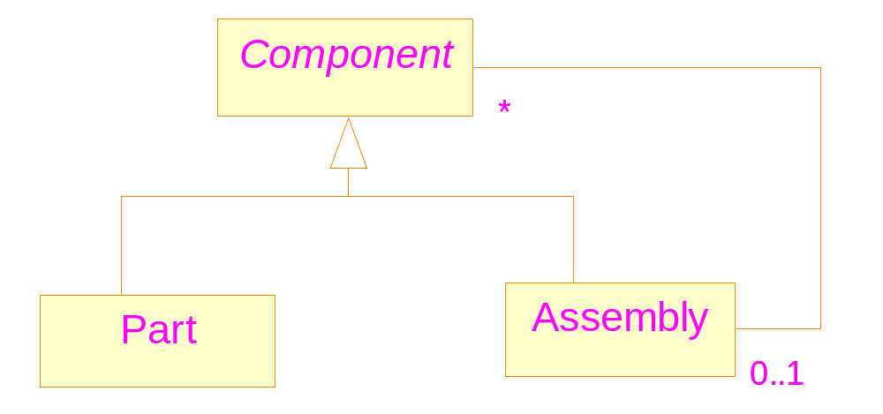
If without aggregation

Slide 10
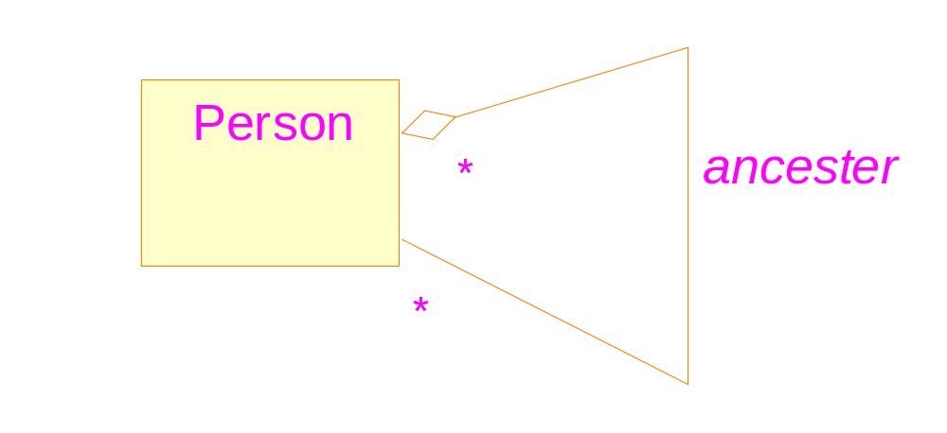
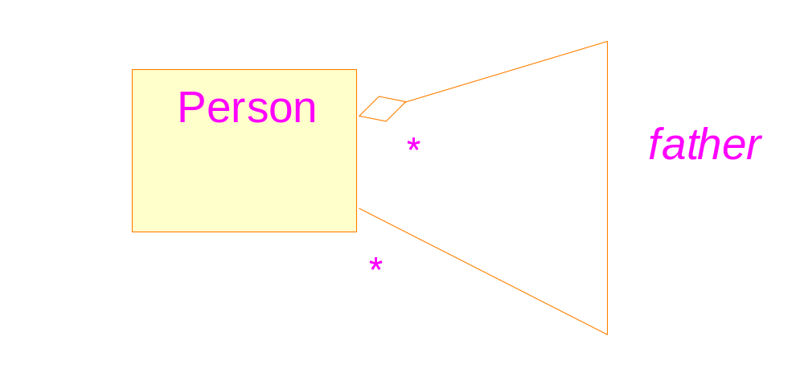
Aggregation: not necessarily be part/whole relationship
correct
Two properties must be observed
wrong

Slide 11
An example of composition

Slide 12
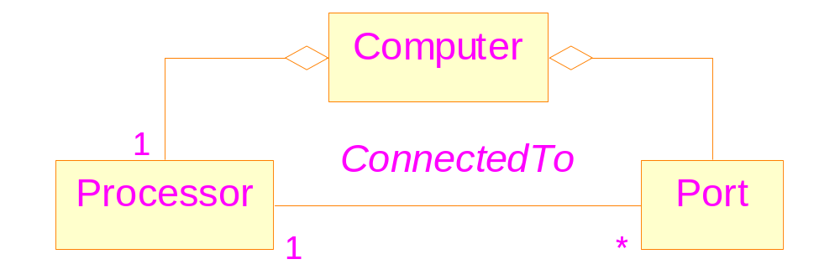
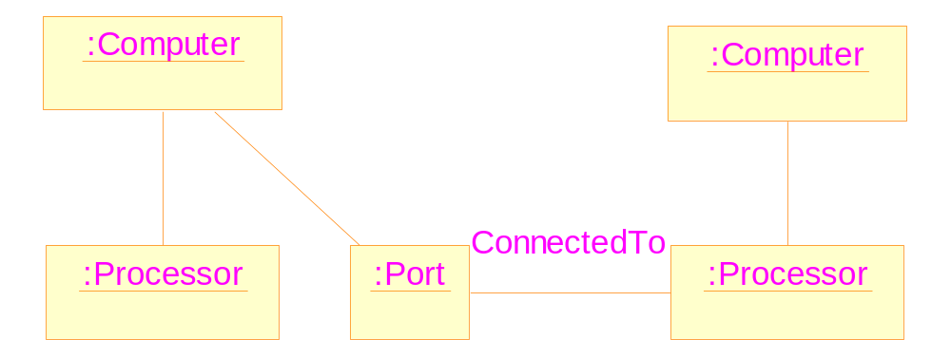
A situation where even composition is not enough
Structure of
a computer

Slide 13
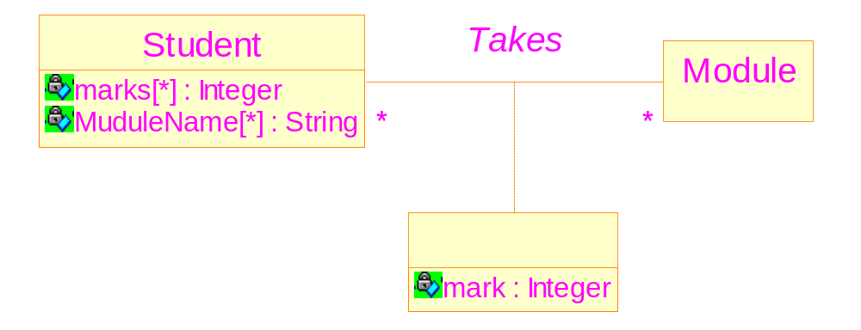
UML notation for association classes

Slide 14
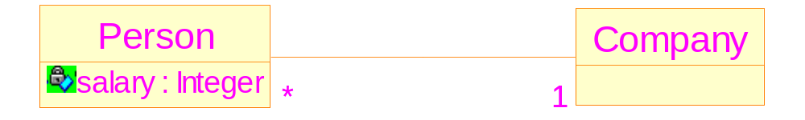
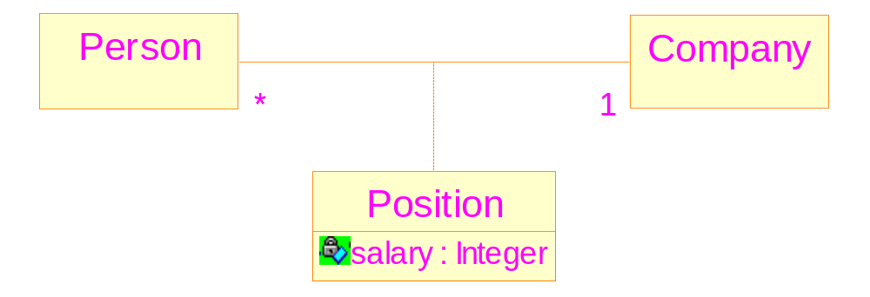
Another example of using association class
Not preferred
More accurate

Slide 15
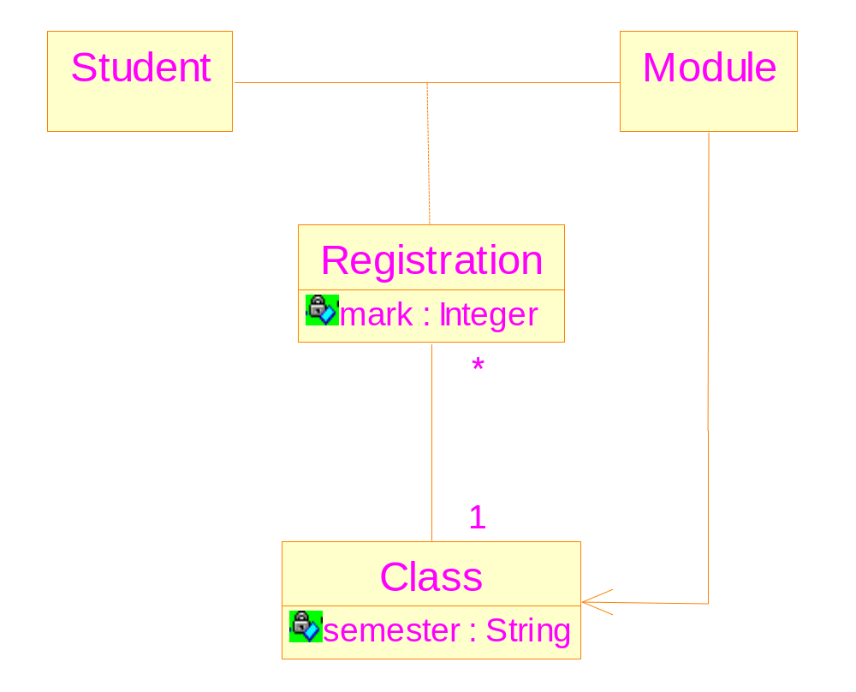
An association class can have associations with other classes

