Slide 1
Qualified associations
An example: Unix file system
  Each file has a unique internal identifier
  Each file can appear multiple times in different directories, even including in the same directory.
  All names within a directory must be different from each other.

Slide 2
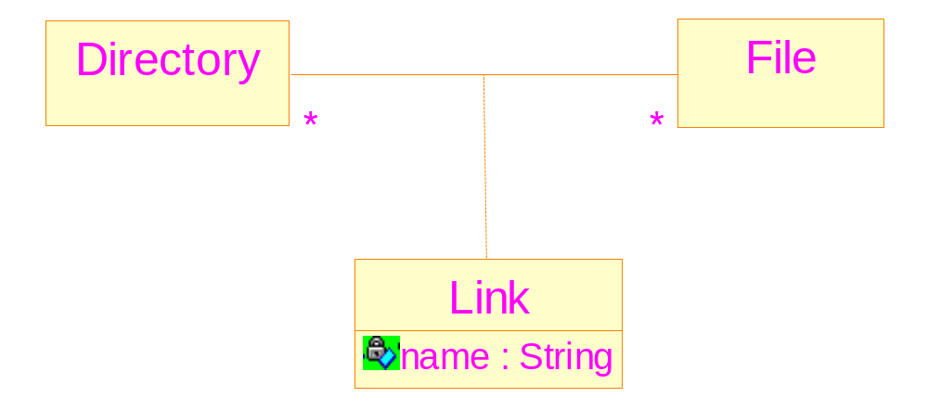
Association class can not describe the relationship
Reasons: It does not allow: a directory may have
different names linked to the same file

Slide 3
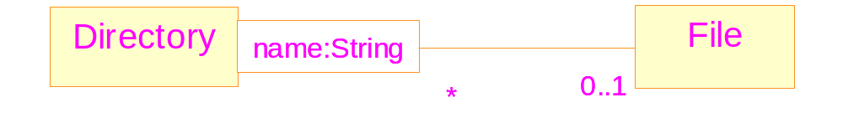
Qualified associations
Definition: an association class which has properties which enable it to act as a key
Mapping from qualifier values to instances of the class at the other end of the association

Slide 4
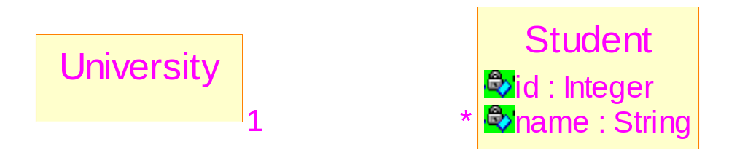
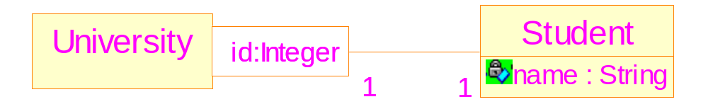
Qualifiers and identifiers
Use of an attribute as an identifier
Better: Use of a qualifier

Slide 5
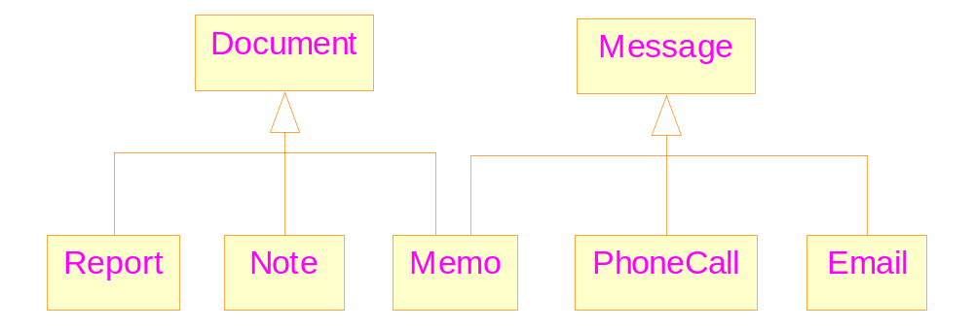
An example of multiple inheritance

Slide 6
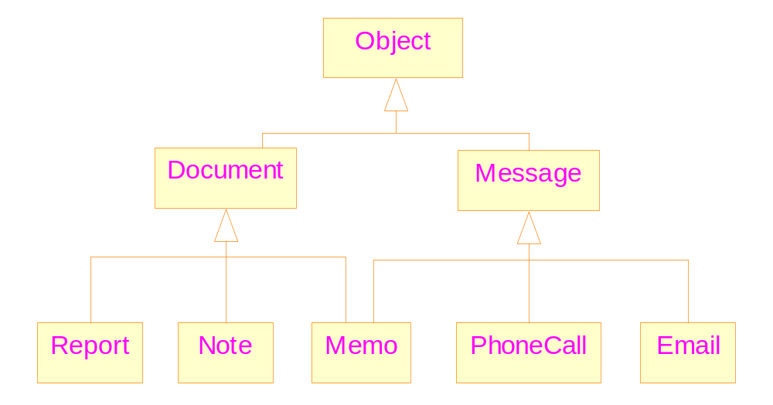
Multiple inheritance with a common ancestor

Slide 7
Mixin class
A mixin class: is intended to provide an optional interface or functionality to other classes.
The functionality should be independent with that of the existing classes.
It is similar to an abstract classes in that it’s not intended to be instantiated.
Mixin classes require multiple inheritance.

Slide 8
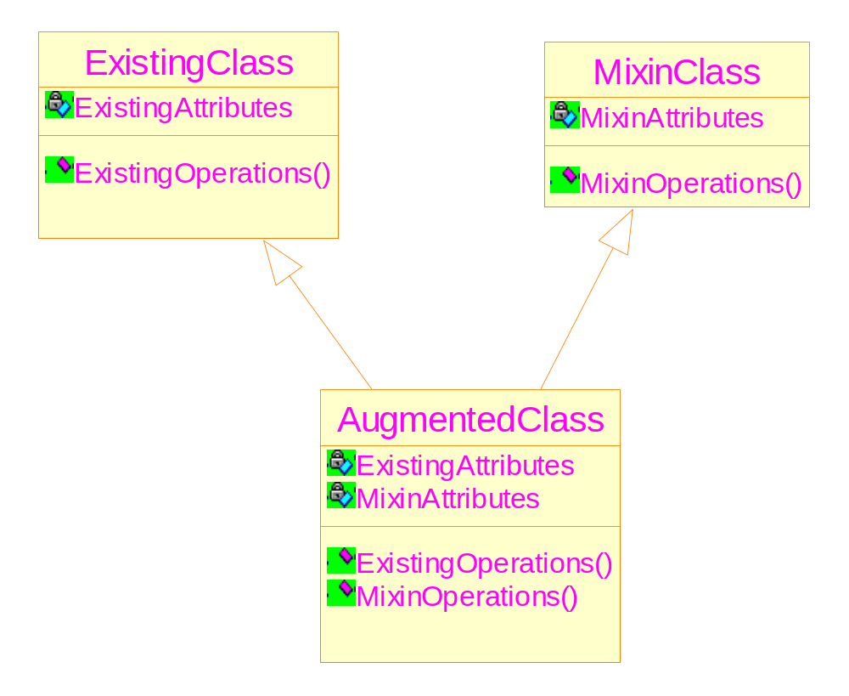
Illustration of mixin classes

Slide 9
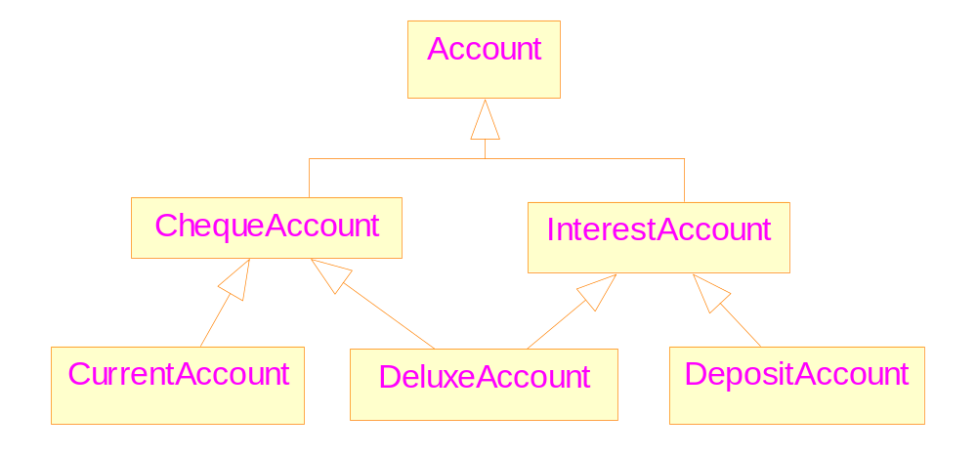
If without mixin class

Slide 10
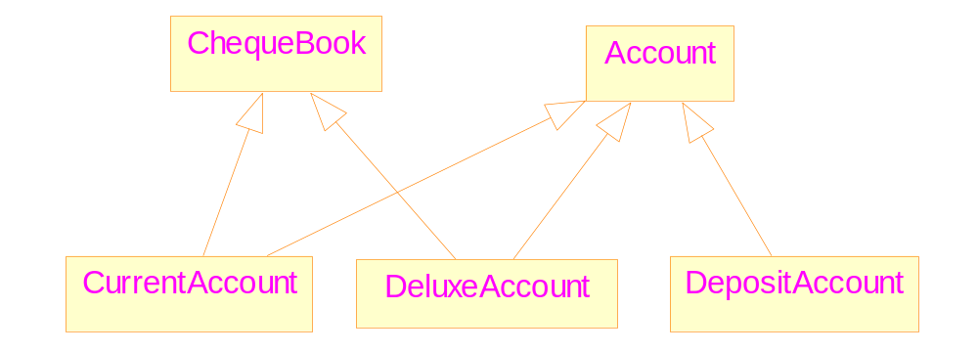
With Mixin class

Slide 11
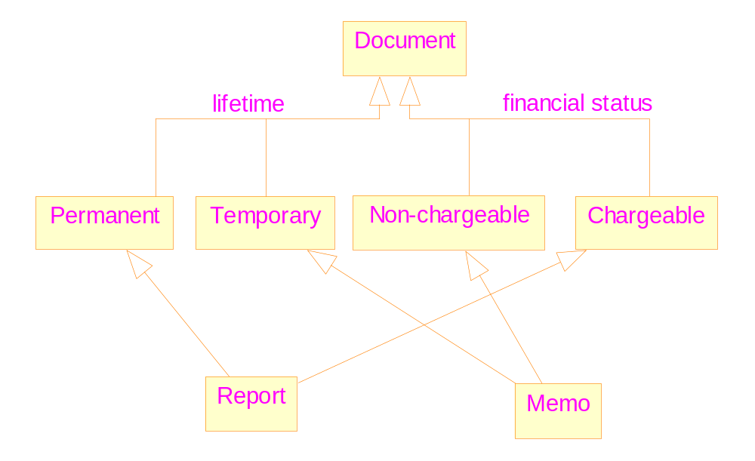
Discriminators

Slide 12
Implementing associations
Uni-directional links
  simple to implement
  Will lead to problems if they are later modified to bi-directional links
Bi-directional links
  Complex to implement ➔ consistency
  With no risk
Both styles of implementation should be hidden from client code

Slide 13
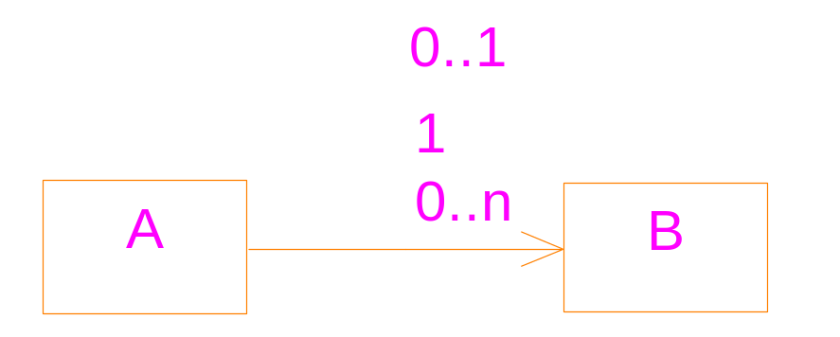
Uni-directional implementations
The multiplicity at the tail of the arrow has no effect on the implementation
Mutable and immutable associations
To implement the semantic correctly, we need:
  Proper declarations of data members, and
  Proper definitions of member functions

Slide 14
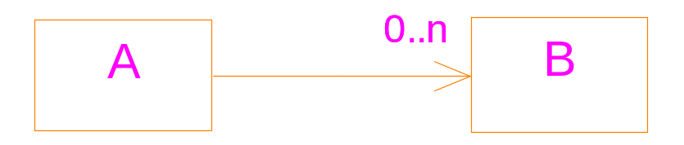
#include <iostream>
#include <vector>
using namespace std;
class B {
//...
public:
operator ==( B & r) {};
};
class A {
vector<B> links;
public:
addLink(B & b) {
links.push_back( b );
};

Slide 15
removeLink(B & b ){
vector<B>::iterator it;
for ( it=links.begin(); it!=links.end();
it++) {
if ( *it == b) break;
}
if ( it != links.end() )
links.erase(it);
};
}
main()
{
}

Slide 16
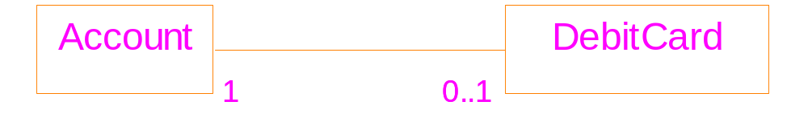
Bidirectional implementation
mutable
immutable

Slide 17
class DebitCard;
class Account {
DebitCard * card;
public:
DebitCard& getCard();
void setCard(DebitCard & p_card );
void removeCard();
};
class DebitCard{
Account * theAccount;
public:
DebitCard(Account & a);
getAccount();
}

Slide 18
main()
{
Account a1;
Account a2;
DebitCard card1(a1);
a1.setCard(card1);
//a2.setCard(card1); → cause problem!
}

Slide 19
A better solution
class Account;
class DebitCard{
Account * theAccount;
private:
DebitCard(Account & a);
public:
getAccount();
friend class Account;
};
class Account {
DebitCard * card;
public:
void addCard() {
card = new DebitCard(*this);
}

Slide 20
DebitCard& getCard();
void removeCard();
};
main()
{
Account a1;
a1.addCard();
}

Slide 21
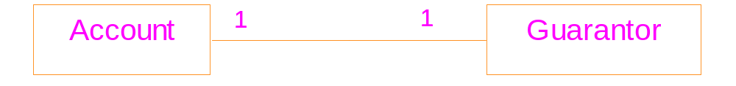
Bidirectional implementation: both directions are immutable
immutable
immutable
A typical mistake: want to create the link
within a single step.

Slide 22
#include <iostream>
using namespace std;
class Guarantor;
class Account {
public:
Guarantor * pGuarantor;
int i;
Account( Guarantor * g) {
pGuarantor = g;
i = 100;
f();
}
virtual f() {cout << "f\n"; }
};

Slide 23
class Guarantor {
public: Account * pAccount;
int j;
Guarantor(Account * a) {
pAccount = a; j = 200;
g();
//a->f();
//cout << a->i;
}
virtual g(){ cout << "g\n"; }
};
main ()
{ Account *a = new Account(new Guarantor(a) );
cout << a->pGuarantor->j;
//cout << a->pGuarantor->pAccount->i;
}
uncertain

Slide 24
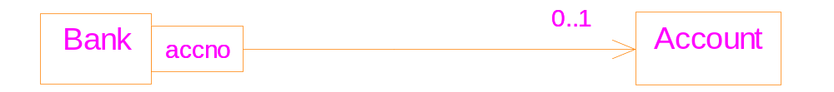
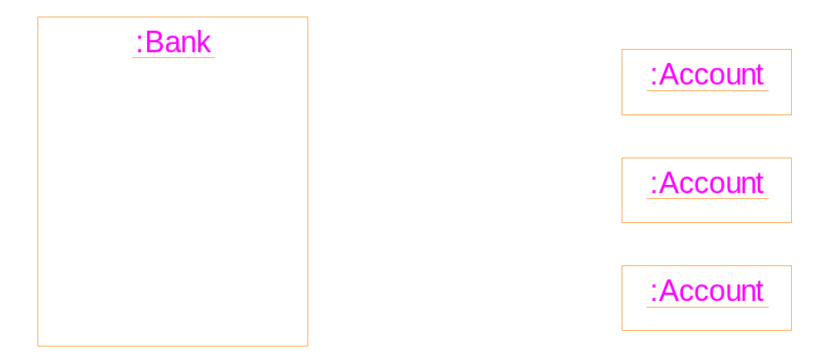
Implementing qualifiers
41
53
99

Slide 25
#include <iostream>
#include <string>
#include <map>
using namespace std;
main( )
{
// a map of expenditure
map<string, double> exp;
string item;
double cost;
while (cin>>item >>cost)
exp[ item ] += cost;
double total=0;
map<string,double>::iterator p;

Slide 26
for (p=exp.begin(); p!=exp.end(); p++){
total += p->second;
cout << p->first << ": "
<< p->second << endl;
}
cout << "total expenditure: " << total;
}
Input:
food 100
book 150
tax 30
book 100
food 180
output:
book: 250
food: 280
tax: 30
total expenditure: 560

Slide 27
Implementation of association classes
Solution: Transform the association class into a simple class linked to the two original classes
The interface of the two original classes should be kept unchanged.
The implementation changed the meaning of the original class diagram. Further constraints should be imposed on the implementation.

Slide 28
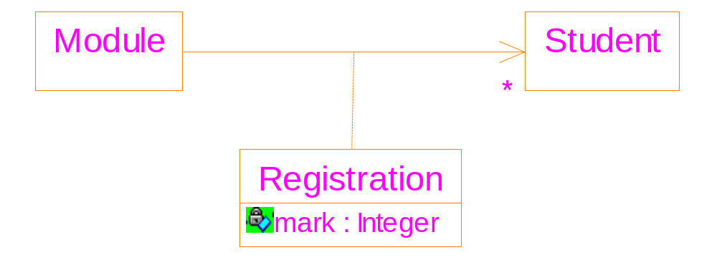
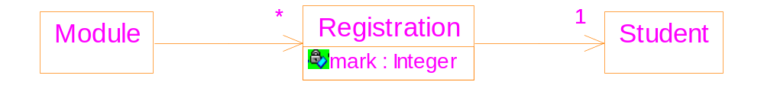

Slide 29
class Registration {
Student * pStudent;
int mark; // the attribute of the link
public:
Registration(Student* st) {
pStudent = st; mark=0; }
};
class Module {
vector<Registration*> registrations;
public:
void enrol(Student* st) { // interface remains
registrations.push_back(new Registration(st));
}
}

