Slide 1
Outline
Use-case Diagram
  Actors
  A use-case should be abstract
  Generalization,Specialization
  Inclusion, Extension
Sequence Diagram
  First step of designing
  An example
  Components of a sequence diagram
  Collaboration diagram
  Conditional/asynchronous message,etc

Slide 2
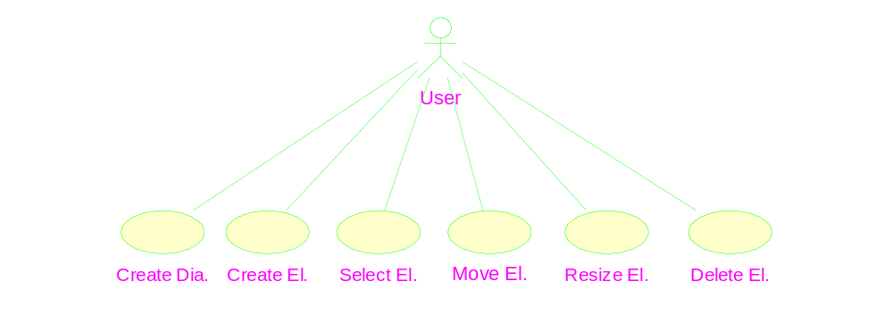
The use case diagram of the diagram editor example
Scenario

Slide 3
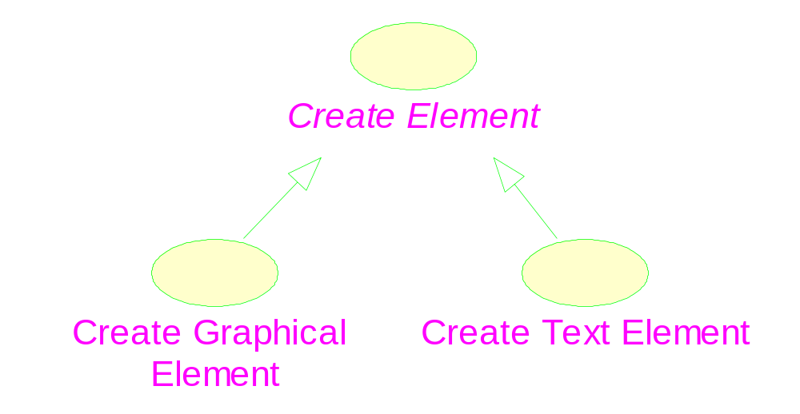
Generalization and Specialization
Abstract use case
Explanation for a use case

Slide 4
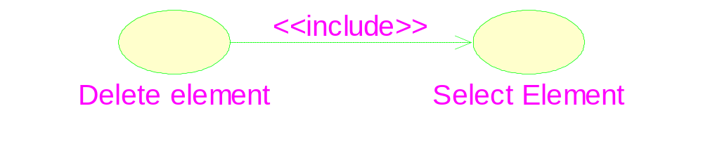
Inclusion of use case
Stereotype: specification of a relationship
The base use case
The inclusion use case

Slide 5
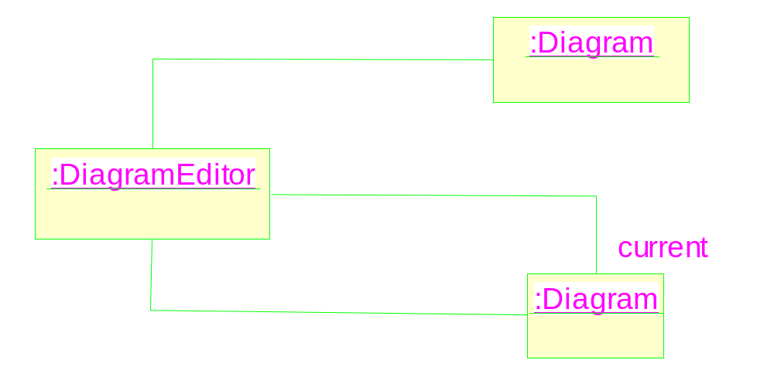

Slide 6

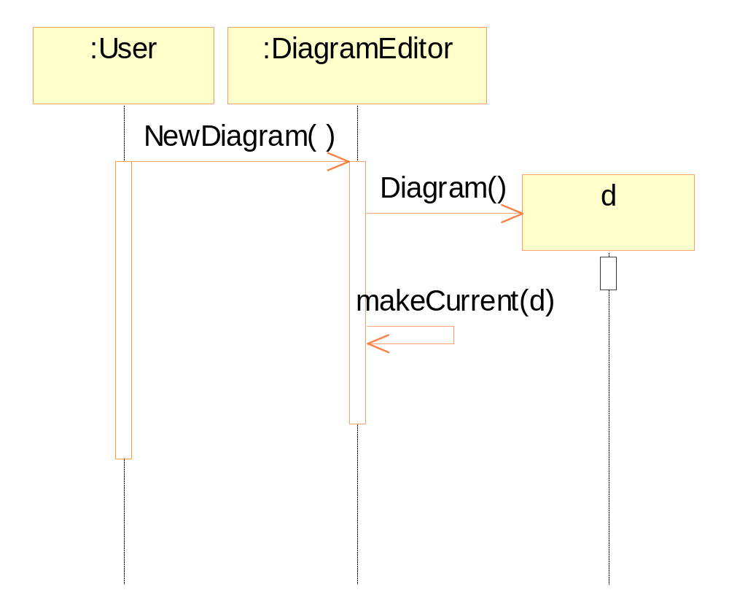
A sequence diagram

Slide 7
Elements in a sequence diagram
Objects are shown at the top.
Time flows downward.
Lifeline.
Messages & message to oneself
Activation: processing a message.
Construction of a new object.

Slide 8
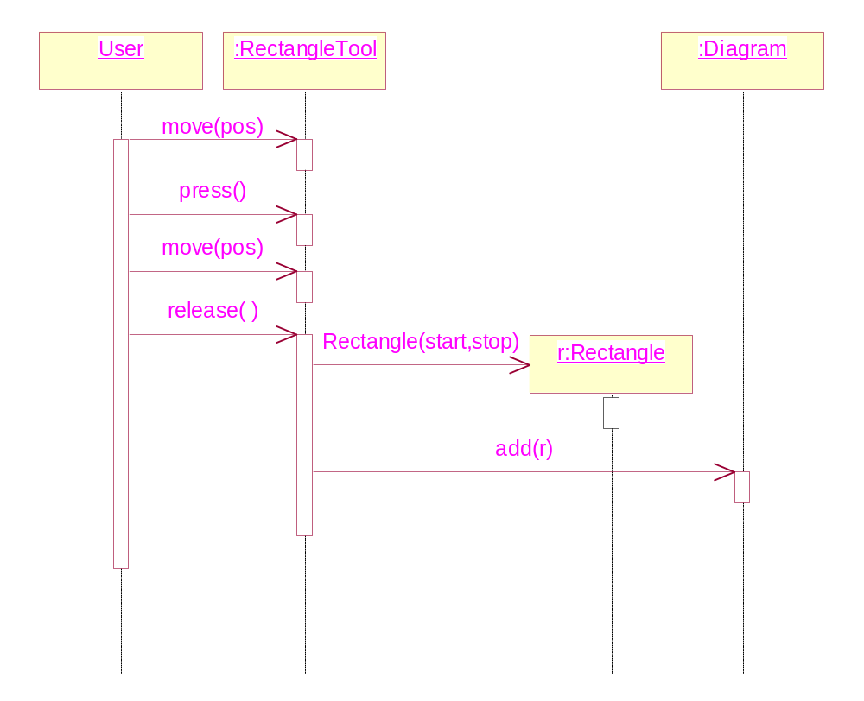
Creating a rectangle element

Slide 9
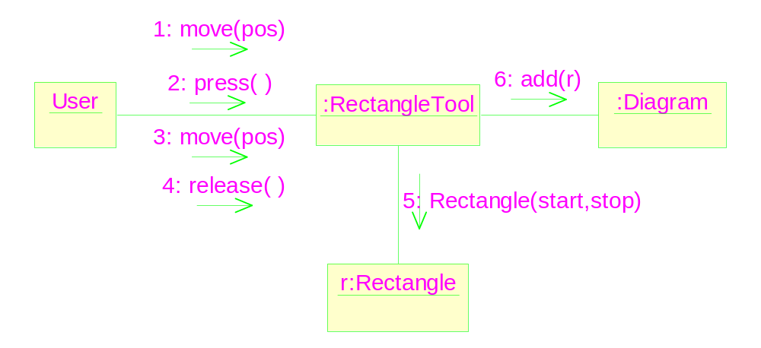
A collaboration diagram
Order of the messages should be explicitly specified.

Slide 10
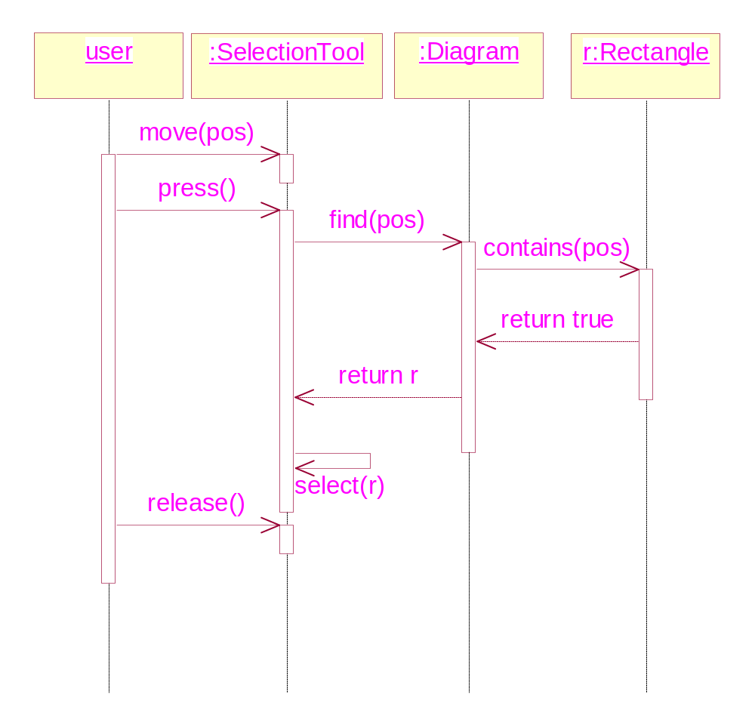
Selecting an element : Return messages

Slide 11
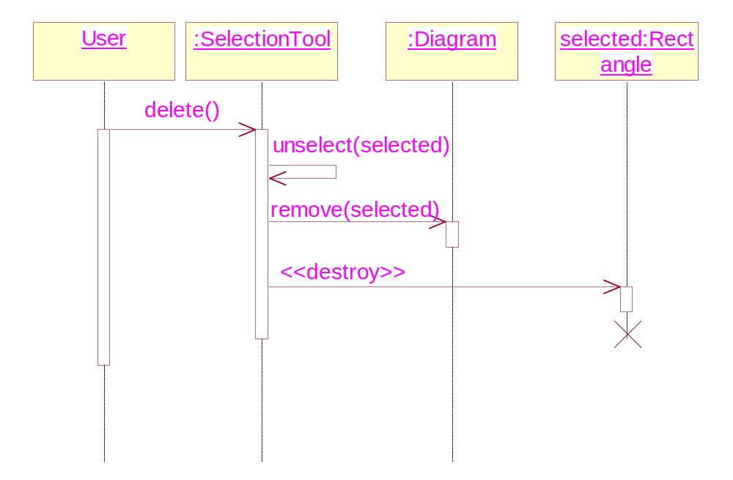
Deleting an element: Termination of objects

Slide 12
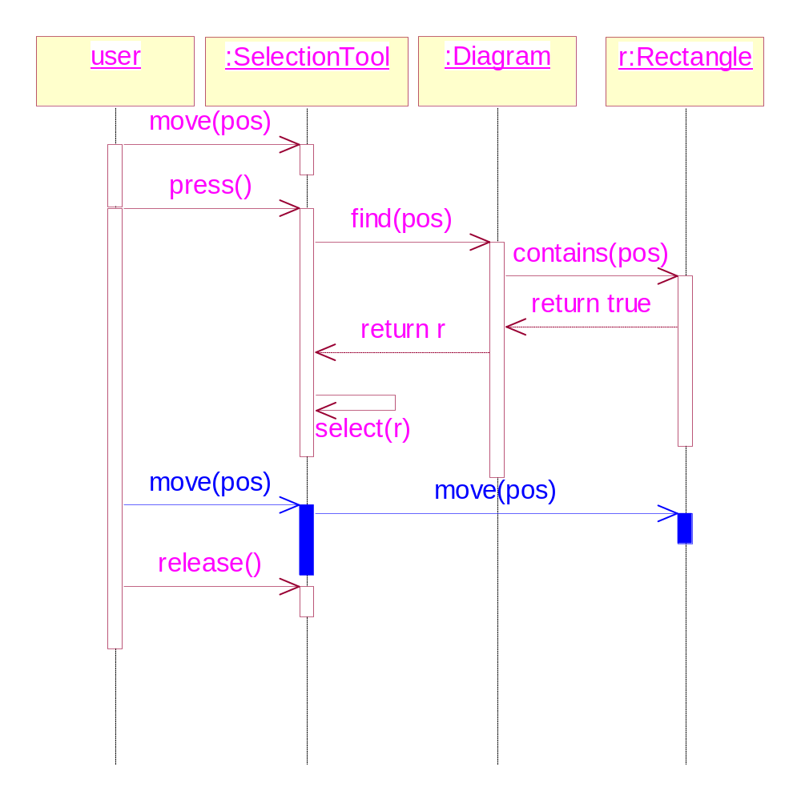
Moving an element: use case extension

Slide 13
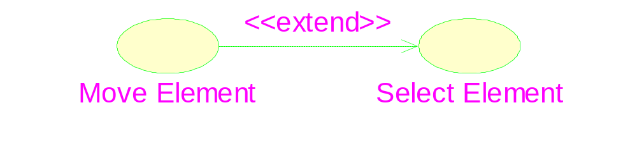
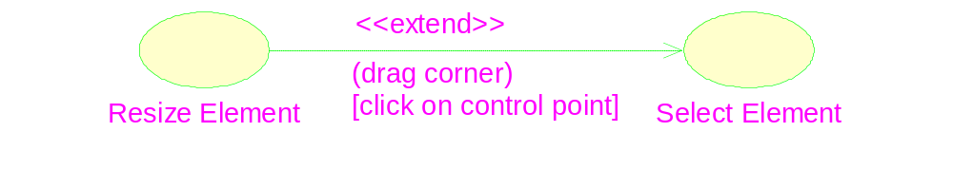
Extension of use case

Slide 14
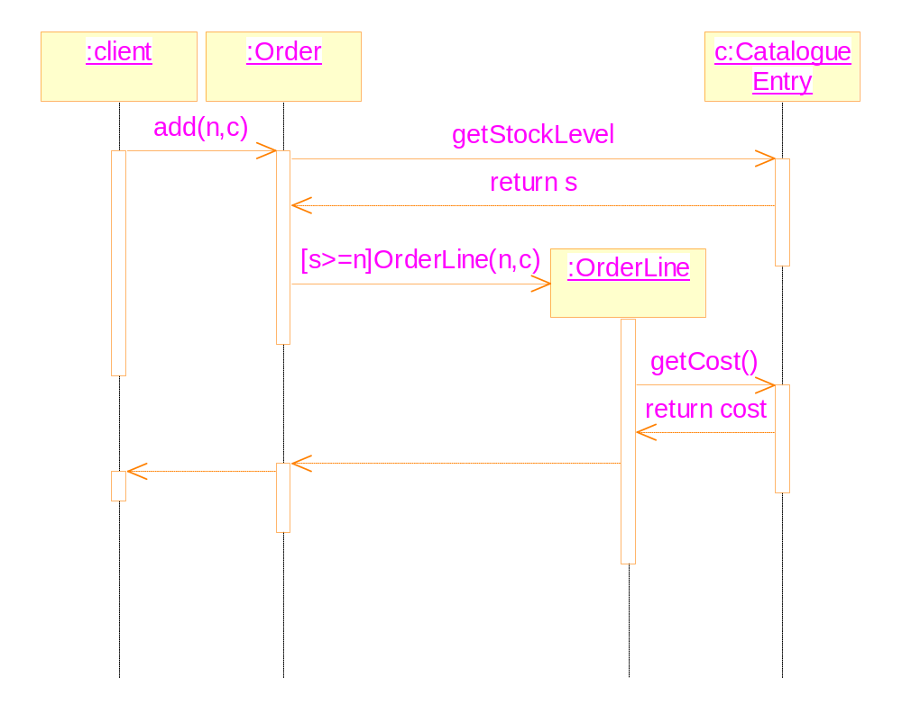
Conditional messages

Slide 15
Message to oneself
It represents implementation details.
But when the return value of the message is used in the further messages, it should be made explicit.
It causes recursive activity

Slide 16
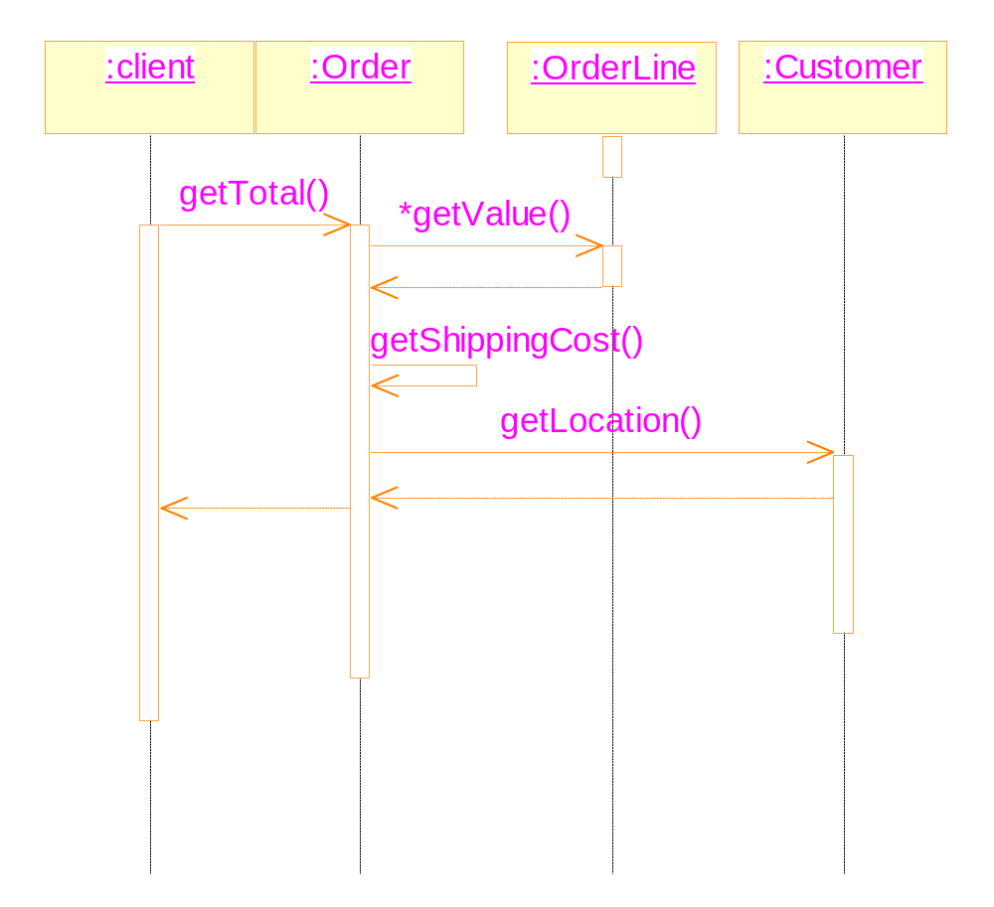

Slide 17
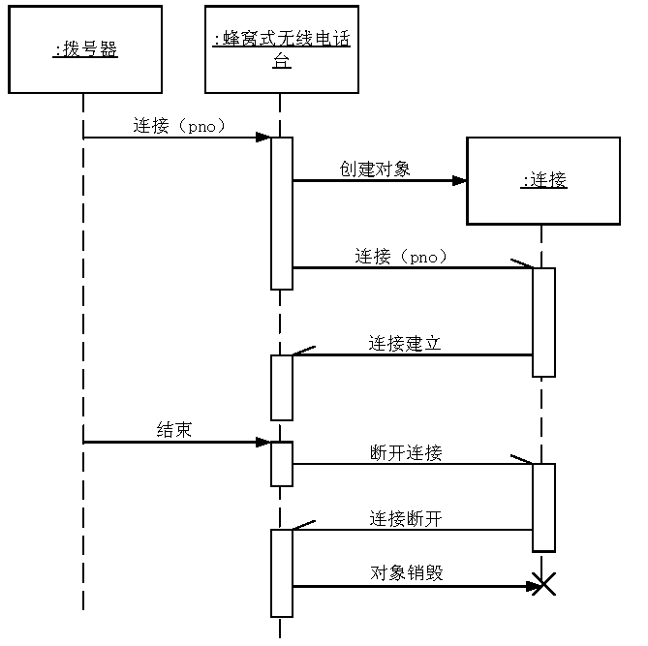
Asynchronous message and multiple threads

Slide 18
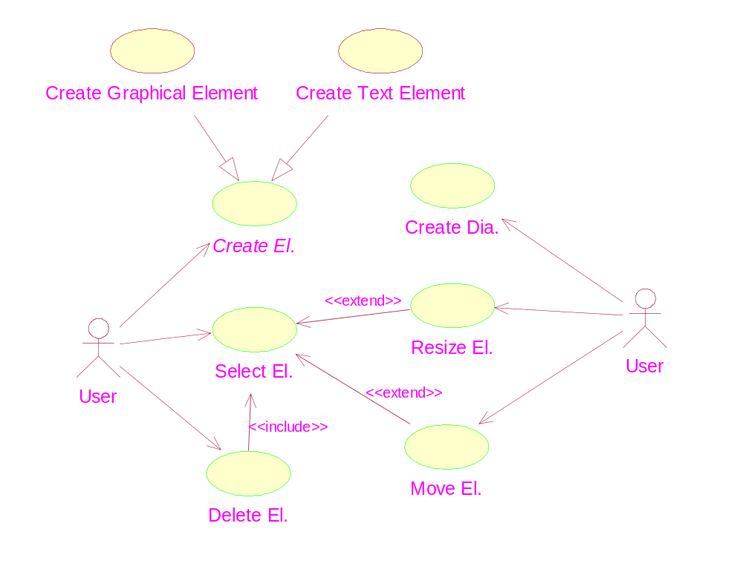
The complete use case diagram

Slide 19
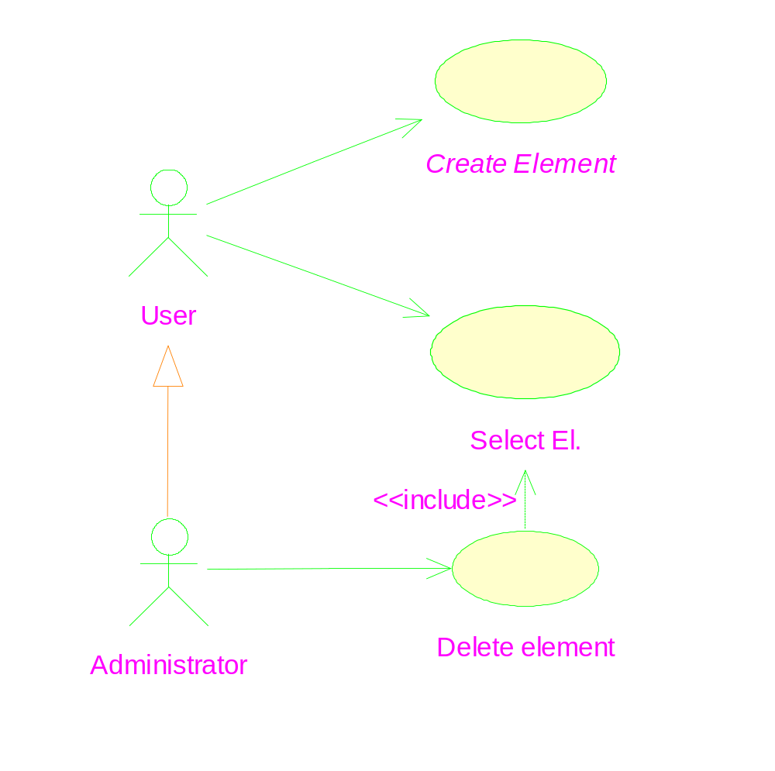
Generalization between actors

