Slide 1
Outline
Introduction
Description of a pattern
Roles of design pattern
A case study: designing a document editor
Composite pattern (document data)
Strategy pattern (document formatting)
Decorator pattern (interface elements)

Slide 2

++
--
==
!=
*
stack::
iterator
stack
Sort( )
vector::
iterator
vector
map::
iterator
map
Common interface

Slide 3
#include <iostream>
#include <vector>
#include <list>
#include <math.h>
using namespace std;
template <class Container>
void Display_Container(Container c)
{
Container::iterator it;
for (it=c.begin(); it!=c.end(); it++)
cout << *it << " ";
cout << endl;
}

Slide 4
template <class Container>
void Sort(Container & c)
{ Container::iterator it1, it2;
Container::value_type temp;
for (it1=c.begin(); it1!=c.end(); it1++) {
for (it2=it1; it2!=c.end(); it2++) {
if ( *it1 > *it2 ) {
temp = *it1;
*it1 = *it2;
*it2 = temp;
}
}
}
}

Slide 5
int main()
{ vector <int> v;
list <double> l;
for (int i=10; i>=0; i--) {
v.push_back(i);
l.push_back( sin(i*3.14) );
}
Display_Container(v); Display_Container(l);
Sort( v ); Sort( l );
Display_Container(v); Display_Container(l);
return 0;
}

Slide 6
Description of a pattern
  Impact on a system’s flexibility, extensibility, and portability.

Slide 7
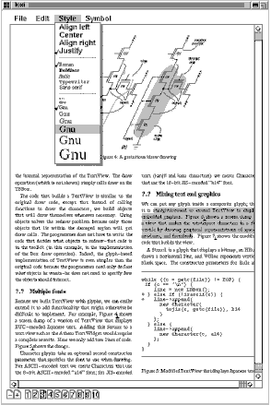
A case study: designing a document editor

Slide 8
Design problems
A WYSIWYG document editor
Design problems
  Document structure
  Formatting
  Embellishing the user interface
  Multiple look-and-feel standards
  User Operations
  Spelling checking and hyphenation

Slide 9
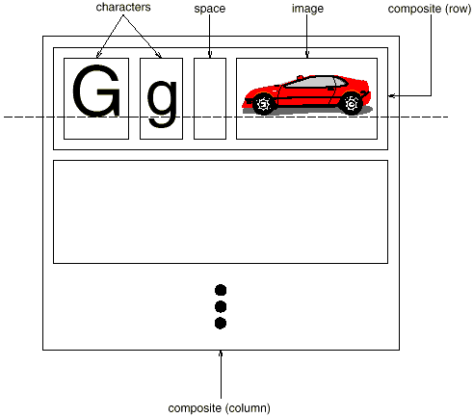
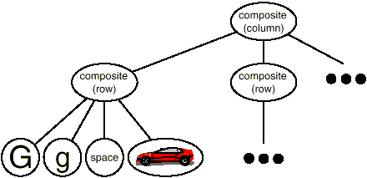
Document structure
The document has a tree-like structure

Slide 10
Features
A substructure may contain other substructures (recursive).
Text and graphics are treated uniformly.
  A figure can be embedded into a line of text
  Characters can be embedded into a figure
Single element and a group of elements are treated uniformly (move, set font, etc).

Slide 11

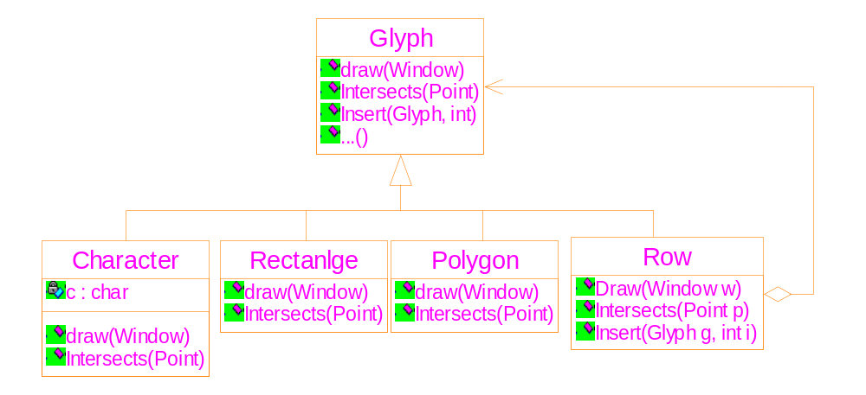
1. The abstract class: a common interface
2. The aggregation association: describes the tree

Slide 12
The common interface
class Glyph {
public:
virtual void Draw( Window * )=0;
virtual void Bounds( Rect & )=0;
virtual bool Intersects( const Point &)=0;
virtual void Insert(Glyph *, int)=0;
virtual void Remove(Glyph *)=0;
virtual Glyph * Child (int)=0;
virtual Glyph * Parent( )=0;
}

Slide 13
The composite pattern
Applicability
  Part-whole hierarchies
  Single object and composite object are treated uniformly
Structure
Participants
  Component
    common interface
    default behaviors
    accessing and managing its child components
    Accessing a component’s parent

Slide 14
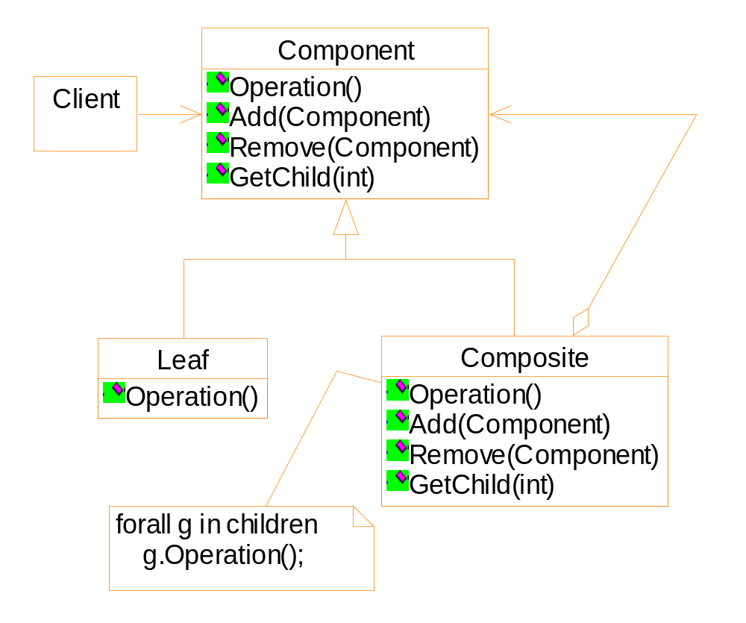
1. The abstract class: a common interface
2. The aggregation association: describes the tree

Slide 15
Exercise
Suppose there is a programming language that contains only three kinds of statements:
  Assignment: Identifier_A = Identifier_B;
  If statement: If (Identifier_A == Identifier_B ) { statement1; statement2; … };
  If-else statement:
  If ( Identifier_A == Identifier_B ) {
  statement1; statement2; … }
  else {
  statement3; statement4; … }
  }

Slide 16
Exercise
Write a formatting program, which takes a program of the previous language as input, and formats it such that:
  A new-line character occurs only after a complete statement, or the ‘{‘ character;
  Statements of the if or if-else statements are indented by 4 characters
  See the sample code below.

Slide 17
A = B ;
if ( C == D ) {
E = F ;
if ( G == H ) {
tmp1 = tmp2 ;
tmp3 = tmp4 ;
}
else {
var5 = var6 ;
}
A = 100 ;
}
B = 200 ;

Slide 18
Exercise
Requirements
  Draw the class diagram
  What operations should be defined in the root class?
  Suppose the do-while statement is appended into the programming language, how to revise your class diagram and your implementation?
  How to apply the following constraint: the if-else statement can not appear within a do-while statement?

Slide 19
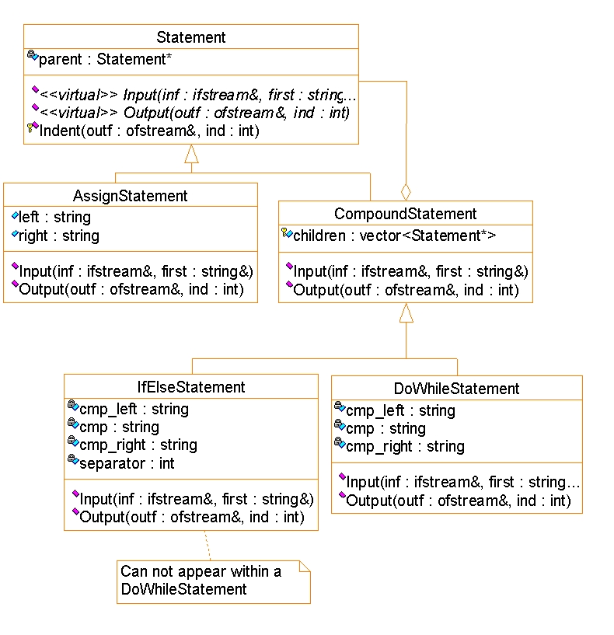

Slide 20
Composition and compositor
Composition
  Initially, it contains the un-formatted objects (characters, figures, etc).
  The formatting algorithms insert structural objects ( Rows, Columns, etc) into it.
Compositor
  Different formatting algorithms are encapsulated into the class
  Interface
    void SetComposition ( Composition* )
    virtual void Compose( )

Slide 21
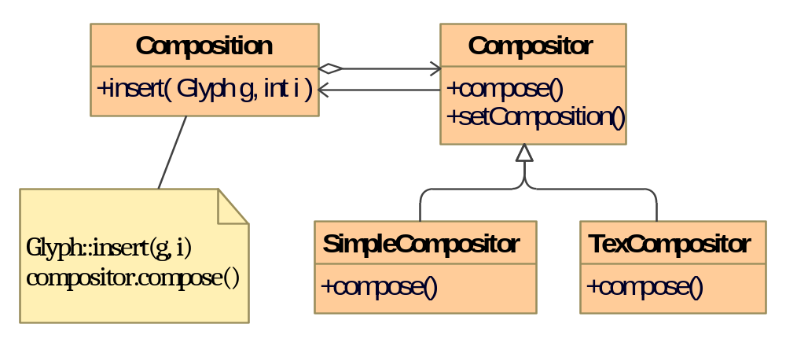

Slide 22
Strategy pattern
Applicability
  You need different variants of an algorithm.
  Some algorithms use data that clients should not know about.
  Essential point: separator the algorithms from the data.
Structure

Slide 23
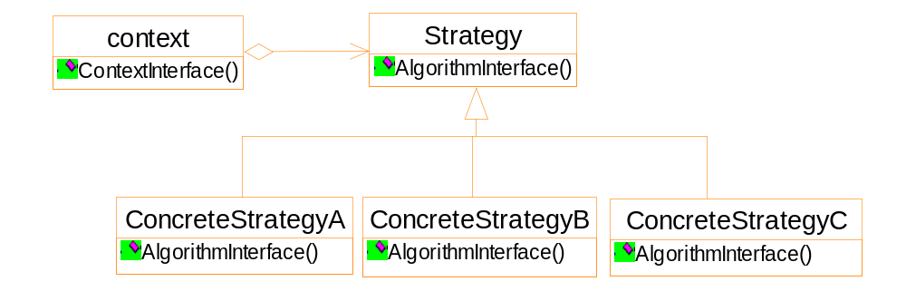
Notes:
Sub-classing the context class can also
implement different algorithms
Drawback: you can not easily change the
algorithms dynamically.

Slide 24
Decorator pattern
Intention
“Attach additional responsibilities to an object dynamically. Decorators provide a flexible alternative to sub-classing for extending functionality.”
It is some individual objects (not an entire class) to which the functionality is extended.
E.g, borders, scrolling bars.

Slide 25
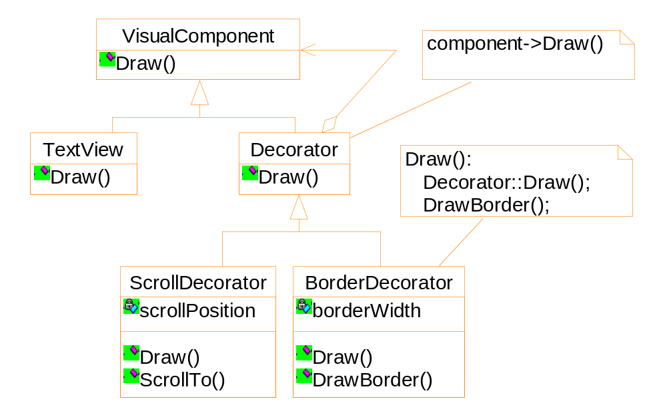
Application of the decorator pattern to the example

Slide 26
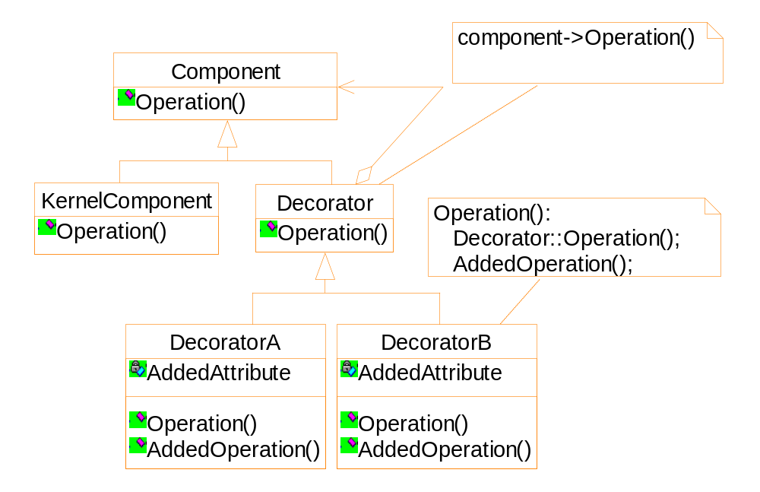
General structure of the decorator pattern

Slide 27
An example
I/O stream class
  Basic functionality: convert objects into bytes to store into a file or a memory block.
  Additional functionalities:
    Data compression
    Convert to 7-bit ASCII characters

Slide 28
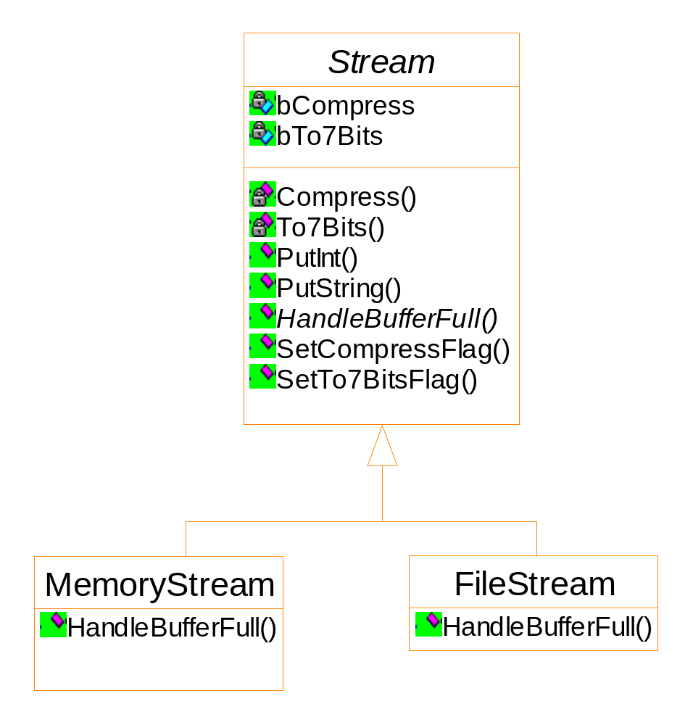
Solution 1: using flags ==>Fat root class

Slide 29
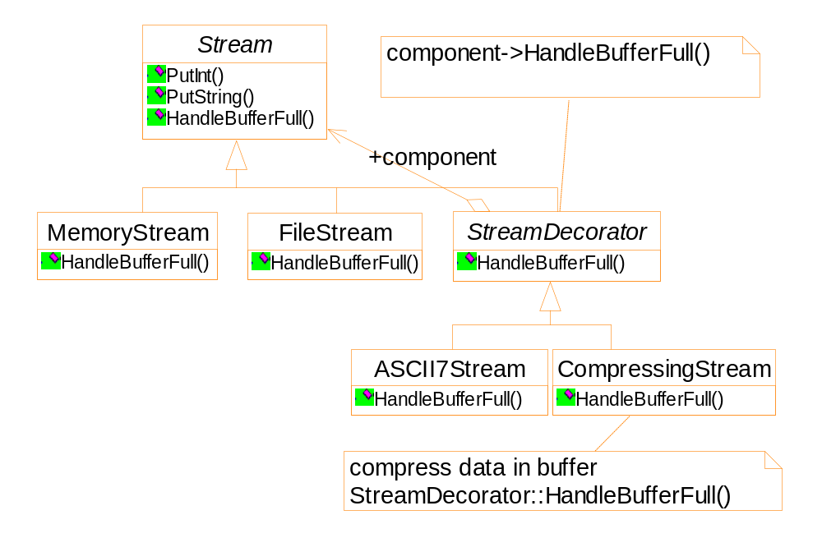
Solution 2:using decorator pattern

Slide 30
Code segments to use the decorator pattern
Stream * fStream = new FileStream("test.cpp");
Stream * mStream = new MemoryStream();
Stream * fcStream = new CompressingStream(
new FileStream("test.cpp") );
Stream * f7Stream = new ASCII7Stream ( new FileStream("test.cpp") );
Stream * fc7Stream = new CompressingStream(
new ASCII7Stream ( new FileStream("test.cpp") ));
fc7Stream->PutInt(12);
fc7Stream->PutString("hello");

Slide 31
A Java example
import java.io.*;
import java.util.zip.*;
public class GZIPCompress {
public static void main ( String [ ] args )
throws IOException {
BufferedReader in =
new BufferedReader (
new FileReader( args[0] ) );

Slide 32
BufferedOutputStream out =
new BufferedOutputStream (
new GZIPOutputStream (
new FileOutputStream(args[1] ) ));
System.out.println("Compressing file...");
int c;
while ( (c = in.read()) != -1 )
out.write(c);
in.close();
out.close();

Slide 33
System.out.println("Verifying file...");
BufferedReader in2 =
new BufferedReader (
new InputStreamReader (
new GZIPInputStream (
new FileInputStream( args[1] ) )));
String s;
while ( (s = in2.readLine()) != null )
System.out.println(s);
}
}

Slide 34
Exercise
For the class ExecutionTimesBaseStatistics, with the use of interface StatisticsLogger, create two decorators, that add the following functionality:
WithMeanStatisticsLogger, that displays the average of the results (values of list executionTimes in ExecutionTimesBaseStatistics) before displaying particular results
WithSummaryStatisticsLogger, that before displaying particular results, displays the following statistics:
  number of records
  sum
  minimum value
  maximum value

Slide 35
import java.util.List;
public interface StatisticsLogger {
void displayStatistics();
List<Double> getExecutionTimes();
}
import java.util.List;
public class ExecutionTimesBaseStatistics implements StatisticsLogger {
private final List<Double> executionTimes;
public ExecutionTimesBaseStatistics(final List<Double> executionTimes) {
this.executionTimes = executionTimes;
}
1/3

Slide 36
@Override
public void displayStatistics() {
final StringBuilder stringBuilder = new StringBuilder();
executionTimes.forEach(executionTime ->
stringBuilder.append("Execution time: ").
append(executionTime).append("\n"));
System.out.println(stringBuilder.toString());
}
@Override
public List<Double> getExecutionTimes() {
return executionTimes;
}
}
2/3

Slide 37
// sample main
public class DecoratorDemo {
public static void main(String[] args) {
final StatisticsLogger statisticsLogger =
new WithMeanStatisticsLogger(
new WithSummaryStatisticsLogger(
new ExecutionTimesBaseStatistics(List.of(1.2, 2.2, 3.4))));
statisticsLogger.displayStatistics();
}
}
3/3

Slide 38
// 参考答案
import java.util.List;
public class WithMeanStatisticsLogger implements StatisticsLogger {
private final StatisticsLogger statisticsLogger;
public WithMeanStatisticsLogger(final StatisticsLogger statisticsLogger) {
this.statisticsLogger = statisticsLogger;
}
@Override
public void displayStatistics() {
final double mean = getExecutionTimes().stream().mapToDouble(x -> x).sum() /
getExecutionTimes().size();
System.out.println("Mean is " + mean);
statisticsLogger.displayStatistics();
}
@Override
public List<Double> getExecutionTimes() {
return statisticsLogger.getExecutionTimes();
}
}
1/2

Slide 39
import java.util.List;
public class WithSummaryStatisticsLogger implements StatisticsLogger {
private final StatisticsLogger statisticsLogger;
public WithSummaryStatisticsLogger(final StatisticsLogger statisticsLogger) {
this.statisticsLogger = statisticsLogger;
}
@Override
public void displayStatistics() {
System.out.println(getExecutionTimes().stream()
.mapToDouble(x -> x).summaryStatistics());
statisticsLogger.displayStatistics();
}
@Override
public List<Double> getExecutionTimes() {
return statisticsLogger.getExecutionTimes();
}
}
2/2

