Slide 1
The Command Pattern
Menu:New
Delete
…
Create a new dialog.
Delete an element
Open a dialog.
Print a dialog.
Copy to clipboard
Paste from clipboard
…
Button:
…
keyboard: Delete
…
User interface
Operations

Slide 2
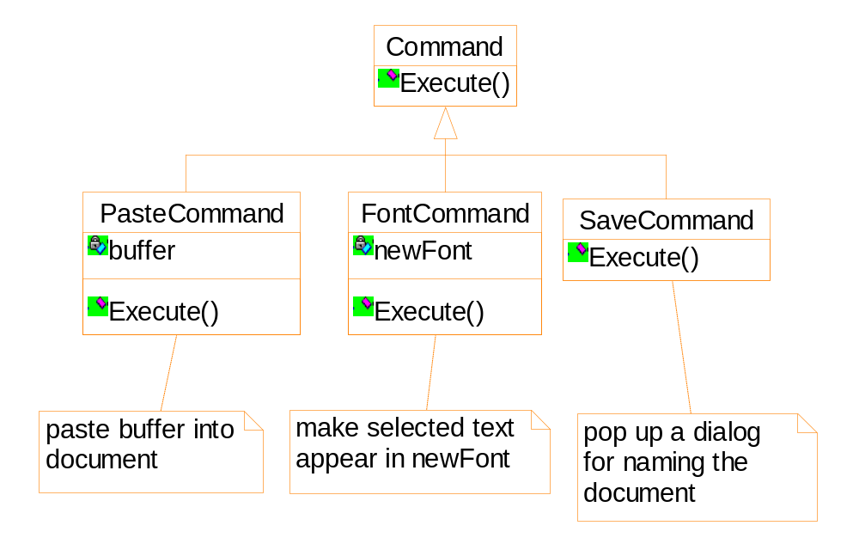
Operation details of the commands are recorded

Slide 3
Applicability
Support undo
Support context-sensitive menus
Support command macros
Support logging changes to recover a crashed system
Support the concept of transaction in an information system

Slide 4
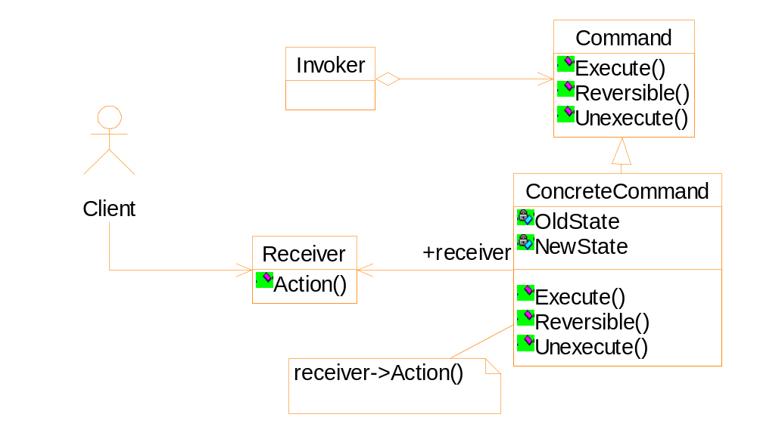
Structure of the Command pattern

