Slide 1
Abstract Factory Pattern
Motivation
some application need to change their interface style at run-time
First step
  Abstract widget classes
  Concrete sub-classes

Slide 2

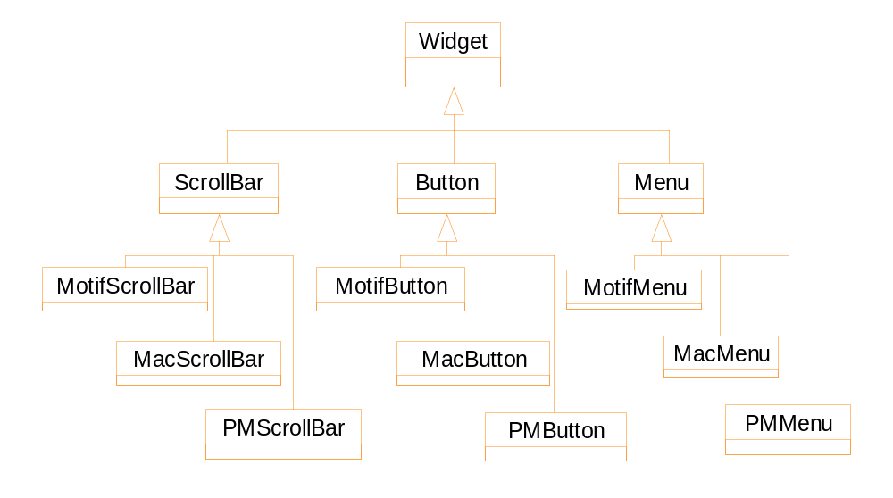
Abstract widget classes & their subclasses

Slide 3
Create objects directly
switch (Style) {
case Motif:
ScrollBar * sb = new MotifScrollBar;
Button * bn = new MotifButton;
Menu * mn = new MotifMenu; break;
case Mac:
ScrollBar * sb = new MacScrollBar;
Button * bn = new MacButton;
Menu * mn = new MacMenu; break;
case PM:
ScrollBar * sb = new PMScrollBar;
Button * bn = new PMButton;
Menu * mn = new PMMenu; break;
}

Slide 4
Problems of the previous solution
Lengthy: each time we create some widgets, we must use a switch statement
May cause problems: you create a Mac-style button, but the current style is Motif.
Difficult to switch styles: how to track the old widgets to destroy them?

Slide 5
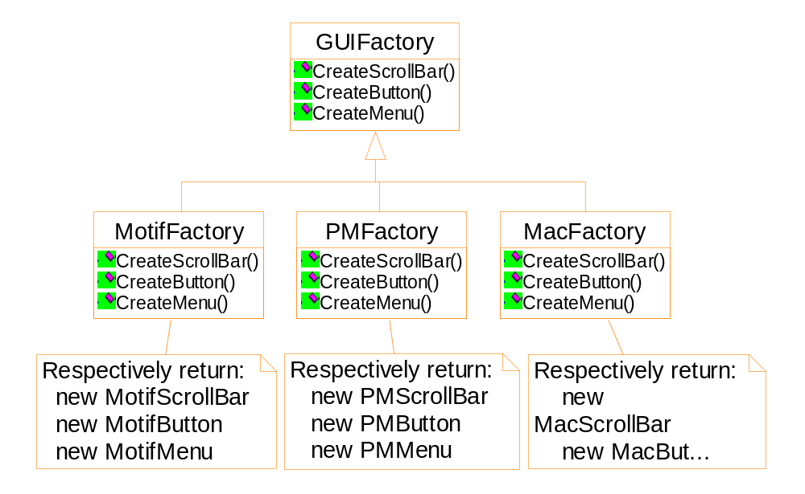
Factory classes and their products

Slide 6
Create objects from an abstract factory
switch (Style) {
case Motif:
guiFactory = new MotifFactory( ); break;
case Mac:
guiFactory = new MacFactory( ); break;
case PM:
guiFactory = new PMFactory( ); break;
}
ScrollBar * sb = guiFactory->CreateScrollBar( );
Button * bn = guiFactory->CreateButton( );
Menu * mn = guiFactory->CreateMenu( );

Slide 7
Iterator & visitor pattern
Lexi: spelling check and hyphenation
  We are only interested in the text of the document
  The text is scattered through out the hierarchy structure
  Different types of glyphs may store their children in different data structures ( array, linked list, etc.)
  Potentially there are many possible textual analysis requirements.

Slide 8
template <class Item>
class List {
List( long size=DEFAULT_LIST_CAPACITY);
long count() const;
Item & Get( long index) const;
void print();
}
template <class Item>
class Iterator {
public:
virtual void First() = 0;
virtual void Nex() = 0;
virtual bool IsDone() const=0;
virtual Item CurrentItem() const = 0;
protected:
Iterator();
}

Slide 9
template <class Item>
class ListIterator: public Iterator<Item> {
public:
ListIterator (const List<Item> * aList):
_list(aList), _current (0)
{ };
virtual void First() { _current = 0; }
virtual void Next() { _current ++; }
virtual bool IsDone() const {
return _current >= _list->Count();
}
virtual Item CurrentItem() const {
if (IsDone () ) throw IteratorOutOfBounds;
return _list->Get( _current );
}

Slide 10
private:
const List<Item> * _list;
long _current;
}
void PrintEmployees(ListIterator<Employee*>&i)
{
  for (i.First(); !i.IsDone(); i.Next() ) {
  i.CurrentItem()->Print();
  }
}
List<Employee*> * employees;
ListIterator<Employee*> forward( employees );
ReverseListIterator<Employee*>
backward( employees);
PrintEmployees( forward );
PrintEmployees( backward );

Slide 11
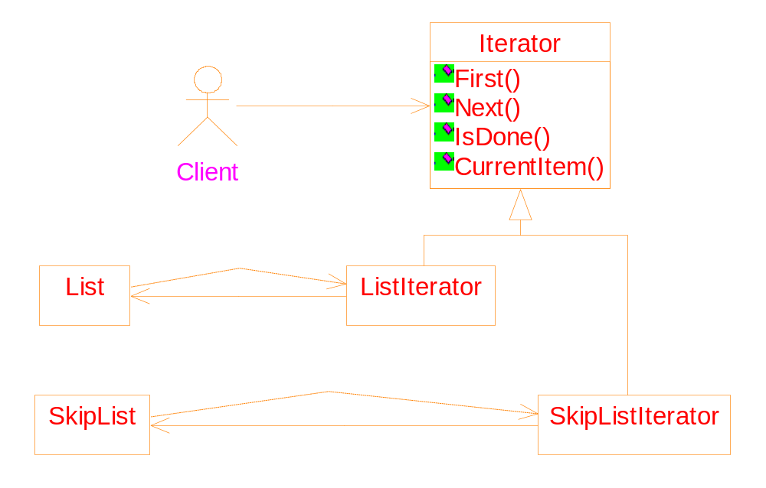
Iterators with common ancestor
void PrintEmployees(Iterator<Employee*>& i)

Slide 12
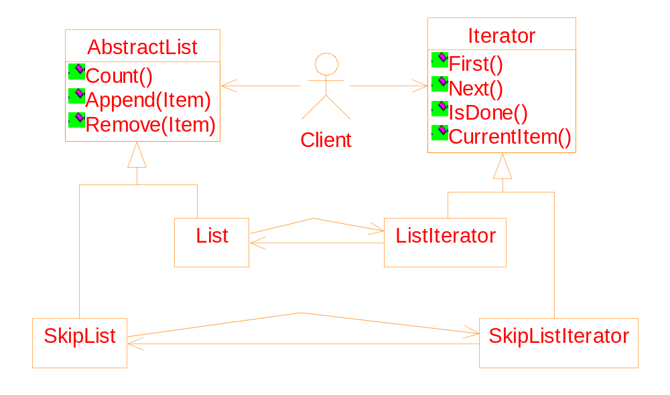
Let lists also have a common ancestor
Write code that works for both List and SkipList

Slide 13
Suppose we want that an item can be inserted into a list only when the list does not contain any item which is identical to the item.
// pseudo-code
void ConditionalInsert(AbstractList * list, Item I)
{
Create an iterator it for the list;
for ( it->First(); ! it->IsDone; it->Next() )
if ( it->CurrentItem == I ) break;
if ( ! it->IsDone() )
return ; // the item already exist.
list->Append( I );
}

Slide 14
How can we
do it?
// pseudo-code
void ConditionalInsert(AbstractList * list, Item I)
{
Create an iterator it for the list;
for ( it->First(); ! it->IsDone; it->Next() )
if ( it->CurrentItem == I ) break;
if ( ! it->IsDone )
return ; // the item already exist.
list->Append( I );
}

Slide 15
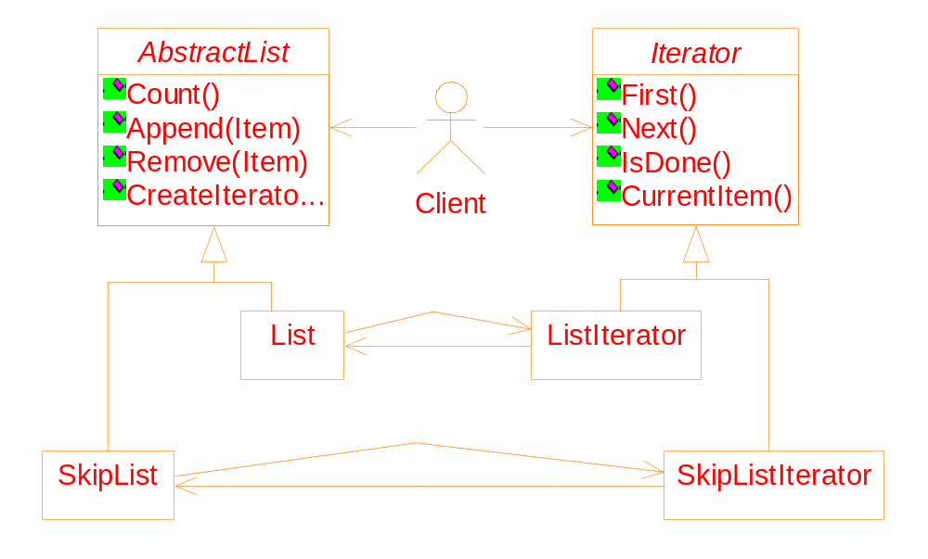
CreateIterator( ): Applying the polymorphism mechanism.
Benefits: More concise interface; greater opportunity to re-use code.

Slide 16
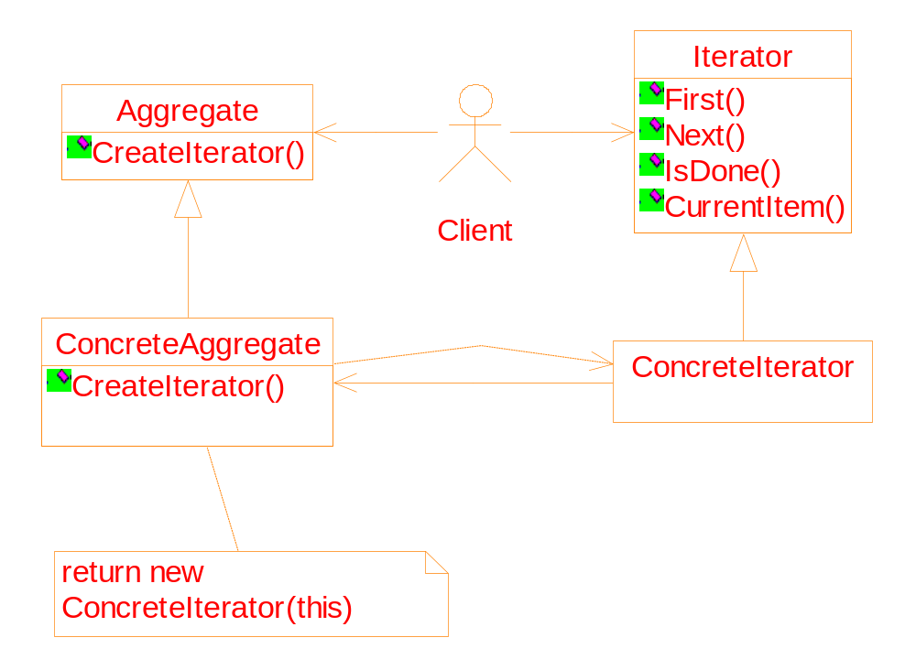
General structure of the iterator pattern

Slide 17
Implementation:
Making sure iterators get deleted
// pseudo-code
void ConditionalInsert(AbstractList * list, Item I)
{
Iterator * it = list->CreateIterator();
for ( it->First(); ! it->IsDone; it->Next() )
if ( it->CurrentItem == I ) break;
if ( ! it->IsDone )
return ; // the item already exist.
list->Append( I );
// We forget deleting it => memory leakage
}

Slide 18
Use the Proxy pattern to solve the problem
Encapsulate each pointer into an object
Within the object, overloading the -> and * operators
Declare the object as a stack variable
When the object goes out of a scope, its destructor deletes the pointer
将每个指针封装到一个对象中，在对象中，重载 -> 和 * 运算符
将对象声明为堆栈变量
当对象超出作用域时，其析构函数将删除指针

Slide 19
template <class Item>
class IteratorPtr {
public:
IteratorPtr( Iterator<Item> * i) : _i(i) {}
~IteratorPtr() { delete _i; }
Iterator<Item>* operator->() { return _i; }
Iterator<Item>& operator*() { return * _i; }
private:
// to avoid multiple deletions of _i
IteratorPtr(const IteratorPtr & );
IteratorPtr& operator=(const IteratorPtr&);
private:
Iterator<Item>* _i;
}

Slide 20
// pseudo-code
void ConditionalInsert(AbstractList * list, Item I)
{
IteratorPtr it( list->CreateIterator() );
// syntax of using an IteratorPtr object is as the
// same as the Iterator*
for ( it->First(); ! it->IsDone; it->Next() )
if ( it->CurrentItem == I ) break;
if ( ! it->IsDone )
return ; // the item already exist.
list->Append( I );
// the "Iterator*" will be deleted automatically
}

