Slide 1
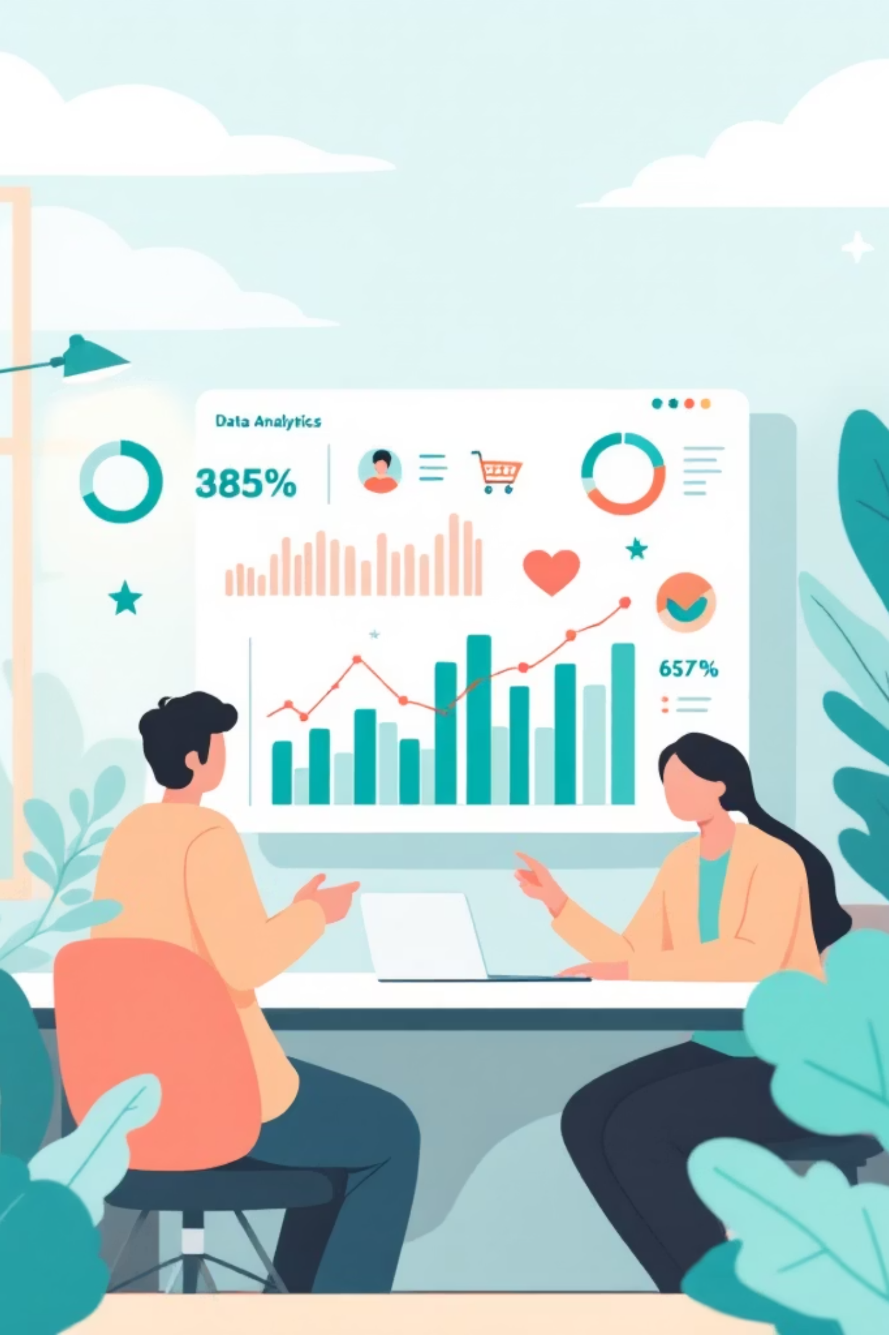
Customer Shopping Behavior Analysis
Uncovering insights from 3,900 purchases to drive strategic decisions

Slide 2
PROJECT SCOPE
Dataset Overview
3,900
18
Total Purchases
Data Features
Key Data Points
Customer demographics & location
Purchase details & product categories
Shopping behavior & review ratings
Subscription & shipping preferences

Slide 3
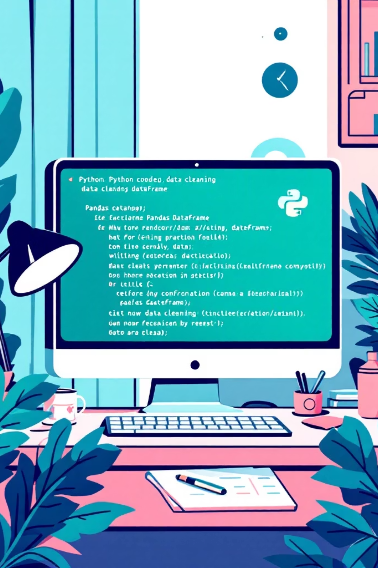
DATA PREPARATION
Python Data Processing
01
Data Loading & Exploration
Imported dataset, checked structure and summary statistics
02
Missing Data Handling
Imputed 37 missing review ratings using category medians
03
Feature Engineering
Created age groups and purchase frequency columns
04
Database Integration
Connected to MySQL for advanced SQL analysis

Slide 4

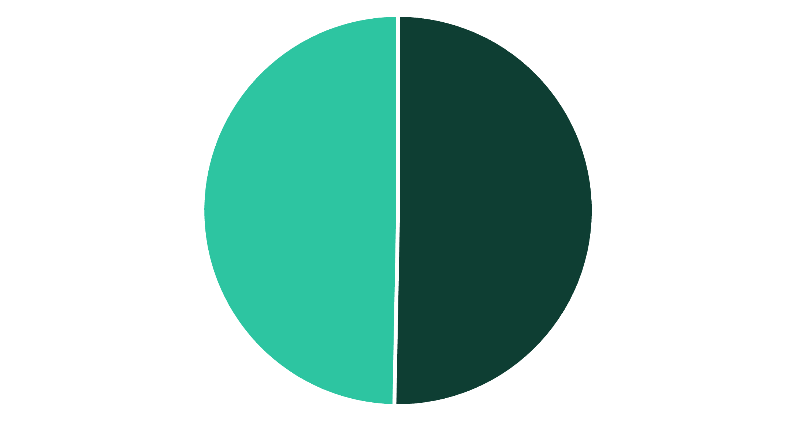

SQL ANALYSIS
Revenue Insights
Gender Revenue Comparison
Nearly equal revenue distribution between male and female customers, indicating balanced market appeal across genders.
Both segments contribute approximately $117K each to total revenue
Male
Female

Slide 5

Subscription Impact
Subscribers
Non-Subscribers
Average spend: $60.12
Average spend: $59.88
Total revenue: $117K
Total revenue: $117K
Subscribers with 5+ purchases show higher retention rates, indicating subscription value for loyalty

Slide 6
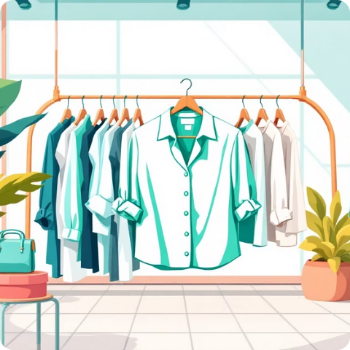



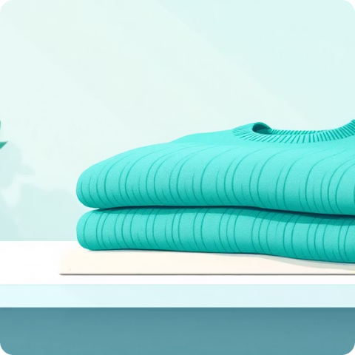
PRODUCT PERFORMANCE
Top-Rated Products
Blouse
Jewelry
Dress
Handbag
⭐ 4.2 rating
⭐ 4.08 rating
⭐ 4.05 rating
⭐ 3.98 rating
Sweater
⭐ 3.97 rating

Slide 7
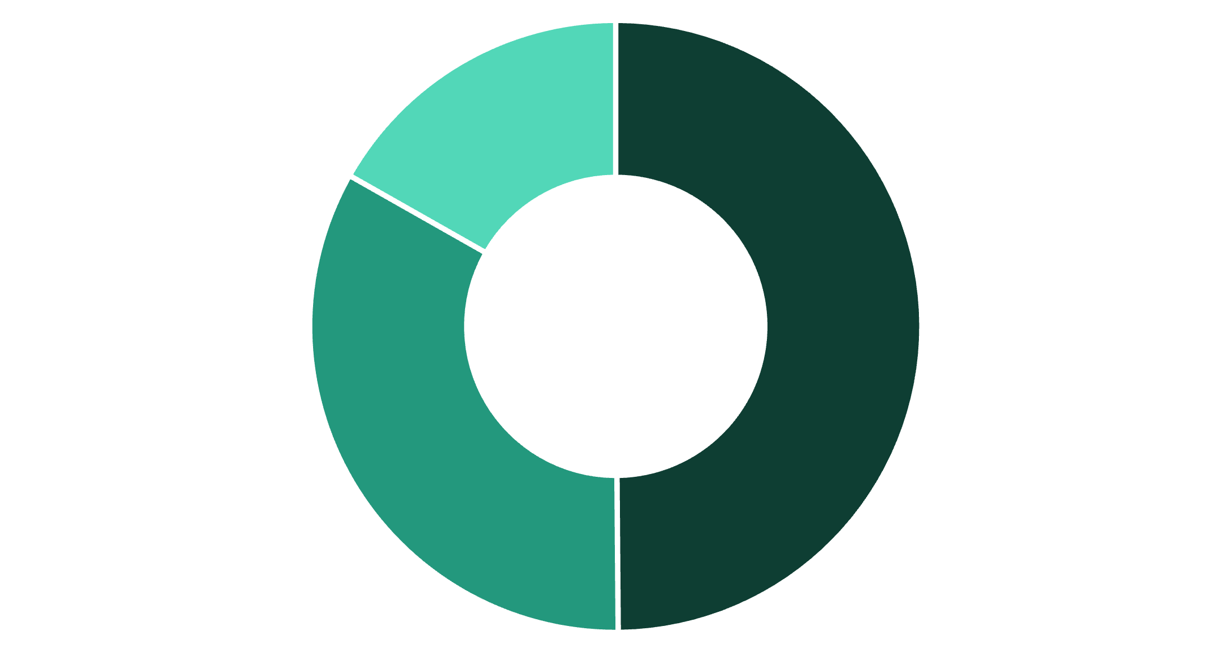
Customer Segmentation
Three Distinct Segments
New (50%)
First-time buyers
Returning (33%)
2-4 purchases
Loyal (17%)
New
Returning
Loyal
5+ purchases

Slide 8
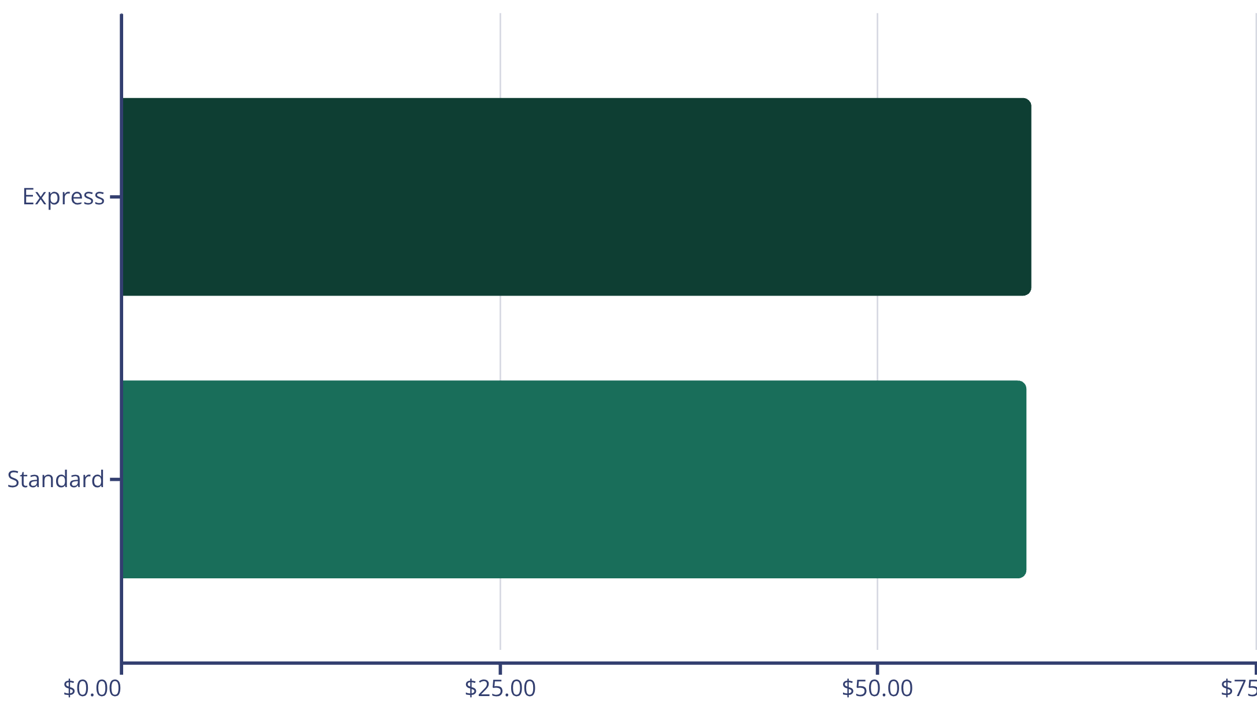
Shipping Preferences
Minimal Difference
Express shipping customers spend slightly more on average
Both options maintain similar purchase values around $60

Slide 9
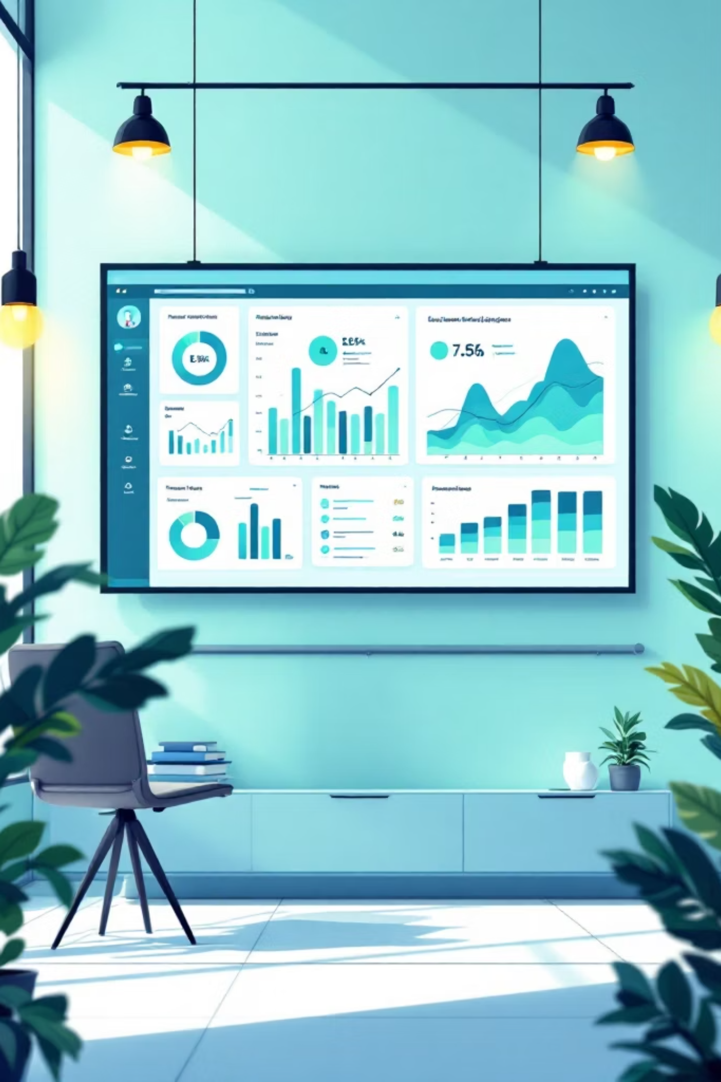
POWER BI
Interactive Dashboard
Comprehensive visual analytics combining all insights into an actionable dashboard for real-time decision making
Dynamic Filtering
Slice data by demographics, products, and time periods
Revenue Tracking
Monitor performance across segments and categories
Customer Insights
Visualize behavior patterns and preferences

Slide 10




STRATEGIC ACTIONS
Business Recommendations
Boost Subscriptions
Loyalty Programs
Promote exclusive benefits to increase subscriber base
Reward repeat buyers to build loyal customer segment
Optimize Discounts
Targeted Marketing
Balance promotional sales with margin control
Focus on high-revenue age groups and top products

