Slide 1

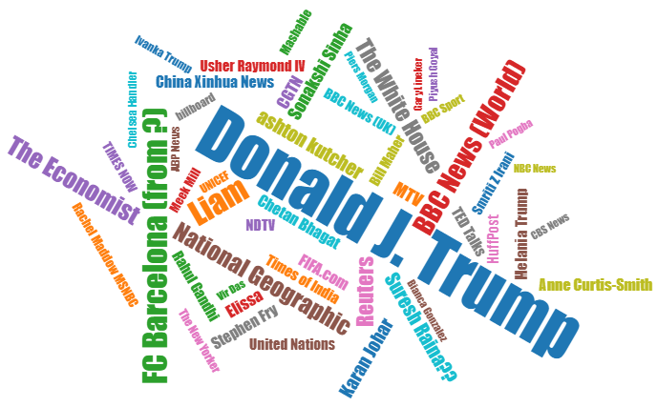
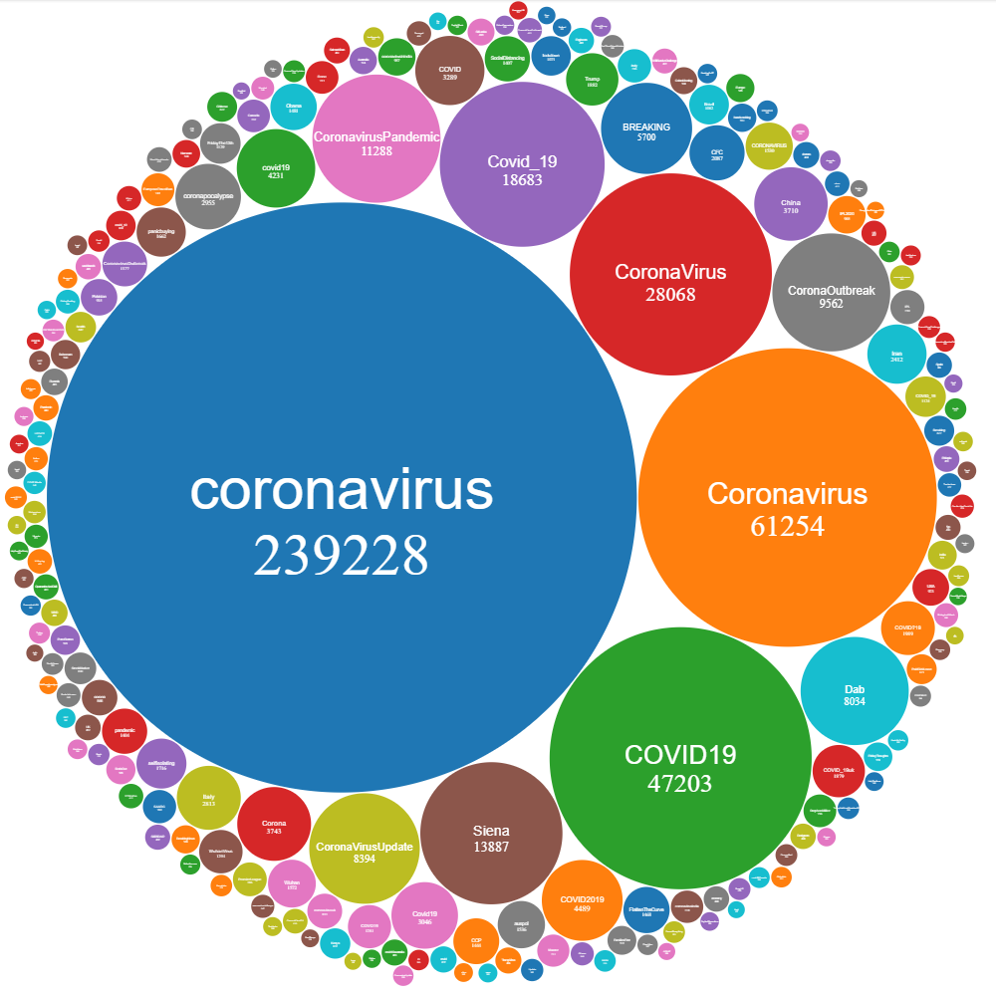
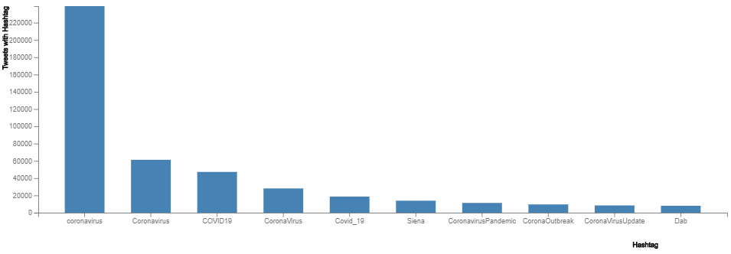
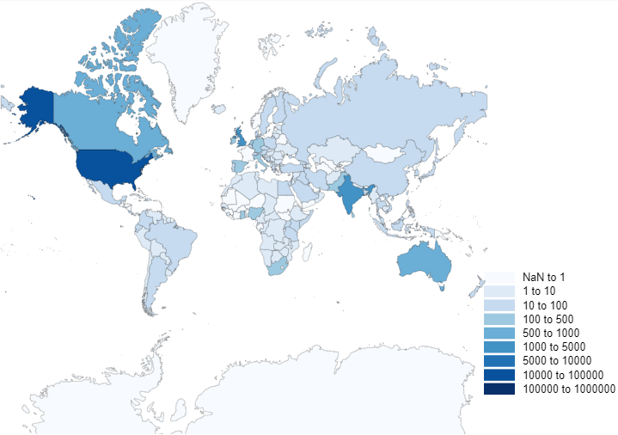
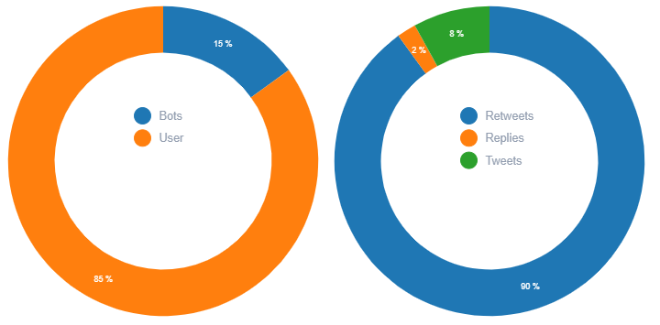
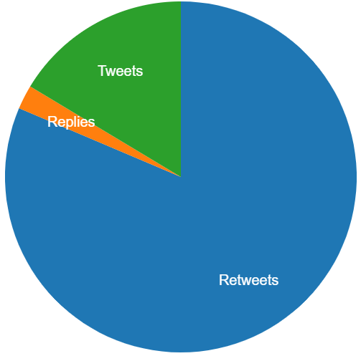
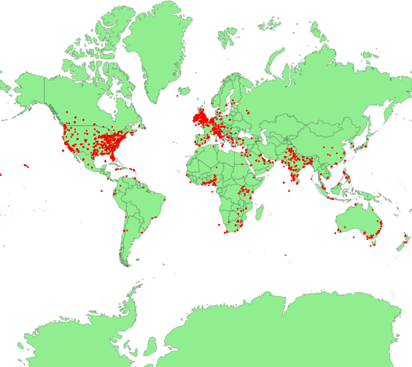
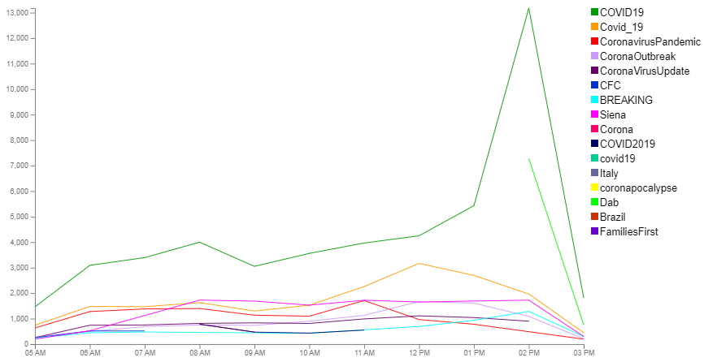








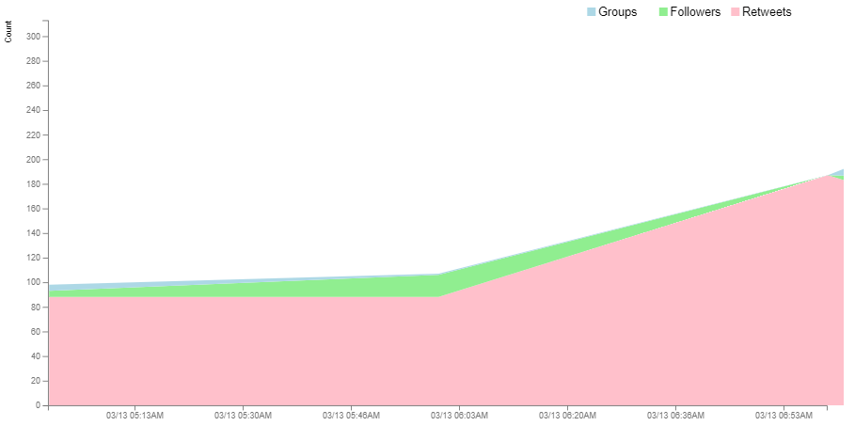
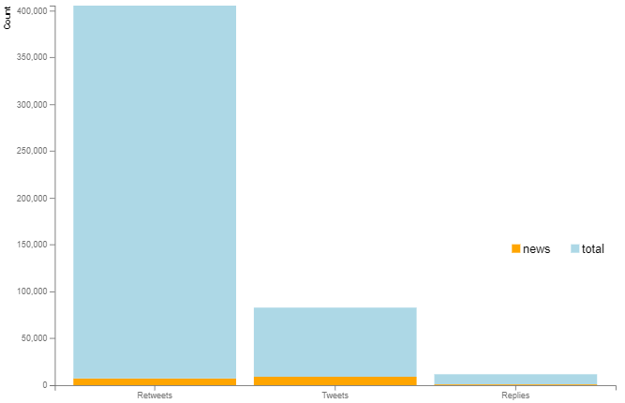






Coronavirus 2019 Tweet Analysis
A Project Developed by Jonathan Wolfe & Rod Skoglund
Principles of Big Data Management (CS 5540) - University of Missouri-Kansas City, Missouri
Introduction
Analysis / Visualizations
Methods
This project provides an analysis of the Coronavirus (COVID-19) which has had a major impact across the globe. This application was designed, developed and deployed to perform and provide visualizations based on sophisticated analytical queries that are applied to tweets captured as part of the application processing.
Developed a Java script that utilized the twitter4j-4.0.7 Java Library to access the Twitter API and capture 2.3 million tweets. The tweets we collected included the tweet information, Hashtags and URLs. We focused on tweets containing #coronavirus and filtered to only include tweets in English.
The tweets were saved to a set of files where each file is limited to 64MB. The files contain tweets as JSON data with a single tweet per line.
Developed and implemented queries to provide data for visualizations using java and accessing the spark library. The application hosted a jetty REST API server utilizing Spark to run queries. D3 was used to create the visualizations. And in the end, Docker was utilized to containerize the REST API server and Ionic web application server.
Objective
The main objective is to analyze the conversations regarding Coronavirus around the world. This required state-of-the-art Big Data tools/libraries to collect, store and analyze the twitter data and provide powerful visualizations to lead us to its conclusions.
Technology Used
Conclusion
We have gained invaluable hands-on experience in not only using Big Data technologies, but also understanding them for data analysis and visualization.
We have gotten insights about Coronavirus by analysis and visualization of tweets. Here is a surprise, President Trump is a top influencers.

