Slide 1
Movie Rating Analysis
Rod Skoglund
Sam Piesterson
Darla Foster

Slide 2
What Impacts Customer Movie Ratings?
  Chose the following three categories to determine what impact they have on a movie’s rating
    Budget
    Runtime
    Profit

Slide 3
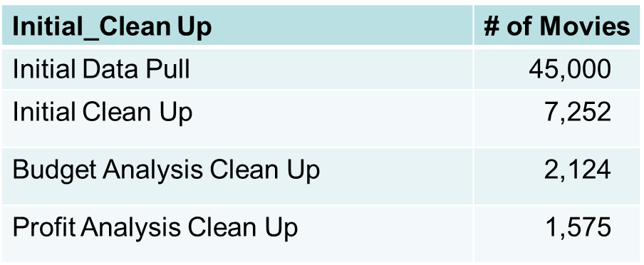
Movie Data Sources
  Initial data source - OMDB
    More comprehensive resource
    API data pull limits
  Final data source - Kaggle csv file
    Less data available

Slide 4
Movie Data Cleanup & Exploration
  Removed invalid data
    Ratings
    Movie ID
    Budget
    Revenue
  Unexpected challenges
    Used two CSVs and the unique identifier was movie ID
    Movie ID had two different column headers

Slide 5
Movie Data Cleanup & Exploration
  Data shifted in original data set – removed the movie from the data set
  Removing NA dropped 27 rows from the initial data set the - removed these movies from the data set

Slide 6
Data Analysis
  Data prep to answer our questions
    We looked at Kaggle csv files and selected movie attributes that we could analyze to see if there were any impacts on the average rating.
    The ratings csv has more than 26M ratings. We took the average of these ratings for each movie and used it as the common metric.
  Jupyter Notebook challenges
    We had issues getting some of the columns converted into numeric values we could use in our graphs. The simple “pd to numeric” was not enough. After some google searches we found a way to get it converted.
    The size of the ratings csv file (692 MB), took a long time to read in, so every retry took tome to get back to checking code changes.

Slide 7
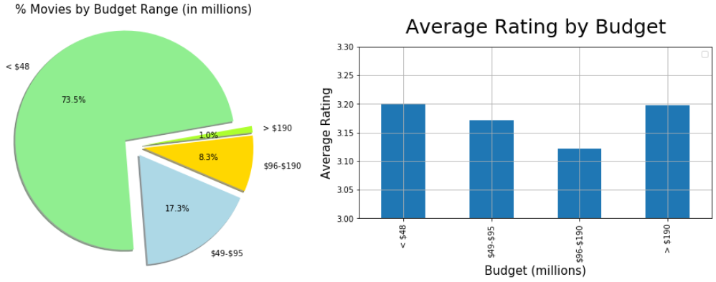
Rating vs Budget Analysis

Slide 8
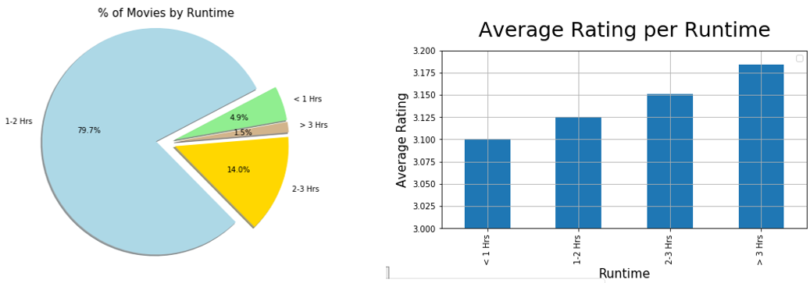
Rating vs Runtime Analysis
  Correlation exists between movie length and rating – the longer the better

Slide 9
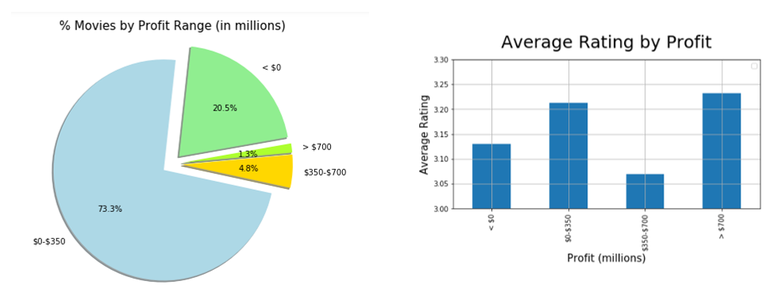
Rating vs Profit Analysis
  No direct correlation between movie ratings and profits.

Slide 10
Questions
Comments

