Slide 1

Project Aviation Data
Strategic Aircraft Selection Through Aviation Risk Analytics
Presented by: Rodolphe Charles
Date: June 29, 2025

Slide 2
Introduction
Objective: Identify low‑risk aircraft for commercial investment.
Context: Company expanding into aviation; requires data‑driven guidance.
Goal: Minimize operational, reputational, and insurance risks.

Slide 3
Data Preparation & Methodology
Historical accident data (1962–2023) imported and validated.
Key variables selected: Event Date, Aircraft Category, Model, Fatalities, Weather.
Data cleaned; missing or irrelevant rows removed.
Engineered metrics: Fatality Rate, Year of Accident, Aircraft Age.

Slide 4
Aircraft Risk Profiling
Grouped aircraft by model and category.
Calculated total accidents and total fatalities.
Derived fatality rate for each model.
Identified Top 10 safest models (lowest total fatalities).

Slide 5
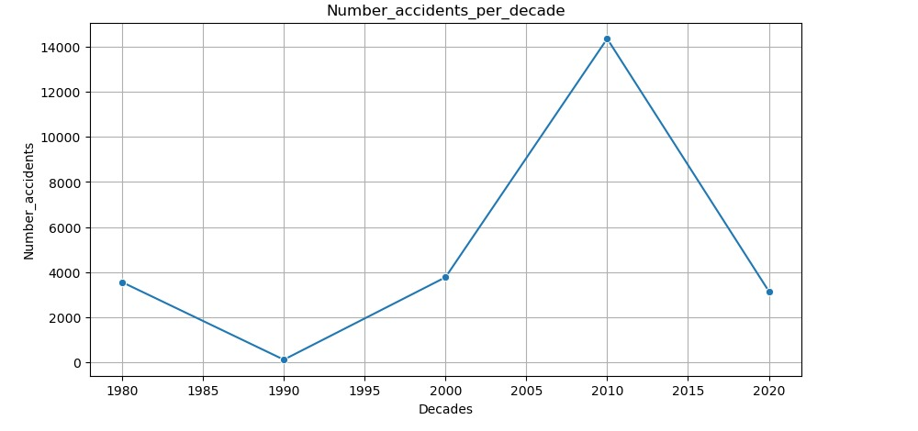
Trend Analysis (1962–2023)
Accident counts and fatality rates tracked by decade.
Significant safety improvements observed post‑1990.
Steady decline in both accident frequency and severity.

Slide 6
Accident Type Risk Analysis
Accident summaries classified into key types (e.g., mid‑air collision, LOC‑I).
Average fatality rate calculated for each accident type.
Most dangerous categories highlighted for mitigation planning.

Slide 7
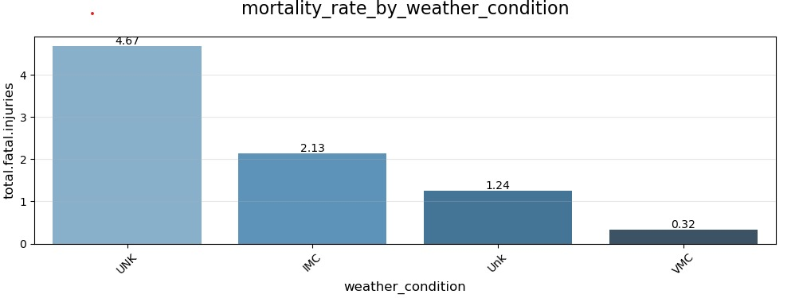
Weather Condition Cross‑Analysis
Grouped accidents by weather condition (VMC vs. IMC).
Highest fatality rates under IMC or unknown conditions.
Lowest accident rates under VMC flights.

Slide 8
Case for ULTR Aircraft
Zero fatalities recorded across all incidents (0% fatality rate).
Extremely low accident frequency in dataset.
Predominantly operated under VMC, further reducing risk.
Ideal candidate for initial fleet acquisition.

Slide 9
Strategic Recommendations
Invest in ULTR aircraft as the initial fleet backbone.
Exclude high‑casualty manufacturers pending technical audit.
Adopt strict no‑go criteria for adverse weather operations.

Slide 10
Conclusion
ULTR offers maximum safety, minimal liability, and operational efficiency.
Data‑driven approach supports confident entry into aviation sector.
Next step: Finalize procurement and integrate safety dashboard.

