Slide 1
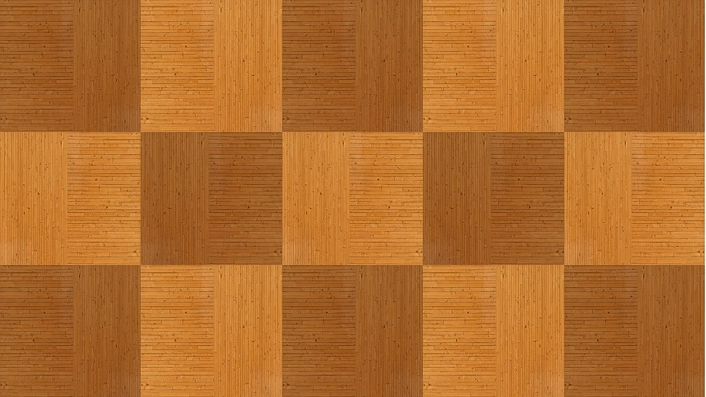
Crossway
Software Development Methods exam
Giulia Bernardi, Marianna Corsano and Rodolfo Tolloi

Slide 2
A QUICK INTRO ON THE GAME: HOW IT WORKS
Crossway is a 2-players game played on a 19x19 board.
At the beginning of the game, each player chooses a colour between black and white. The black will place a piece first. Then, the players will keep alternating placing one piece per turn. Pieces are to be placed on the intersections of the lines drawn on the board.
The objective of the game is to form a contiguous sequence of white stones connecting the left edge of the board to the right one for the white player, and to form a contiguous sequence of black stones connecting the top edge of the board to the bottom one for the black player.

Slide 3
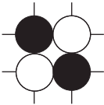
A QUICK INTRO TO THE GAME: PIE RULE AND ILLEGAL PLACEMENTS
The current player can place their piece wherever they prefer on the board with just two rules:
A piece cannot be placed where there is already another piece.
The formation in the picture on the right can never be formed.
PIE RULE
When the white player begins their first turn, they will have two options:
Placing a white piece wherever they prefer.
Stealing the black piece already placed on the board.

Slide 4
Organising the project

Slide 5
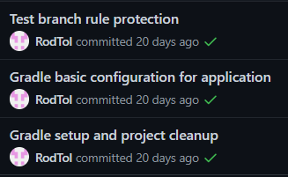

STEP 1: STRUCTURE DEFINITION AND VERSION CONTROL INITIALISATION
We first started the project by setting up a Github repository as a Version Control system. We set up Gradle for Test Driven Development, and we set up Circle CI.
Then, we chose the basic structure of the project. We decided:
That we wanted to implement a GUI by using Swing.
That we wanted three main packages: model, controller, and GUI.

Slide 6



STEP 2: FIRST WORKLOAD DISTRIBUTION
It was decided that Marianna Corsano would start implementing the basis of the GUI, while Giulia Bernardi and Rodolfo Tolloi worked on the logic of the model. The work was partly done individually and partly done together on the same pc, especially when important decisions were to be taken.
Test Driven Development was put in practice implementing the model by first creating the failing tests and then making them pass by updating the code.
This was used a bit less in the implementation of the GUI, since tests on the GUI are pretty heavy and since (especially in the beginning) it is more effective to simply look at the results.

Slide 7
FIRST STEPS IMPLEMENTING THE GUI: THE BASICS
The first implementation of the GUI consisted of:
Drawing the lines forming the board by overriding the paint method in Swing.
Adding a MouseMotionListener, since we decided that we wanted a transparent piece to follow the movements of the player’s mouse.
Placing a piece on the board (only graphically).

Slide 8
FiRST STEPS IMPLEMENTING THE MODEL
The classes Piece, Node, and Board were implemented.
At this point in the development, the model was able to:
Check if a node was empty and if not check the content of the node;
Place a Piece on a Node of a Board;

Slide 9



STEP 3: MAKING THE MODEL AND THE GUI WORK TOGETHER
In this phase, we all collaborated on all parts of the project.
MODEL
We realised we needed another class, Coordinates, in order to properly communicate with the GUI.
GUI
The GUI at this point became able to place a piece also logically.
CONTROLLER
We decided that the olace method in the Controller should return a Status, which contains the enum:
PLACED, which signals the piece has been correctly placed on the board.
NOT_PLACED, which signals that the piece has not been correctly placed on the board.
WON, which signals that the player asked to place a piece in a position that will grant them a victory.

Slide 10
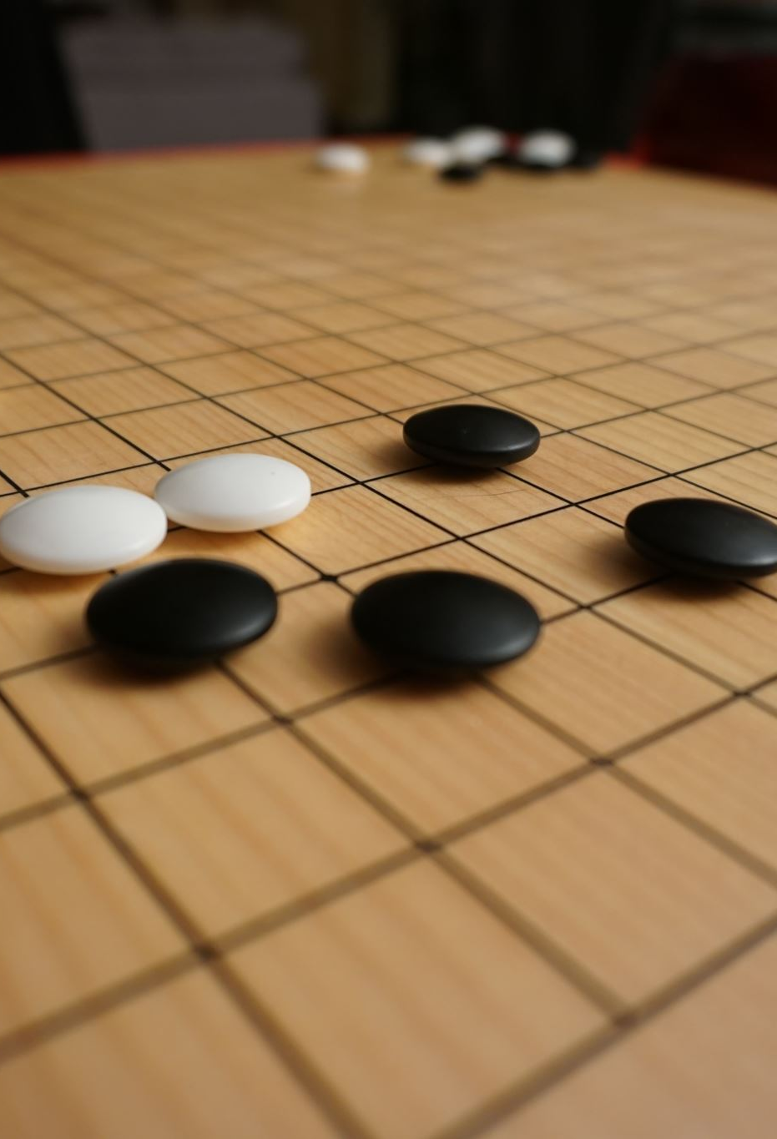
STEP 4: IMPLEMENTATION OF THE RULES
At this point, we had a working board (both logically and graphically) but the rules of the game had not been implemented yet. This was the next step.

Slide 11

IMPLEMENTATION OF THE RULES: ILLEGAL POSITIONS
We decided that the transparent piece which follows the mouse of the players should only appear on legal placements of the piece, that is on placements that do not form the disposition shown above.
In order to do so, each time the mouse hovers over a coordinate the canPlace method is called. This method checks the 8 nodes neighbouring the chosen coordinates: if it finds that they are near a diagonal of the opposite colour and that on the other side of this diagonal there is a piece of the current colour, canPlace will return false and the transparent piece will not be shown. If the player tries to click there anyway the piece will not be placed.
The canPlace method also checks if a piece is already present on the chosen coordinates, not allowing a placement on an occupied node.

Slide 12

IMPLEMENTATION OF THE RULES: WIN CONDITION
Since the win condition requires to have a continuous path of same coloured pieces, our idea was to create a graph containing all the pieces with the same colour starting from a piece in the last row or column.
Therefore, the classes Graph and Vector were implemented by Giulia Bernardi.
The class WinController, which checks for victory at the end of each turn, was implemented by Rodolfo Tolloi. Before creating the graph to check if the player won, some simpler but necessary conditions are evaluated:
Is there a sufficient number of white/black pieces on the board to win?
Is there at least a piece of the player colour for each row/column index?

Slide 13


NEW ELEMENTS: THE PLAYER CLASS AND THE STARTING GUI
At this point we decided that it would be nice to have the name of the players on the GUI, so that when one of them wins, a congratulations message will appear. This «end of the game» panel, was implemented by Rodolfo Tolloi.
This decision lead to the addition of the Player class implemented by Marianna Corsano and of the StartingGui class, implemented by Rodolfo Tolloi.
This GUI asks the users to insert their name before playing.

Slide 14

IMPLEMENTATION OF THE RULES: PIE RULE
The pie rule can be invoked only once in the game, that is on white player’s first turn. Therefore, Marianna Corsano added to the GUI a button that appears at such time which, if clicked, activates the logic implemented by Giulia Bernardi, which simply switches the colours of the two players proceding with the turns normally. If the button is not clicked and a piece is placed instead, it disappears.

Slide 15


STEP 4: A SPECIAL CASE
A special case occurs in the game when a player has no available positions for its pieces. In this rare occasion, the player will skip their turn until the other player wins.
This check, which simply calls canPlace on all the board at the beginning of each turn returning true at the first available position, was implemented by Giulia Bernardi.
We additionally decided to indicate the turn on the GUI by highlighting the current player in a different colour.

Slide 16
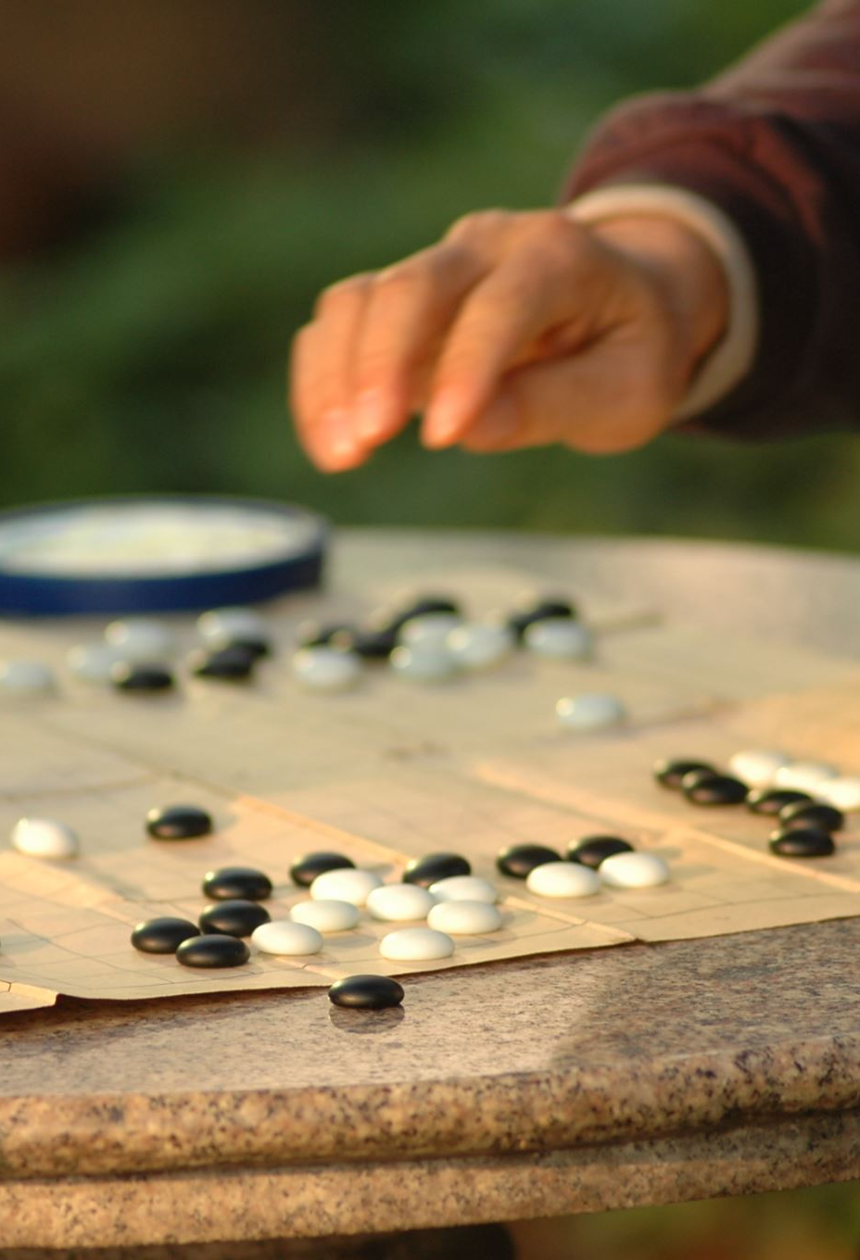
STEP 5: FINISHING TOUCHES AND REFACTORING
At this point, the game was functional: everything worked and it was already usable. We then focused on making the GUI look better, adding some non-essential features, and refactoring to remove code smells.

Slide 17
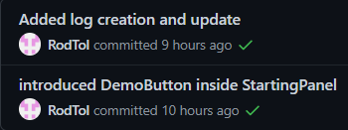

STEP 5: FINISHING TOUCHES
A wooden background and letters and numbers were added to the board by Marianna Corsano.
Rodolfo Tolloi had the idea of inserting a demo, that is an automatic game. This can be activated by clicking a button in the Starting Gui. He also added a log file, taking note of the moves done by the players.
Giulia Bernardi prepared the presentation for the exam.
An additional idea was to insert a «I give up» button.

Slide 18
STEP 5: A LOT OF REFACTORING

Slide 19
FUTURE STEPS: POSSIBLE UPDATES
We identified some possible future improvements that can be added to make this software even better:
A timer to regulate turns’ length.
An ‘undo’ button, in case the user clicks unvoluntarily placing a piece.

Slide 20
DEMONSTRATION OF OUR CODE
NOW WE WILL SHOW OUR RESULTS

Slide 21
THANK YOU FOR YOUR ATTENTION

