Slide 1
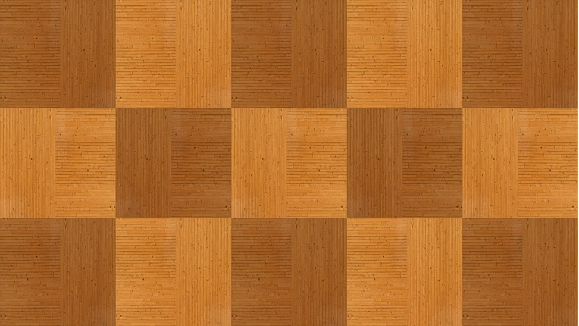
Crossway
Software Development Methods exam
Giulia Bernardi, Marianna Corsano and Rodolfo Tolloi

Slide 2
A QUICK INTRO ON THE GAME: HOW IT WORKS
Crossway is a 2-players game played on a 19x19 board.
At the beginning of the game, each player chooses a colour between black and white. The black will place a piece first. Then, the players will keep alternating placing one piece per turn. Pieces are to be placed on the intersections of the lines drawn on the board.
The objective of the game is to form a contiguous sequence of white stones connecting the left edge of the board to the right one for the white player, and to form a contiguous sequence of black stones connecting the top edge of the board to the bottom one for the black player.

Slide 3
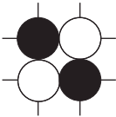
A QUICK INTRO TO THE GAME: PIE RULE AND ILLEGAL PLACEMENTS
The current player can place their piece wherever they prefer on the board with just two rules:
A piece cannot be placed where there is already another piece.
The formation in the picture on the right can never be formed.
PIE RULE
When the white player begins their first turn, they will have two options:
Placing a white piece wherever they prefer.
Stealing the black piece already placed on the board.

Slide 4
Organising the project

Slide 5
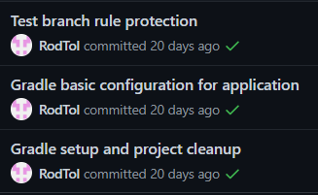

STEP 1: STRUCTURE DEFINITION AND VERSION CONTROL INITIALISATION
We first started the project by setting up a Github repository as a Version Control system. We set up Gradle for Test Driven Development, and we set up Circle CI.
Then, we chose the basic structure of the project. We decided:
That we wanted to implement a GUI by using Swing.
That we wanted three main packages: model, controller, and GUI.

Slide 6



STEP 2: FIRST WORKLOAD DISTRIBUTION
It was decided that Marianna Corsano would start implementing the basis of the GUI, while Giulia Bernardi and Rodolfo Tolloi worked on the logic of the model. The work was partly done individually and partly done together on the same pc, especially when important decisions were to be taken.
Test Driven Development was put in practice implementing the model by first creating the failing tests and then making them pass by updating the code.
This was used a bit less in the implementation of the GUI, since tests on the GUI are pretty heavy and since (especially in the beginning) it is more effective to simply look at the results.

Slide 7
FIRST STEPS IMPLEMENTING THE GUI: THE BASICS
The first implementation of the GUI consisted of:
Drawing the lines forming the board by overriding the paint method in Swing.
Adding a MouseMotionListener, since we decided that we wanted a transparent piece to follow the movements of the player’s mouse.
Placing a piece on the board (only graphically).

Slide 8
FiRST STEPS IMPLEMENTING THE MODEL
The classes Piece, Node, and Board were implemented.
At this point in the development, the model was able to:
Check if a node was empty and if not check the content of the node;
Place a Piece on a Node of a Board;

Slide 9



STEP 3: MAKING THE MODEL AND THE GUI WORK TOGETHER
In this phase, we all collaborated on all parts of the project.
MODEL
We realised we needed another class, Coordinates, in order to properly communicate with the GUI.
GUI
The GUI at this point became able to place a piece also logically.
CONTROLLER
We decided that the olace method in the Controller should return a Status, which contains the enum:
PLACED, which signals the piece has been correctly placed on the board.
NOT_PLACED, which signals that the piece has not been correctly placed on the board.
WON, which signals that the player asked to place a piece in a position that will grant them a victory.

Slide 10
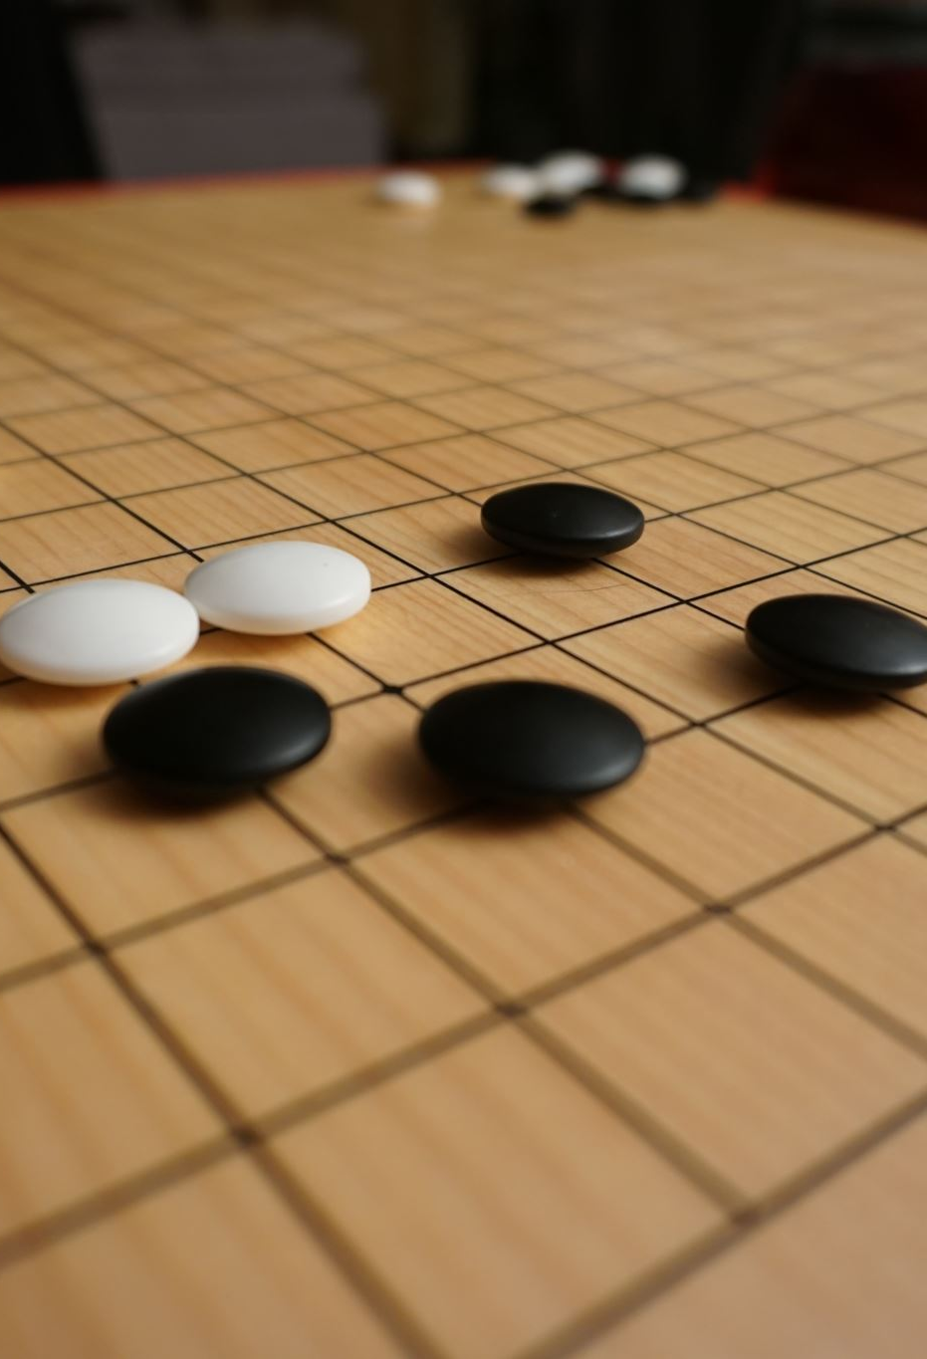
STEP 4: IMPLEMENTATION OF THE RULES
At to this point, we had a working board (both logically and graphically) but the rules of the game had not been implemented yet. This was the next step.

