Slide 1
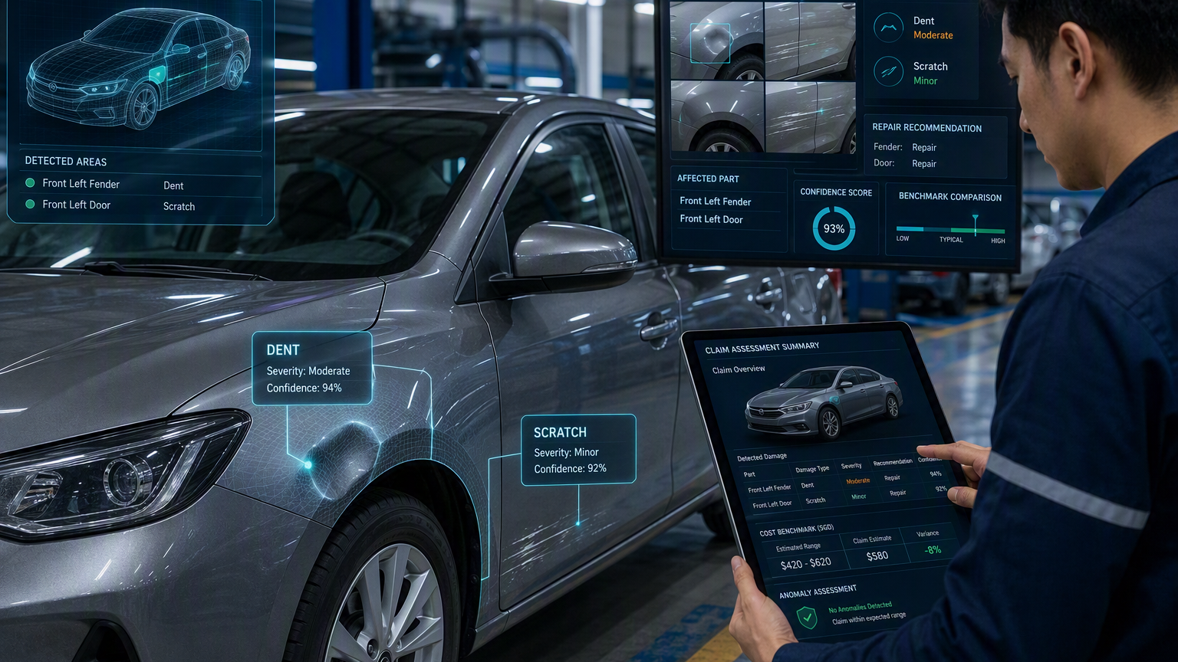
PROJECT PRESENTATION
AI-Based Vehicle Damage Assessment
Cross-Modal Evidence Verification of Declared Repair Scope Against Photographic Damage Evidence in Motor Own-Damage Claims (CLAIM-CMEV)
ACERY (Group 34)
Divakaran Pillai Arunkumar
Lau Lay Khoon
Lim Chong Jen
Miguel Rodel Felipe
Sun Yan
Initial concept, data strategy and system architecture
Notes:
[Sources]
- Project_Proposal_ACERY_v1.docx
- System Architecture Overview.docx
- Visual on this slide was generated with Microsoft Copilot.
[/Sources]

Slide 2
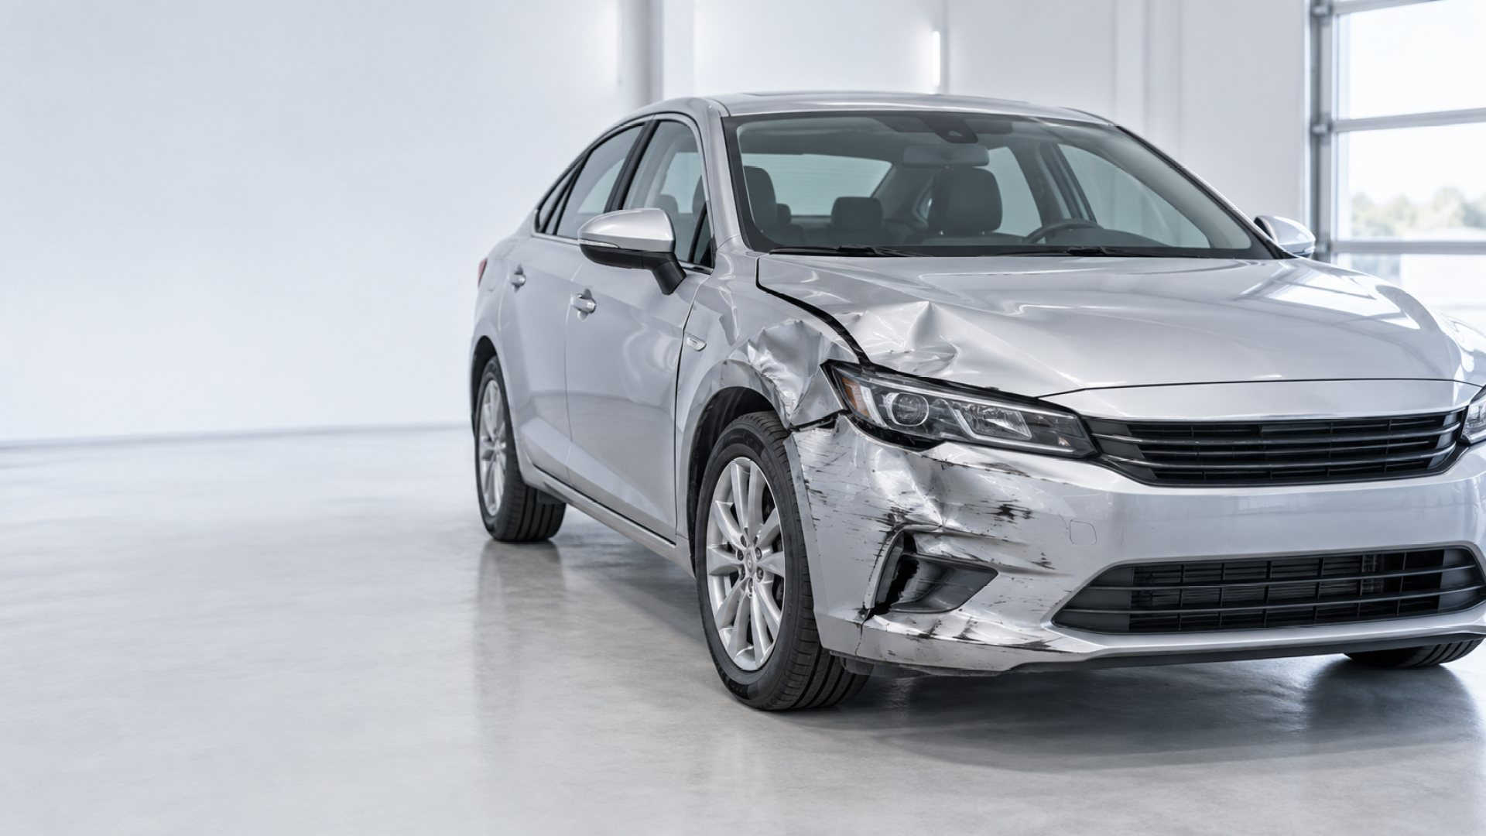
Current Situation
The current workflow contains valuable evidence, but much of it remains manual and unstructured.
Claim event
Surveyor report
For a motor claim, the authorised workshop first estimates the repair cost based on the damaged parts and labour charges. An insurer-appointed surveyor then independently assesses the repair cost.
The surveyor’s report includes an executive summary of the damage and endorses the repair cost, supported by photographic evidence of the damaged parts.
Claim handling
Insurer-specific challenges
Productivity and Efficiency – Claims processing is limited by the number of surveyors available.
Consistency and Predictability – A consistent and predictable basis for claim costs is needed.
Claim Inflation – Photographic evidence is required, but inflated or fraudulent claims can still be difficult to detect.
The claims handler reviews the surveyor’s report and processes the claim, including reserving the claim amount in the financial records and processing the payout.
Singapore’s motor insurance market reached S$1.28 billion in 2025, with rising claims costs and insurers estimated to face up to S$140 million annually from inflated and fraudulent claims.
ACERY | Group 34
National University of Singapore | ISS
Notes:
[Sources]
- Project_Proposal_ACERY_v1.docx
[/Sources]

Slide 3
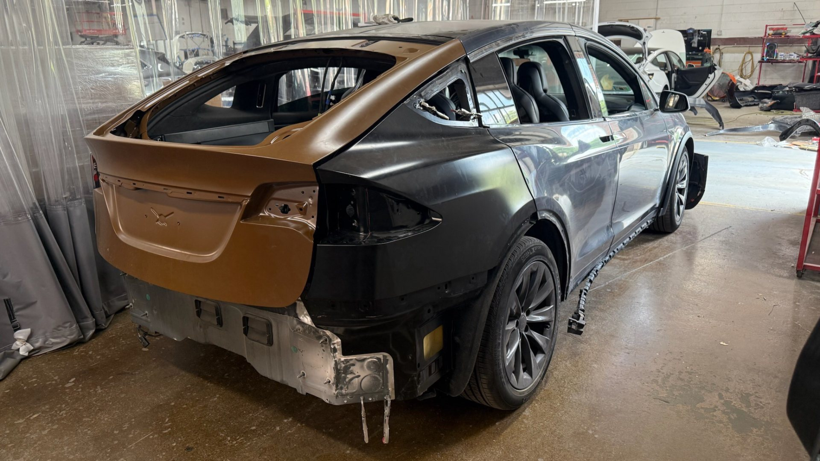



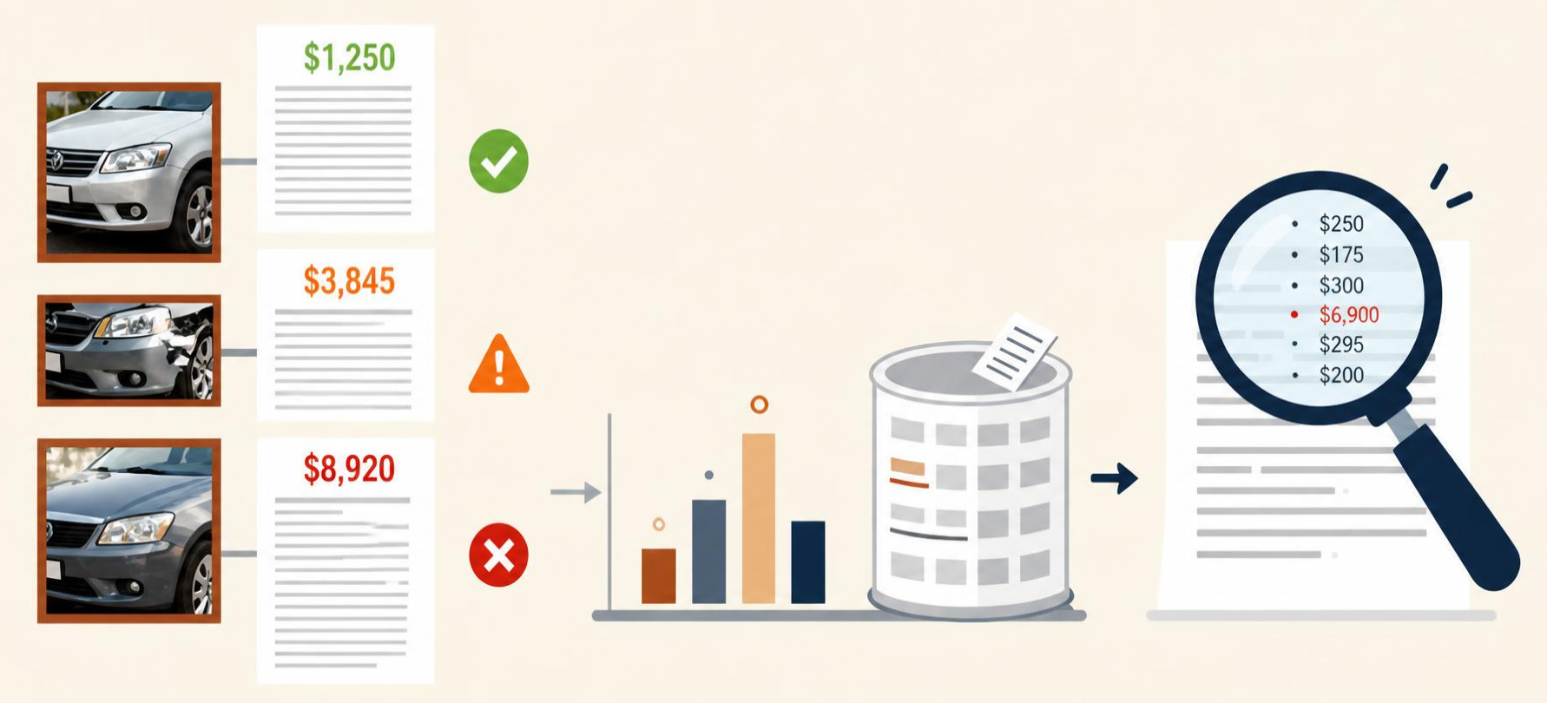
Why this project matters
The current workflow contains valuable evidence, but much of it remains manual and unstructured.
Manual visual assessment
Throughput constraint
Surveyors identify affected parts, damage severity and repair scope from photographs.
Repetitive image review can consume capacity when physical inspection volumes are high.
Lost data value
Weak empirical baseline
Photos, estimates and reports are often retained as documents rather than reusable structured records.
Limited structured history makes consistent cost benchmarking and unusual-line-item detection harder.
Opportunity: convert visual evidence into a reusable operational and pricing intelligence layer.
ACERY | Group 34
National University of Singapore | ISS
Notes:
[Sources]
- Project_Proposal_ACERY_v1.docx
[/Sources]

Slide 4
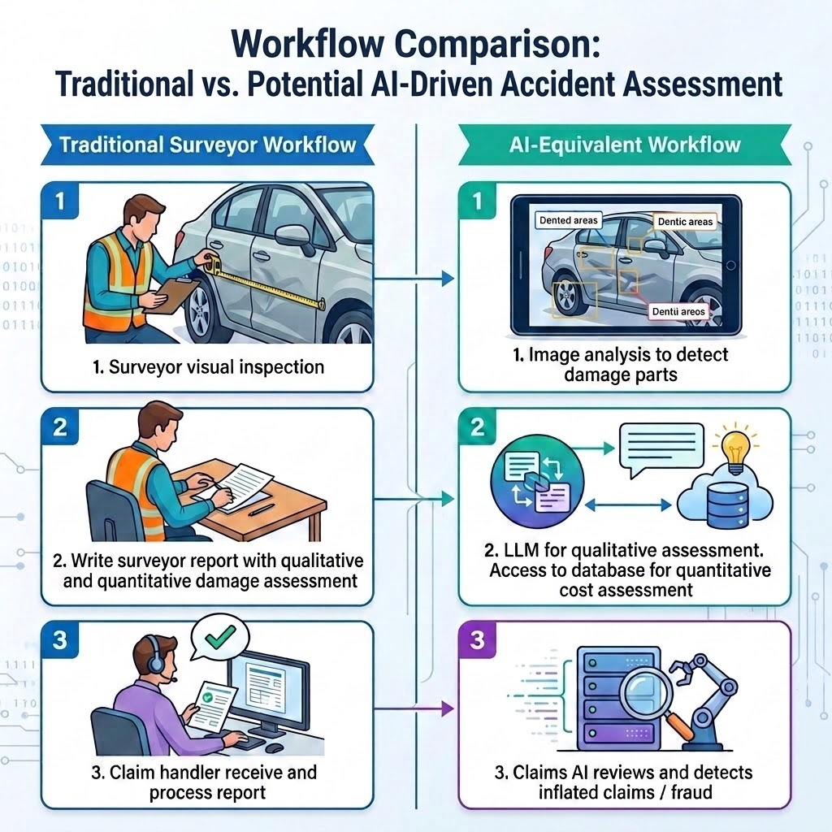
ACERY | Group 34
National University of Singapore | ISS

Slide 5
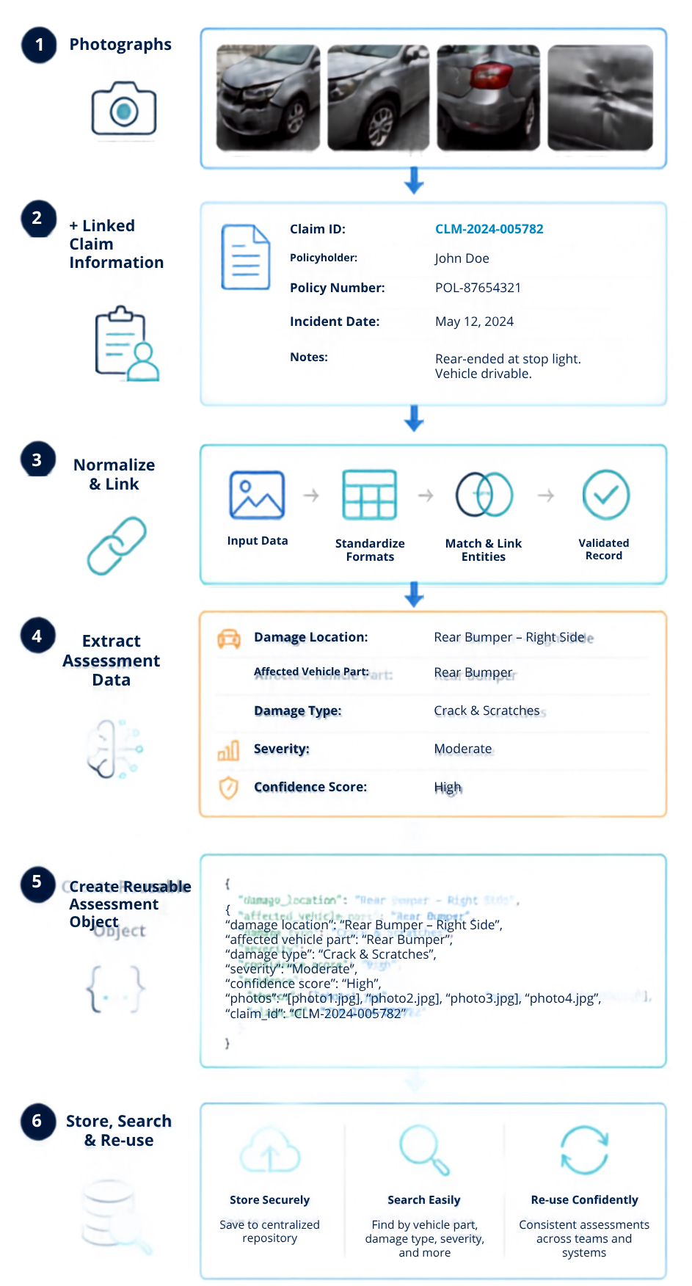
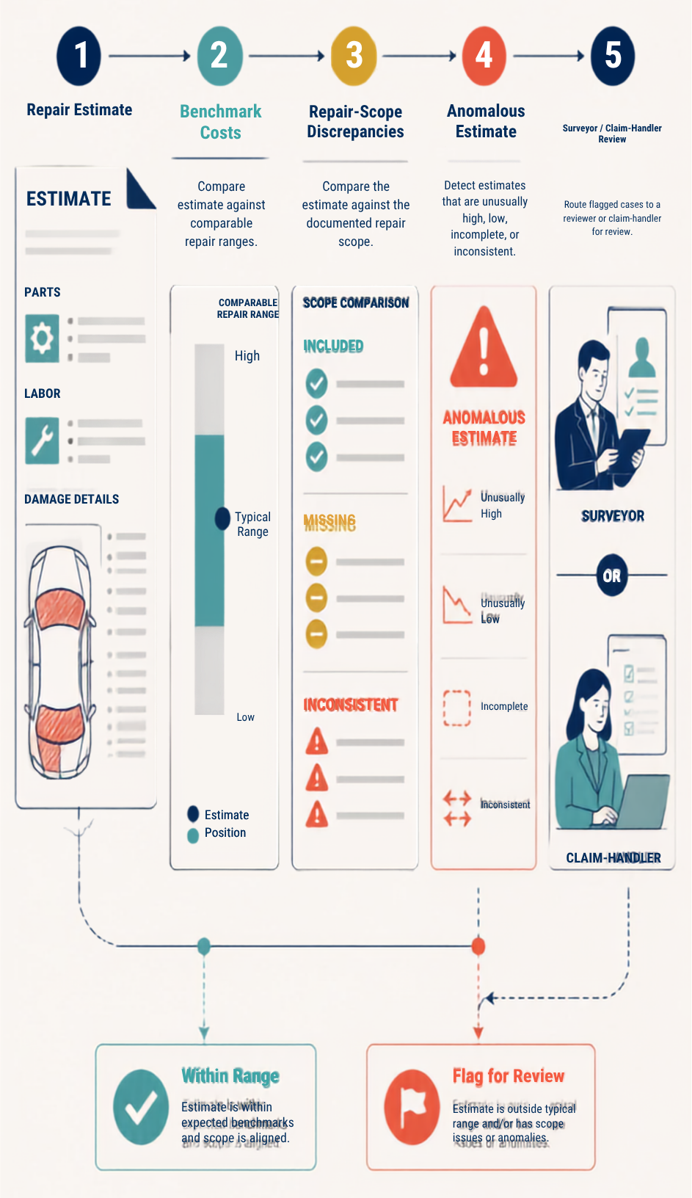
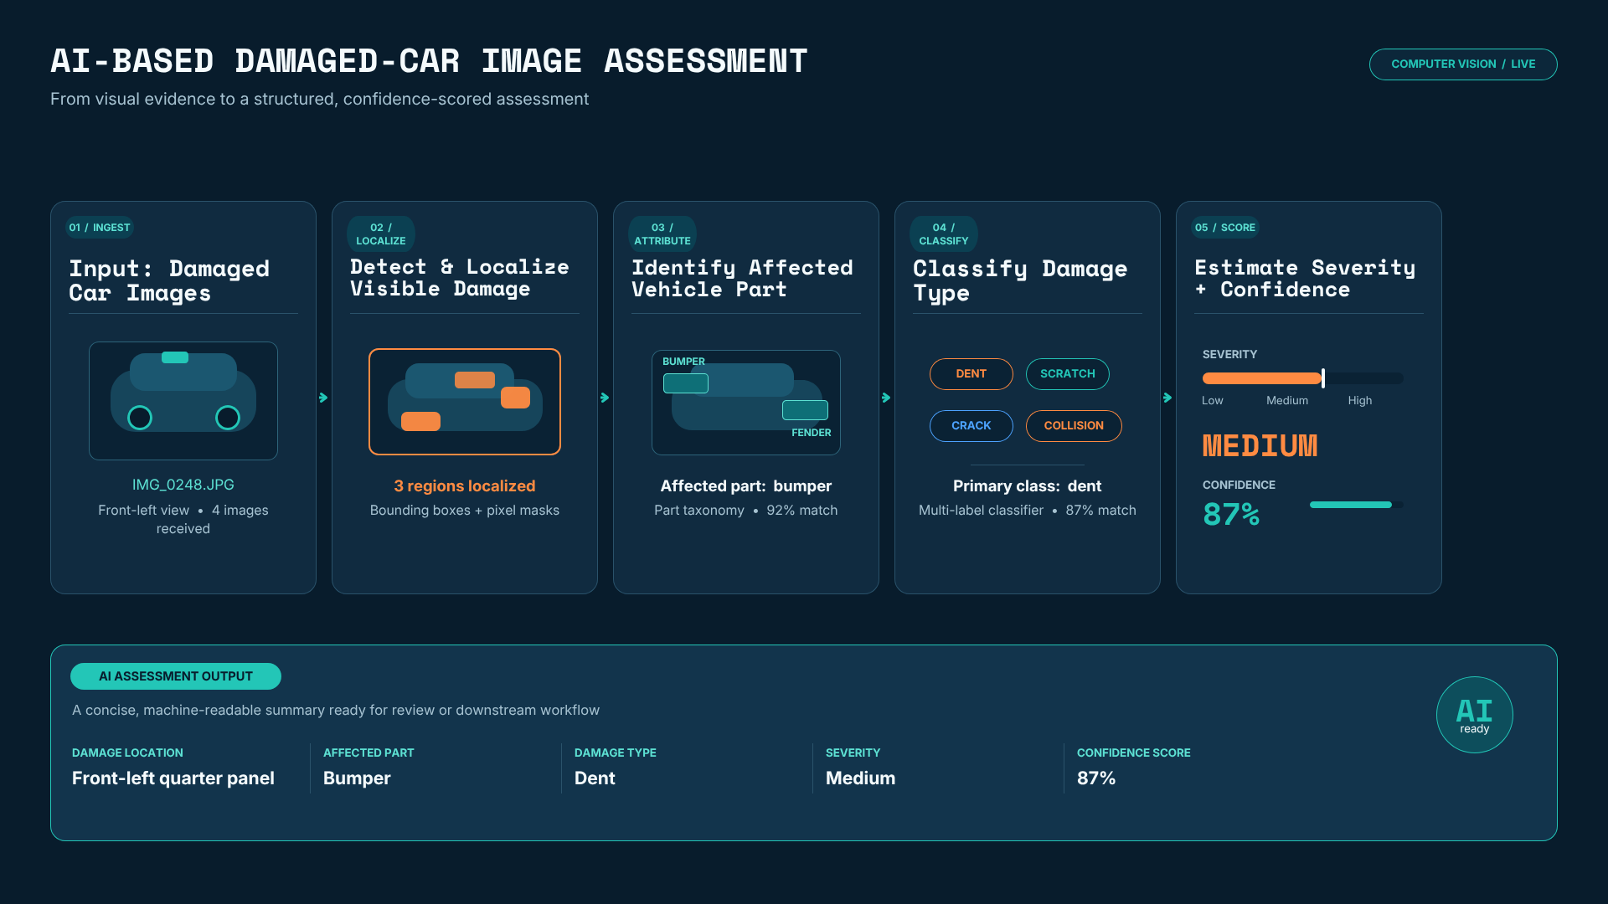
Project goals and intended outcomes
A decision-support prototype, not an automated claims settlement engine.
1. Understand damage
2. Structure evidence
3. Support review
Detect and localize visible damage, identify the affected vehicle part, classify damage type and estimate severity with confidence scores.
Transform photographs and linked claim information into a consistent assessment object that can be stored, searched and reused.
Benchmark costs, identify repair-scope discrepancies and flag anomalous estimates for surveyor or claim-handler review.
Human-in-the-loop principle: low-confidence or irregular cases are routed for professional judgment.
ACERY | Group 34
National University of Singapore | ISS
Notes:
[Sources]
- Project_Proposal_ACERY_v1.docx
- System Architecture Overview.docx
[/Sources]

Slide 6
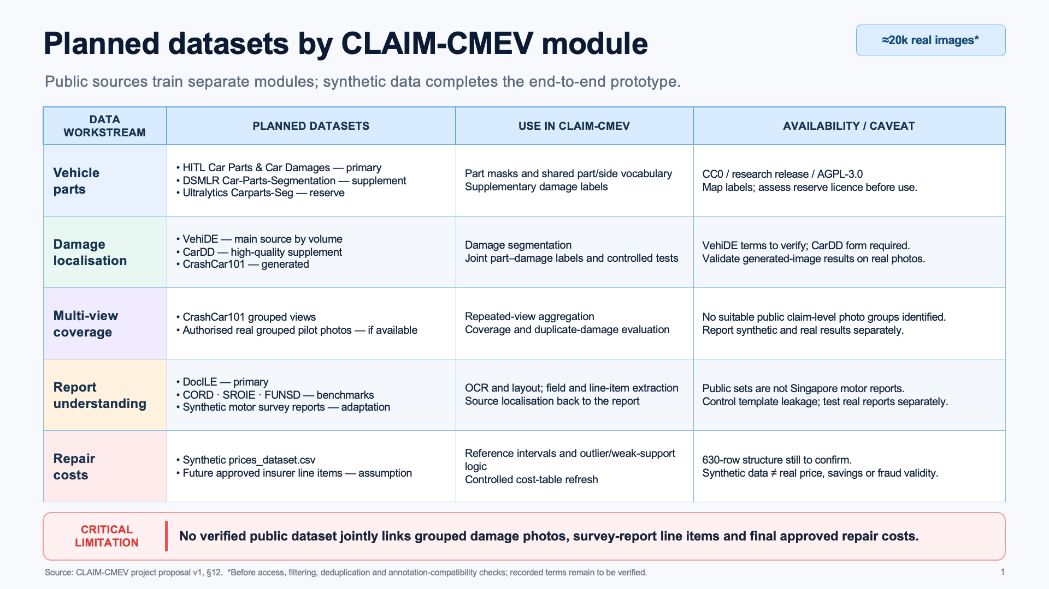
ACERY | Group 34
National University of Singapore | ISS

Slide 7







High-level system architecture
A modular flow from claim intake to explainable review support.
Surveyor workbench
Module 9
Backend application
Intake, jobs, comparison and review
Modules 7-8
Background job queue
Shared storage
Claim database, files and model versions
Image worker
Modules 1-3
Document worker
Modules 4-5
Offline training and cost refresh
Including Module 6
ACERY | Group 34
National University of Singapore | ISS
Notes:
[Sources]
- System Architecture Overview.docx
[/Sources]

Slide 8
Technical system design
Containerised event runtime with separate image and document processing branches
PLANNED WORKER SPLIT
Dedicated module containers replace the shared fixture producers.
EDGE AND API
cmev-web
cmev-api
M9
cmev-kafka
IMAGE BRANCH · M1 → M2 → M3
React / TypeScript / nginx
FastAPI, review actions, print
Redpanda / Kafka event bus
cmev-worker-parts
M1
cmev-worker-damage
M2
EVENT PROCESSING · COMMANDS AND COMPLETION EVENTS
cmev-worker-summary
M3
cmev-orchestrator
cmev-worker-producers
M1–M6
cmev-consolidator
M8
DOCUMENT BRANCH · M4 → M5 → M6
Stage dispatch and joins
Retries and dead letters
Fixture outputs for all six stages
Image and document branches
Deterministic findings
Pinned cost-table lookup
cmev-worker-ocr
M4
cmev-worker-lineitems
M5
SHARED STATE · USED BY THE API AND EVERY WORKER
cmev-worker-penmarks
M6
cmev-db
cmev-objectstore
cmev-cost-bootstrap
M7
PostgreSQL 16
Claims, revisions, results
MinIO (S3 API)
Original evidence files
One-shot offline synthetic build
Read-only cost-table volume
LEAN PROFILE
cmev-worker-combined runs the orchestrator, producer and consolidator roles in a single container.
Read-only model registry
Running container
Running with fixture outputs
Planned container
Offline training publishes versioned weights that the image and document workers mount.
CLAIM-CMEV
01
Notes:
Sources: infra/compose/docker-compose.yml (current service definitions and lean/full profiles), docs/specs/technical_specification.md sections 3-4, docs/specs/integration_contracts.md, CONTEXT.md status correction dated 2026-09-27.
The left drawing shows the containers created for the full Compose profile: eight long-running services plus the one-shot cmev-cost-bootstrap job. All six evidence stages currently run as fixture producers in one cmev-worker-producers container (amber). The dashed workers on the right are the target architecture, not existing per-module deployments. In the lean profile, cmev-worker-combined replaces the orchestrator, producer and consolidator containers.
Browser requests reach the web/API. API outbox events and worker commands/completions travel via Kafka. The orchestrator controls readiness, retries and joins. M8 produces deterministic findings and reads a pinned M7 synthetic cost table. API and workers share PostgreSQL and object storage; shared persistence access is grouped rather than drawing every connection. The cost volume is implemented; model training/registry delivery and derived model artifacts are planned.
Target image dependency: M1 parts, then M2 damage/part assignment, then M3 summary. Document dependency: M4 OCR, then M5 rows, then M6 linked marks (mark detection itself may run earlier). Human review is required for marks and uncertain identities. Final claim approval remains separate. The API does not load neural weights.
Background image: the project's own generated decorative image (src/workbench/public/images/damaged-car.png), cropped and tinted.

Slide 9
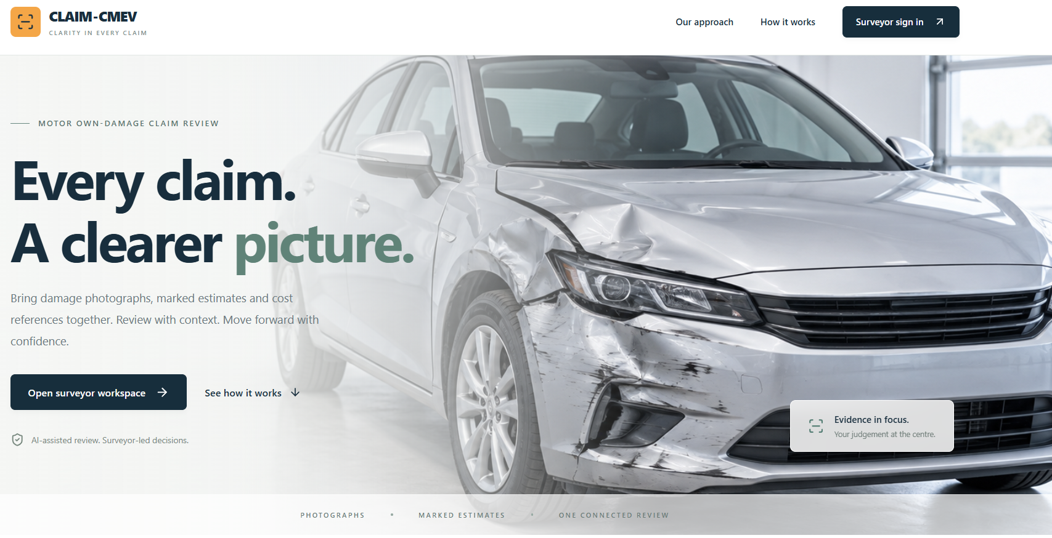
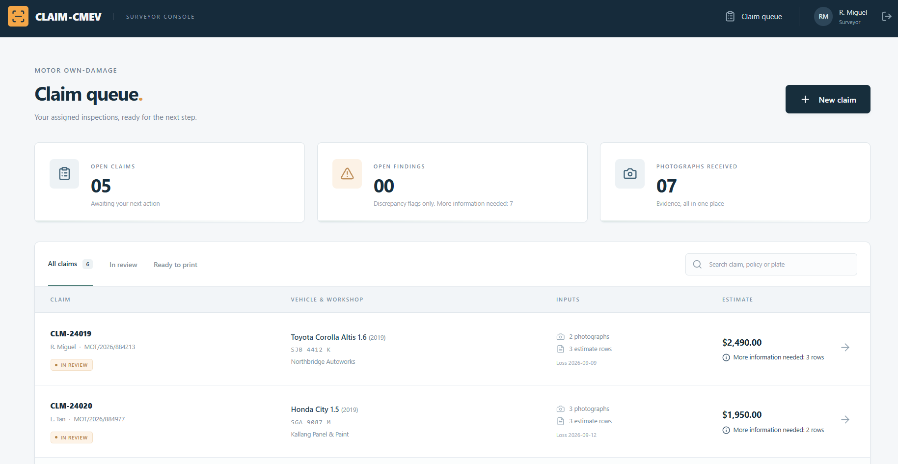
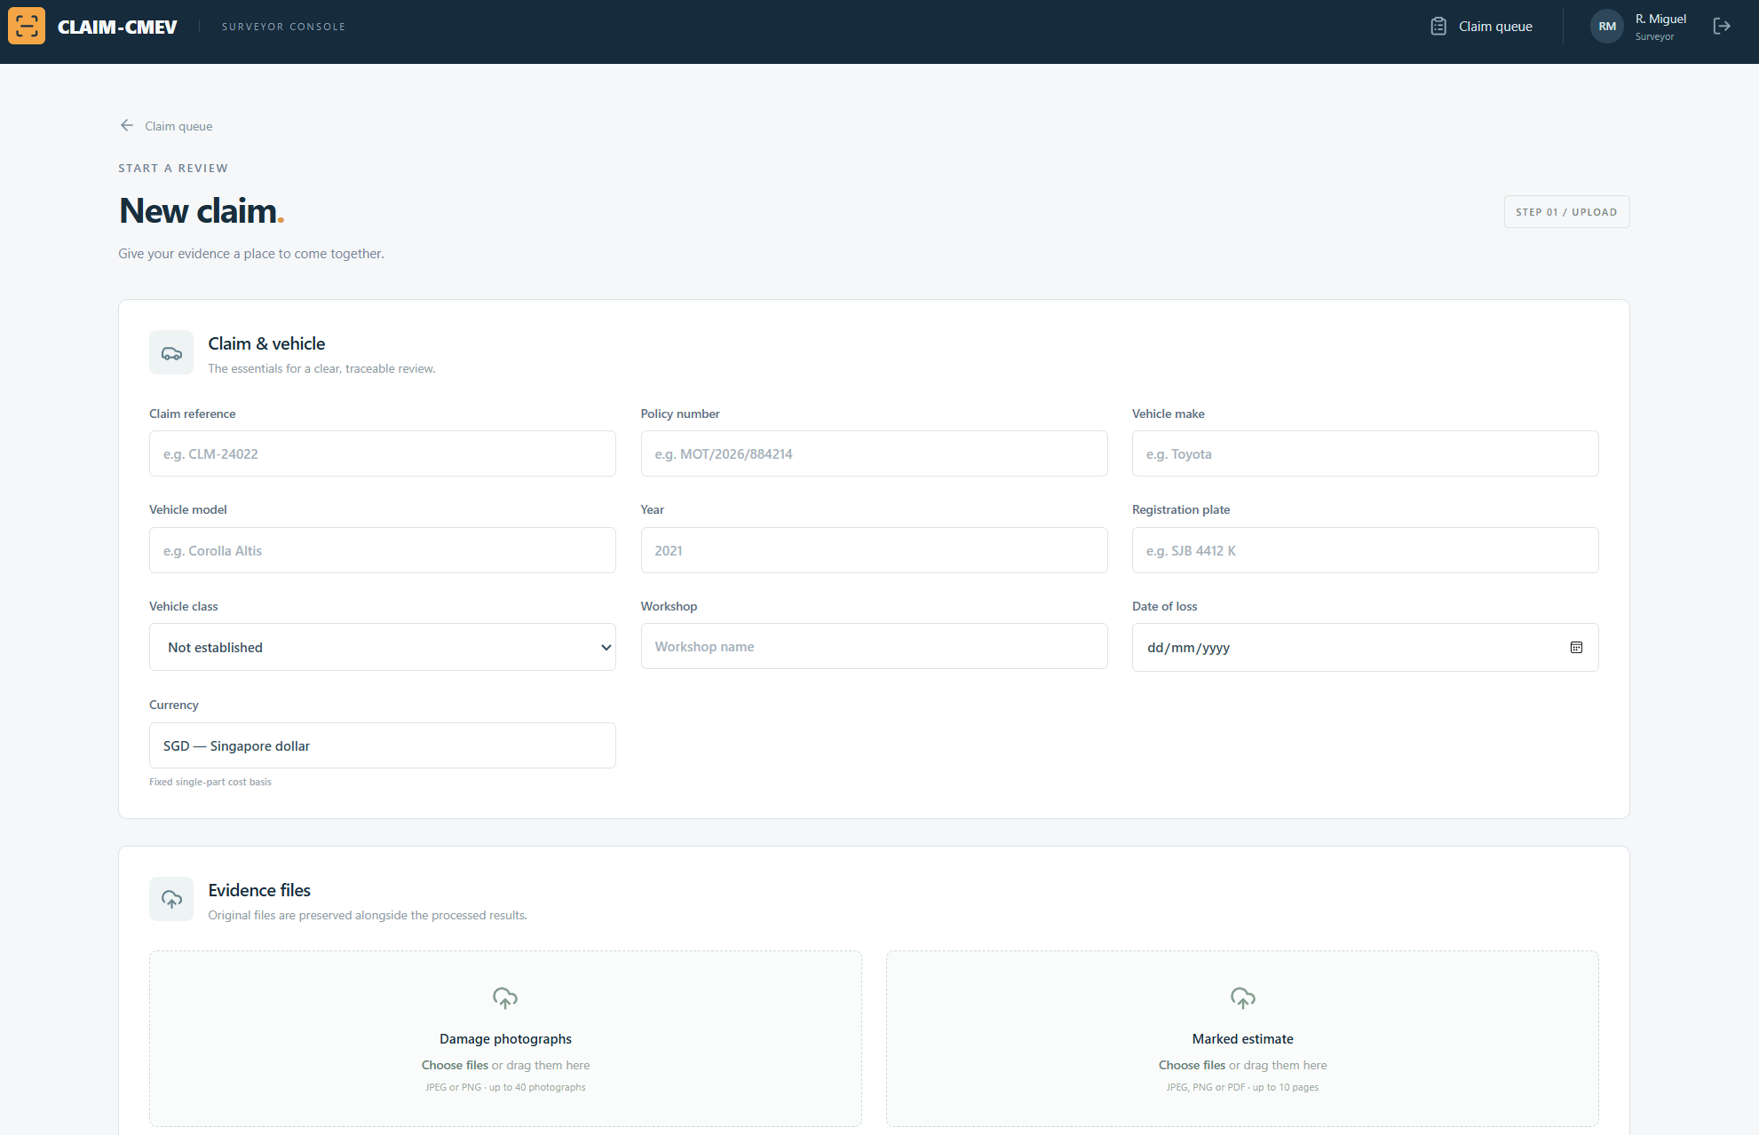
Project Progress and Discussion
The UI and backend harness are in place, and the first car defects model has been trained
1,413
9
1st
automated tests passing on fixture and synthetic data
containers in the full Compose profile, eight long-running
car defects model trained: SegFormer-B2
COMPLETED AND PLANNED WORK
IMPLEMENTED
System UI and backend harness
Upload, review, evidence access and PDF export. API, orchestration, storage and rule checks run on fixtures.
TRAINING
First car part segmentation model available, car damages model currently training, document extraction model currently training
SegFormer-B2, ResNET-50 training, LayoutLMv3
DEFINED
Component contracts
Typed records and Kafka events, versioned artifacts, claim revisions and exact monetary values.
IDENTIFIED
Datasets
HITL vehicle parts, CarDD damage (access pending), marked estimates and synthetic repair costs.
PLANNED
Model approach
SegFormer vision, pretrained PaddleOCR, Faster R-CNN pen marks, rule-based line items and offline cost ranges.
CLAIM-CMEV
Background photo: Scientificranking, Wikimedia Commons, CC BY 4.0 (cropped, greyscale, tinted)
02
Notes:
Sources: user's presentation request (SegFormer-B2 trained and desired progress points); CONTEXT.md current status and 2026-09-27 correction, including the combined validation of 1413 passed and 1 skipped Python tests on fixture/synthetic data; infra/compose/docker-compose.yml (nine full-profile containers, eight long-running); docs/specs/model_training_specification.md section 3; docs/specs/data_contracts.md; docs/specs/integration_contracts.md; docs/specs/ui_specification.md.
Completed UI/backend means the implemented fixture-backed application and system harness, not completion of every requirement or model integration. The test count is fixture and synthetic validation, not model accuracy or real-price accuracy. Actual image overlays, real-model worker integration, runtime acceptance and remaining defects still require work.
The training milestone is a fresh team update supplied by the user: the first car defects model, SegFormer-B2, has been trained. Older repository notes say no model exists and propose SegFormer-B0. The slide reflects the user's newer training update without claiming that checkpoint, dataset, evaluation results or model integration have been verified in this repository.
Datasets are identified, which does not imply all files/permissions/labels are ready. HITL is the planned parts source; CarDD is the planned core damage source with access pending in repository records. Model plan: SegFormer for vision, pretrained PaddleOCR, deterministic parser for 2-3 layouts, Faster R-CNN ResNet-50 FPN for pen marks, and offline empirical/LightGBM cost ranges. LayoutLMv3 and TrOCR remain stretch goals.
The right column contains intentionally editable placeholders for the next team sync: model dataset/checkpoint and measured metrics; completed modules and integration blockers; next owners and dates.
Background photo: "Rear End Tesla Model X Collision Damage Repair" by Scientificranking, Wikimedia Commons, licensed CC BY 4.0 (https://creativecommons.org/licenses/by/4.0/). Source: https://commons.wikimedia.org/wiki/File:Rear_End_Tesla_Model_X_Collision_Damage_Repair.jpg. Changes: cropped to 16:9, converted to greyscale, darkened and tinted.

Slide 10




Evaluation and quality controls
Each module has measurable technical performance and explicit operational safeguards.
Computer vision quality
Cost model
Precision / recall by part and damage type
IoU for localization
Cross-image consistency
MAE and RMSE
Prediction-interval coverage
Residuals by vehicle segment
Anomaly review
Governance
Precision–recall for rare cases
TPR / FPR trade-off
Surveyor false-positive feedback
PII removal and secure storage
Audit trail and model versions
Low confidence → manual review
Success means useful, explainable review support with known limitations, not only a high model. score.
ACERY | Group 34
National University of Singapore | ISS
Notes:
[Sources]
- System Architecture Overview.docx
[/Sources]

