Slide 1
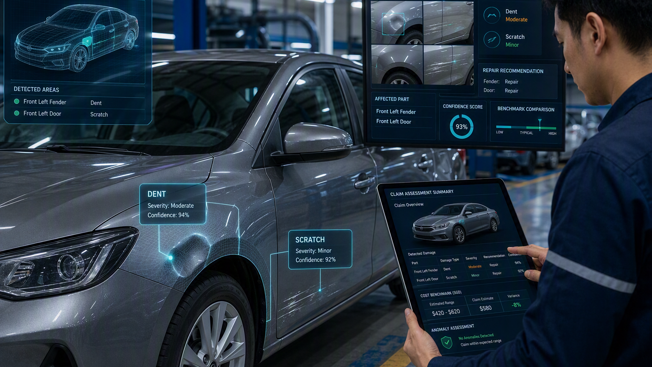
FINAL PRESENTATION · V1
AI-Based Vehicle Damage Assessment
Cross-Modal Evidence Verification of Declared Repair Scope Against Photographic Damage Evidence in Motor Own-Damage Claims (CLAIM-CMEV)
ACERY (Group 34)
Divakaran Pillai Arunkumar
Lau Lay Khoon
Lim Chong Jen
Miguel Rodel Felipe
Sun Yan
Final project presentation | CLAIM-CMEV
Notes:
CLAIM-CMEV final presentation v1. Template and cover artwork retained from ACERY_Project_Presentation_v2.pptx. Seven sections follow the team assignment. Only architecture and future improvements contain prepared section content.

Slide 2
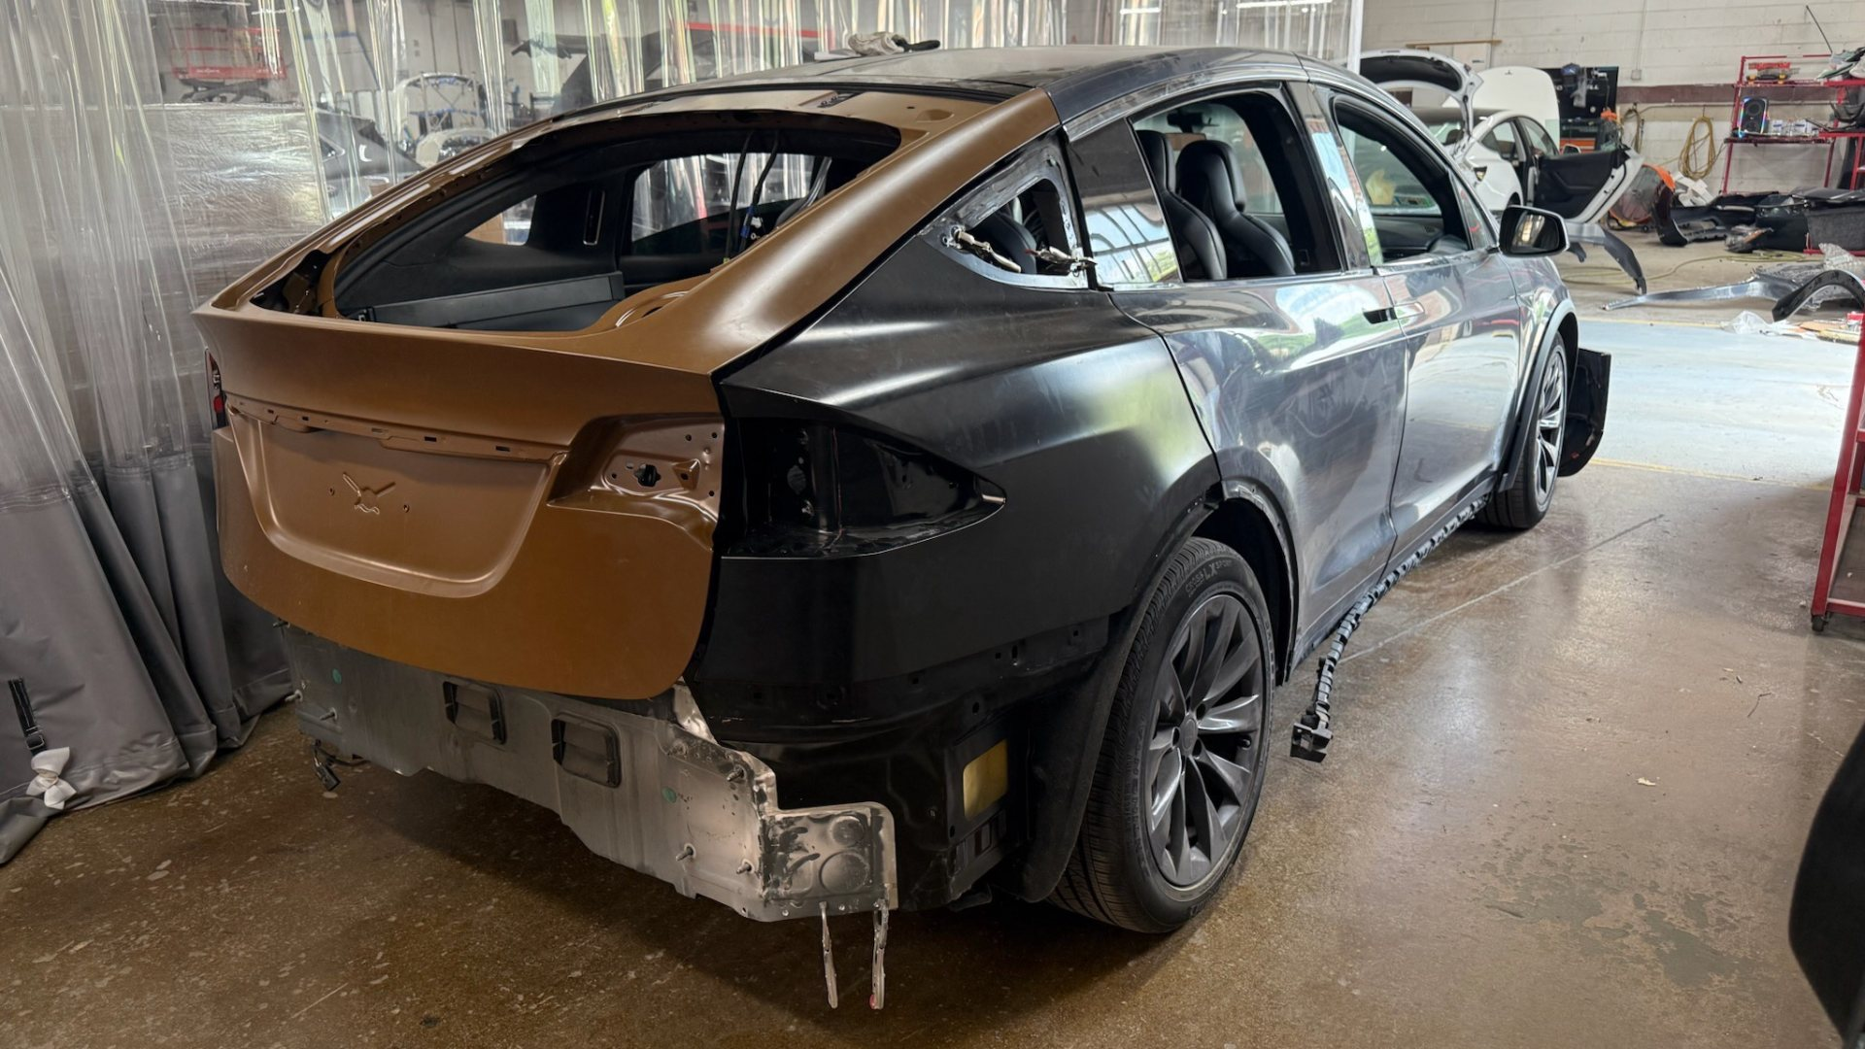
Opening background
Section 1 | Edwin
ACERY | Group 34
National University of Singapore | ISS
2
Notes:
Section 1: Opening background. Presenter: Edwin. Content intentionally left blank for the assigned teammate.

Slide 3
Show interview with industry pain points
Section 2 | Edwin
ACERY | Group 34
National University of Singapore | ISS
3
Notes:
Section 2: Show interview with industry pain points. Presenter: Edwin. Content intentionally left blank for the assigned teammate.

Slide 4
High-level system architecture
Section 3 | Rodel
Surveyor workbench
Backend API
Event-driven orchestration
M9 · Upload and review evidence
Intake · revisions · review actions
Kafka commands, stage chaining and branch joins
Photograph branch · M1 → M2 → M3
Vehicle parts → damage-to-part matching
→ grouped observations and coverage
M8 · Checks
M9 · Review
Deterministic rules
Evidence + cost ranges
Human confirmation
Frozen report / PDF
Document branch · M4 → M5 → M6
OCR → structured line items
→ pen-mark detection and row linking
SHARED SERVICES AND OFFLINE ARTIFACTS
Evidence and claim storage
Versioned model registry
M7 · Reference cost ranges
PostgreSQL + MinIO (S3)
Offline training → read-only weights
Offline build → pinned lookup table
ACERY | Group 34
National University of Singapore | ISS
4
Notes:
Architecture updated from slide 7 of the original presentation, checked against current repository code and live-stack overlays (2026-10-23).
Sources: scripts/live-stack.sh; infra/compose/docker-compose.image.yml; infra/compose/docker-compose.document.yml; src/claim_cmev/worker.py; src/claim_cmev/orchestration/consolidation.py; docs/specs/application_platform.md; docs/adr/0002-containerised-event-runtime.md.
M1/M2 use configured SegFormer models; M3 is deterministic. M4 is pretrained PaddleOCR, M5 LayoutLMv3, M6 Faster R-CNN plus geometric linking. M5/M6 remain synthetic-validation candidates. This diagram documents configured architecture, not a new live-stack acceptance test.
M7 is an offline synthetic reference build and frozen read-only lookup, separate from M6. Human decisions create revisions; final reports use the matching completed assessment and frozen review. The system supports review; it does not automatically settle claims. No LLM participates in decisions.
Our architecture brings together two sources of claim evidence: vehicle photographs and repair-estimate documents.
The surveyor uploads these through the workbench. The backend records the claim and starts processing through an event-driven workflow.
The photograph branch identifies vehicle parts, detects damage, and groups observations across photographs. The document branch reads the estimate, extracts repair line items, and detects surveyor marks such as exclusions and price changes.
Both branches feed into M8, which applies deterministic rules to compare the declared repair scope with the photographic evidence. It also checks amounts against a pinned reference-cost table built offline by M7. These costs are synthetic benchmarks.
The surveyor then reviews the findings, confirms marks and revised amounts, and produces the final report. Uncertain evidence remains available for human review.

Slide 5
Technical system design
Section 3 | Rodel
LIVE STACK · CONTAINERISED EVENT RUNTIME · LEAN ORCHESTRATION
cmev-web · M9
cmev-api
cmev-worker-combined
React / TypeScript / nginx
FastAPI · intake and review
Orchestration + M8 · dispatch, joins and deterministic checks
cmev-kafka · Redpanda / Kafka · commands and completion events
cmev-worker-image · M1–M3
cmev-worker-ocr
cmev-worker-lineitems
cmev-worker-penmarks
SegFormer-B2 parts + SegFormer-B3 damage
Deterministic matching, summary and coverage
M4 · PaddleOCR
Text + line boxes
M5 · LayoutLMv3
Structured rows
M6 · Faster R-CNN
Pending linked marks
SHARED STATE · ORIGINAL EVIDENCE, VERSIONED RESULTS AND FROZEN ARTIFACTS
cmev-db
cmev-objectstore
Model registry
cmev-cost-bootstrap · M7
PostgreSQL 16
Claims, revisions, results
MinIO / S3
Evidence and derived files
Read-only pinned weights
Loaded once at startup
Offline LightGBM quantile build
Pinned read-only cost table
M4 → M5 → M6 is orchestrator-chained via Kafka. M7 publishes synthetic reference ranges; M8 performs table lookups.
ACERY | Group 34
National University of Singapore | ISS
5
Notes:
Updated from slide 8 of ACERY_Project_Presentation_v2.pptx. The old shared fixture producers and planned worker split have been replaced with the configured live topology.
Deployment: scripts/live-stack.sh combines the base, image and document Compose overlays with the lean profile. cmev-worker-combined hosts orchestration and M8; real-stage ownership disables its fixture stage consumers. cmev-worker-image hosts M1/M2/M3. M4, M5 and M6 run as cmev-worker-ocr, cmev-worker-lineitems and cmev-worker-penmarks. The latter two share the document image but are separate containers. The full orchestration profile may separate orchestrator/consolidator roles; this diagram describes the wrapper's lean topology.
Sources: infra/compose/docker-compose.yml; infra/compose/docker-compose.image.yml; infra/compose/docker-compose.document.yml; src/claim_cmev/worker.py; src/claim_cmev/orchestration/services.py; configs/models/{parts,damage,ocr,lineitems,penmarks}.yaml; configs/costs/cost_table.yaml.
Every online handoff uses commands/completion events; branch dependencies remain sequential despite the shared event bus. Shared state is accessed by services as required; the registry is mounted by model workers and cost tables by comparison/API services.
M7 uses two LightGBM quantile regressors with conformal calibration offline, trained on synthetic records; M8 reads the frozen range table and runs no pricing model. The architecture has not been retested live during deck preparation. Candidate integration does not demonstrate accuracy on real estimates.
echnically, the application runs as separate Docker containers.
The frontend uses React, TypeScript and nginx, while FastAPI handles uploads and review actions. Kafka, provided by Redpanda, carries processing commands and completion events.
For our laptop deployment, one combined worker manages orchestration and consolidation. Photograph processing runs in one image worker, while OCR, line-item extraction and pen-mark detection use three separate document workers.
PostgreSQL stores claim records, revisions and results. MinIO stores original evidence and generated files. Workers load versioned model weights from a read-only registry.
This separation lets us update individual models while retaining traceable evidence, processing results and human decisions.

Slide 6
Demo
Section 4 | Yann
ACERY | Group 34
National University of Singapore | ISS
6
Notes:
Section 4: Demo. Presenter: Yann. Content intentionally left blank for the assigned teammate.

Slide 7
Models used
Section 5 | Charlene / Arun
ACERY | Group 34
National University of Singapore | ISS
7
Notes:
Section 5: Models used. Presenter: Charlene / Arun. Content intentionally left blank for the assigned teammate.

Slide 8
Limitations of the project
Section 6 | Charlene · Future improvements
•
Damage severity not assessed
Damage severity, which may influence repair costs and repair-or-replacement decisions, was not evaluated.
•
Sensitivity to vehicle-part segmentation accuracy
Inaccurate part boundaries may affect damage-to-part assignment, particularly across adjacent panels.
•
Limited integration of classification and segmentation
ResNet50 and SegFormer-B3 were evaluated separately, potentially limiting the identification of challenging damage types such as flaking and paint chips.
•
Limited generalisability of repair cost estimation
The pricing model may not cover all vehicle makes and models, with repair costs varying by vehicle type and repair requirements.
•
Limited scope of damage assessment
The CarDD and HITL datasets primarily cover external vehicle damage, excluding internal mechanical damage such as engine and transmission damage.
ACERY | Group 34
National University of Singapore | ISS
8
Notes:
Section 6 - Future improvements. Presenter: Charlene. Limitations of the project. Text transcribed from the user-provided reference image and recreated as editable PowerPoint text using the original deck template. The supplied wording about ResNet50 evaluation is retained; no additional experiment verification was performed while preparing this presentation. Repair cost ranges in the current project are synthetic references, not validated real-market prices.

Slide 9
Recommendations for motor insurance applications
Section 6 | Charlene · Future improvements
•
Standardise photographic documentation
Train motor surveyors in standardised image capture to ensure adequate image quality, viewing angles and visibility of damaged areas.
•
Expand training datasets
Increase the availability and diversity of annotated damage images, particularly for underrepresented categories such as flaking and paint chips.
•
Integrate classification and segmentation models
Explore combining ResNet50 and SegFormer-B3 to improve damage identification and localisation accuracy.
•
Evaluate implementation feasibility and cost
Assess computational requirements, implementation costs, integration with existing claims workflows and potential operational benefits.
•
Extend model generalisability
Evaluate model transferability to electric vehicles and different vehicle makes and models, incorporating vehicle-specific repair costs for more accurate cost estimation.
ACERY | Group 34
National University of Singapore | ISS
9
Notes:
Section 6 - Future improvements. Presenter: Charlene. Recommendations for motor insurance applications. Text transcribed from the user-provided reference image and recreated as editable PowerPoint text using the original deck template. The supplied wording about ResNet50 evaluation is retained; no additional experiment verification was performed while preparing this presentation. Repair cost ranges in the current project are synthetic references, not validated real-market prices.

Slide 10
Potential applications
Section 7 | Arun
ACERY | Group 34
National University of Singapore | ISS
10
Notes:
Section 7: Potential applications. Presenter: Arun. Content intentionally left blank for the assigned teammate.

