Slide 1
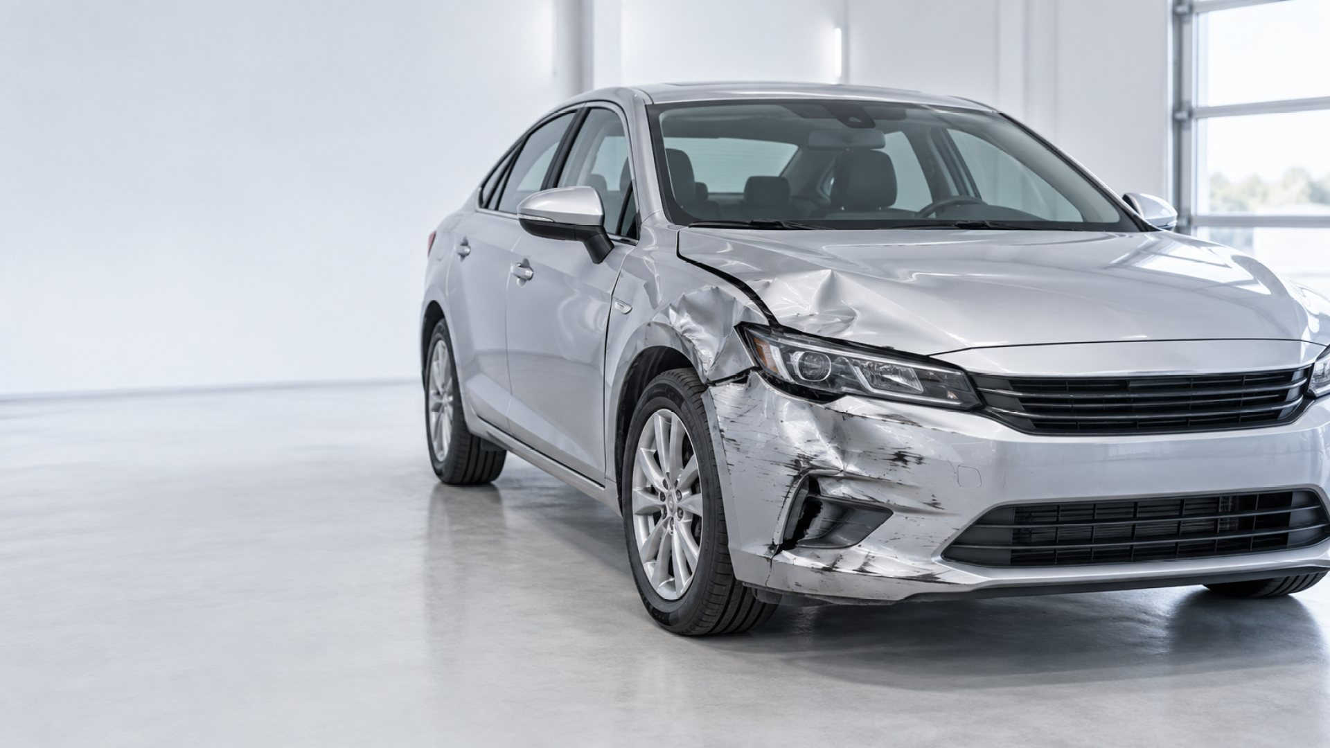
Technical system design
Containerised event runtime with separate image and document processing branches
EDGE AND API
cmev-web
cmev-api
M9
cmev-kafka
PLANNED WORKER SPLIT
React / TypeScript / nginx
FastAPI, review actions, print
Redpanda / Kafka event bus
Dedicated module containers replace the shared fixture producers.
IMAGE BRANCH · M1 → M2 → M3
EVENT PROCESSING · COMMANDS AND COMPLETION EVENTS
cmev-worker-parts
M1
cmev-worker-damage
M2
cmev-orchestrator
cmev-worker-producers
M1–M6
cmev-consolidator
M8
Stage dispatch and joins
Retries and dead letters
Fixture outputs for all six stages
Image and document branches
Deterministic findings
Pinned cost-table lookup
cmev-worker-summary
M3
DOCUMENT BRANCH · M4 → M5 → M6
SHARED STATE · USED BY THE API AND EVERY WORKER
cmev-worker-ocr
M4
cmev-db
cmev-objectstore
cmev-cost-bootstrap
M7
cmev-worker-lineitems
M5
PostgreSQL 16
Claims, revisions, results
MinIO (S3 API)
Original evidence files
One-shot offline synthetic build
Read-only cost-table volume
cmev-worker-penmarks
M6
Read-only model registry
LEAN PROFILE
cmev-worker-combined runs the orchestrator, producer and consolidator roles in a single container.
Offline training publishes versioned weights that the image and document workers mount.
Running container
Running with fixture outputs
Planned container
CLAIM-CMEV
01
Notes:
Sources: infra/compose/docker-compose.yml (current service definitions and lean/full profiles), docs/specs/technical_specification.md sections 3-4, docs/specs/integration_contracts.md, CONTEXT.md status correction dated 2026-09-27.
The left drawing shows the containers created for the full Compose profile: eight long-running services plus the one-shot cmev-cost-bootstrap job. All six evidence stages currently run as fixture producers in one cmev-worker-producers container (amber). The dashed workers on the right are the target architecture, not existing per-module deployments. In the lean profile, cmev-worker-combined replaces the orchestrator, producer and consolidator containers.
Browser requests reach the web/API. API outbox events and worker commands/completions travel via Kafka. The orchestrator controls readiness, retries and joins. M8 produces deterministic findings and reads a pinned M7 synthetic cost table. API and workers share PostgreSQL and object storage; shared persistence access is grouped rather than drawing every connection. The cost volume is implemented; model training/registry delivery and derived model artifacts are planned.
Target image dependency: M1 parts, then M2 damage/part assignment, then M3 summary. Document dependency: M4 OCR, then M5 rows, then M6 linked marks (mark detection itself may run earlier). Human review is required for marks and uncertain identities. Final claim approval remains separate. The API does not load neural weights.
Background image: the project's own generated decorative image (src/workbench/public/images/damaged-car.png), cropped and tinted.

Slide 2
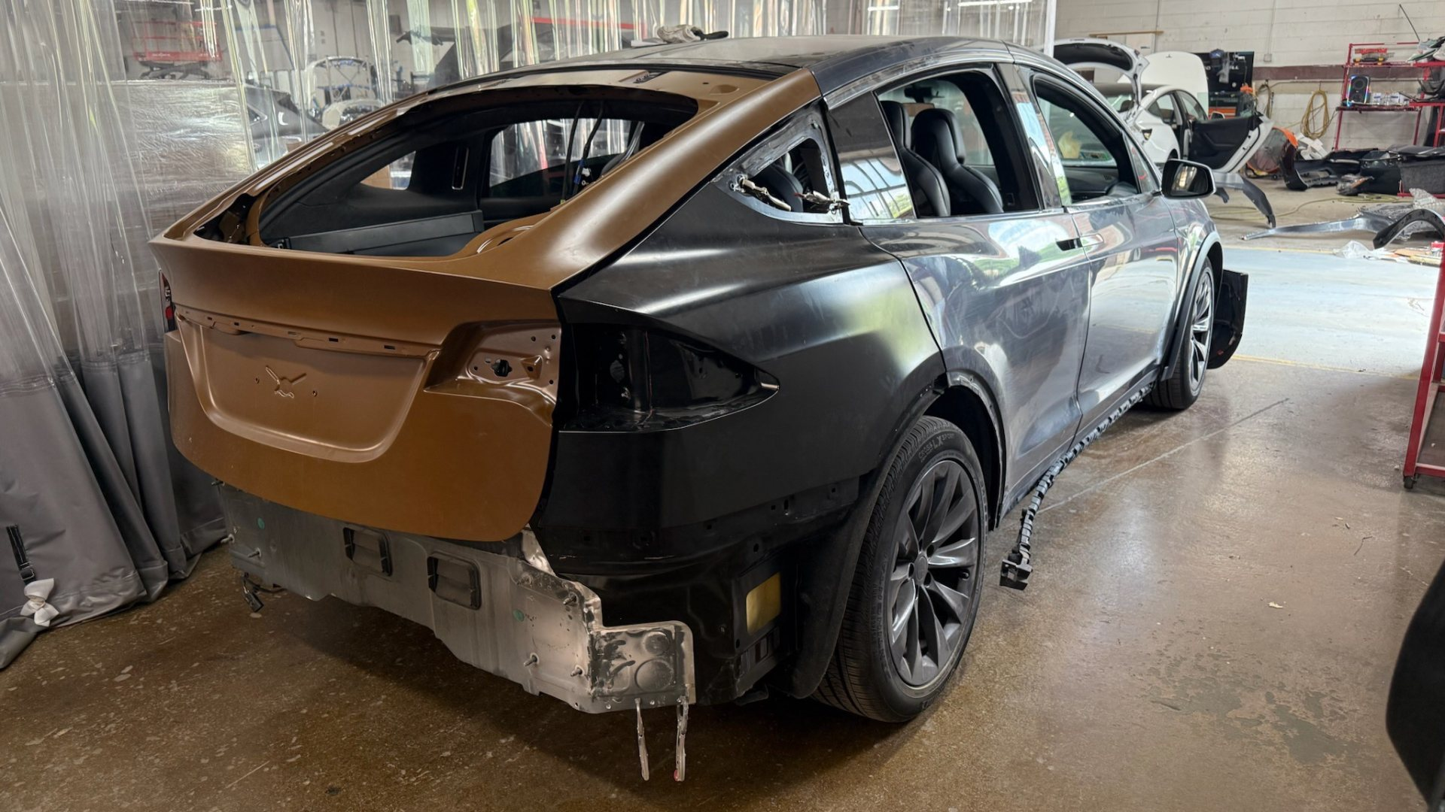
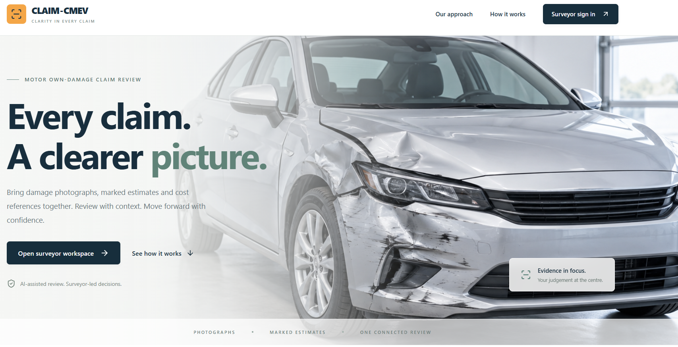
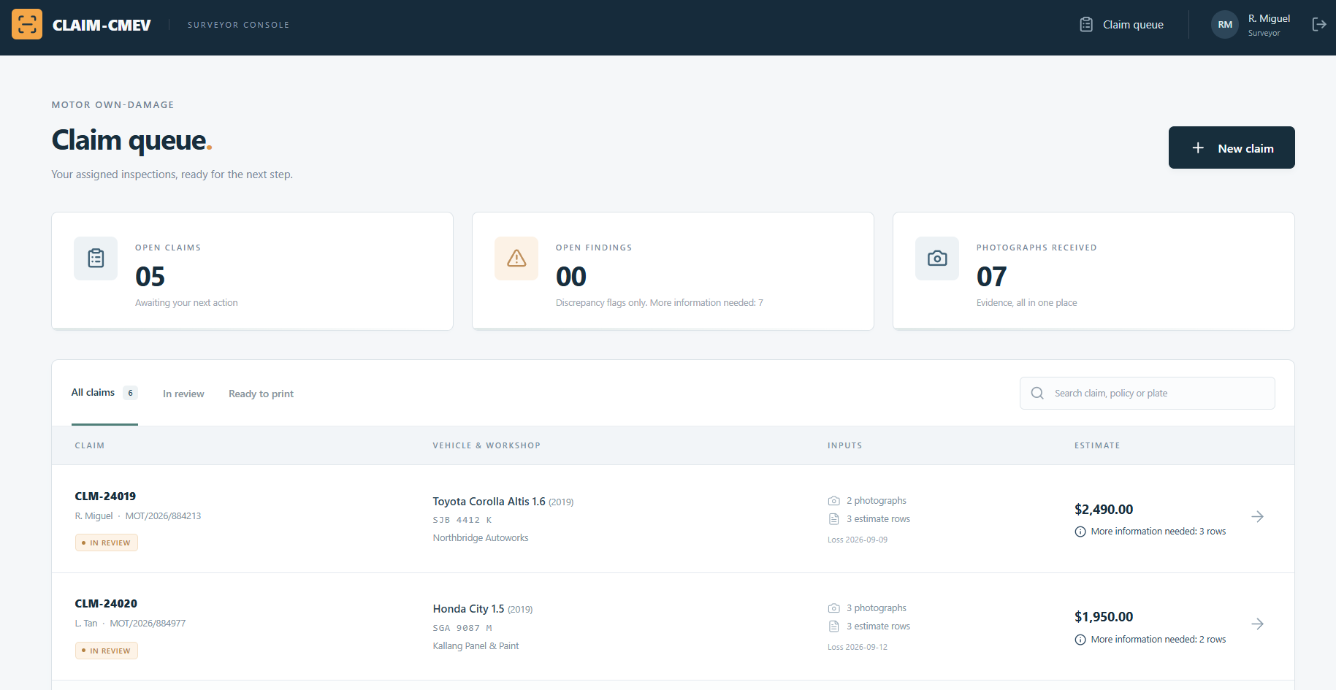
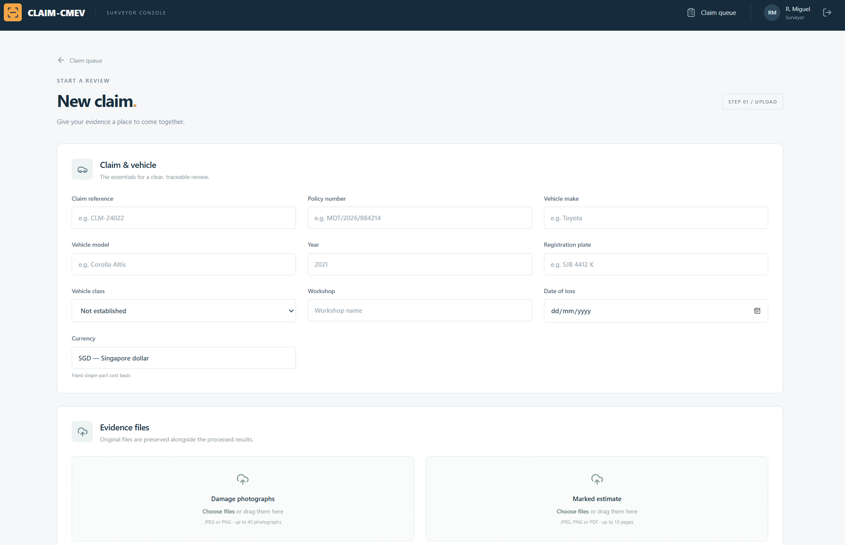
Project progress
The UI and backend harness are in place, and the first car defects model has been trained
1,413
9
1st
automated tests passing on fixture and synthetic data
containers in the full Compose profile, eight long-running
car defects model trained: SegFormer-B2 (team-reported)
COMPLETED AND PLANNED WORK
IMPLEMENTED
System UI and backend harness
Upload, review, evidence access and PDF export. API, orchestration, storage and rule checks run on fixtures.
TRAINED
First car defects model
SegFormer-B2 training complete. Evaluation results and runtime integration update to follow.
DEFINED
Component contracts
Typed records and Kafka events, versioned artifacts, claim revisions and exact monetary values.
IDENTIFIED
Datasets
HITL vehicle parts, CarDD damage (access pending), marked estimates and synthetic repair costs.
PLANNED
Model approach
SegFormer vision, pretrained PaddleOCR, Faster R-CNN pen marks, rule-based line items and offline cost ranges.
CLAIM-CMEV
Background photo: Scientificranking, Wikimedia Commons, CC BY 4.0 (cropped, greyscale, tinted)
02
Notes:
Sources: user's presentation request (SegFormer-B2 trained and desired progress points); CONTEXT.md current status and 2026-09-27 correction, including the combined validation of 1413 passed and 1 skipped Python tests on fixture/synthetic data; infra/compose/docker-compose.yml (nine full-profile containers, eight long-running); docs/specs/model_training_specification.md section 3; docs/specs/data_contracts.md; docs/specs/integration_contracts.md; docs/specs/ui_specification.md.
Completed UI/backend means the implemented fixture-backed application and system harness, not completion of every requirement or model integration. The test count is fixture and synthetic validation, not model accuracy or real-price accuracy. Actual image overlays, real-model worker integration, runtime acceptance and remaining defects still require work.
The training milestone is a fresh team update supplied by the user: the first car defects model, SegFormer-B2, has been trained. Older repository notes say no model exists and propose SegFormer-B0. The slide reflects the user's newer training update without claiming that checkpoint, dataset, evaluation results or model integration have been verified in this repository.
Datasets are identified, which does not imply all files/permissions/labels are ready. HITL is the planned parts source; CarDD is the planned core damage source with access pending in repository records. Model plan: SegFormer for vision, pretrained PaddleOCR, deterministic parser for 2-3 layouts, Faster R-CNN ResNet-50 FPN for pen marks, and offline empirical/LightGBM cost ranges. LayoutLMv3 and TrOCR remain stretch goals.
The right column contains intentionally editable placeholders for the next team sync: model dataset/checkpoint and measured metrics; completed modules and integration blockers; next owners and dates.
Background photo: "Rear End Tesla Model X Collision Damage Repair" by Scientificranking, Wikimedia Commons, licensed CC BY 4.0 (https://creativecommons.org/licenses/by/4.0/). Source: https://commons.wikimedia.org/wiki/File:Rear_End_Tesla_Model_X_Collision_Damage_Repair.jpg. Changes: cropped to 16:9, converted to greyscale, darkened and tinted.

