Slide 1
Red-Black Trees
and B+ Trees

Slide 2
Structure | Properties | Operations | Analysis
RB Tree
B+ Tree

Slide 3

Red-Black Trees and B+ Trees
Red-Black Trees
parent
color
key
Target : Balanced binary search tree
left
right
NULL =
NIL
【Definition】A red-black tree is a binary search tree that satisfies the following red-black properties:
(1) Every node is either red or black.
(2) The root is black.
(3) Every leaf (NIL) is black.
If a node is red, then both its children are black.
For each node, all simple paths from the node to descendant leaves contain the same number of black nodes.
7
Internal node
2
11
External node
1
5
8
14
4
15
NIL

Slide 4

Red-Black Trees and B+ Trees
【Definition】 The black-height of any node x, denoted by bh(x), is the number of black nodes on any simple path from x (x not included) down to a leaf. bh(Tree) = bh(root).
Number of internal nodes in the subtree rooted at x
【Lemma】 A red-black tree with N internal nodes has height at most 2ln(N +1).
sizeof(x) ≥ 2^{h/2} – 1
Proof: ① For any node x, sizeof(x) ≥ 2^{bh(x)} – 1. Prove by induction.

If h(x) = 0, x is NIL sizeof(x) = 2⁰ – 1 = 0
Suppose it is true for all x with h(x) ≤ k.
For x with h(x) = k + 1, bh(child) = ?
bh(x) or bh(x) – 1
Since h(child) ≤ k, sizeof(child) ≥ 2^{bh(child)} – 1
≥ 2^{bh(x) – 1} – 1

Hence sizeof(x) = 1 + 2sizeof(child) ≥ 2^{bh(x)} – 1
② bh(Tree) ≥ h(Tree) / 2 ?
Since for every red node, both of its children must be black, hence on any simple path from root to a leaf, at least half the nodes (root not included) must be black.
Discussion 2: Please finish the proof.
Sizeof(root) = N ≥ 2^{bh(Tree)} – 1 ≥ 2^{h/2} – 1

Slide 5
Red-Black Trees and B+ Trees
☞ Insert
— can be done iteratively
Sketch of the idea: Insert & color red
Symmetric
11
Case 1:
2
14
1
7
15
7
5
8
5
8
Case 2:
4
4
11
7
14
2
8
15
1
5
Case 3:
4
7
2
11
1
5
8
14
4
15
T = O( h ) = O( lnN )
Notes:
Case 2: why not an AVL double rotation?
A: it will result in a red root. The solution gives a black root so we can stop.

Slide 6
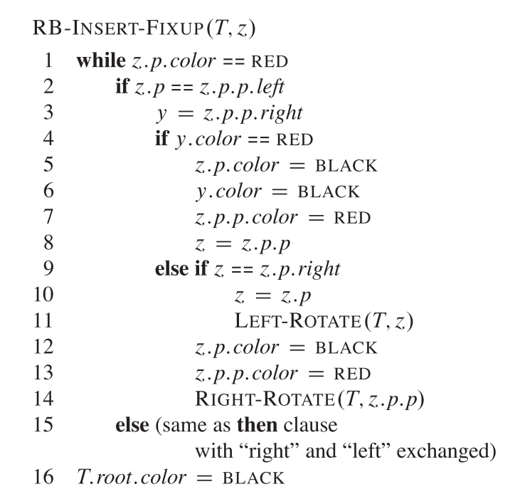

Red-Black Trees and B+ Trees
☞ Insert
— Code
Case 1:
Case 2:
Case 3:
Case 3 adjust color, alternatives?
Left-Leaning Red-Black Trees and 2-3 Trees
Notes:
To memorize, consider which properties can be violated at the beginning of each while loop

Slide 7

Red-Black Trees and B+ Trees
☞ Insert
— Top-Down
Previous : Top-down insertion
Bottom-up fixup
Case 1:
Top-down: Fixup then insert with one top-down traversal
Case 2:
Why: Will it save operations?
Case 3:
How: How to perform Top-Down Insertion? Can AVL trees be implemented this way?
Top-Down RB Tree
Notes:
To memorize, consider which properties can be violated at the beginning of each while loop

Slide 8
Structure | Properties | Operations | Analysis
RB Tree | Five rules | Insertion Deletion | 2ln(N+1) by induction
B+ Tree
Definitions (Red-Black Tree)
Leaf Nodes. Of a RB Tree are empty black nodes, implemented as pointing to a NIL node and not drawn in the tree.
Black Height bh(x). #Black nodes (not counting x) along the path to a leaf. NIL is counted unless NIL is x.
Internal Node. A node in a RB Tree which is not a leaf (i.e. NIL).

Slide 9
Red-Black Trees and B+ Trees
☞ Delete
❖ Delete a leaf node : Reset its parent link to NIL.
❖ Delete a degree 1 node : Replace the node by its single child.
❖ Delete a degree 2 node :
Adjust only if the node
is black.
① Replace the node by the largest one in its left subtree or the smallest one in its right subtree.
Keep the color
② Delete the replacing node from the subtree.
Must add 1 black to the path of the replacing node.
Case 1:
w
Still not solved
x
w
x
w
x
Case 2:
Case 3:
Case 4:
x
w
x
w
x
w

Slide 10
Red-Black Trees and B+ Trees
Case 2:

x
w
w
w
w
x
Continue to add 1 black to the path of x
w
Case 3:
x
w
x
w
x
w
Case 4
w
Case 4:
?
?

x
w
x
?
x

Slide 11
Red-Black Trees and B+ Trees
Case 1
10
10
10
10
5
15
5
15
7
15
7
15
x
3
7
11
17
3
7
11
17
5
8
11
17
5
8
5
11
17
6
8
6
8
3
6
Case 2.1
3
6
10
10
Case 2.2
10
7
15
7
15
x
7
15
5
8
11
17
x
5
8
11
17
5
8
11
17
6
Case 2.2
6
6
10
10
10
10
10
7
15
7
15
7
15
7
15
6
15
5
8
8
6
8
11
6
8
11
7
x
11
5
11
5
11
6
Case 3
6
5
Case 4
5
8

Slide 12
Red-Black Trees and B+ Trees
Number of rotations
AVL
Red-Black Tree
Insertion
≤ 2
≤ 2
Deletion
O(logN)
≤ 3

Slide 13
Structure | Properties | Operations | Analysis
RB Tree | Five rules | Insertion Deletion | 2ln(N+1) by induction
B+ Tree
Definitions (Red-Black Tree)
Leaf Nodes. Of a RB Tree are empty black nodes, implemented as pointing to a NIL node and not drawn in the tree.
Black Height bh(x). #Black nodes (not counting x) along the path to a leaf. NIL is counted unless NIL is x.
Internal Node. A node in a RB Tree which is not NIL.

Slide 14
Remarks (Red-Black Tree)
Make sure you learned the five rules by heart.
Rule 2 is not important and automatically fixed by Case 1.
Rule 4 makes sure there are no consecutive red nodes down the path so tree is balanced.
In every case op of RB-Insert Fixup:
  Black depth of subtrees not modified
  Only one rule can be violated (usually Rule 4, Rule 2 means z is root)
  At most 2 rotations: Case 2 -> Case 3.
In deletion, remember to keep the color.
  Stop when x is root.
  At most 3 rotations: Case 1 -> Case 3 -> Case 4.
插入看叔叔，删除看侄子。插入时自己是红的，删除时自己是黑的。自己和判断的节点颜色不一样时需要分情况讨论。在同侧时需要转换成异侧的操作。

Slide 15
Red-Black Trees and B+ Trees
B+ Trees
【Definition】A B+ tree of order M is a tree with the following structural properties:
(1) The root is either a leaf or has between 2 and M children.
(2) All nonleaf nodes (except the root) have between ⎡M/2⎤ and M children.
(3) All leaves are at the same depth.
Assume each nonroot leaf also has between ⎡M/2⎤ and M children.
Each interior node contains M pointers to the children.
And M − 1 smallest key values in the subtrees except the 1st one.
All the actual data are stored at the leaves.
A B+ tree of order 4
(2-3-4 tree)
21
48
72
12
15
25
31
41
59
84
91
1,4,8,11
12,13
15,18,19
21,24
25,26
31,38
41,43,46
48,49,50
59,68
72,78
84,88
91,92,99
<
<
<
<
<
<
<
<
<
<
<

Slide 16
Internal node Structure
pt₁ | k₁ | pt₂ | k₂ | … | k_{K-1} | pt_{K}
pt: pointer to substrees; k: search key
K subtrees and K-1 keys
Leaf node Structure
pr₀ | k₀ | pr₁ | k₁ | … | pr_{K-1} | k_{K-1}
pr: pointer to a record
K records and K keys
⚠️ Different from B tree, data only stored on the leaves.

Slide 17
Red-Black Trees and B+ Trees
A B+ tree of order 3
(2-3 tree)
✓
22:−
22:−
16:−
✓
11:16
41:58
41:58
1, 8
8,11,12
11,12
16,17
16,17,18
16,17,18
22,23,31
22,23,31
41,52
41,52
58,59,61
58,59,61
☞ Find: 52
☞ Insert: 18
☞ Insert: 1
☞ Insert: 19
16:22
☞ Insert: 28
11:−
18:−
41:58
1, 8
11,12
16,17
18,19
22,23,31
41,52
58,59,61

Slide 18
Red-Black Trees and B+ Trees
☞ Insert: 70
22:−
16:−
41:−
11:−
18:−
28:−
58:−
1, 8
11,12
16,17
18,19
22,23
28,31
41,52
58,59,61
First find a sibling with 2 keys and adjust. Keep more nodes full.
☞ Deletion is similar to insertion except that the root is removed when it loses two children.

Slide 19

Red-Black Trees and B+ Trees
For a general B+ tree of order M
T = O(M)
Btree Insert ( ElementType X, Btree T )
{
Search from root to leaf for X and find the proper leaf node;
Insert X;
while ( this node has M+1 keys ) {
split it into 2 nodes with ⎡(M+1)/2⎤ and ⎣(M+1)/2 ⎦ keys, respectively;
if (this node is the root)
create a new root with two children;
check its parent;
}
}
T(M, N) = O( (M/log M) log N )
Depth(M, N) =
O( ⎡log_{⎡M/2⎤} N ⎤ )
Note: The best choice of M is 3 or 4. Just for math.
T_{Find} (M, N) = O( log N )

Slide 20
Node type | Min #keys | Max #keys | Min #children | Max #children
Root as a leaf | 0 | M | 0 | 0
Root as an internal node | 1 | M-1 | 2 | M
Internal node | ⎡M/2⎤ -1 | M-1 | ⎡M/2⎤ | M
Leaf | ⎡M/2⎤ | M | 0 | 0

Slide 21
Structure | Properties | Operations | Analysis
RB Tree | Five rules | Insertion Deletion | 2ln(N+1) by induction
B+ Tree | Height balanced order M | Split, Merge, Adjust | O(log_{⎡M/2⎤} N)O(logM) = O(logN)
Definitions (B+ Tree)
Order. Max children number of a B+ Tree.
Child. Internal node: pointer to a subtree; leaf node: key and data record pair.
Min children size. An internal node has at least ⎡M/2⎤ children.

Slide 22
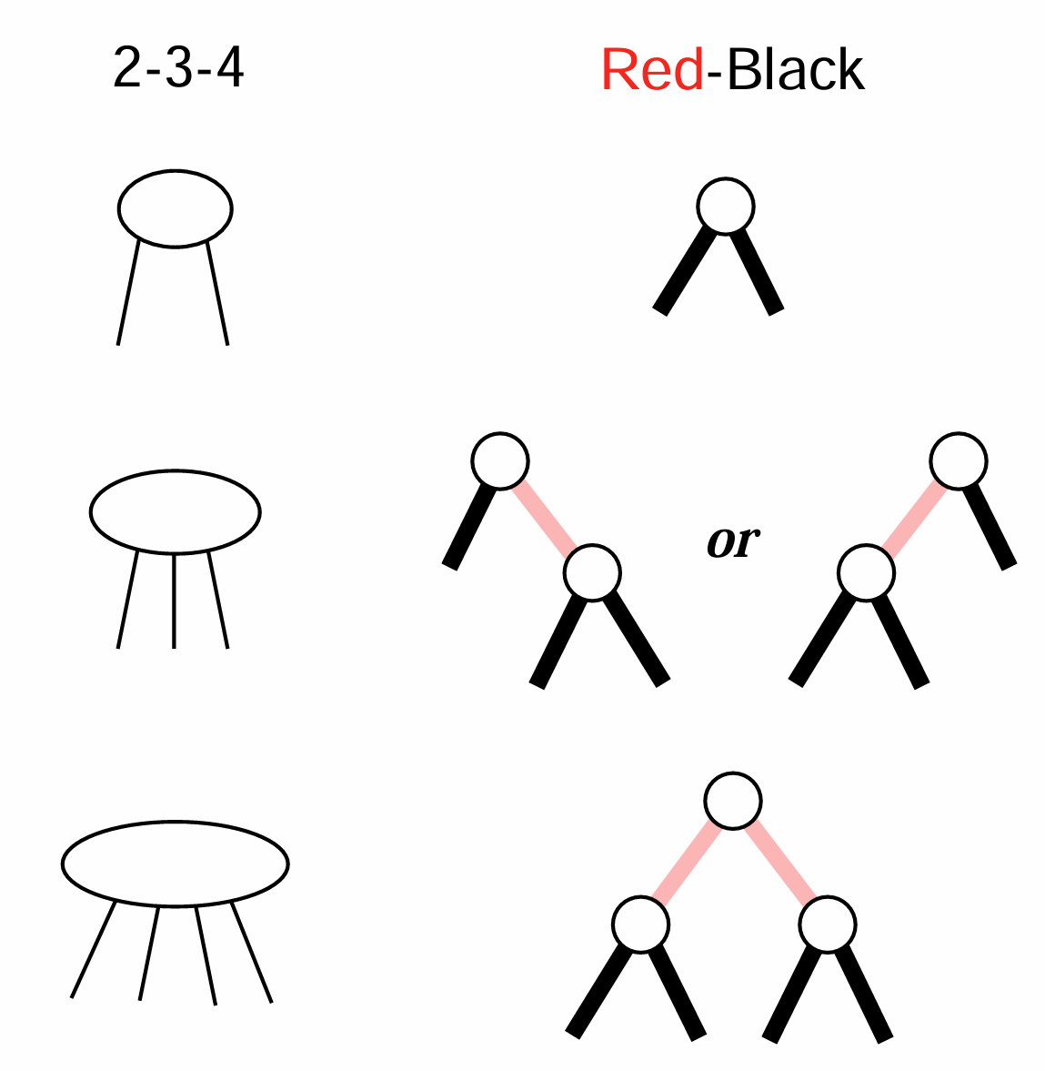
Remarks (B+ Tree)
Typical order of a B+ tree is 100+
Compared to B Tree, in B+ tree the internal nodes do not store any pointers to records, thus all pointers to records are stored in the leaf nodes.
In addition, a leaf node may include a pointer to the next leaf node to speed sequential access.
Because B+ tree internal nodes have fewer pointers, each node can hold more keys, causing the tree to be shallower, and thus, faster to search.
A RB tree corresponds to a 2-3-4 tree

Slide 23
Reference:
Introduction to Algorithms, 3rd Edition: Ch.13，p. 308-338； Ch.18，p. 484-504； Thomas H. Cormen, Charles E. Leiserson, Ronald L. Rivest and Clifford Stein. The MIT Press. 2009

