Slide 1
Leftist Heaps
and Skew Heaps

Slide 2
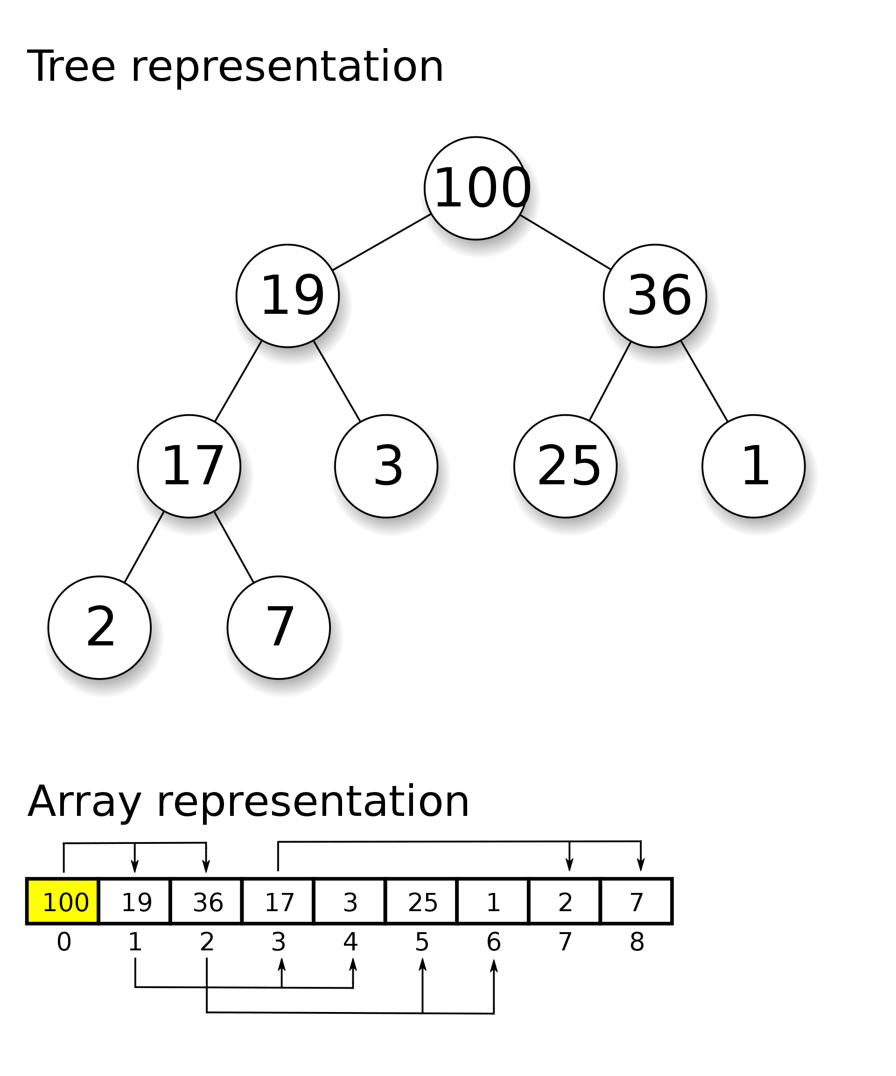
Leftist Heaps & Skew Heaps
Heaps
Definition
Almost complete binary tree
Max/min heap
Implementation
Operations
Basic:
find-min (peek)
insert (push)
delete-min
Creation:
create-heap
heapify
merge (meld)

Slide 3


Leftist Heaps & Skew Heaps
Leftist Heaps
Target : Speed up merging in O(N).
 Heap: Structure Property + Order Property
 Have to copy one array into another Θ(N)
Discussion 5: How fast can we merge two heaps if we simply use the original heap structure?
 Use pointers
 Slow down all the operations
Leftist Heap:
Order Property – the same
Structure Property – binary tree, but unbalanced

Slide 4

Leftist Heaps & Skew Heaps
【Definition】The null path length (零路径), Npl(X), of any node X is the length of the shortest path from X to a node without two children. Define Npl(NULL) = –1.
Note:
Npl(X) = min { Npl(C) + 1 for all C as children of X }
【Definition】The leftist heap (左偏堆/树) property is that for every node X in the heap, the null path length of the left child is at least as large as that of the right child.
1
1
1
0
The tree is biased to get deep toward the left.
1
0
✓
✗
0
0
0
1
0
0
0

Slide 5
Leftist Heaps & Skew Heaps
【Theorem】A leftist tree with r nodes on the right path must have at least 2^{r} – 1 nodes.
Proof: By induction on p. 162.
Note: The leftist tree of N nodes has a right path containing at most ⎣log(N+1)⎦ nodes.
Discussion 6: How long is the right path of a leftist tree of N nodes? What does this conclusion mean to us?
 We can perform all the work on the right path, which is guaranteed to be short.
❓Is the right path the shortest root-to-leaf path in the heap?
Trouble makers: Insert and Merge
Note: Insertion is merely a special case of merging.

Slide 6
Structure | Properties | Operations | Analysis
Leftist Heap | NPL Right Path | Insert = Merge | log(N+1) by induction
Skew Heap
Definitions (Leftist Heap)
Null path length. shortest path from X to a node without two children. NPL(NULL) = –1.
Leftist Heap. NPL of the left child is no shorter than the right’s.

Slide 7
Leftist Heaps & Skew Heaps
☞ Declaration:
Step 1:
Merge( H₁->Right, H₂ )
6
struct TreeNode
{
ElementType Element;
PriorityQueue Left;
PriorityQueue Right;
int Npl;
} ;
12
7
18
24
8
37
33
17
18
Step 2:
Attach( H₂, H₁->Right )
26
3
☞ Merge (recursive version):
10
6
3
6
21
14
12
7
10
8
12
7
23
18
24
8
37
21
14
17
18
24
37
18
33
17
18
23
26
33
26
Step 3:
Swap(H₁->Right, H₁->Left )
if necessary
H₁
H₂

Slide 8
Leftist Heaps & Skew Heaps
PriorityQueue Merge ( PriorityQueue H1, PriorityQueue H2 )
{
if ( H1 == NULL ) return H2;
if ( H2 == NULL ) return H1;
if ( H1->Element < H2->Element ) return Merge1( H1, H2 );
else return Merge1( H2, H1 );
}
static PriorityQueue
Merge1( PriorityQueue H1, PriorityQueue H2 )
{
if ( H1->Left == NULL ) /* single node */
H1->Left = H2; /* H1->Right is already NULL
and H1->Npl is already 0 */
else {
H1->Right = Merge( H1->Right, H2 ); /* Step 1 & 2 */
if ( H1->Left->Npl < H1->Right->Npl )
SwapChildren( H1 ); /* Step 3 */
H1->Npl = H1->Right->Npl + 1;
} /* end else */
return H1;
}
What if Npl is NOT updated?
T_{p} = O(log N)

Slide 9
Leftist Heaps & Skew Heaps
☞ Merge (iterative version):
Step 2: Swap children if necessary
3
6
3
10
8
12
7
21
14
17
18
24
37
18
6
10
23
26
33
12
7
21
14
H₁
H₂
18
24
8
37
23
Step 1: Sort the right paths without changing their left children
33
17
18
26
3
☞ DeleteMin:
10
6
Step 1: Delete the root
21
14
12
7
Step 2: Merge the two subtrees
23
18
24
37
8
33
17
18
T_{p} = O(log N)
26

Slide 10
Leftist Heaps & Skew Heaps
Skew Heaps
-- a simple version of the leftist heaps
Target : Any M consecutive operations take at most O(M log N) time.
☞ Merge: Always swap the left and right children except that the largest of all the nodes on the right paths does not have its children swapped. No Npl.
3
6
3
Not really a special case, but a natural stop in the recursions.
10
8
12
7
6
10
21
14
17
18
24
37
18
7
12
21
14
23
26
33
35
8
37
18
24
23
H₁
H₂
18
17
33
35
26
This is NOT always the case.
https://www.cs.usfca.edu/~galles/JavascriptVisual/SkewHeap.html

Slide 11
Leftist Heaps & Skew Heaps
【Example】Insert 15
3
15
3
6
10
10
6
7
12
21
14
14
21
7
12
8
37
18
24
23
15
23
8
37
18
24
18
17
33
18
17
33
26
26
☞ Merge (iterative version):
3
3
6
6
10
10
8
12
7
7
12
21
14
21
14
17
18
24
37
18
8
37
18
24
23
23
26
33
18
17
33
H₁
H₂
26

Slide 12
Structure | Properties | Operations | Analysis
Leftist Heap | NPL Right Path | Insert = Merge | log(N+1) by induction
Skew Heap | Always Swap | Natural Recursion Stop

Slide 13
Leftist Heaps & Skew Heaps
Note:
☞ Skew heaps have the advantage that no extra space is required to maintain path lengths and no tests are required to determine when to swap children.
☞ It is an open problem to determine precisely the expected right path length of both leftist and skew heaps.

Slide 14
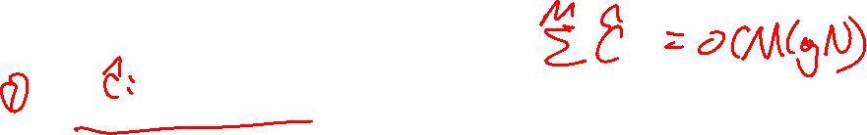
Leftist Heaps & Skew Heaps
Amortized Analysis for Skew Heaps
Insert & Delete are just Merge
T_{amortized} = O(log N) ?
D_{i} = ?
Φ( D_{i} ) = ?
the root of the resulting tree
number of right nodes?
number of heavy nodes
【Definition】A node p is heavy if the number of descendants of p’s right subtree is at least half of the number of descendants of p, and light otherwise. Note that the number of descendants of a node includes the node itself.
Notes:
关键是：potential function要能分辨出bad luck和good luck。
Right node的数量只能体现bad luck，但没有变好的可能。

Slide 15



Leftist Heaps & Skew Heaps
3
1
1
6
8
2
5
3
2
10
14
9
17
11
7
5
6
16
12
7
11
10
14

8
16
The only nodes whose heavy/light status can change are nodes that are initially on the right path.
17
9
12
H_{i} : l_{i} + h_{i} ( i = 1, 2 )
T_{worst} = l₁ + h₁ + l₂ + h₂
Along the right path
Before merge: Φ_{i} = h₁ + h₂ + h
After merge: Φ_{i+1} ≤ ?
T_{amortized} = T_{worst} + Φ_{i+1} – Φ_{i}
≤ 2 (l₁ + l₂)
l₁ + l₂ + h
l = O( log N )
T_{amortized} = O( log N )
the exact amortized complexity is known to be log_{φ} n (approximately 1.44 log₂ n)

Slide 16
Structure | Properties | Operations | Analysis
Leftist Heap | NPL Right Path | Insert = Merge | log(N+1) by induction
Skew Heap | Always Swap | Natural Recursion Stop | Amortized Analysis
Definition (Skew Heap)
Heavy node. R ≥ (L + R + 1) / 2, R > L.
Remarks
In amortized analysis, the energy function is usually selected to reflect the saving and paying extra cost, i.e. not monotonic.

Slide 17
Reference:
Data Structure and Algorithm Analysis in C (2nd Edition)：Ch.5，p.161-169； Ch.11，p.435-437；M.A.Weiss著、陈越改编，人民邮件出版社，2005

