Slide 1

AVL Trees
Splay Trees
Red-Black Trees
B+ Trees

Slide 2
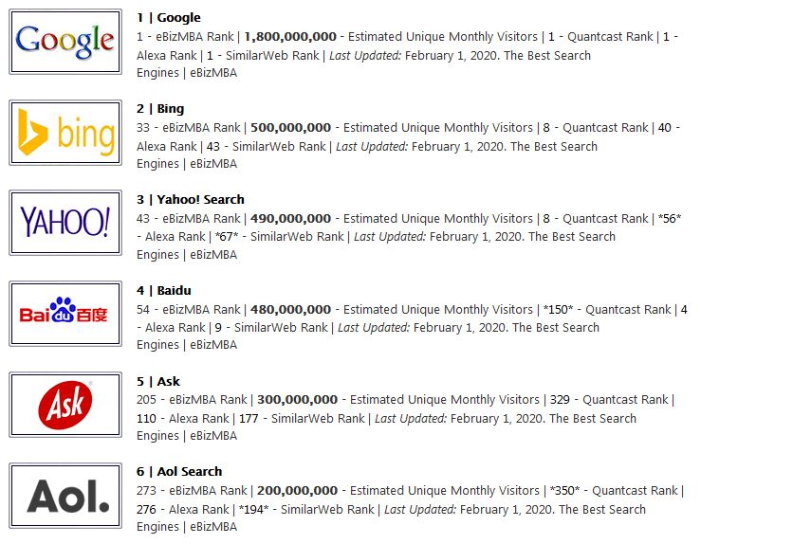
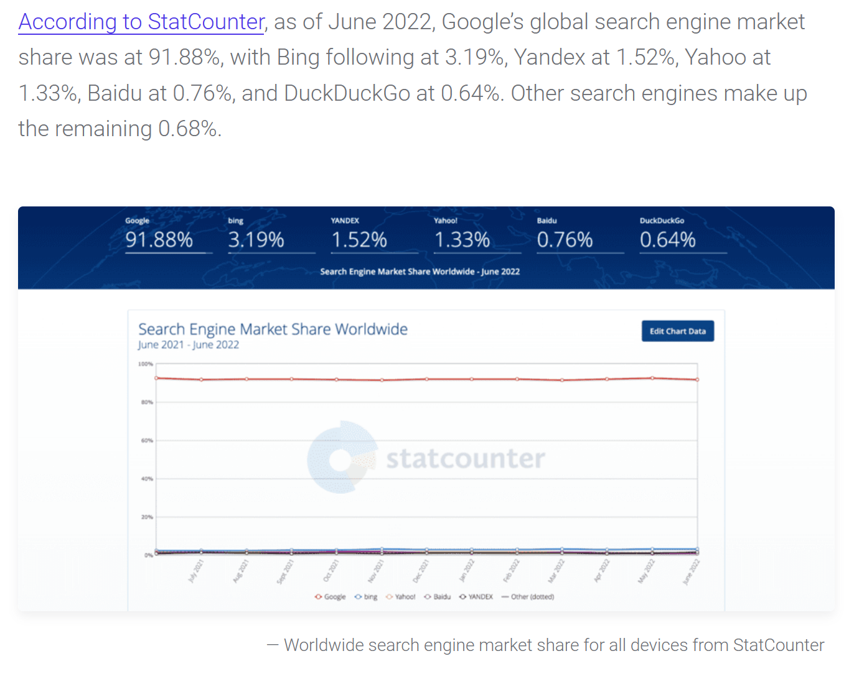

Slide 3
Inverted File Index

Slide 4

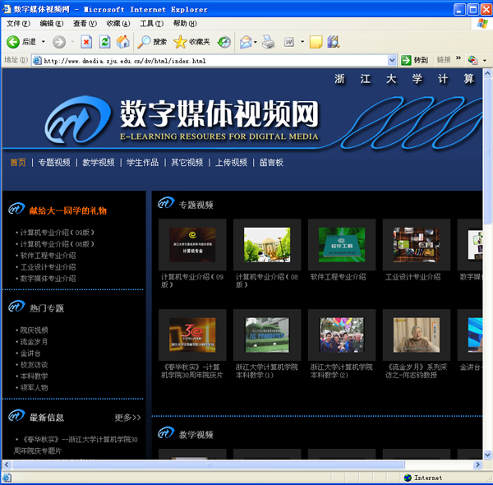
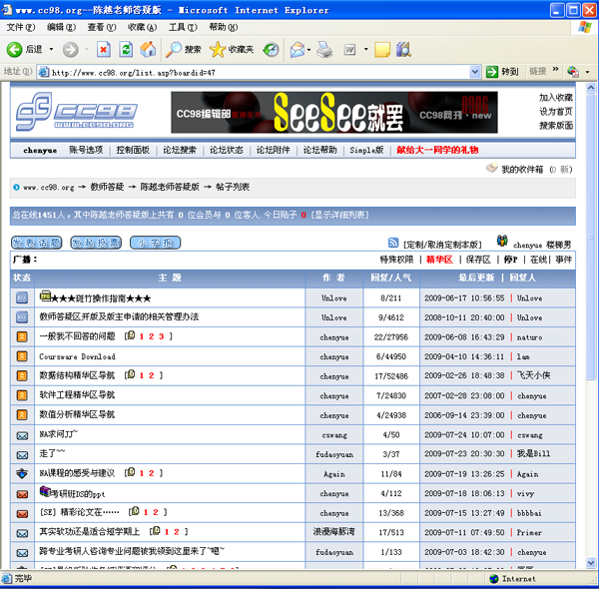
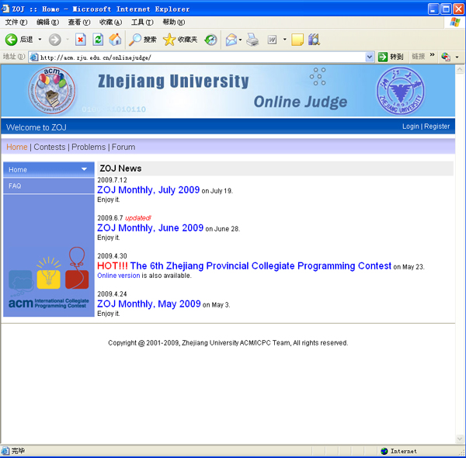
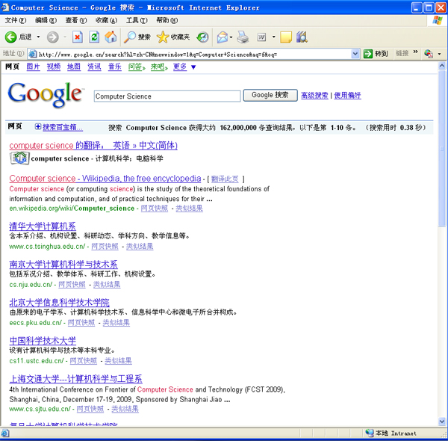
Inverted File Index
How can I find in which
retrieved web pages that include
"Computer Science"?

Slide 5


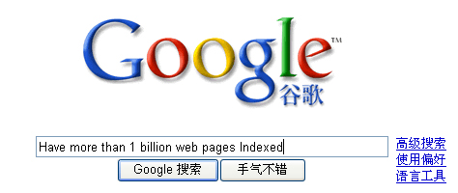

Inverted File Index
☞ Solution 1: Scan each page for the string "Computer Science".
Wait till your next life !
How did Google do?
1 trillion

Slide 6
Inverted File Index
☞ Solution 2: Term-Document Incidence Matrix
〖Example〗 Document sets
Doc | Text
1 | Gold silver truck
2 | Shipment of gold damaged in a fire
3 | Delivery of silver arrived in a silver truck
4 | Shipment of gold arrived in a truck
 | 1 | 2 | 3 | 4
a | 0 | 1 | 1 | 1
arrived | 0 | 0 | 1 | 1
damaged | 0 | 1 | 0 | 0
delivery | 0 | 0 | 1 | 0
fire | 0 | 1 | 0 | 0
gold | 1 | 1 | 0 | 1
of | 0 | 1 | 1 | 1
in | 0 | 1 | 1 | 1
shipment | 0 | 1 | 0 | 1
silver | 1 | 0 | 1 | 0
truck | 1 | 0 | 1 | 1
silver & truck = 1010 & 1011 = 1010
Boolean Query

Slide 7
Inverted File Index
☞ Solution 3: Compact Version - Inverted File Index
【Definition】 Index is a mechanism for locating a given term in a text.
【Definition】 Inverted file contains a list of pointers (e.g. the number of a page) to all occurrences of that term in the text.
No. | Term | Times; Documents
1 | a | <3; 2,3,4>
2 | arrived | <2; 3,4>
3 | damaged | <1; 2>
4 | delivery | <1; 3>
5 | fire | <1; 2>
6 | gold | <3; 1,2,4>
7 | of | <3; 2,3,4>
8 | in | <3; 2,3,4>
9 | shipment | <2; 2,4>
10 | silver | <2; 1,3>
11 | truck | <3; 1,3,4>
Doc | Text
1 | Gold silver truck
2 | Shipment of gold damaged in a fire
3 | Delivery of silver arrived in a silver truck
4 | Shipment of gold arrived in a truck
Inverted because it lists for a term,
all documents that contain the term
Inverted File Index

Slide 8

Inverted File Index
Times; Documents Words
<3; (2;6),(3;6),(4;6)>
<2; (3;4),(4;4)>
<1; (2;4)>
<1; (3;1)>
<1; (2;7)>
<3; (1;1),(2;3),(4;3)>
<3; (2;2),(3;2),(4;2)>
<3; (2;5),(3;5),(4;5)>
<2; (2;1),(4;1)>
<2; (1;2),(3;3,7)>
<3; (1;3),(3;8),(4;7)>
No. | Term | Times; Documents
1 | a | <3; 2,3,4>
2 | arrived | <2; 3,4>
3 | damaged | <1; 2>
4 | delivery | <1; 3>
5 | fire | <1; 2>
6 | gold | <3; 1,2,4>
7 | of | <3; 2,3,4>
8 | in | <3; 2,3,4>
9 | shipment | <2; 2,4>
10 | silver | <2; 1,3>
11 | truck | <3; 1,3,4>
Doc | Text
1 | Gold silver truck
2 | Shipment of gold damaged in a fire
3 | Delivery of silver arrived in a silver truck
4 | Shipment of gold arrived in a truck
Term Dictionary
Posting List
How to easily print the sentences which contain the words and highlight the words?
Why do we keep “times” (frequency)?
Often kept in a linked list and sorted for easy mering
Notes:
Q2: AND操作从最小频率的term开始求交，速度快。

Slide 9





Inverted File Index
Index Generator
while ( read a document D ) {
while ( read a term T in D ) {
if ( Find( Dictionary, T ) == false )
Insert( Dictionary, T );
Get T’s posting list;
Insert a node to T’s posting list;
}
}
Write the inverted index to disk;
Token Analyzer
Stop Filter
Vocabulary Scanner
Vocabulary Insertor
Memory management

Slide 10
Inverted File Index
While reading a term ……
 Word Stemming
Process a word so that only its stem or root form is left.
〖Example〗
Process
processing
processes
processed
says
said
saying
process
say
 Stop Words
Some words are so common that almost every document contains them, such as “a” “the” “it”. It is useless to index them. They are called stop words. We can eliminate them from the original documents.

Slide 11
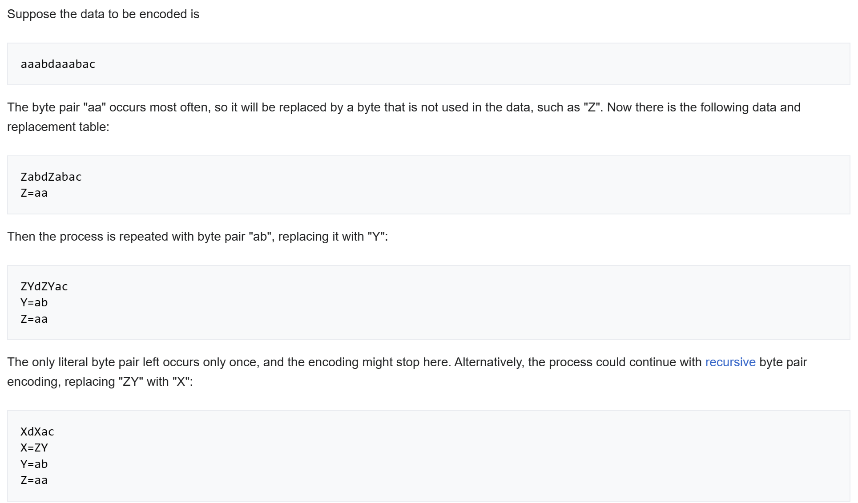
Byte Pair Encoding
https://github.com/openai/tiktoken

Slide 12
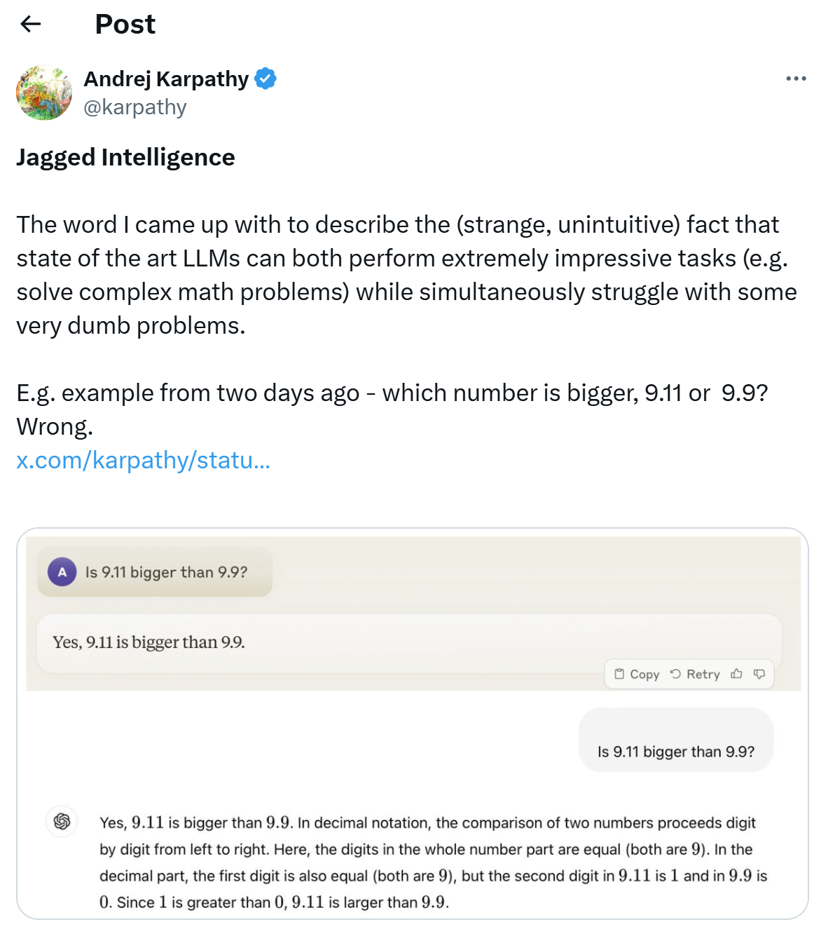

Slide 13

Inverted File Index
While accessing a term ……
☞ Solution 1: Search trees ( B- trees, B+ trees, Tries, ... )
☞ Solution 2: Hashing
Discussion 3:
What are the pros and cons of using hashing, comparing to using search trees?
 faster for one word
 scanning in sequential order is not possible (e.g. range searches are expensive)

Slide 14
Inverted File Index
While not having enough memory ……
BlockCnt = 0;
while ( read a document D ) {
while ( read a term T in D ) {
if ( out of memory ) {
Write BlockIndex[BlockCnt] to disk;
BlockCnt ++;
FreeMemory;
}
if ( Find( Dictionary, T ) == false )
Insert( Dictionary, T );
Get T’s posting list;
Insert a node to T’s posting list;
}
}
for ( i=0; i<BlockCnt; i++ )
Merge( InvertedIndex, BlockIndex[i] );
Sorted
Notes:
在写磁盘之前先排序，归并效率高。

Slide 15

Inverted File Index
Distributed indexing (for web-scale indexing — don’t try this at home!)
—— Each node contains index of a subset of collection
☞ Solution 1: Term-partitioned index
…………
A~C
D~F
X~Z
☞ Solution 2: Document-partitioned index
…………

1~
10000

10001~
20000

90001~
100000

Slide 16
Inverted File Index
Dynamic indexing
☞ Docs come in over time
  - postings updates for terms already in dictionary
  - new terms added to dictionary
☞ Docs get deleted
 New Docs
Main Index
auxiliary index
When to re-index?
How to delete a doc?
Search Results

Slide 17
Inverted File Index
Compression
Term
a
arrive
damage
deliver
fire
gold
of
in
shipment
silver
truck
arrivedamagedeliverfiregoldshipmentsilvertruck
Posting List:
computer 2, 15, 47, …, 58879, 58890, …
2, 13, 32, … …, 11, …
 Most gaps can be encoded with far fewer than 20 bits

Slide 18
Inverted File Index
Thresholding
阈值 != 阀值
☞ Document: only retrieve the top x documents where the documents are ranked by weight
 Not feasible for Boolean queries
 Can miss some relevant documents due to
truncation
☞ Query: Sort the query terms by their frequency in ascending order; search according to only some percentage of the original query terms
T1
T2
T3
T4
T5
T6
T7
T8
T9
T10
20%
40%
80%

Slide 19
Inverted File Index
Measures for a search engine
☞ How fast does it index
  - Number of documents/hour
☞ How fast does it search
  - Latency as a function of index size
☞ Expressiveness of query language
  - Ability to express complex information needs
  - Speed on complex queries
?
☞ User happiness
- Data Retrieval Performance Evaluation (after establishing correctness)
  > Response time
  > Index space
- Information Retrieval Performance Evaluation
  > + How relevant is the answer set?

Slide 20
Inverted File Index
Relevance measurement requires 3 elements:
A benchmark document collection
A benchmark suite of queries
A binary assessment of either Relevant or Irrelevant for each query-doc pair
 | Relevant | Irrelevant
Retrieved | R_{R} | I_{R}
Not Retrieved | R_{N} | I_{N}
Collection
Retrieved
Precision P = R_{R} / (R_{R} + I_{R})
Recall R = R_{R} / (R_{R} + R_{N})
Relevant Docs

Slide 21
Inverted File Index
Returns relevant documents but
misses many useful ones too
The ideal
1
Precision
0
1
Recall
Returns most relevant
documents but includes
lot of junk

Slide 22

Inverted File Index
Discussion 4:
How to improve the relevancy of
search results?
 Page Rank
Semantic Web
……

Slide 23
Reference:
Download “InvertedFileIndex.zip”.
  The Google File System.pdf
  Building an Inverted Index.pdf
  Inverted Index Construction(ppt).pdf
  Compression.pdf

Slide 24
Definitions
Index. A mechanism for locating a given term in a text.
Inverted File. Key: terms (dictionary); Value: #occurences+doc id
Posting List. A linked list keeping which document contains the term (and its position).
Stemming. Process a word so that only its stem or root form is left.
Stop Word. Common, useless words which are eliminated from indexing.
Distributed Indexing. Each node contains index of a subset of collection, grouped by documents (document partitioned index).
Dynamic Indexing. Split into a main and an auxiliary index.
Thresholding. By query term frequency > by document weight.
Precision. TP / (TP + FP).
Recall. TP / (TP + FN).

