Slide 1
Backtracking

Slide 2
Elements of an Algorithm. (Through the following courses, we will have a more formal definition.)
Computational Problem. The type of problems we can use algorithm to solve. (We will come back to it in the P/NP course.)
Feasibility. A feasible solution satisfies the constraints of the problem.
Solution Space. The set of feasible solutions. It can be finite or infinite.
Convex Optimization/Linear Programming. Continuous space.
Combinatorial Optimization. Discrete & finite space.
Integer Programming. Discrete & infinite space.
Optimality. For the hard problems, we care about the tradeoff between optimality vs. complexity.
Backtracking helps us enumerate over all feasible solutions.

Slide 3
Main Takeaways (Backtracking)
Problems
8-Queens.
Turnpike Reconstruction Problem.
Tic-Tac-Toe.
Definitions
Game Tree.
Value.
Position.
Algorithm
Minimax Strategy.
Alpha-Beta Pruning.

Slide 4

Backtracking
Rationale of the Backtracking Algorithms
A sure-fire way to find the answer to a problem is to make a list of all candidate answers, examine each, and following the examination of all or some of the candidates, declare the identified answer.
Backtracking enables us to eliminate the explicit examination of a large subset of the candidates while still guaranteeing that the answer will be found if the algorithm is run to termination.
Suuuure — if the list is finite and it is
possible to identify the answer following
the examinations. AND, if there are
not too many candidates.

Slide 5
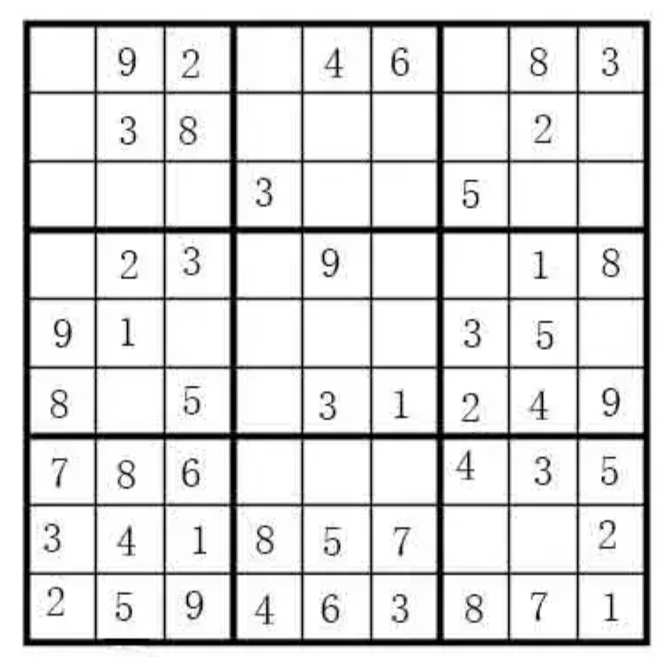

Slide 6
Backtracking
Rationale of the Backtracking Algorithms
A sure-fire way to find the answer to a problem is to make a list of all candidate answers, examine each, and following the examination of all or some of the candidates, declare the identified answer.
Backtracking enables us to eliminate the explicit examination of a large subset of the candidates while still guaranteeing that the answer will be found if the algorithm is run to termination.
Suuuure — if the list is finite and it is
possible to identify the answer following
the examinations. AND, if there are
not too many candidates.
The basic idea is to start with a partial solution ( x₁, ... , x_{i} ) where each x_{k} ∈ S_{k} for 1 ≤ k ≤ i < n. Then, we add x_{i+1} ∈ S_{i+1} and check if ( x₁, ... , x_{i}, x_{i+1} ) satisfies the constraints. If the answer is “yes”, we continue to add the next x, else we delete the current x_{i+1} and try the next x_{i+1} ∈ S_{i+1}. If all possible x_{i+1} ∈ S_{i+1} fail to satisfy the constraints, we backtrack to the previous partial solution ( x₁, ... , x_{i−1} ).
pruning

Slide 7
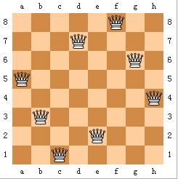
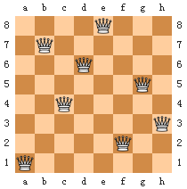
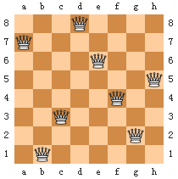

Backtracking
Eight Queens
Find a placement of 8 queens on an 8 × 8 chessboard such that no two queens attack.
Two queens are said to attack iff they are in the same row, column, diagonal, or antidiagonal of the chessboard.
Discussion 16:
Please draw 2 different solutions.

Slide 8

Backtracking
1
2
3
4
5
6
7
8
Q_{i} ::= queen in the i-th row
1
Q
x_{i} ::= the column index in which Q_{i} is
2
Q
This implies
that the solution must
be a permutation of 1, 2, ... , 8.
Thus the number of candidates
in the solution space
is reduced to 8!.
3
Q
Solution = ( x₁, x₂, ... , x₈ )
4
Q
= ( 4, 6, 8, 2, 7, 1, 3, 5 )
5
Q
This implies 8⁸ candidates
in the solution space.
6
Q
7
Q
8
Q
Constrains:
① S_{i} = { 1,2,3,4,5,6,7,8 } for 1 ≤ i ≤ 8
② x_{i} ≠ x_{j} if i ≠ j
③ ( x_{i}− x_{j} ) / (i − j ) ≠ ± 1
For the problem with n queens,
there are n! candidates
in the solution space.

Slide 9
Backtracking
Method: Take the problem of 4 queens as an example
Step 1: Construct a game tree
1
x1 = 1
2
3
4
2
18
34
50
x2 = 2
3
4
1
3
4
1
2
4
1
2
3
3
8
13
19
24
29
35
40
45
51
56
61
x3 = 3
4
2
4
2
3
3
4
1
4
1
3
2
4
1
4
1
2
2
3
1
3
1
2
4
6
9
11
14
16
20
22
25
27
30
32
36
38
41
43
46
48
52
54
57
59
62
64
x4 = 4
3
4
2
3
2
4
3
4
1
3
1
4
2
4
1
2
1
3
2
3
1
2
1
5
7
10
12
15
17
21
23
26
28
31
33
37
39
42
44
47
49
53
55
58
60
63
65
4 ! leaves
Each path from the root to a leaf defines an element of the solution space.

Slide 10

Backtracking
1
x1 = 1
2
3
4
2
18
34
50
x2 = 2
3
4
1
3
4
1
2
4
1
2
3
3
8
13
19
24
29
35
40
45
51
56
61
x3 = 3
4
2
4
2
3
3
4
1
4
1
3
2
4
1
4
1
2
2
3
1
3
1
2
4
6
9
11
14
16
20
22
25
27
30
32
36
38
41
43
46
48
52
54
57
59
62
64
x4 = 4
3
4
2
3
2
4
3
4
1
3
1
4
2
4
1
2
1
3
2
3
1
2
1
5
7
10
12
15
17
21
23
26
28
31
33
37
39
42
44
47
49
53
55
58
60
63
65
Step 2: Perform a depth-first search ( post-order traversal ) to examine the paths
( 2, 4, 1, 3 )
Q
Q
Q
Q
Q
Q
Q
Q
Note: No tree is actually constructed. The game tree is just an abstract concept.
Q
Q
Q
Q
Q
Q
Q

Slide 11
Main Takeaways (Backtracking)
Problems
8-Queens. Place eight queens on a 8x8 chessboard so that no two queens threaten each other. (Backtracking eliminates infeasible solutions.)
Turnpike Reconstruction Problem.
Tic-Tac-Toe.
Definitions
Game Tree. Depth-first search represents all possible game states. Traversing the subtree will yield the optimal solution for this step.
Algorithm
Alpha-Beta Pruning. (Backtracking eliminates suboptimal solutions.)

Slide 12

https://www.bilibili.com/video/BV1xo4y1c74F/

Slide 13
Backtracking
The Turnpike Reconstruction Problem
Given N points on the x-axis with coordinates x₁ < x₂ < …< x_{N} . Assume that x₁ = 0. There are N ( N – 1 ) / 2 distances between every pair of points.
Given N ( N – 1 ) / 2 distances. Reconstruct a point set from the distances.
〖Example〗Given D = { 1, 2, 2, 2, 3, 3, 3, 4, 5, 5, 5, 6, 7, 8, 10 }
Step 1: N ( N – 1 ) / 2 = 15 implies N = ?
6
x₅ = 8
x₂ = 2
Step 2: x₁ = 0 and x₆ = 10
Step 3: find the next largest distance and check
x₄ = 7
x₂ = 3
x₃ = 6
x₂ = 4
x₃ = 4
x₄ = 6
( 0, 3, 5, 6, 8, 10 )
x₃ = 5

Slide 14
Backtracking
bool Reconstruct ( DistType X[ ], DistSet D, int N, int left, int right )
{ /* X[1]...X[left-1] and X[right+1]...X[N] are solved */
bool Found = false;
if ( Is_Empty( D ) )
return true; /* solved */
D_max = Find_Max( D );
/* option 1：X[right] = D_max */
/* check if |D_max-X[i]|∈D is true for all X[i]’s that have been solved */
OK = Check( D_max, N, left, right ); /* pruning */
if ( OK ) { /* add X[right] and update D */
X[right] = D_max;
for ( i=1; i<left; i++ ) Delete( |X[right]-X[i]|, D);
for ( i=right+1; i<=N; i++ ) Delete( |X[right]-X[i]|, D);
Found = Reconstruct ( X, D, N, left, right-1 );
if ( !Found ) { /* if does not work, undo */
for ( i=1; i<left; i++ ) Insert( |X[right]-X[i]|, D);
for ( i=right+1; i<=N; i++ ) Insert( |X[right]-X[i]|, D);
}
}
/* finish checking option 1 */

Slide 15
Backtracking
if ( !Found ) { /* if option 1 does not work */
/* option 2: X[left] = X[N]-D_max */
OK = Check( X[N]-D_max, N, left, right );
if ( OK ) {
X[left] = X[N] – D_max;
for ( i=1; i<left; i++ ) Delete( |X[left]-X[i]|, D);
for ( i=right+1; i<=N; i++ ) Delete( |X[left]-X[i]|, D);
Found = Reconstruct (X, D, N, left+1, right );
if ( !Found ) {
for ( i=1; i<left; i++ ) Insert( |X[left]-X[i]|, D);
for ( i=right+1; i<=N; i++ ) Insert( |X[left]-X[i]|, D);
}
}
/* finish checking option 2 */
} /* finish checking all the options */
return Found;
}

Slide 16
Backtracking
A Template
bool Backtracking ( int i )
{ Found = false;
if ( i > N )
return true; /* solved with (x₁, …, x_{N}) */
for ( each x_{i} ∈ S_{i} ) {
/* check if satisfies the restriction R */
OK = Check((x₁, …, x_{i}) , R ); /* pruning */
if ( OK ) {
Count x_{i} in;
Found = Backtracking( i+1 );
if ( !Found )
Undo( i ); /* recover to (x₁, …, x_{i-1}) */
}
if ( Found ) break;
}
return Found;
}
Notes:
注：回溯的效率跟S的规模、约束函数的复杂性、满足约束条件的结点数相关。
约束函数决定了剪枝的效率，但是如果函数本身太复杂也未必合算。
满足约束条件的结点数最难估计，使得复杂度分析很难完成。

Slide 17
Main Takeaways (Backtracking)
Problems
8-Queens. Place eight queens on a 8x8 chessboard so that no two queens threaten each other. (Backtracking eliminates infeasible solutions.)
Turnpike Reconstruction Problem. Given a set of distances, determine the positions of the points on a line. (The catch is enumerate from the largest distances since the end points are known. Be sure you can write the code.)
Tic-Tac-Toe.
Definitions
Game Tree. Depth-first retrieval represents all possible game states. Traversing the subtree will yields the optimal solution for this step.
Algorithm
Alpha-Beta Pruning. (Backtracking eliminates suboptimal solutions.)

Slide 18
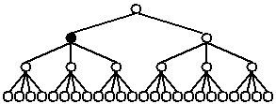
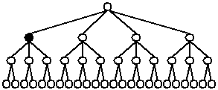
Backtracking
When different S_{i}’s have different sizes
Smaller S_{i} first

Slide 19
Backtracking
Games – how did AlphaGo win
Tic-tac-toe
The player who succeeds in placing three of their marks in a horizontal, vertical, or diagonal row wins the game.
Notes:
also known as noughts and crosses or Xs and Os

Slide 20
Backtracking
Tic-tac-toe
19,683 possible board layouts (3⁹ since each of the nine spaces can be X, O or blank), and
362,880 (i.e., 9!) possible games (different sequences for placing the Xs and Os on the board)
……
……
……
……
……
……
……
……
……
……
……
……

Slide 21
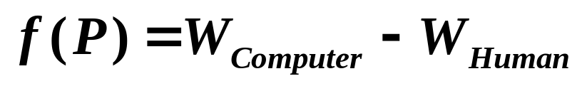
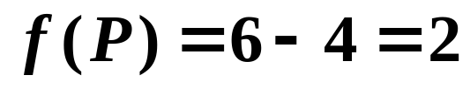
Backtracking
Tic-tac-toe: Minimax Strategy
Use an evaluation function to quantify the "goodness" of a position. For example:
where W is the number of potential wins at position P.
The human is trying to minimize the value of the position P, while the computer is trying to maximize it.
Notes:
Here X is computer and O is the human
A “win” is a win line.

Slide 22
Backtracking
Tic-tac-toe
1
max
ply
1
-2
-1
min
re-ply
1
2
-1
0
-1
-2
0
1
0
-1
1
0
……
……
……
……
……
……
……
……
……
……
……
……

Slide 23

Backtracking
α pruning
44
max
44
≥
40
min
40
?

Slide 24
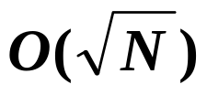
Backtracking
β pruning
44
min
44
≤
68
max
68
?
α-β pruning: when both techniques are combined. In practice, it limits the searching to only
nodes, where N is the size of the full game tree.
Notes:
Thus allow us to go deeper.

Slide 25
Main Takeaways (Backtracking)
Problems
8-Queens. Place eight queens on a 8x8 chessboard so that no two queens threaten each other.
Turnpike Reconstruction Problem. Given a set of distances, determine the positions of the points on a line. (The catch is enumerate from the largest distances since the end points are known. Be sure you can write the code.)
Tic-Tac-Toe.
Definitions
Game Tree. Depth-first retrieval represents all possible game states. Traversing the subtree will yields the optimal solution for this step.
Value. In two-player game, the value can be considered as the win-rate of a certain player.
Position. A state in a game.
Algorithm
Minimax Strategy. An adversarial search with each layer alternating the goal.
Alpha-Beta Pruning. Decreases nodes in minimax without affecting the result.

Slide 26
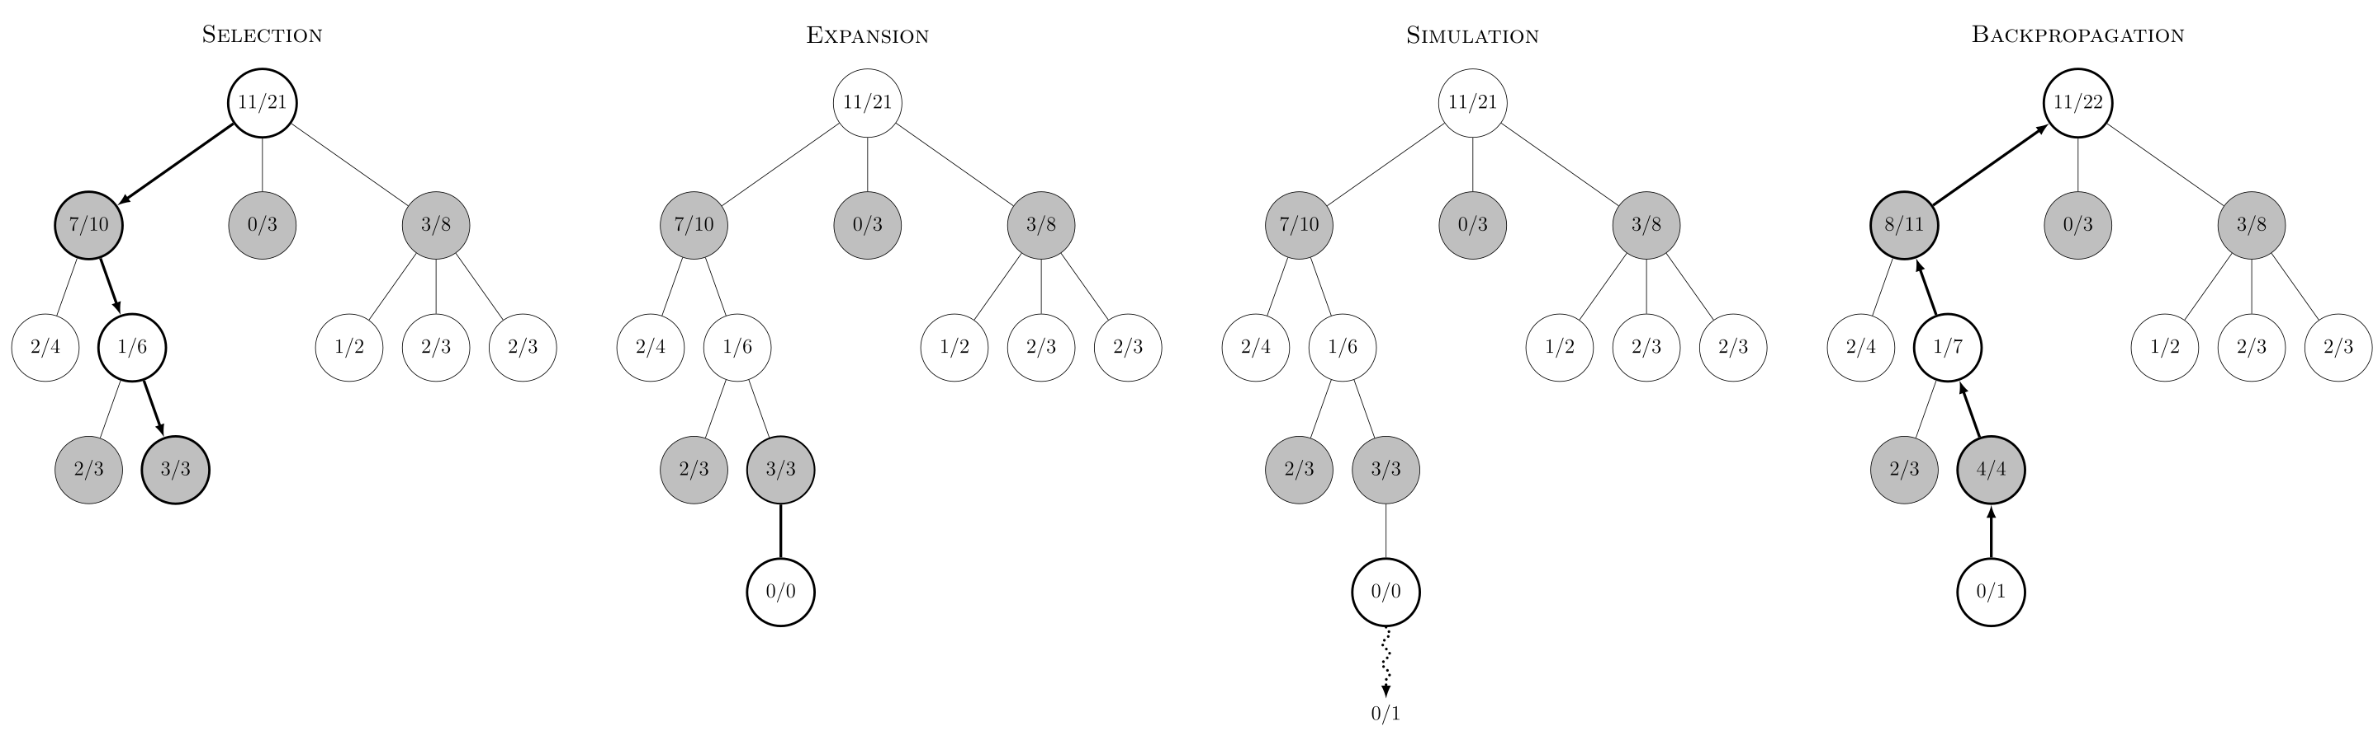
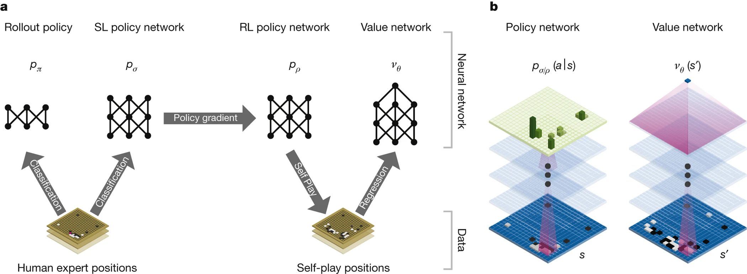
AlphaGO: Monte Carlo Tree Search + Deep RL
https://www.nature.com/articles/nature16961

Slide 27

Research Project 3
Safe Fruit (26)
There are a lot of tips telling us that some fruits must not be eaten with some other fruits, or we might get ourselves in serious trouble. For example, bananas can not be eaten with cantaloupe (哈密瓜), otherwise it will lead to kidney deficiency (肾虚).
Now you are given a long list of such tips, and a big basket of fruits. You are supposed to pick up those fruits so that it is safe to eat any of them.
Detailed requirements can be downloaded from
https://pintia.cn/

Slide 28
Reference:
Data Structure and Algorithm Analysis in C (2nd Edition)：Ch.10，p.403-414；M.A.Weiss著、陈越改编，人民邮件出版社，2005

