Slide 1
NP-Completeness
https://www.quantamagazine.org/complexity-theorys-50-year-journey-to-the-limits-of-knowledge-20230817/

Slide 2
Definitions (NP)
Solve vs. Decide vs. Verify
Turing Machine
Deterministic
Nondeterministic
P problems:
NP problems:
Polynomial-Time (Many-One) Reduction:
NP-Hard:
NP-Complete:
Formal Language.
Decision of P and NP under formal language.
co-NP:

Slide 3
NP-Completeness
NP-Completeness
 Recall:
❖ Euler circuit problem: Find a circuit that touches every edge exactly once.
☺
❖ Hamiltonian cycle problem: Find a simple cycle (i.e. no repeated vertices) that contains every vertex.
☹
❖ Single-source unweighted shortest-path problem
☺
❖ Single-source unweighted longest-path problem
☹
☹ No known algorithms are guaranteed to run in polynomial time.

Slide 4
How to define a unified space so all the complexity of the computable problems can be compared?
Different inputs
Different objectives
Graphs
Sets
Arrays
…
different algorithms
Optimization
Check Existence
Search
…
Formalization: 01001101… Turing Machine 0 or 1 (decision)
decidable in poly ≤ verify in poly ≤ in exponential ≤ … ≤ undecidable

Slide 5

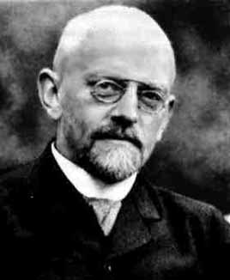
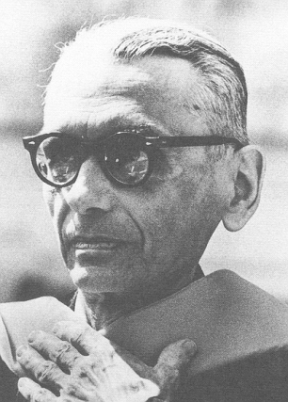
NP-Completeness
☞ Easy vs. Hard
The easiest: O( N ) – since we have to read inputs at least once.
The hardest:
– undecidable problems.
The great mathematician David Hilbert at the 1900 International Congress of Mathematicians outlined 23 research problems to be investigated in the coming century. One of the problems is the question of Decidability — Could there exist, at least in principle, any definite method or process by which all mathematical questions could be decided?
Kurt Gödel proved in 1931 that not all true statements that evolve from an axiomatic system can be proven – we can never know everything nor prove everything we discover.
https://math.stanford.edu/~feferman/papers/deciding.pdf

Slide 6
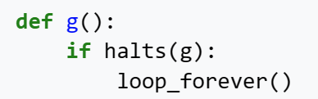
NP-Completeness
【Example】Halting problem: Is it possible to have your C compiler detect all infinite loops?
Answer:
No.
Proof: If there exists an infinite loop-checking program H, then surely it could be used to check itself.
Loop( P )
{
/* 1 */ if ( H(P) ) print (YES);
/* 2 */ else infinite_loop();
}
Impossible to tell
What will happen to Loop( Loop ) ?
➢ Terminates
/* 2 */ is true
Loops
➢ Loops
/* 1 */ is true
Terminates

Slide 7
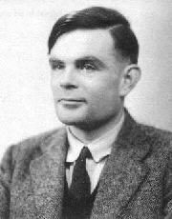

NP-Completeness
☞ The Class NP
TURING MACHINE
Alan Mathison Turing (June 21, 1912 – June 7, 1954)
Founder of Computer Science.
More details can be found at http:\\www.turing.org.uk .
Task
To simulate any kind of computation which a mathematician can do by some arithmetical
method (assuming that the mathematician has infinite time, energy, paper and pen, and is completely dedicated to the work).

Slide 8
NP-Completeness
☞ The Class NP
TURING MACHINE
Components
Infinite Memory
Scanner
and
Operations
One head can point to
one and only one unit at each state,
and it may move at most one unit
to the left or right.
Infinite 1-dimensional
tape(s) divided into units.
DATA storage
① Change the finite control state.
Finite state controller:
control head movements according to
current state and the symbol that
head is pointing to.
INSTRUCTION storage
② Erase the symbol in the unit currently pointed by head, and write a new symbol in.
Scanner
...
③ Head moves one unit to the left (L), or to the right (R), or stays at its current position (S).
... ...
... ... ... ...
...
... ... ... ...

Slide 9
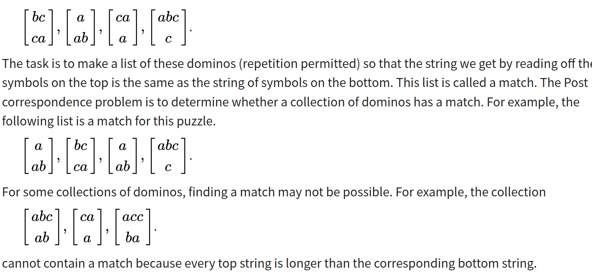
https://en.wikipedia.org/wiki/Post_correspondence_problem#Proof_sketch_of_undecidability

Slide 10

NP-Completeness
A Deterministic Turing Machine executes one instruction at each point in time. Then depending on the instruction, it goes to the next unique instruction.
A Nondeterministic Turing Machine is free to choose its next step from a finite set. And if one of these steps leads to a solution, it will always choose the correct one.
NP: Nondeterministic polynomial-time
The problem is NP if we can verify any solution is true in polynomial time.
Undecidable problems are still undecidable.
〖Example〗Hamilton cycle problem: Find a single cycle that contains every vertex – does this simple circuit include all the vertices?
NP
Note: Not all decidable problems are in NP. For example, consider the problem of determining whether a graph does not have a Hamiltonian cycle.

Slide 11
Definitions (NP)
Turing Machine is a mathematical model of computation describing an abstract machine that moves its heads (m) manipulates symbols (σ) on a strip of tape according to a table of rules (finite control states q).
Deterministic TM: m_{t}, σ_{t}, q_{t} = DTM(σ_{t-1}, q_{t-1})
Nondeterministic TM: transition relation instead of function. “Luck machine”, always choose the correct path in search.
P problems: Solved by DTM in poly.
NP problems: Verified by DTM in poly, solved by NTM in poly. Nondeterministic polynomial-time.
Polynomial-Time (Many-One) Reduction:
NP-Hard:
NP-Complete:
Formal Language.
Decision of P and NP under formal language.
co-NP:

Slide 12
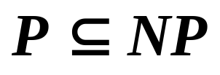


NP-Completeness

⬧
☞ NP-Complete Problems
-- the hardest
An NP-complete problem has the property that any problem in NP can be polynomially reduced to it.
If we can solve any NP-complete problem in polynomial time, then we will be able to solve, in polynomial time, all the problems in NP!
Given any instance α ∈ Problem A, if we can find a program R(α) → β ∈ Problem B with T_{R}(N) = O(N^{k1}), and another program D(β) to get an answer in time O(N^{k2}). And more, if the answer for β is the same as the answer for α. Then
Decision problem is easier
O(N^{k1})
O(N^{k2})
∀ α ∈ A
β = R(α)
D(β)
answer for β
= answer for α
O(N^{k})
Notes:
Decision problem is easier, since we only have to answer yes or no.
Optimization problem can be related to a decision problem.
Example: SHORTEST-PATH relates to PATH: given a directed graph G, vertices u and v, and an integer k, does a path exist from u to v consisting of at most k edges?

Slide 13
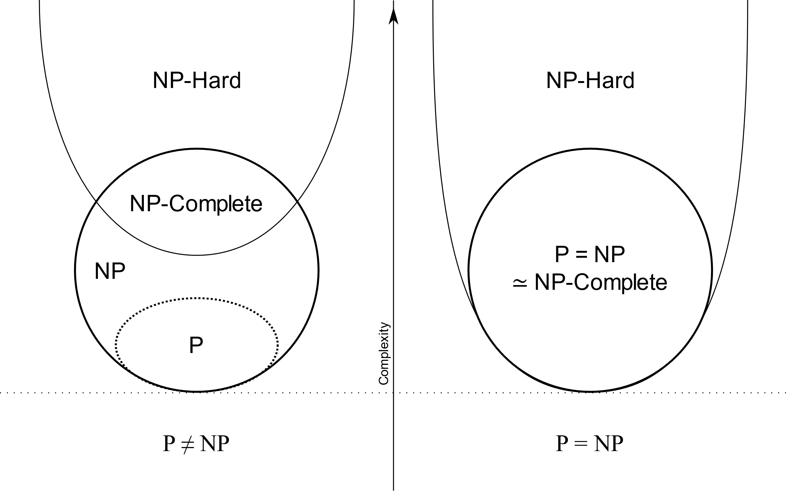
H in NP-H if for all L in NP, L ≤_{p} H
C in NP-C if C in NP-H and C in NP.

Slide 14
NP-Completeness
〖Example〗 Suppose that we already know that the Hamiltonian cycle problem is NP-complete. Prove that the traveling salesman problem is NP-complete as well.
❖ Hamiltonian cycle problem: Given a graph G=(V, E), is there a simple cycle that visits all vertices?
❖ Traveling salesman problem: Given a complete graph G=(V, E), with edge costs, and an integer K, is there a simple cycle that visits all vertices and has total cost ≤ K?
Proof: TSP is obviously in NP, as its answer can be verified polynomially.
V₁
K = |V|
1
1
2
G has a Hamilton cycle iff G’ has a traveling salesman tour of total weight |V|.
V₂
1
V₃
2
2
1
2
1
✓
V₄
1
V₅
Notes:
Any problem A can be reduced to HCP, then reduced to TSP.

Slide 15
NP-Completeness
The first problem that was proven to be NP-complete was the Satisfiability problem (Circuit-SAT): Input a boolean expression and ask if it has an assignment to the variables that gives the expression a value of 1.
Cook showed in 1971 that all the problems in NP could be polynomially transformed to Satisfiability. He proved it by solving this problem on a nondeterministic Turing machine in polynomial time.

Slide 16
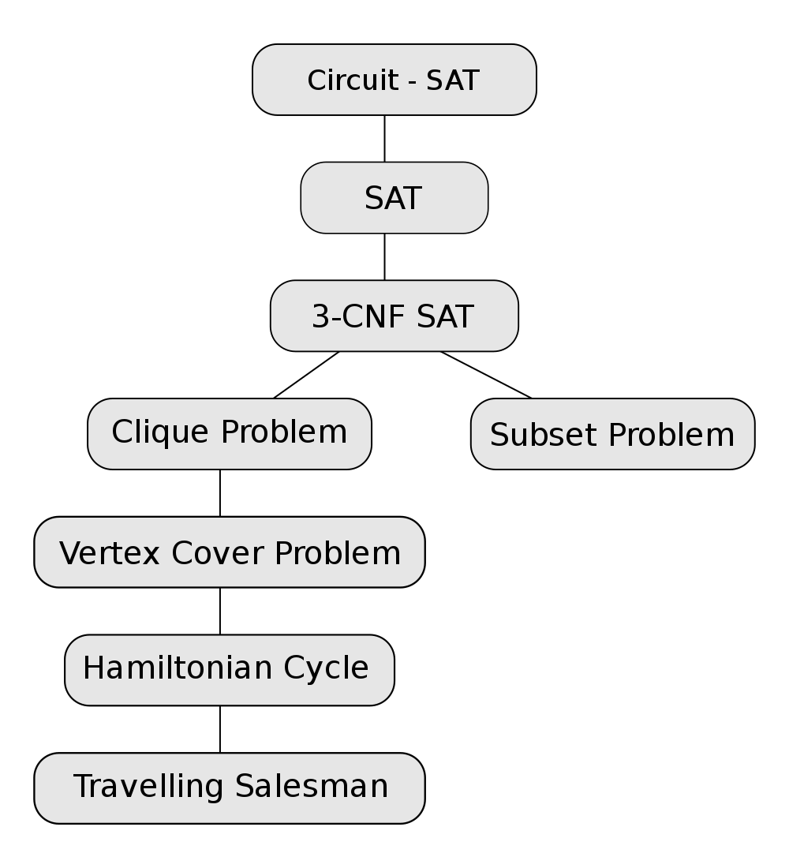

Slide 17
Definitions (NP)
Turing Machine is a mathematical model of computation describing an abstract machine that moves its heads (m) manipulates symbols (σ) on a strip of tape according to a table of rules (finite control states q).
Deterministic TM: m_{t}, σ_{t}, q_{t} = DTM(σ_{t-1}, q_{t-1})
Nondeterministic TM: transition relation instead of function. “Luck machine”, always choose the correct path in search.
P problems: Solved by DTM in poly.
NP problems: Verified by DTM in poly, solved by NTM in poly. Nondeterministic polynomial-time.
Polynomial-Time (Many-One) Reduction: poly transform inputs to A into inputs to B, such that the transformed problem has the same answer as the original, aka Karp Reduction. A ≤_{p} B.
NP-Hard: H in NP-H if for all L in NP, L ≤_{p} H.
NP-Complete: C in NP-C if C in NP-H and C in NP.
Formal Language.
Decision of P and NP under formal language.
co-NP:

Slide 18
NP-Completeness
A Formal-language Framework
☞ Abstract Problem
an abstract problem Q is a binary relation on a set I of problem instances and a set S of problem solutions.
〖Example〗For SHORTEST-PATH problem
I = { <G, u, v>: G=(V, E) is an undirected graph; u, v ∈ V };
S = { <u, w₁, w₂, …, w_{k}, v>: <u, w₁>, …, <w_{k}, v> ∈ E }.
For every i ∈I, SHORTEST-PATH(i) = s ∈ S.
For decision problem PATH:
I = { <G, u, v, k>: G=(V, E) is an undirected graph; u, v ∈ V;
k ≥ 0 is an integer };
S = { 0, 1 }.
For every i ∈I, PATH(i) = 1 or 0.
☞ Encodings
Map I into a binary string { 0, 1 }* → Q is a concrete problem.

Slide 19
NP-Completeness
☞ Formal-language Theory
— for decision problem
{ 0, 1 }
An alphabet Σ is a finite set of symbols
A language L over Σ is any set of strings made up of symbols from Σ
Denote empty string by ε
Denote empty language by Ø
Language of all strings over Σ is denoted by Σ*
The complement of L is denoted by Σ*-L
The concatenation of two languages L₁ and L₂ is the language
L = { x₁x₂ : x₁ ∈ L₁ and x₂ ∈ L₂ }.
The closure or Kleene star of a language L is the language
L*= {ε} ∪ L ∪ L² ∪ L³ ∪ ···,
where L^{k} is the language obtained by concatenating L to itself k times
L = { x ∈ Σ*: Q(x) = 1 }

Slide 20
NP-Completeness
Algorithm A accepts a string x ∈ {0, 1}* if A(x) = 1
Algorithm A rejects a string x if A(x) = 0
A language L is decided by an algorithm A if every binary string in L is accepted by A and every binary string not in L is rejected by A
To accept a language, an algorithm need only worry about strings in L, but to decide a language, it must correctly accept or reject every string in {0, 1}*
P = { L ⊆ {0, 1}* : there exists an algorithm A that decides
L in polynomial time }

Slide 21

NP-Completeness
A verification algorithm is a two-argument algorithm A, where one argument is an ordinary input string x and the other is a binary string y called a certificate.
A two-argument algorithm A verifies an input string x if there exists a certificate y such that A(x, y) = 1.
The language verified by a verification algorithm A is L = { x ∈ {0, 1}* : there exists y ∈ {0, 1}* such that A(x, y) = 1}.
〖Example〗 For SAT
Certificate:
A language L belongs to NP iff there exist a two-input polynomial-time algorithm A and a constant c such that L = { x ∈ {0, 1}* : there exists a certificate y with |y| = O(|x|^{c}) such that A(x, y) = 1 }. We say that algorithm A verifies language L in polynomial time.

Slide 22

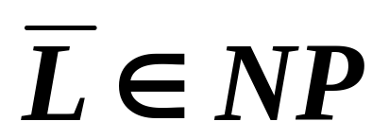

NP-Completeness
⬧
complexity class co-NP = the set of languages L such that
Four possibilities:
P=NP=co-NP
co-NP
P=NP∩co-NP
NP
NP=co-NP
co-NP
NP∩co-NP
NP
P
P

Slide 23
NP-Completeness
no harder than
A language L₁ is polynomial-time reducible to a language L₂ ( L₁ ≤_{P} L₂ ) if there exists a polynomial-time computable function f : {0, 1}* → {0,1}* such that for all x {0, 1}*, x ∈ L₁ iff f (x) ∈ L₂.
We call the function f the reduction function, and a polynomial-time algorithm F that computes f is called a reduction algorithm.
A language L ⊆ {0, 1}* is NP-complete if
  1. L ∈ NP, and
  2. L’ ≤_{P} L for every L’ ∈ NP.

Slide 24
NP-Completeness
〖Example〗 Suppose that we already know that the clique problem is NP-complete. Prove that the vertex cover problem is NP-complete as well.
❖ Clique problem: Given an undirected graph G = (V, E) and an integer K, does G contain a complete subgraph (clique) of (at least) K vertices?
CLIQUE = { <G, K> : G is a graph with a clique of size K }.
❖ Vertex cover problem: Given an undirected graph G = (V, E) and an integer K, does G contain a subset V' ⊆ V such that |V'| is (at most) K and every edge in G has a vertex in V' (vertex cover)?
VERTEX-COVER = { <G, K> : G has a vertex cover of size K }.
Proof: ① VERTEX-COVER ∈ NP
Given any x = <G, K>, take V' ⊆ V as the certificate y.
Verification algorithm: check if |V'| = K; check if for each edge (u, v) ∈ E, that u ∈ V' or v ∈ V'.
O( N³ )

Slide 25





NP-Completeness
Proof (con.): ② CLIQUE ≤_{P} VERTEX-COVER
G has a clique of size K iff
has a vertex cover of size |V| − K.
⇒ G has a clique V' ⊆ V of size K
O(N²)
Let (u, v) be any edge in
At least one of u or v does not belong to V'
At least one of u or v does belong to V-V'
Every edge of
is covered by a vertex in V-V'
Hence, the set V-V', which has size |V| − K forms
a vertex cover for
⇐ has a vertex cover V' ⊆ V of size |V| − K
For all u, v ∈ V, if (u, v) ∉E , then u ∈V' or v ∈ V' or both.
For all u, v ∈ V, if u ∉V' AND v ∉ V', then (u, v) ∈ E.
V-V' is a clique and it has size |V|−|V'| = K.

Slide 26
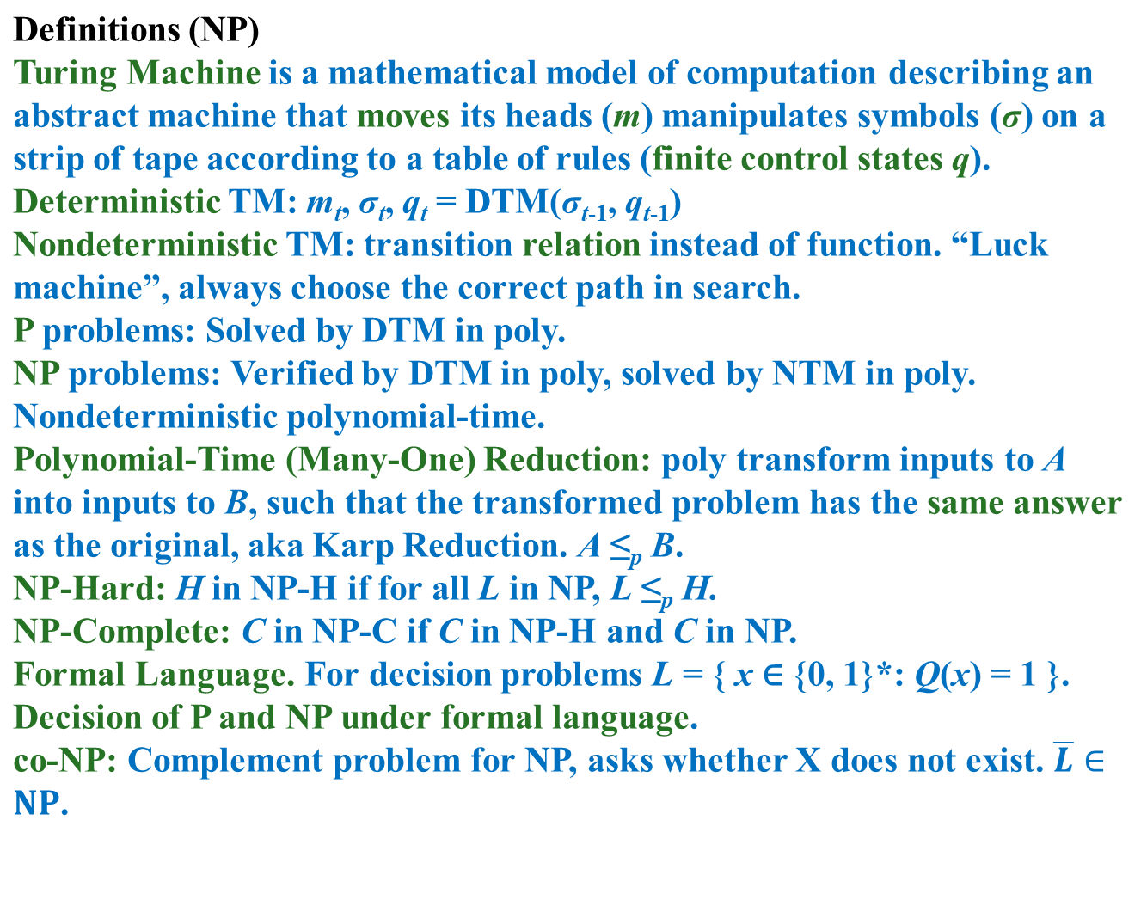

Slide 27
To prove a problem B is in NP-C
1. Make sure it’s in NP, i.e. verifiable in poly.
2. Find a known NP-C problem A.
3. Show A can be polynomial-time reduced to B.
Remarks (NP)
1. DTM and NTM are not real machines (unlimited memory/precision). So don’t bother why NTM can search all states at one time.
2. Decision vs optimization problems. Optimization problems can be solved by solving its corresponding decision problem (whether a solution with cost less than X exists).
3. NP and co-NP are also thought to be unequal. See the relationship to other classes.
Example Problems
Euler path/circuit. P, O(E).
Hamiltonian cycle. NP-C.
Traveling salesman. NP-C.
Clique. NP-C.
Vertex Cover. NP-C.
Halting problem. Undecidable.

Slide 28
Reference:
Introduction to Algorithms, 3rd Edition: Ch.34, p. 1048 - 1105； Thomas H. Cormen, Charles E. Leiserson, Ronald L. Rivest and Clifford Stein. The MIT Press. 2009

