Slide 1
Binomial Queue

Slide 2


Binomial Queues
☞ Structure:
A binomial queue is not a heap-ordered tree, but rather a collection of heap-ordered trees, known as a forest. Each heap-ordered tree is a binomial tree.
According to Theorem 5.1 on p.156,
the total time should be O(N)…
Constant!
So O(log N) for an insertion is
NOT good enough!
Haven’t we
had enough about queues?
What is a binomial queue for?
Well, what is the average
time for insertions with
leftist or skew heaps?
What is the total time
for inserting N keys into
an empty binary heap?
O(log N) – What’s wrong?
Then what is the average time?
A binomial tree of height 0 is a one-node tree.
A binomial tree, B_{k}, of height k is formed by attaching a binomial tree, B_{k – 1}, to the root of another binomial tree, B_{k – 1}.
B₀
B₁
B₂
B₃
Binomial coefficient
Observation : B_{k} consists of a root with children, which are . B_{k} has exactly nodes. The number of nodes at depth d is .
k
B₀, B₁, …, B_{k – 1}
2^{k}
k
d

Slide 3
Binomial Queues
B_{k} structure + heap order + one binomial tree for each height
A priority queue of any size can be uniquely represented by a
collection of binomial trees.
【Example】Represent a priority queue of size 13 by a collection of binomial trees.
Solution:
13 = 2⁰ + 0×2¹ + 2² + 2³ = 1101₂
B₀
B₁
B₂
B₃
13
23
12
51
24
21
24
14
65
65
26
16
18

Slide 4

Binomial Queues
☞ Operations:
 FindMin:
The minimum key is in one of the roots.
There are at most roots, hence T_{p} = O( ).
⎡log N⎤
log N
Note: We can remember the minimum and update whenever it is changed. Then this operation will take O(1).
 Merge:
H₁
12
16
21
24
18
1 1 0 ₂ = 6
+ 1 1 1 ₂ = 7
Must keep the trees in the binomial queue sorted by height.
65
H₂
23
14
13
51
24
26
c
c
65
H₁
1
1
0
1
12
14
13
21
24
23
26
16
65
51
24
18
T_{p} = O( )
65
log N

Slide 5
Definition (Binomial Queue)
Binomial Tree. (Recursive definition) B_{i}: two B_{i-1}s, make one a child of root of the other.
Forest. A collection of trees.
Binomial Queue. A list of B_{i}s, for each i, at most one tree of size 2^{i}. It’s called a queue because it implements a priority queue.
Remark. We don’t use the word binomial heap, it sometimes refers to the tree and sometimes refers to the queue.
B₀
B₁
B₂
B₃
13
23
12
51
24
21
24
14
65
65
26
16
18

Slide 6
Operation | find-min | delete-min | insert | decrease-key | merge
Binary | Θ(1) | Θ(log n) | O(log n) | O(log n) | Θ(n)
Leftist
Skew

Slide 7
Operation | find-min | delete-min | insert | decrease-key | merge
Binary | Θ(1) | Θ(log n) | O(log n) | O(log n) | Θ(n)
Leftist | Θ(1) | Θ(log n) | Θ(log n) | O(log n) | Θ(log n)
Skew | Θ(1) | Θ(log n) | Θ(log n) | O(log n) | Θ(log n)
Red is amortized time.

Slide 8
Operation | find-min | delete-min | insert | decrease-key | merge
Binary | Θ(1) | Θ(log n) | Build-heap in O(n) | O(log n) | Θ(n)
Leftist | Θ(1) | Θ(log n) | Θ(log n) | O(log n) | Θ(log n)
Skew | Θ(1) | Θ(log n) | Θ(log n) | O(log n) | Θ(log n)
Binomial | Θ(1) | Θ(log n) |  | Θ(log n) | O(log n)
Skew binomial | Θ(1) | Θ(log n) |  | Θ(log n) | O(log n)
Red is amortized time.

Slide 9
Binomial Queues
 Insert: a special case for merging.
【Example】Insert 1, 2, 3, 4, 5, 6, 7 into an initially empty queue.
1
1
5
3
7
5
2
3
2
6
4
4
Note:
If the smallest nonexistent binomial tree is B_{i} , then
T_{p} = Const · (i + 1).
Performing N Inserts on an initially empty binomial queue will take O(N) worst-case time. Hence the average time is constant.
Constant worst case insertion variant: https://en.wikipedia.org/wiki/Skew_binomial_heap

Slide 10
Operation | find-min | delete-min | insert | decrease-key | merge
Binary | Θ(1) | Θ(log n) | O(log n) | O(log n) | Θ(n)
Leftist | Θ(1) | Θ(log n) | Θ(log n) | O(log n) | Θ(log n)
Skew | Θ(1) | Θ(log n) | Θ(log n) | O(log n) | Θ(log n)
Binomial | Θ(1) | Θ(log n) | Θ(1) | Θ(log n) | O(log n)
Skew binomial | Θ(1) | Θ(log n) | Θ(1) | Θ(log n) | O(log n)
Red is amortized time.

Slide 11
Operation | Implementation | Analysis
FindMin | Track the minimum and update when changed | Θ(1)
Merge | Resembles binary addition | O(log n)
Insertion | Same as merge | Θ(1). Similar to build binary heap. Also amortized analysis
DeleteMin

Slide 12
Binomial Queues
 DeleteMin ( H ):
H
12
14
13
21
24
23
26
16
65
51
24
18
65
Step 1: FindMin in B_{k}
/* O(log N) */
H’
14
13
26
16
Step 2: Remove B_{k} from H
18
/* O(1) */
H”
23
24
21
Step 3: Remove root from B_{k}
51
24
65
/* O(log N) */
65
Step 4: Merge (H’, H”)
H
14
13
/* O(log N) */
26
16
23
21
24
18
51
24
65
65

Slide 13
Definition (Binomial Queue)
Binomial Tree. (Recursive definition) B_{i}: two B_{i-1}s, make one a child of root of the other.
Forest. A collection of trees.
Binomial Queue. A list of B_{i}s, for each i, at most one tree of size 2^{i}. It’s called a queue because it implements a priority queue.
Remark. We don’t use the word binomial heap, it sometimes refers to the tree and sometimes refers to the queue.
Operation | Implementation | Analysis
FindMin | Track the minimum and update when changed | Θ(1)
Merge | Resembles binary addition | O(log n)
Insertion | Same as merge | Θ(1). Similar to build binary heap. Also amortized analysis
DeleteMin | FindMin, remove root, then Merge | O(log n)

Slide 14
Binomial Queues
☞ Implementation:
Binomial queue = array of binomial trees
Operation
Property
Solution
DeleteMin
Find all the subtrees quickly
Left-child-next-sibling with linked lists
Merge
The children are ordered by their sizes
The new tree will be the largest. Hence maintain the subtrees in decreasing sizes
Discussion 7:
How can we implement the trees so that all the subtrees can be accessed quickly?
Discussion 8:
In which order must we link the subtrees?
[4]
[3]
[2]
[1]
[0]
H
……
12
14
13
23
24
21
16
26
12
14
13
21
24
23
26
16
24
51
65
18
65
51
24
18
65
65

Slide 15
Binomial Queues
typedef struct BinNode *Position;
typedef struct Collection *BinQueue;
typedef struct BinNode *BinTree; /* missing from p.176 */
struct BinNode
{
ElementType Element;
Position LeftChild;
Position NextSibling;
} ;
struct Collection
{
int CurrentSize; /* total number of nodes */
BinTree TheTrees[ MaxTrees ];
} ;

Slide 16
Binomial Queues
BinTree
CombineTrees( BinTree T1, BinTree T2 )
{ /* merge equal-sized T1 and T2 */
if ( T1->Element > T2->Element )
/* attach the larger one to the smaller one */
return CombineTrees( T2, T1 );
/* insert T2 to the front of the children list of T1 */
T2->NextSibling = T1->LeftChild;
T1->LeftChild = T2;
return T1;
}
T_{p} = O( 1 )
T1
T2
12
14
24
21
16
26
65
18

Slide 17
Binomial Queues
BinQueue Merge( BinQueue H1, BinQueue H2 )
{ BinTree T1, T2, Carry = NULL;
int i, j;
if ( H1->CurrentSize + H2-> CurrentSize > Capacity ) ErrorMessage();
H1->CurrentSize += H2-> CurrentSize;
for ( i=0, j=1; j<= H1->CurrentSize; i++, j*=2 ) {
T1 = H1->TheTrees[i]; T2 = H2->TheTrees[i]; /*current trees */
switch( 4*!!Carry + 2*!!T2 + !!T1 ) {
case 0: /* 000 */
case 1: /* 001 */ break;
case 2: /* 010 */ H1->TheTrees[i] = T2; H2->TheTrees[i] = NULL; break;
case 4: /* 100 */ H1->TheTrees[i] = Carry; Carry = NULL; break;
case 3: /* 011 */ Carry = CombineTrees( T1, T2 );
H1->TheTrees[i] = H2->TheTrees[i] = NULL; break;
case 5: /* 101 */ Carry = CombineTrees( T1, Carry );
H1->TheTrees[i] = NULL; break;
case 6: /* 110 */ Carry = CombineTrees( T2, Carry );
H2->TheTrees[i] = NULL; break;
case 7: /* 111 */ H1->TheTrees[i] = Carry;
Carry = CombineTrees( T1, T2 );
H2->TheTrees[i] = NULL; break;
} /* end switch */
} /* end for-loop */
return H1;
}
/* assign each digit to a tree */
Carry
T2
T1

Slide 18
Binomial Queues
ElementType DeleteMin( BinQueue H )
{ BinQueue DeletedQueue;
Position DeletedTree, OldRoot;
ElementType MinItem = Infinity; /* the minimum item to be returned */
int i, j, MinTree; /* MinTree is the index of the tree with the minimum item */
if ( IsEmpty( H ) ) { PrintErrorMessage(); return –Infinity; }
for ( i = 0; i < MaxTrees; i++) { /* Step 1: find the minimum item */
if( H->TheTrees[i] && H->TheTrees[i]->Element < MinItem ) {
MinItem = H->TheTrees[i]->Element; MinTree = i; } /* end if */
} /* end for-i-loop */
DeletedTree = H->TheTrees[ MinTree ];
H->TheTrees[ MinTree ] = NULL; /* Step 2: remove the MinTree from H => H’ */
OldRoot = DeletedTree; /* Step 3.1: remove the root */
DeletedTree = DeletedTree->LeftChild; free(OldRoot);
DeletedQueue = Initialize(); /* Step 3.2: create H” */
DeletedQueue->CurrentSize = ( 1<<MinTree ) – 1; /* 2^{MinTree} – 1 */
for ( j = MinTree – 1; j >= 0; j – – ) {
DeletedQueue->TheTrees[j] = DeletedTree;
DeletedTree = DeletedTree->NextSibling;
DeletedQueue->TheTrees[j]->NextSibling = NULL;
} /* end for-j-loop */
H->CurrentSize – = DeletedQueue->CurrentSize + 1;
H = Merge( H, DeletedQueue ); /* Step 4: merge H’ and H” */
return MinItem;
}
This can be replaced by the actual number of roots

Slide 19
Remarks
It’s more practical to implement a binomial queue with linked list.
The merge for list structured binomial queue consists of two steps: root merge and union.
Carry also stays in the list implementation.
Illustration: https://www.prepbytes.com/blog/heap/implementation-binomial-heap/
Code: https://www.cs.unc.edu/~bbb/#binomial_heaps

Slide 20


Binomial Queues
【Claim】A binomial queue of N elements can be built by N successive insertions in O(N) time.
Proof 1 (Aggregate):
+1
B₀ /*step = 1 */
Total steps =
N
The worst case time for each insertion is
?
+0
B₁ /*step = 1, link = 1 */
Total links =
+1
B₁ B₀ /*step = 1*/
O( log N )
–1
B₂ /*step = 1, link = 2 */
+1
B₂ B₀ /*step = 1*/
B₂ B₁ /*step = 1, link = 1*/
Expensive
insertions remove
trees, while cheap ones
create trees.
B₂ B₁ B₀ /*step = 1*/
–2
B₃ /*step = 1, link = 3*/
B₃ B₀ /*step = 1*/
… … …

Slide 21


Binomial Queues
Proof 2:
An insertion that costs c units results in a net increase of 2 – c trees in the forest.
C_{i} ::= cost of the ith insertion
Φ_{i} ::= number of trees after the ith insertion (Φ₀ = 0)
C_{i} + (Φ_{i} – Φ_{i-1}) = 2 for all i = 1, 2, …, N
Add all these equations up
T_{worst} = O(log N), but T_{amortized} = 2

Slide 22
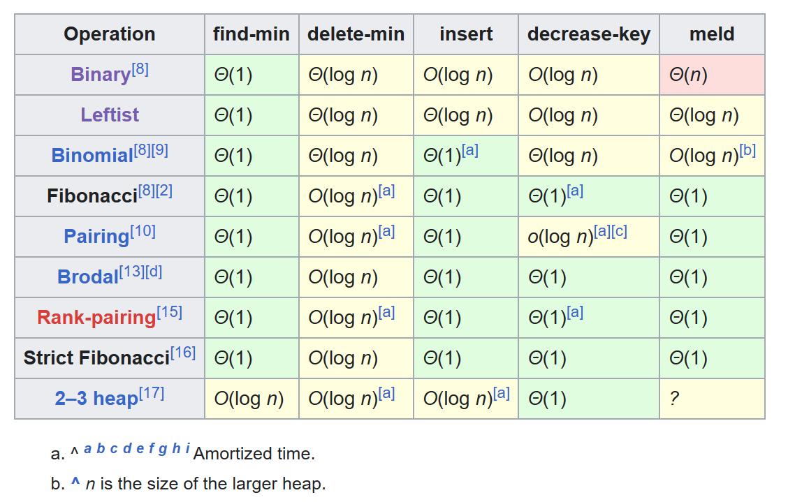
A Back-to-Basics Empirical Study of Priority Queues

Slide 23
Definition (Binomial Queue)
Binomial Tree. (Recursive definition) B_{i}: two B_{i-1}s, make one a child of root of the other.
Forest. A collection of trees.
Binomial Queue. A list of B_{i}s, for each i, at most one tree of size 2^{i}.
Implementation. Array of roots; Left-child-next-sibling;
Operation | Implementation | Analysis
FindMin | Track the minimum and update when changed | Θ(1)
Merge | Resembles binary addition | O(log n)
Insertion | Same as merge | Θ(1). Similar to build binary heap. Also amortized analysis
DeleteMin | FindMin, remove root, then Merge | O(log n), FindMin, remove root and Merge are all O(log n),

Slide 24


Research Project 2
Shortest Path Algorithm
with Heaps (26)
This project requires you to implement Dijkstra's algorithm based on a min-priority queue, such as a Fibonacci heap. The goal of the project is to find the best data structure for Dijkstra's algorithm.
Detailed requirements can be downloaded from
https://pintia.cn/
Extended reading
Fibonacci Heaps or "How to invent an extremely clever data structure"

Slide 25
Reference:
Data Structure and Algorithm Analysis in C (2nd Edition)：Ch.5，p.170-180； Ch.11，p.430-435；M.A.Weiss著、陈越改编，人民邮件出版社，2005
Introduction to Algorithms, 3rd Edition: Ch.19, p. 505-530； Thomas H. Cormen, Charles E. Leiserson, Ronald L. Rivest and Clifford Stein. The MIT Press. 2009

